Slide 1
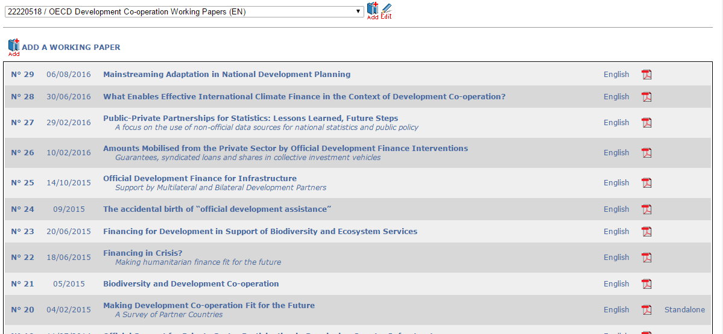
Series in English
All working papers are in English
This one ALSO exists in French

Slide 2
Series
English
Online
Work
Expression
Manifestation
Has paper
Paper
English
French
Standalone
PDF
PDF

Slide 3
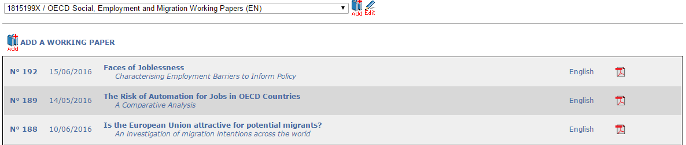
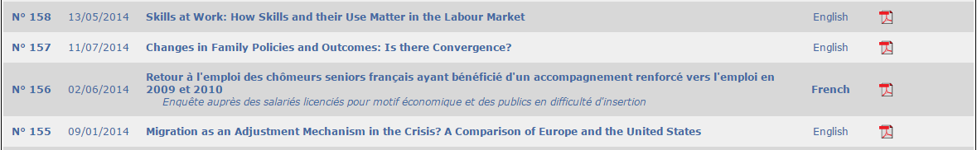
Series in English
All working papers are in English
This one ONLY exists in French

Slide 4
Series
English/French
Online
Work
Expression
Manifestation
Has paper
Paper
French
PDF

Slide 5
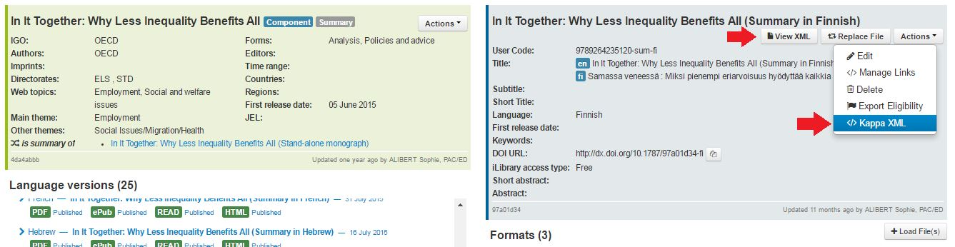
Content XML
Kappa XML

