Slide 1
Mind managed
Empowering tool to manage your mental health

Slide 2

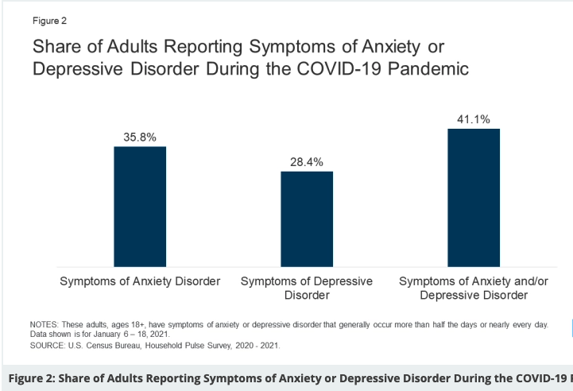
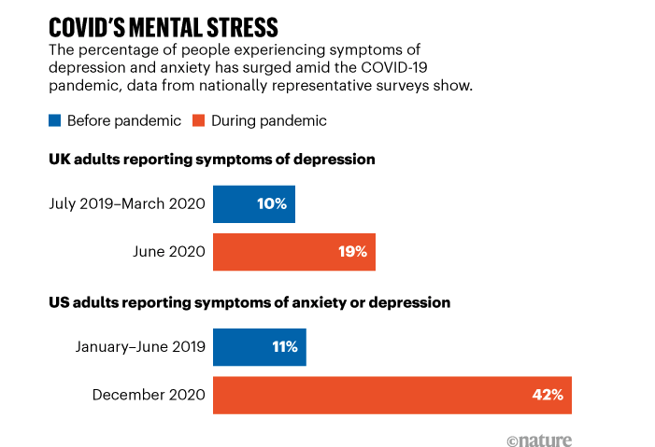
Created out of necessity - research
Many reports have been published as of May 2021 regarding an emerging trend of mental stress and anxiety among Americans amid the COVID-19 pandemic.
These result in adults feeling fear and isolation. Especially among younger adults, who require more social interaction.
Nature.com – Feb 3 2021 https://www.nature.com/articles/d41586-021-00175-z
https://www.kff.org/coronavirus-covid-19/issue-brief/the-implications-of-covid-19-for-mental-health-and-substance-use/

Slide 3



Mind manage puts the power back in your hands
Track Medication
Mental state updates
Active participation with therapy sessions
Track your current medication
Inform on drug facts/interactions
Help you stay on track, so you don’t forget to take your dosages
User can track daily moods
Journal important details / events which effect mood and life
Easy to access information to provide to one’s Mental Healthcare Professional
Easy charting feature to identify patters and breaks in pattern along with corresponding journal entries

