Slide 1
Distracted Driving Impact Analysis: Fault & Severity
Name: Caroline Ayieko
Question: Does Distracted driving significantly increase the likelihood of a driver being found “At Fault” and lead to more severe vehicle damage?
Notes:
Why it matters: Distracted driving is a major public safety issue. Quantifying the specific risk helps inform insurance models and public policy.

Slide 2
Data & hypotheses
Data Source: “Crash Reporting- Drivers Data” (Montgomery County, MD) from Data.gov
  Size: ~160,000 drivers analyzed
Key Variables:
  Independent: Distraction Status (Distracted vs. Not Distracted).
  Dependent: Fault Status (Binary) and Vehicle Damage (Ordinal 0-4).
Hypothesis:
  Null: Distraction has no effect on fault rates or damage severity.
  Alternative: Distracted drivers are more likely to be at fault and cause more severe damage.

Slide 3
Methodology
Approach: Used resampling techniques (5,000 iterations) to avoid assumptions about data normality.
Metric 1: Fault Rate (Difference in Proportions)
  Tested via Permutation Test (to establish significance) and Bootstrapping (to estimate uncertainty).
Metric 2: Damage Severity (Difference in Medians)
  Tested via Bootstrapping only.
  Why CLT does not apply:
  The damage score is discrete and ordinal (integers 0-4) and the sampling distribution of a median
  from such a distribution is generally not normal, making standard parametric confidence intervals invalid.

Slide 4
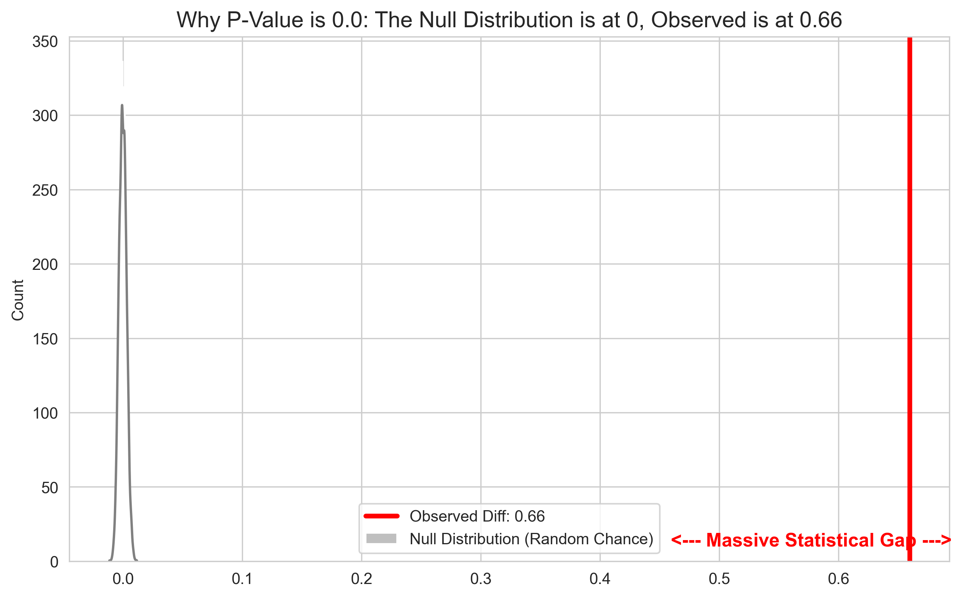
Key result: metric 1-fault rate
Finding: Distracted drivers were approximately 66% more likely to be found at fault
than non-distracted drivers.
Significance: P-value = 0.0000.
Uncertainty: 95% Confidence Interval: [0.656, 0.663].
The "Massive Statistical Gap" Plot.
  Why: This visualization (the side-by-side plot with the grey null distribution on the left and your red observed line far to the right) is the strongest evidence you have. It visually proves that the observed effect is impossible to generate by random chance.

Slide 5
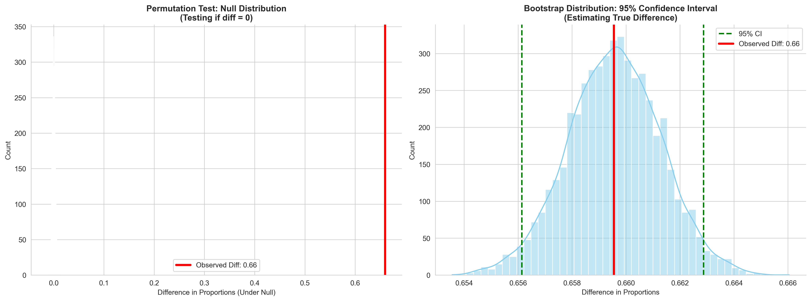
Bootstrap distribution

Slide 6
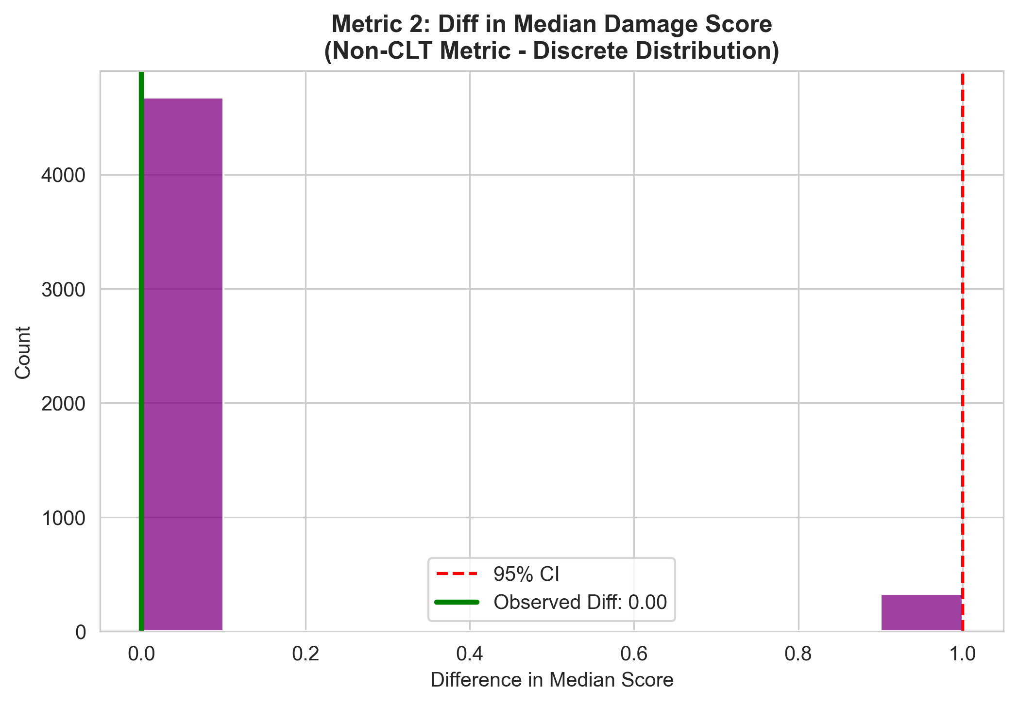
Key result metric 2: Damage severity
Finding: The observed difference in median damage was 0.0. Both groups had a median score of 2.0
("Functional Damage").
Uncertainty: 95% Confidence Interval: [0.0, 1.0].
Interpretation: While the median didn't shift, the interval extends to 1.0,
suggesting a potential skew toward higher severity that the median metric misses
due to the coarse data scale.
The Bootstrap Median Histogram.
  Why: This (the purple histogram) shows the discrete nature of the data and
helps explain why the result is less conclusive than the fault rate.

Slide 7
Conclusion & limitations
Conclusion: Distraction is a definitive predictor of liability (causing the crash),
but it does not guarantee the crash will be more severe than a baseline accident.
Limitations:
  Self-Reporting Bias: Distraction is likely underreported in police data.
  Ordinal Scale: The 0-4 damage scale is too coarse to capture subtle differences
  in crash intensity (e.g., repair costs).

