Slide 1

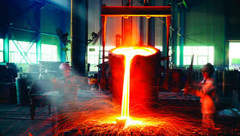
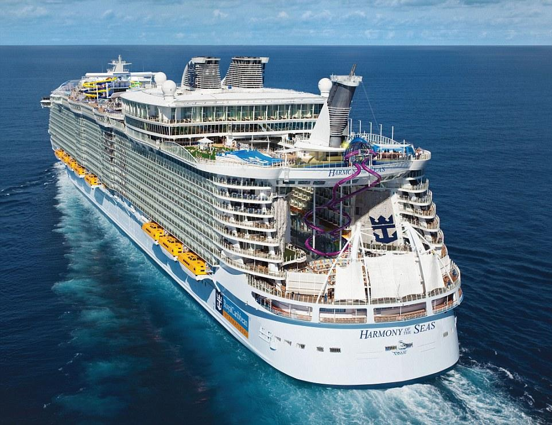
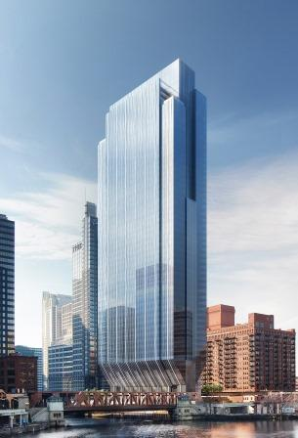
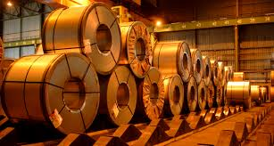
ArcelorMittal Millennial Retention and Recruitment Strategy
Caroline Braun, Patrick Albers, Richard Reece, Young Oh, Alexandria El Ghatit
Notes:
Hello ArcelorMittal, today, we at Vision Quest are going to introduce our plan of how you can both recruit and retain the millennial generation to your company. We understand that you have a growing problem with the aging employees of yo
ur workforce retiring and that you are looking to hire new talent that will be assets to your company and stay long-term. We realize your need for change and are here to help.

Slide 2
Recruitment Strategy
Retention Logistics
Retention Strategy
Retention Feasibility
Recruitment Logistics
Recruitment Feasibility
Return on Investment
Notes:
We will start by explaining our recruitment strategy and how it will help ArcelorMittal to attract the attention of millenials to their positions in Burns Harbor, IN
We will then show you how we will implement this strategy and the logistics behind our idea
Finally, for recruitment, we will discuss the simplicity and ease integrating our idea
Moving on to retention, we will explain our retention strategy and how we think it will help you to keep your millennial employees working longer
We will then talk about the logistics of our plan
Finally, we will explain how our plan will give your company a great return on your investment and how it is ultimately the best idea for ArcelorMittal

Slide 3
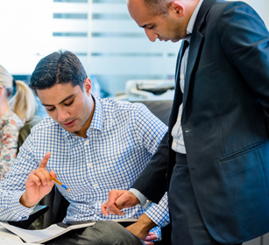
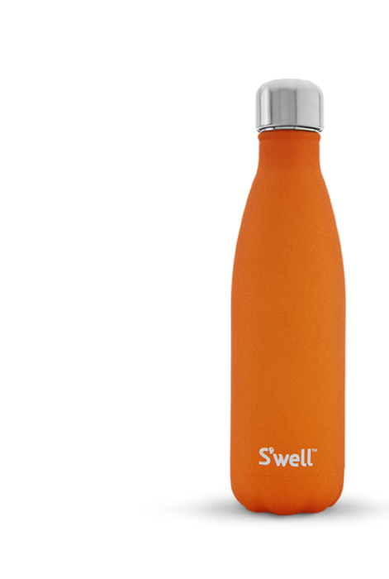
Recruitment Strategy
Entice millennial students to learn more about ArcelorMittal
Gather crucial data about what these students value in the workplace
Gain brand recognition from use of water bottles on campus
Recruitment Retention
Return on Investment
Strategy Logistics Feasibility Strategy Logistics Feasibility
Notes:
Our strategy will achieve three main benefits for you if you choose to implement it...

Slide 4





How will this work?
Recruitment Retention
Return on Investment
Strategy Logistics Feasibility Strategy Logistics Feasibility
Notes:
A slide will be emailed to business professors at certain Big Ten schools to be shown in classes
Slides will detail when ArcelorMittal will be on campus and will also contain a link to a survey for students
The survey will gather data about what millennials value in the workplace
Completion of the survey will result in a confirmation code
A printed code must be taken to company reps at networking events to be exchanged for a stainless steel water bottle
According to an article on Forbes by Lara Fishbane, college students love free stuff. Therefore the possibility of getting a free high quality water bottle just for completing a survey is very appealing to these students

Slide 5


LEARN MORE ABOUT THE COMPANY AND GET A FREE STAINLESS STEEL WATER BOTTLE!
***Must complete survey (link below) and bring confirmation code to event
What: ArcelorMittal information session
When: Thursday, 9/24
Where: HH2083
TAKE OUR SURVEY: https://www.surveymonkey.com/r/8C77TNS
Notes:
Example of slide that could be sent out; contains info about when AM will be on campus and also a link to the survey

Slide 6
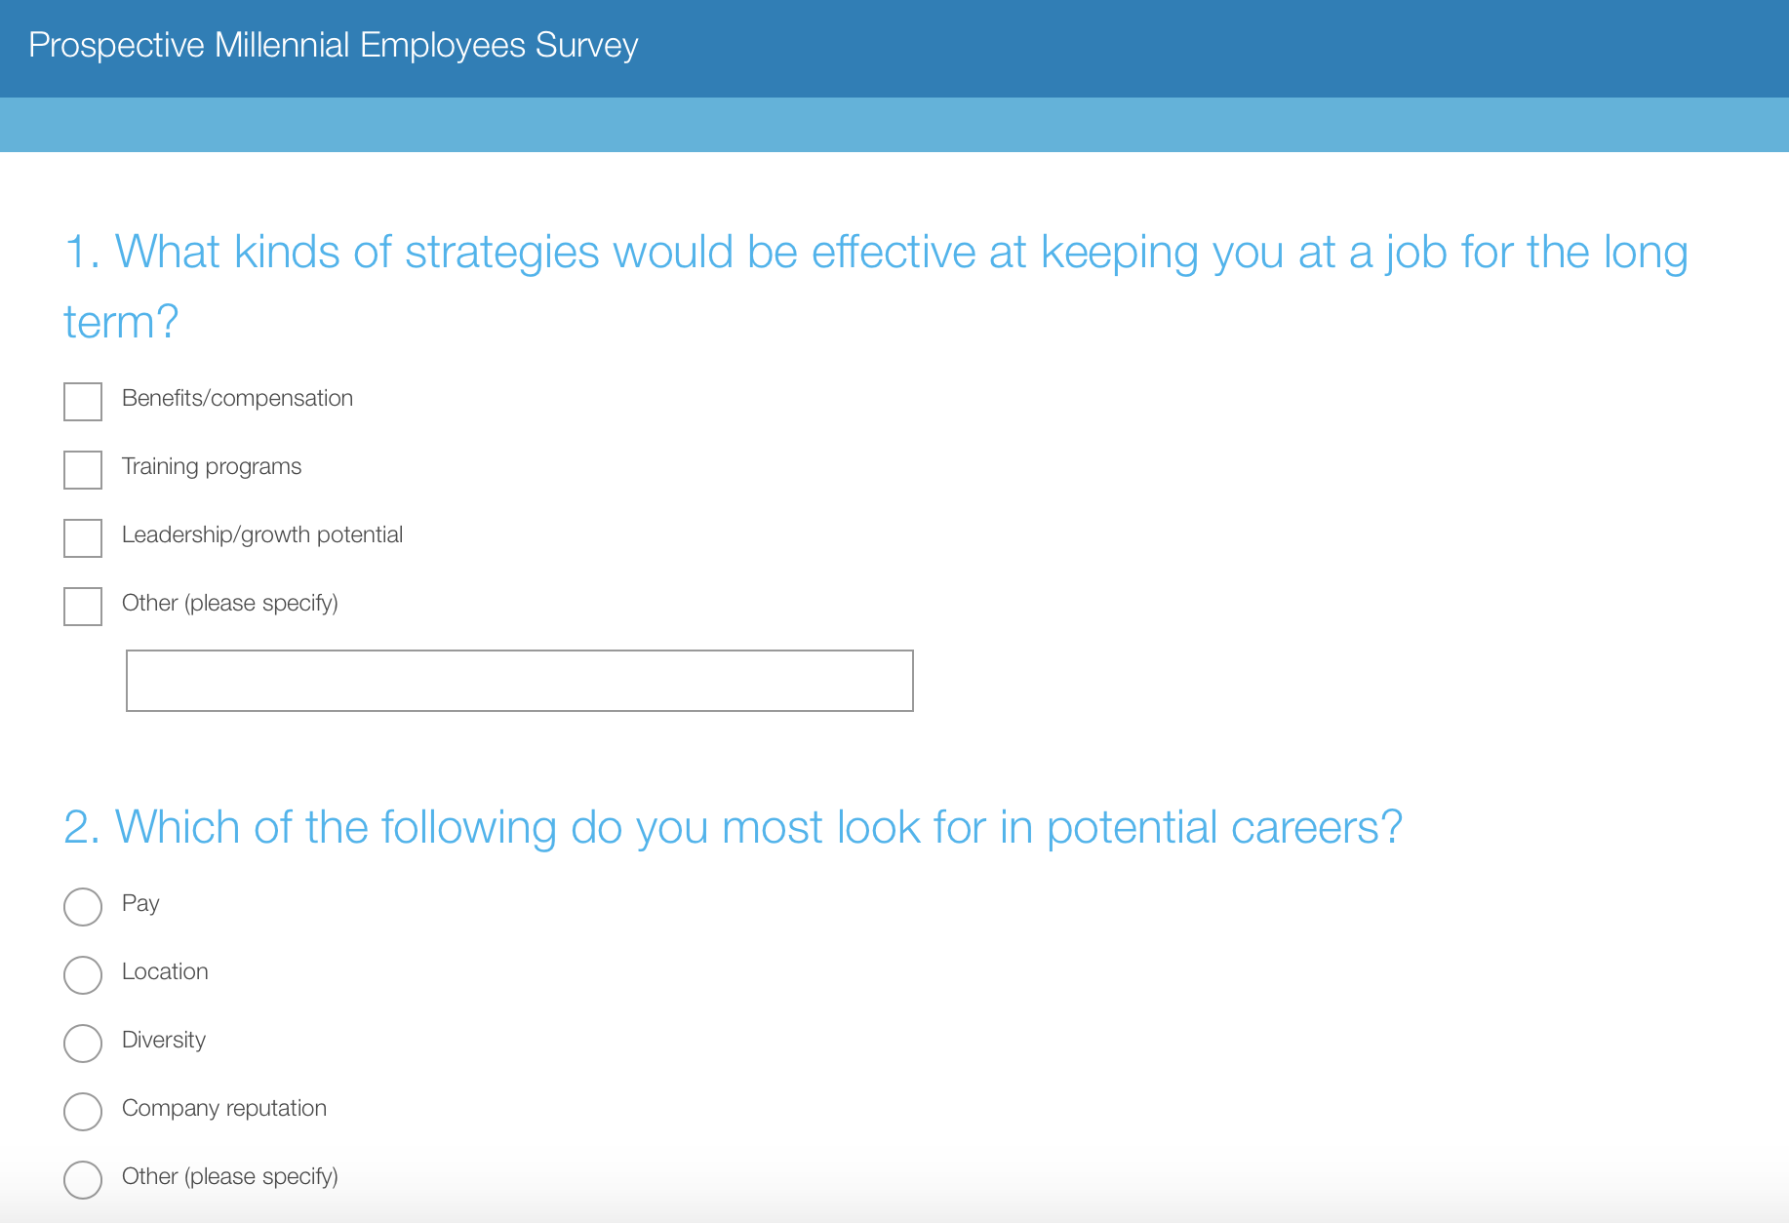
Sample Survey
Recruitment Retention
Return on Investment
Strategy Logistics Feasibility Strategy Logistics Feasibility
Notes:
Example of survey that contains potential questions AM could ask students about what they value in the workplace

Slide 7
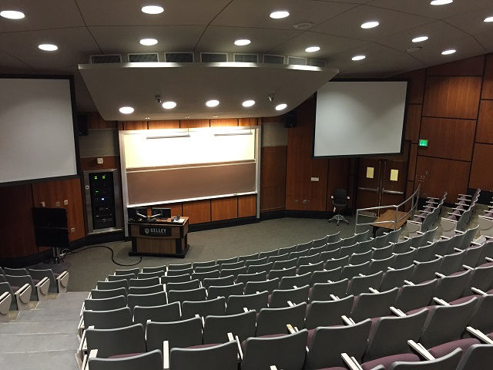
Feasibility
ArcelorMittal recruiters reach out to business professors through email (already a sponsor of Big Ten schools)
ArcelorMittal takes our example and develops their own slide and survey
ArcelorMittal mass orders an additional 1,000 stainless steel water bottles
Recruitment Retention
Return on Investment
Strategy Logistics Feasibility Strategy Logistics Feasibility
Notes:
According to Dr. John Sullivan, from Ere Media, a source of information for talent acquisition, there are many advantages for creating relationships with faculty. It can give a company insights on top students, give them the ability to influence curriculum, and push employment branding messages.
In an article on time.com free products made people talk about a company 20% more than they would have without a freebie

Slide 8
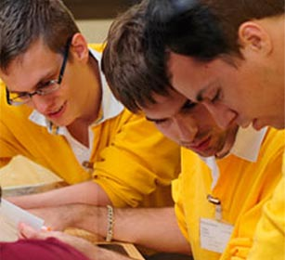
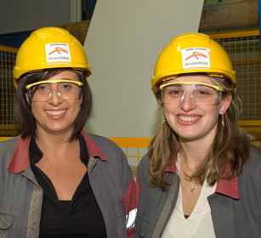
Retention Strategy
Annual Innovation Workshops encourage creativity from within the workplace
Foster closer relationships between generations
Promote transparency between management and employees
Innovative ideas brought about from those on the inside
Recruitment Retention
Return on Investment
Strategy Logistics Feasibility Strategy Logistics Feasibility

Slide 9



How will this work?
Recruitment Retention
Return on Investment
Strategy Logistics Feasibility Strategy Logistics Feasibility
Notes:
Throughout the year, employees will be encouraged by management to think more innovatively and come up with creative solutions to company problems
Teams will be formed with people of different generations
They will then present their ideas to management

Slide 10

Retention Feasibility
Employees take off 2 hours per week for 6 weeks to work with their teams
Winning Prize: $1000
Various cost implementation
No given budget to base the proposal on
Recruitment Retention
Return on Investment
Strategy Logistics Feasibility Strategy Logistics Feasibility

Slide 11
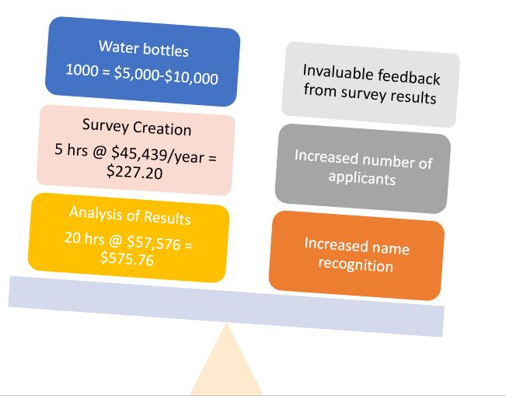
Return on Investment
Recruitment
Recruitment Retention
Return on Investment
Strategy Logistics Feasibility Strategy Logistics Feasibility
Notes:
At an average kelley networking event, there are x students - average class size is between 50-250 students, 10-15% will take an external survey, 8% will visit booth
Recruitment
Stainless steel water bottles
Add 1,000 to an existing order
$5,000-$10,000 before quantity discount
Survey creation
Average salary of HR rep: $45,439
5 hours: $227.20
Analysis of results
Average salary of business analyst: $57,576
20 hours: $575.76
Retention
Opportunity cost of time
Average employee salary: $55,000
2 hours/week for 6 weeks: $330
570 salaried employees
Approx ⅓ are business = 190
190*330=$62,700/year
Prize for winning team
$1,000/year
Cost to implement proposal
Varies
$3,000/year

Slide 12
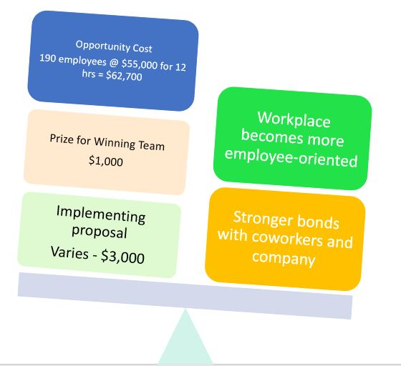
Return on Investment
Retention
Recruitment Retention
Return on Investment
Strategy Logistics Feasibility Strategy Logistics Feasibility
Notes:
In the end, the benefits really outweigh the costs.
At an average kelley networking event, there are x students - average class size is between 50-250 students, 10-15% will take an external survey, 8% will visit booth
Recruitment
Stainless steel water bottles
Add 1,000 to an existing order
$5,000-$10,000 before quantity discount
Survey creation
Average salary of HR rep: $45,439
5 hours: $227.20
Analysis of results
Average salary of business analyst: $57,576
20 hours: $575.76
Retention
Opportunity cost of time
Average employee salary: $55,000
2 hours/week for 6 weeks: $330
570 salaried employees
Approx ⅓ are business = 190
190*330=$62,700/year
Prize for winning team
$1,000/year
Cost to implement proposal
Varies
$3,000/year

Slide 13
Recruitment Strategy
Retention Logistics
Retention Strategy
Retention Feasibility
Recruitment Logistics
Recruitment Feasibility
Return on Investment
Notes:
We explained our recruitment strategy and how it will help ArcelorMittal to attract the attention of millennials to their positions in Burns Harbor, IN
We then showed you how we will implement this strategy and the logistics behind our idea
Finally, for recruitment, we will discuss the simplicity and ease integrating our idea
Retention strategy
Retention logistics
Return on investment

