Slide 1
Exploratory Data Visualization with Large Datasets Utilizing two Python Modules
Caroline Grant
BIOF309: April, 2018

Slide 2
Overall Objectives
Gain familiarity with data visualization in multiple python modules
Practice cleaning and indexing large datasets (>1,000,000 data points)

Slide 3
Specific Objectives
Use graphics to learn about drug crime:
Visualize drug induced deaths throughout the United States in the year 2015
Visualize Heroin drug charges throughout Chicago from 2012-2017

Slide 4
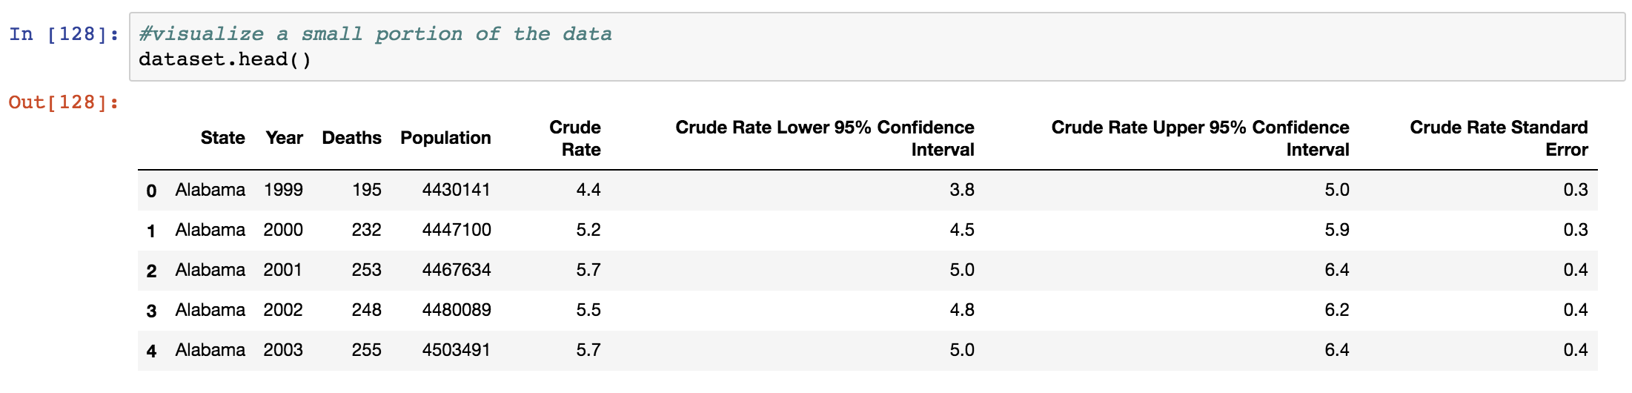
Objective 1 - Drug Induced Deaths
Dataset courtesy of Kaggle
Drug deaths by state from 1999-2015
Visualization using plotly module

Slide 5
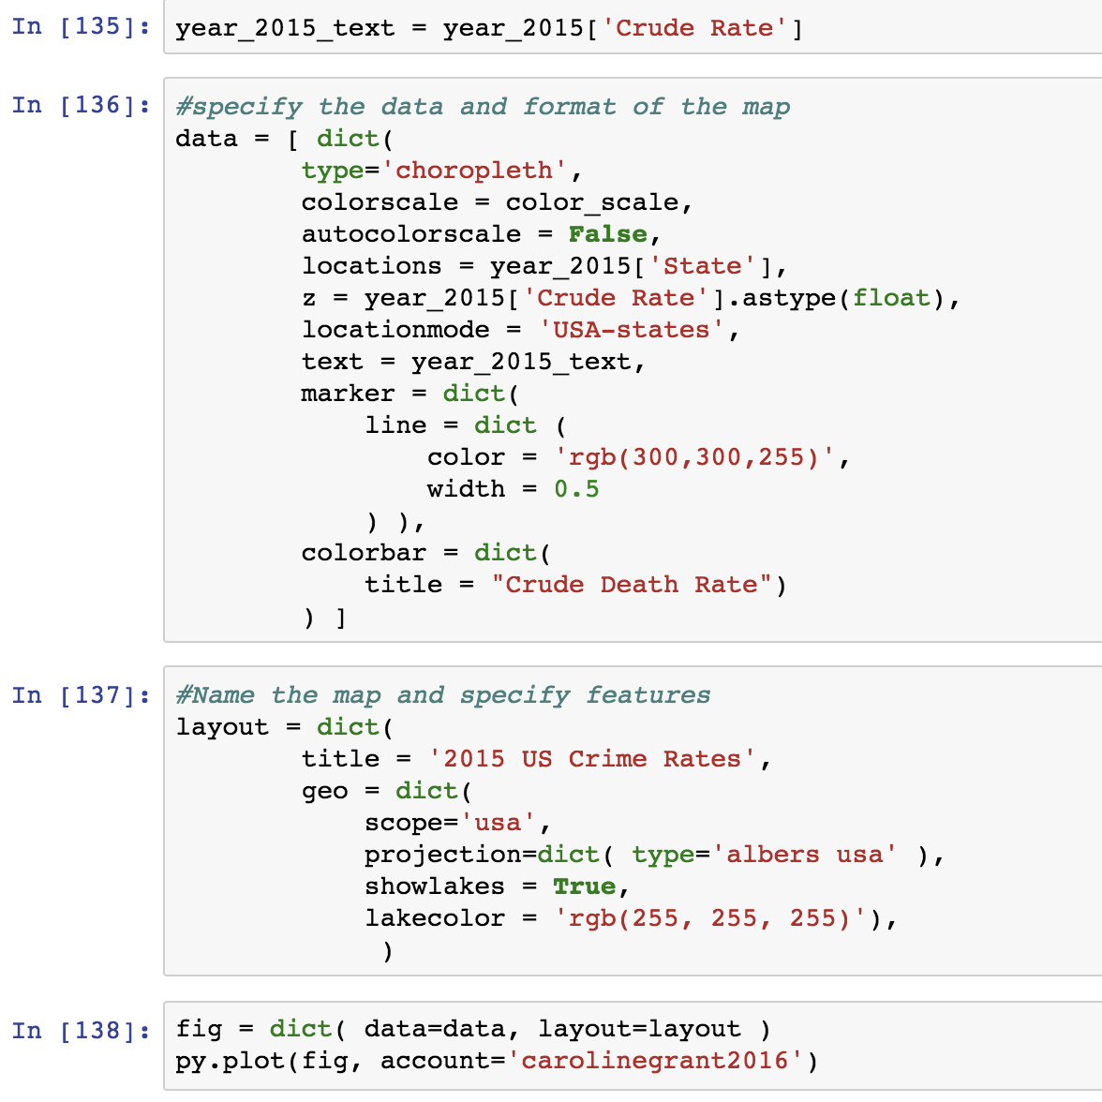
Objective 1 - Drug Induced Deaths

Slide 6
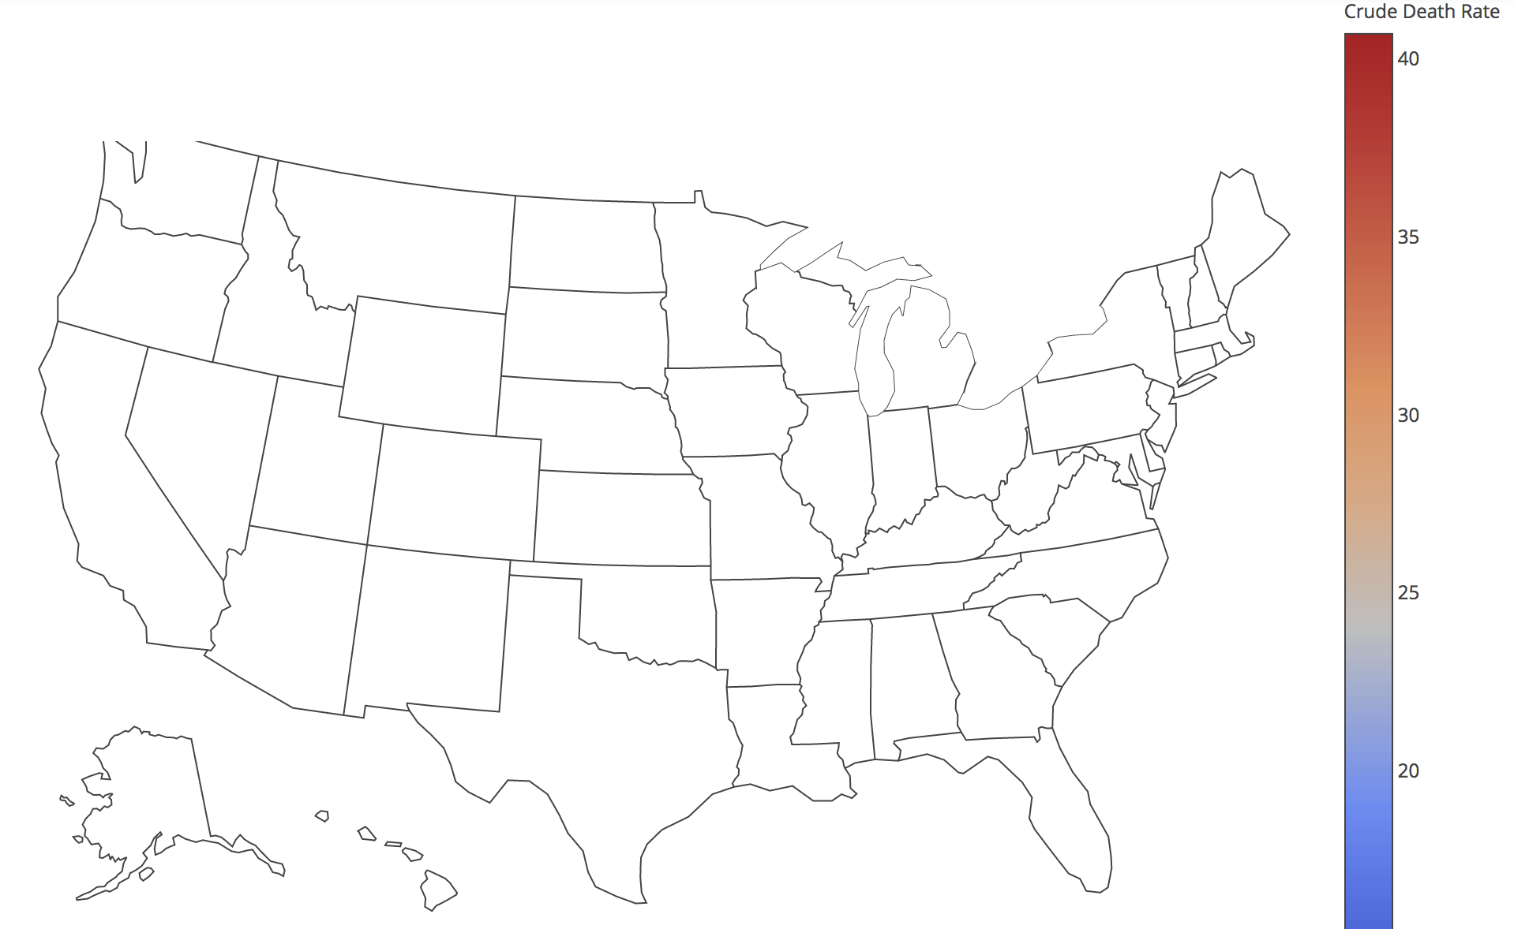
Objective 1 - Drug Induced Deaths

Slide 7
Objective 1 - Drug Induced Deaths
The Bad:
No choropleth map of drug induced deaths
The Good:
Downloaded plotly module
Accessed plotly account
Learned to change the color scheme by setting the color scale
Type of map is correct (Specific USA map with borders, lakes, thin state lines)
Crude death rate scale is labeled correctly and has the appropriate scale

Slide 8
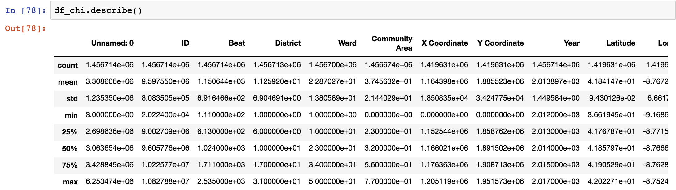
Objective 2 - Heroin Charges in Chicago
Dataset courtesy of Kaggle
1.45 million rows, 22 columns of data
Visualize with matplotlib

Slide 9
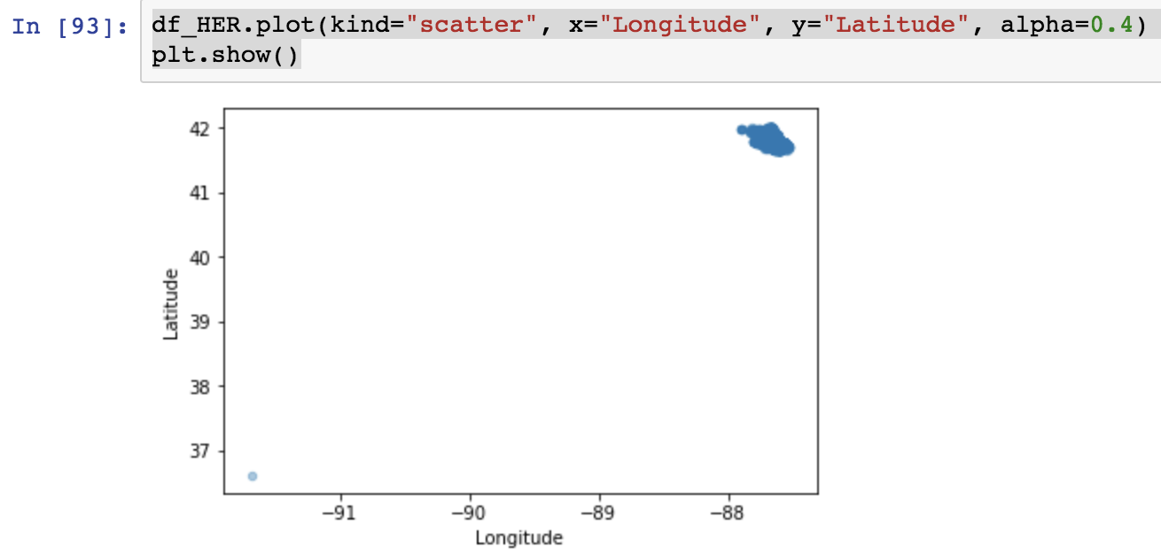
Objective 2 - Heroin Charges in Chicago
Filtered by crime type:
df_chi.loc[:, "Primary Type"]
Used only narcotics crimes
df_narc = df_chi.loc[:, "Primary Type"] == 'NARCOTICS'
Narrowed narcotics crimes to possession of heroin
df_heroin = (df_chi[df_narc]).loc[:, "Description"] == 'POSS: HEROIN(WHITE)'
df_chi[df_narc][df_heroin]
Mapped heroin crimes

Slide 10
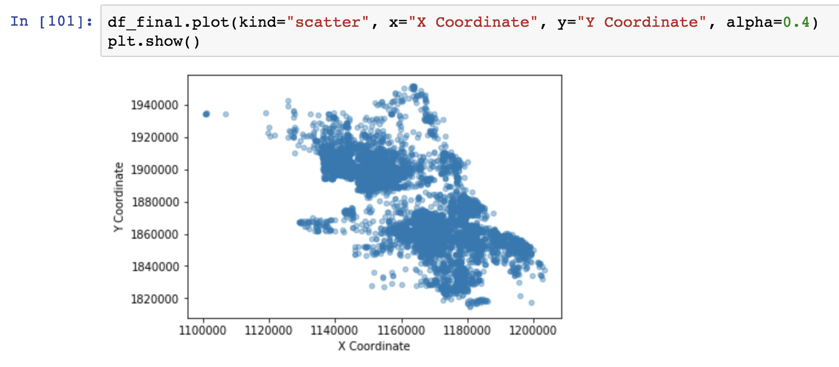
Objective 2 - Heroin Charges in Chicago
Continued to filter:
Removed NaN values
filt_df_HER = df_HER[df_HER['Longitude'].notnull()]
2. Restricted geographical coordinates to the known coordinates of Chicago
df_final = filt_df_HER[filt_df_HER['Latitude'] > 37]

Slide 11
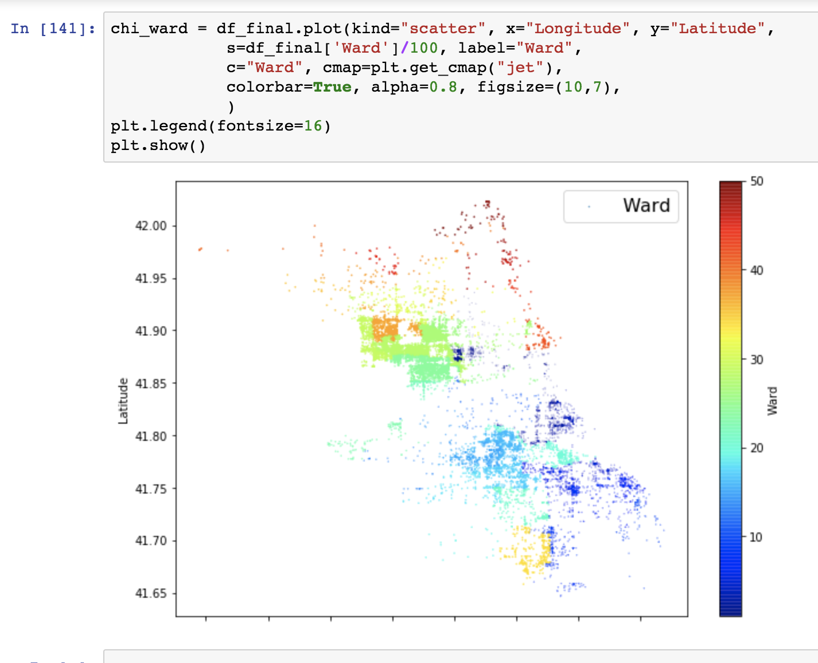
Objective 2 - Heroin Charges in Chicago
Mapped to distinguish crime areas by city ward

Slide 12
Summary
Visualized datasets with two different python packages (plotly and matplotlib)
Extracted relevant information from large datasets by re-indexing and filtering
Saw distribution of heroin charges across Chicago

