Slide 1

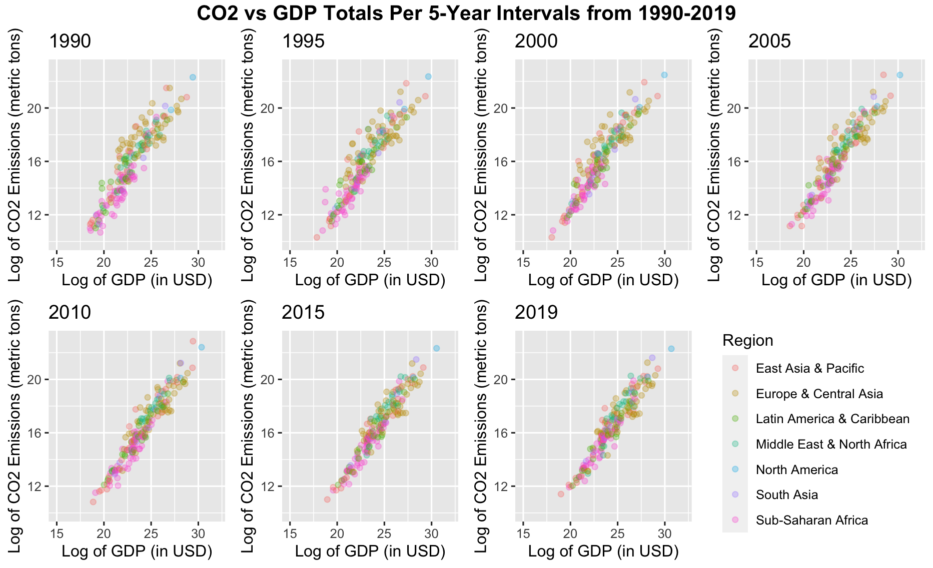
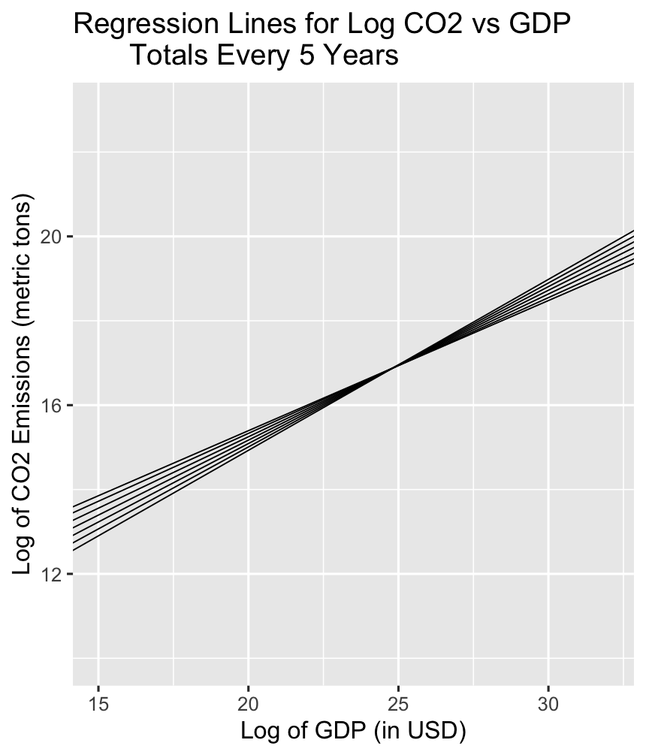
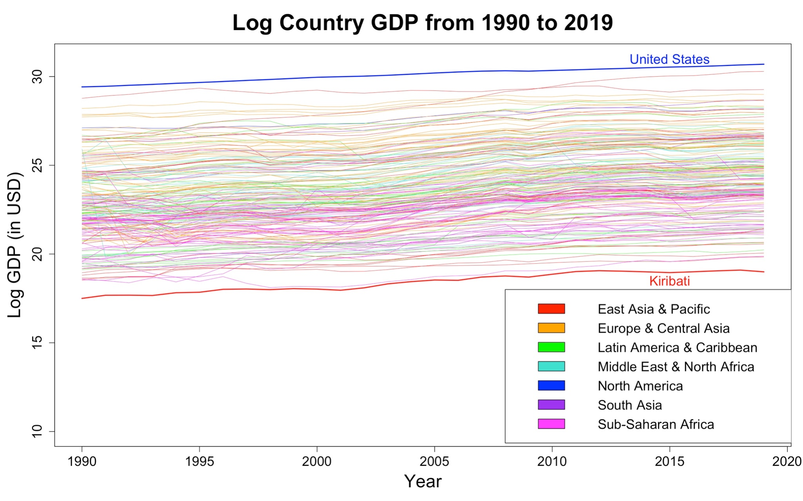
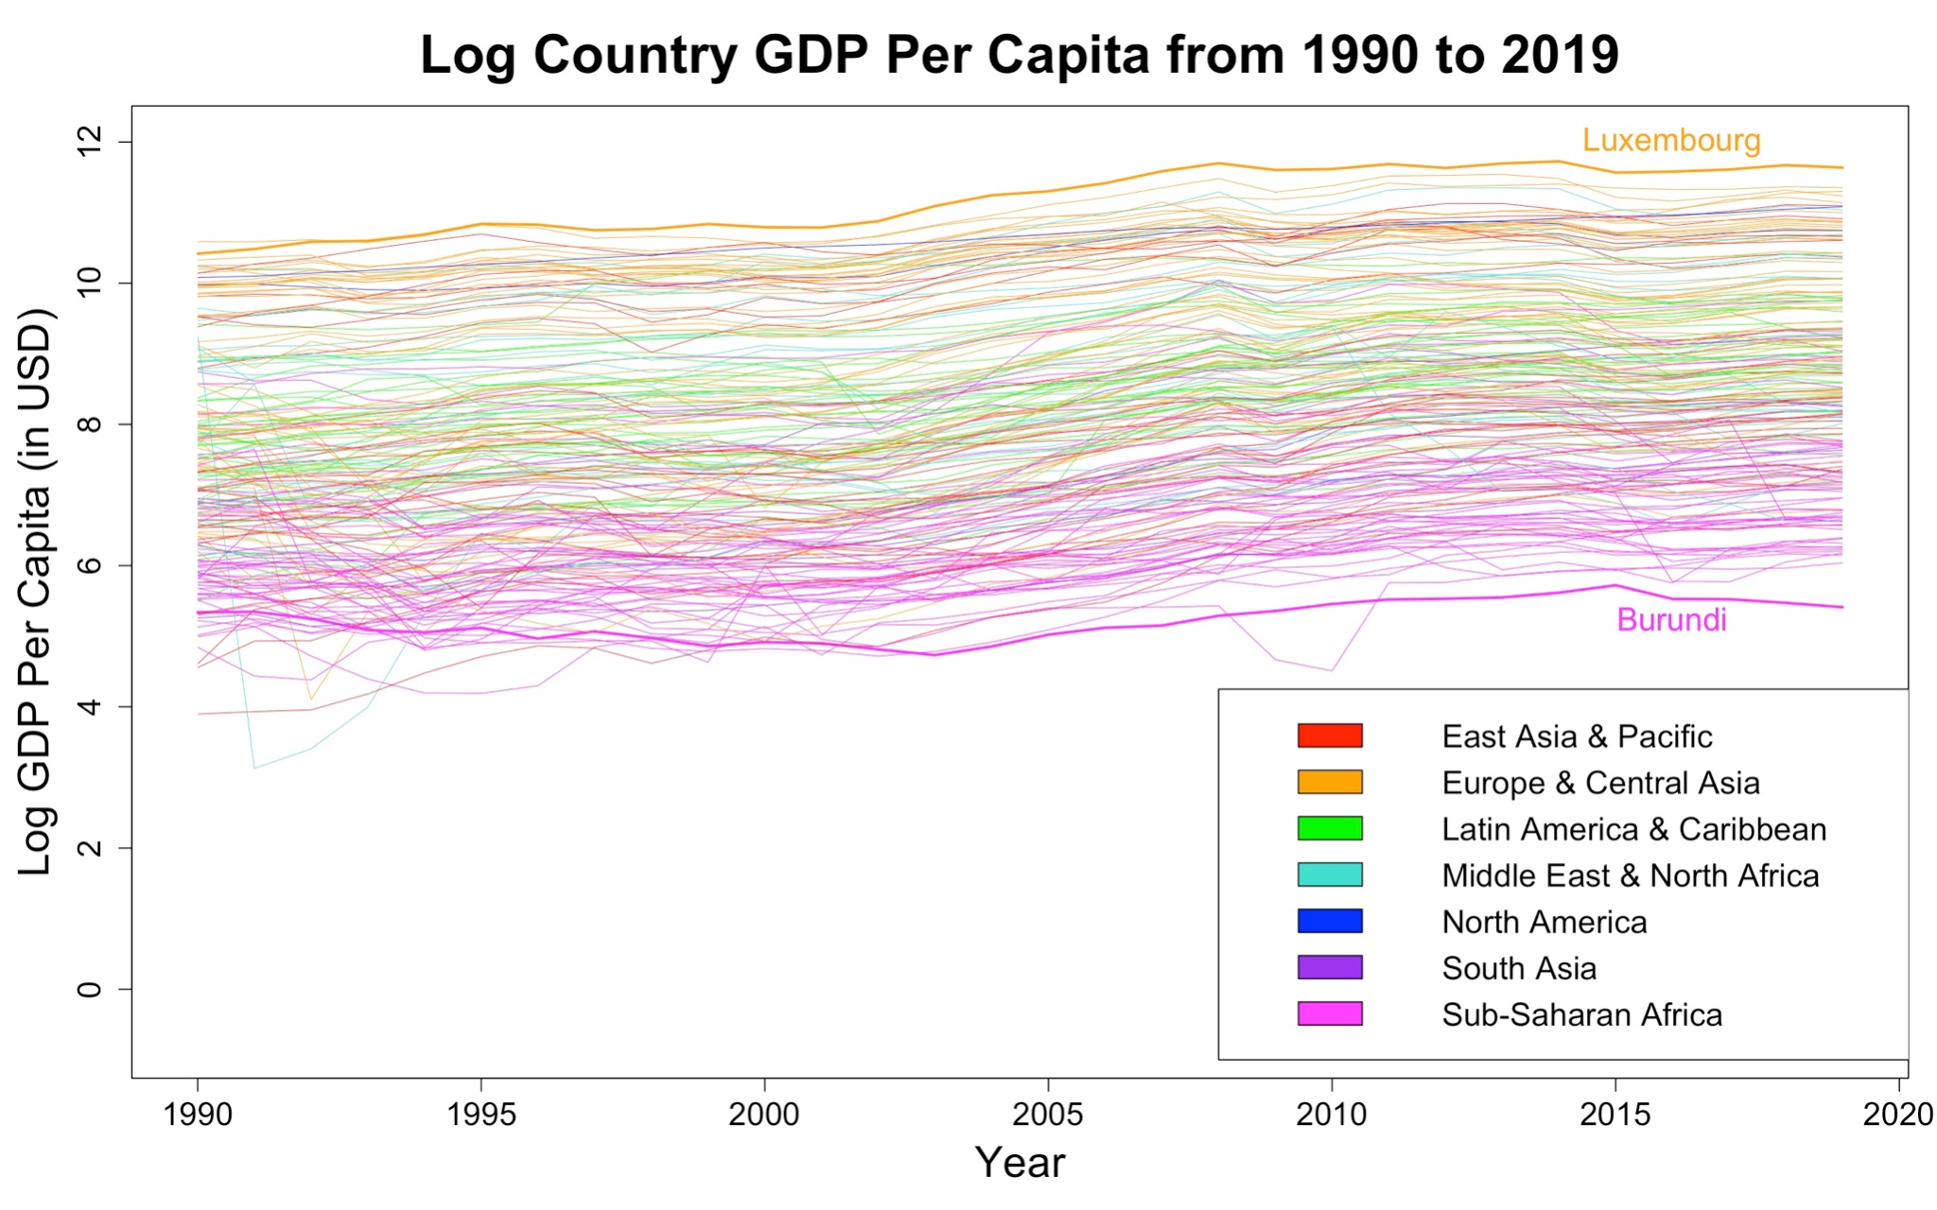
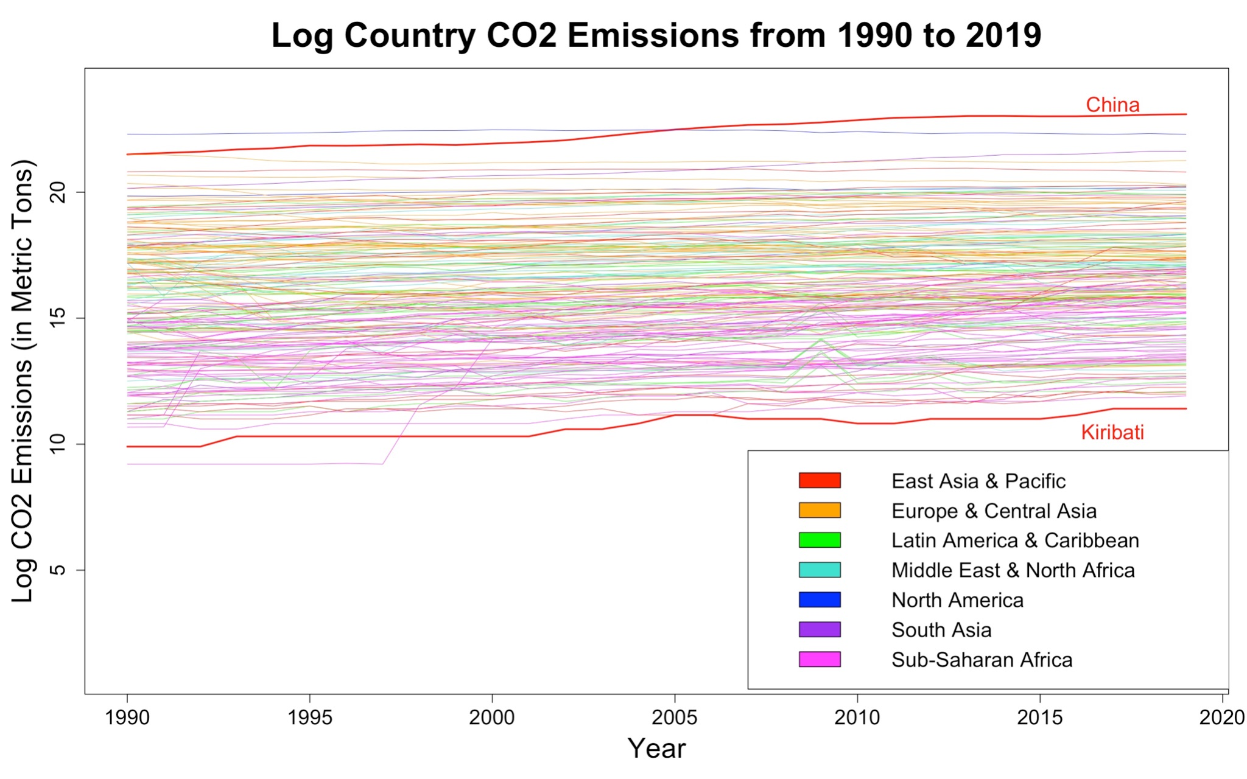
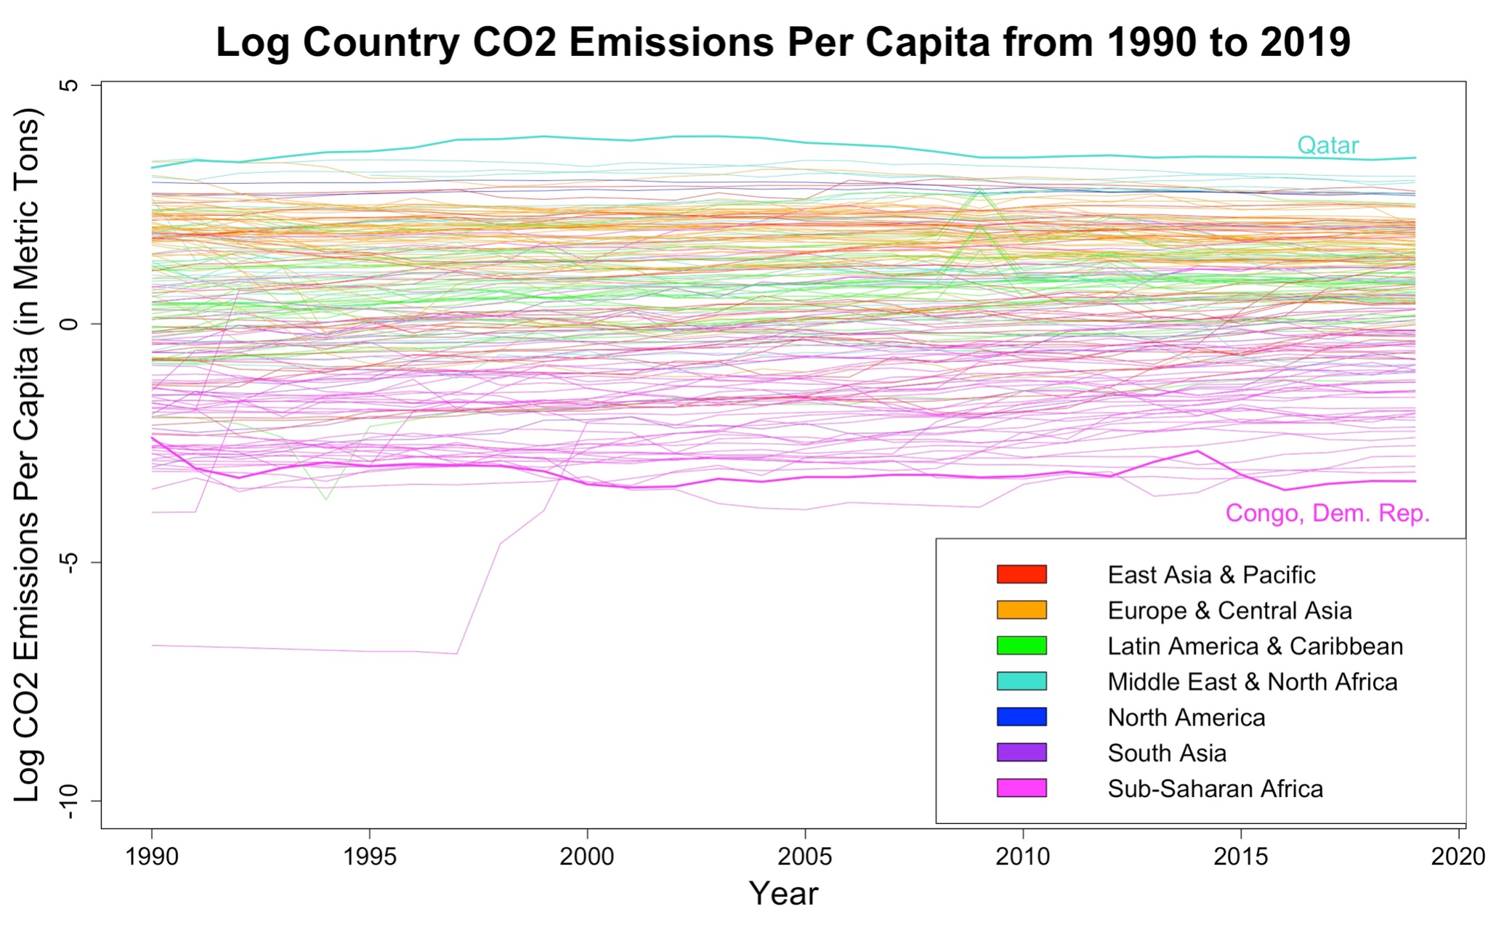
The Relationship Between Country GDP and
CO₂ Emissions Is Changing Over Time
Caroline Jung, Sarah Katz, Tayae Rogers
Background
CO₂ vs GDP Totals Every 5 Years
Historically, increases in countries’ gross domestic products (GDPs) have been strongly correlated with increases in their carbon dioxide (CO₂) emissions, which is concerning because CO₂ emissions are the primary cause of global warming.¹ We investigated if this relationship between countries’ GDPs and CO₂ emissions has changed over time. Our results will improve understanding of the relationship between a country’s economic growth and change in CO₂ emissions.
Data and Methods
1990
Our data – which contains countries’ GDPs, CO₂ emissions, populations, geographical regions, and income groups – primarily come from World Bank datasets. We merged the raw datasets, selected the years 1990-2019, and adjusted the GDP and CO₂ values onto the same scales.
To prepare the data, we researched and manually filled in missing values. We then limited our dataset to cover only currently UN-recognized countries (195 countries), and then further restricted it to countries with populations of 50,000 or more in the year 1990 due to concerns about the accuracy of small countries’ data. Similarly, we also dropped one country, Kosovo, from the dataset because there was no CO₂ emissions data, leaving 186 countries. Lastly, we imputed the six remaining missing values (two GDP values for North Korea, two CO₂ values for Micronesia, one CO₂ value for Mali, one CO₂ value for Namibia), assuming linear change over time.
Lastly, we made two versions of our data, one with total country data and one with per capita data, to decide which to proceed with. We plotted both datasets in line graphs on a log scale to see which scale was better suited for a linear model (Figures 1 and 3, the totals, are more linear than Figures 2 and 4). Based on the visualizations, we chose to proceed with country totals data.
After cleaning our data, we used a fixed effects model to run a linear regression on GDP, year (as a continuous variable), the interaction between GDP and year, and country.
2019
Left: Figure 5. Log GDP against log CO₂ emissions in snapshots every five years from 1990 to 2019.
Right: Figure 6. The regression lines from each of the snapshots of log GDP against log CO₂ emissions in Figure 5. The line with the steepest slope (the lowest line on the left side and highest on the right side) is the regression from 1990, while the line with the smallest slope (the highest on the left side and lowest on the right) is the regression from 2019. This suggests that the effect of log GDP on log CO₂ emissions may have lessened over time.
Results
Based on our regression, the predictors log GDP, year, and the interaction between log GDP and year do have an effect on the mean log CO₂ outcome (their p-values were close to 0). Additionally, our scatterplots that capture log CO₂ emissions against log GDP every five years from 1990 to 2019 seem to show that the correlation seems to strengthen over time. Specifically, it appears that European and Central Asian countries’ growth in log CO₂ emissions has decreased relative to their growth in their log GDPs over time. Furthermore, when we derived a general linear regression equation that can be used to model log CO₂ emissions for each year (Equation 1), we observed that for the same increase in log GDP, there is a smaller increase in log CO₂ emissions in recent years.
To test if our model that includes interaction between log GDP and year is well-fit, we compared its BIC with the BIC of a model without the interaction between log GDP and year. The BIC for the model with interaction is smaller than the other model’s BIC (5040 and 5253, respectively), suggesting that the model with interaction is not overfit compared to the model without.
GDP and CO₂ Totals vs Per Capita for All Countries
Figure 1
Figure 2
Equation 1. This equation predicts the mean log CO₂ emissions for a given year and models how the relationship between log GDP and year changed over time. It uses Bolivia, which had approximately median CO₂ emissions over the time period, as an estimate for an average country.
Discussion
Figure 3
Figure 4
Our research question investigates the relationship between GDP and CO₂ emissions and whether it has changed over time. However, our analysis had some limitations. First, we did not fully account for spatial and temporal relationships. Second, we were constrained by the availability and accuracy of CO₂ emissions data, especially for smaller states. To account for this, we researched and imputed as many of those values as possible. We also created a population minimum cutoff since the countries under this cut-off seemed to have questionable data, which condensed our dataset to 186 countries. For countries that did not exist until recently (i.e. after 1990), we used only the data for the relevant years.
Conclusion
Overall, our model adds understanding to the relationship between countries’ GDPs and CO₂ emissions and how this relationship has changed over time from 1990 to 2019. We found that the relationship between GDP and CO₂ emissions has changed over time, as evidenced by the statistical significance of the interaction between log GDP and year. Specifically, our analysis shows that in recent years, for the same increase in GDP, there is a smaller increase in CO₂ emissions overall. This is consistent with recent findings that some wealthier countries have decoupled their GDP from CO₂ emissions in recent decades, meaning that as their GDPs have increased, their CO₂ emissions have actually decreased.¹
Top row: Figures 1-2. The log country GDP compared to the log country GDP per capita, from 1990 to 2019.
Bottom row: Figures 3-4. The log country CO2 emissions compared to the log country CO2 emissions per capita, from 1990 to 2019.
All: Figures 1-4. In both comparisons, the graphs seem fairly linear, although the per capita graphs have more variation and are thus less linear.
1 - Ritchie, H. (2021, December 1). Many countries have decoupled economic growth from CO₂ emissions, even if we take offshored production into account. Our World in Data. Retrieved December 12, 2022, from https://ourworldindata.org/co2-gdp-decoupling

