Slide 1

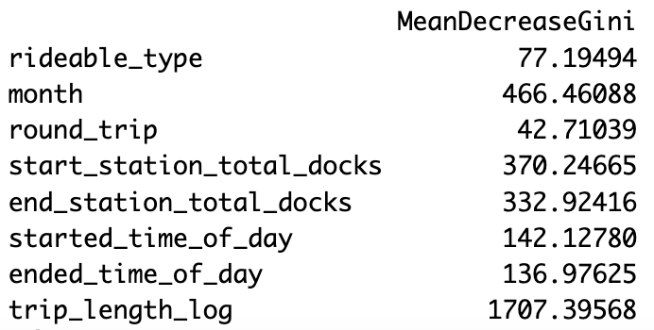
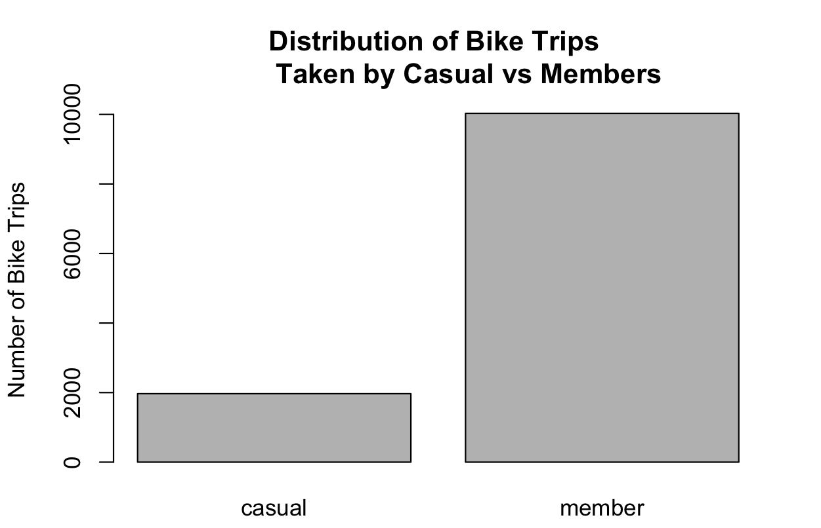

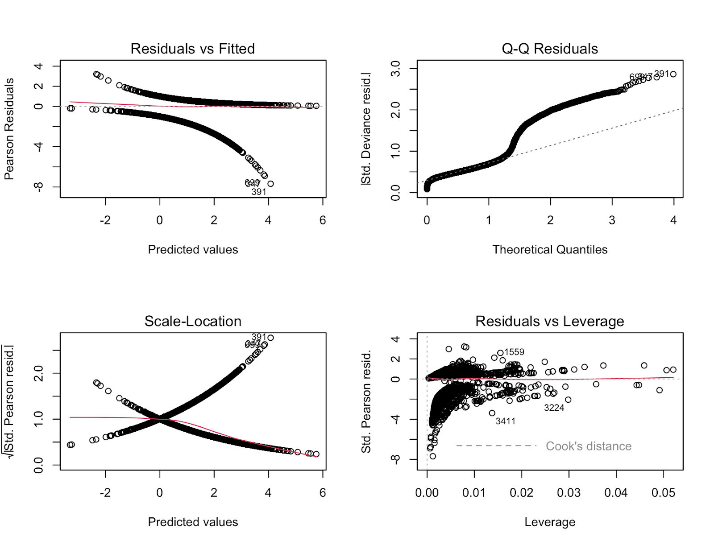
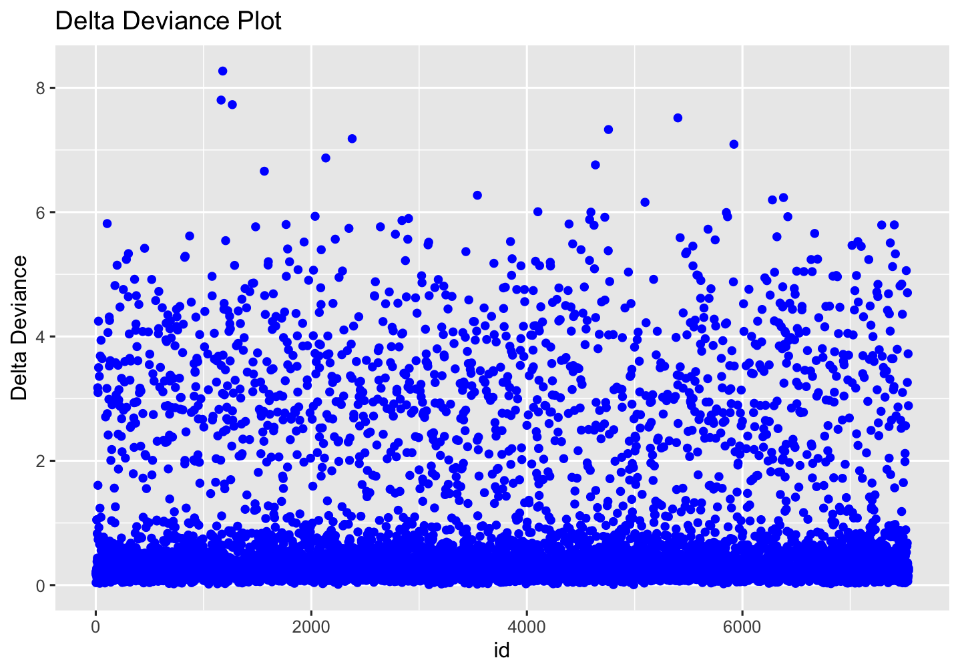
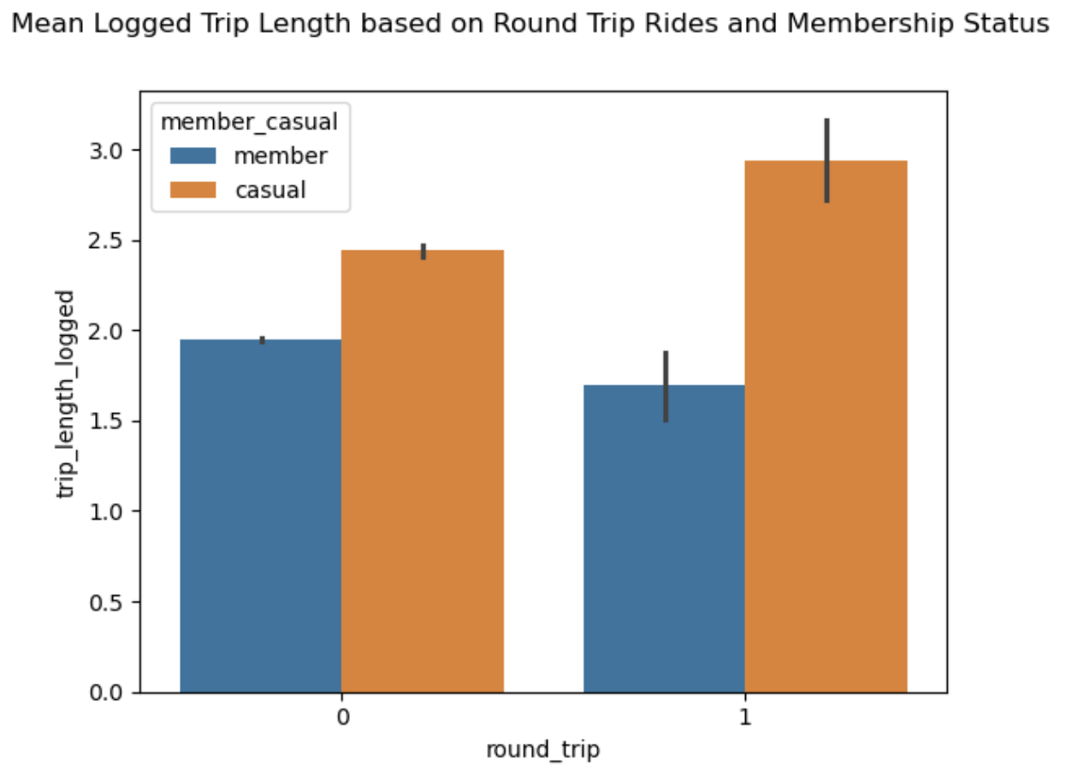
Predicting Membership Status of Blue Bike Trips
Caroline Jung ’25, Data Science Major Capstone
Introduction
Methodology
Results
Motivation
Bike share is a form of public transportation that promotes sustainability
Collect data on bike usage and its membership marketing tactics for the city of Cambridge
Research Question
How can we best predict the membership status for Blue Bike trips taken within Cambridge in 2024 based on rider & trip attributes?
STEP 1: Screen for multicollinearity ⇒ none
STEP 2: Identify best first-order model & tune threshold via 10-fold CV
F-measure: precision & sensitivity tradeoff regarding correct predictions for members → optimize for high value
Difference in TPR and TNR: equilibrium considers tradeoff between correct predictions for members vs non-members → optimize for low value
Best first-order model: logit AIC with threshold 0.8
STEP 3: Consider higher order models & interaction terms in regression
Two proposals of best models:
First-order logistic regression, selected by AIC criterion: allows for quantitative analysis, prediction, and accessible interpretation
Classification tree with ensemble method (bagging): allows for easy interpretation and list of most important predictors
STEP 4: Check regression diagnostics, outliers, and influential observations
Outliers do not seem to be highly influential ⇒ kept full dataset
Classification Tree (Bagging)
 | F-measure |  |  |  | Difference (|TPR-TNR|)
 | Logit |  | Probit |  | Logit |  | Probit
Threshold | AIC | BIC | AIC | BIC | AIC | BIC | AIC | BIC
0.8 | 0.838 | 0.841 | 0.835 | 0.838 | 0.263 | 0.314 | 0.242 | 0.301
0.7 | 0.900 | 0.906 | 0.899 | 0.906 | 0.651 | 0.697 | 0.653 | 0.703
0.6 | 0.913 | 0.913 | 0.913 | 0.913 | 0.821 | 0.834 | 0.827 | 0.841
0.5 | 0.915 | 0.915 | 0.915 | 0.915 | 0.873 | 0.895 | 0.879 | 0.901
0.4 | 0.915 | 0.915 | 0.915 | 0.915 | 0.925 | 0.931 | 0.930 | 0.936
Top 3 most important variables:
Trip length (logged)
Month
Total # docks at stations
Data Cleaning
Fig 5. Importance plot of classification tree determined by bagging ensemble method.
Table 1. Performance metrics for first-order models at different thresholds via 10-fold CV.
MeanDecreaseGini: avg decrease in node heterogeneity from splitting on variable
Higher scores → more homogeneous nodes → indicate important variables
Dataset: Blue Bikes 2024 trip history and station info, only trips taken within Cambridge (962052 observations)
New variables:
Month (categorical)
Round-trip (binary categorical)
Trip length (in logged mins) – difference in start & end time
Time of day (categorical) – start & end times based on hour
Dropped rows with suspected recording errors (start times > end times), which was only 0.00003% of observations
Created smaller data subset due to limited processing power
Dimensions: 12000 observations x (8 predictors + 1 response)
First-Order Logistic AIC Model
 | Predictor | Coefficient | Interpretation: expect odds of being a member to…
 | Bike type: Electric | -0.044 | - 4.30%, compared to trips taken with classic bike
 | February (month 2) | -0.097 | - 9.24% | compared to trips taken in January (month 1)
 | March (month 3) | -0.262 | - 23.05%
*** | April (month 4) | -0.613 | - 45.83%
*** | May (month 5) | -0.666 | - 48.62%
*** | June (month 6) | -0.675 | - 49.08%
*** | July (month 7) | -0.977 | - 62.36%
*** | August (month 8) | -0.824 | - 56.13%
*** | September (month 9) | -0.755 | - 53.00%
*** | October (month 10) | -0.550 | - 42.31%
*** | November (month 11) | -0.513 | - 40.13%
 | December (month 12) | -0.288 | - 25.02%
*** | Round trip: yes | -0.946 | - 61.17%, compared to non-round trips
** | Start station total docks | 0.013 | + 1.31%
*** | End station total docks | 0.030 | + 3.05%
 | Started time of day: afternoon | 0.276 | + 31.79% | compared to trips starting in the morning
** | Started time of day: evening | 0.708 | + 102.99%
 | Started time of day: night | 0.346 | + 41.34%
*** | Ended time of day: afternoon | -0.777 | - 54.02% | compared to trips ending in the morning
*** | Ended time of day: evening | -0.931 | - 60.58%
** | Ended time of day: night | -0.900 | - 59.34%
*** | Trip length (logged) | -0.887 | - 58.81%
 | First-order logit AIC | Interaction logit BIC | Tree (bagging) | Tree (random forest) | Support Vector Machine
F-measure | 0.838 | 0.838 | 0.789 | 0.826 | 0.914
|TPR-TNR| | 0.262 | 0.296 | 0.166 | 0.292 | 0.828
Visualizations
Table 2. Performance metrics for all potential (higher-order) models at threshold 0.8, validated via 10-fold CV.
Table 4. Regression coefficients & interpretation on odds scale for first-order logistic AIC model. Positively (blue) and negatively (green) correlated coefficients indicated.
Fig 1. Bar plot of the class imbalance for binary response variable (member vs casual).
Discussion & Limitations
Fig 3 (left). Regression diagnostic plots for first-order logistic AIC model to identify outliers.
Fig 4 (right). Delta deviance plot for first-order logistic AIC model to identify influential observations.
Discussion & Conclusion
Both models indicate trip length, month, and number of docks at stations to be among the most significant predictors – trips are more likely to be taken by members if trips were shorter, taken in January, and started/ended at stations with more docks
I propose two models to the city of Cambridge:
The classification tree may be preferred due to easy interpretation of important trip attributes and no inherent assumptions
The first-order logistic AIC model may be preferred for a more comprehensive quantitative analysis of significant attributes, while maintaining accessible interpretation (no higher order terms)
Limitations & Future Work
All models do not account for time series analysis (month was treated as a categorical variable with independent levels), concentrated to one year
Comparative analysis with other Massachusetts cities (spatial analysis)
ID | Membership Status | Bike Type | Month | Round Trip | Start station #docks | End station #docks | Started time of day | Ended time of day | Trip length logged
699 | casual | electric | 1 | 0 | 19 | 19 | morning | morning | 0.624
391 | casual | electric | 1 | 0 | 27 | 53 | morning | morning | 1.540
347 | casual | classic | 1 | 0 | 27 | 18 | evening | evening | 0.587
3411 | casual | classic | 4 | 0 | 15 | 19 | night | morning | 2.287
3224 | casual | classic | 4 | 0 | 19 | 19 | night | morning | 3.580
1559 | member | classic | 1 | 0 | 19 | 19 | morning | morning | 2.401
Fig 2. Side-by-side bar plot of the relationship between round trips, trip lengths (logged), and membership status.
Table 3. Observed data values for predictor & response variable for identified outliers. Bolded values indicate departures from the direction of correlation based on membership status in first-order logistic AIC model.
References: https://bluebikes.com/system-data

