Slide 1

What is new in HTML5
By Peter Wilson

Slide 2
What is new in HTML5
<!DOCTYPE HTML PUBLIC "-//W3C//DTD HTML 4.01 Transitional//EN" "http://www.w3.org/TR/html4/loose.dtd">
<html>
<head>
<meta http-equiv="Content-Type" content="text/html;charset=utf-8">
<title>Title of the document</title>
</head>
<body>
Content of the document......
</body>
</html>

Slide 3
What is new in HTML5
<!DOCTYPE html>
<html>
<head>
<meta charset="UTF-8">
<title>Title of the document</title>
</head>
<body>
Content of the document......
</body>
</html>

Slide 4
New semantic elements
<header>
<nav></nav>
</header>
<section>
<article></article>
</section>
<section>
<figure></figure>
</section>
<footer></footer>

Slide 5
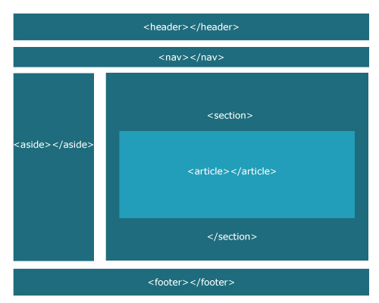
Example

Slide 6
New semantic elements
<article> Defines an article in the document
<aside> Defines content aside from the page content
<bdi> Defines a part of text that might be formatted in a different direction from other text
<details> Defines additional details that the user can view or hide
<dialog> Defines a dialog box or window
<figcaption> Defines a caption for a <figure> element
<figure> Defines self-contained content, like illustrations, diagrams, photos, code listings, etc.
<footer> Defines a footer for the document or a section

Slide 7
New semantic elements
<header> Defines a header for the document or a section
<main> Defines the main content of a document
<mark> Defines marked or highlighted text
<menuitem> Defines a command/menu item that the user can invoke from a popup menu
<meter> Defines a scalar measurement within a known range (a gauge)
<nav> Defines navigation links in the document
<progress> Defines the progress of a task
<rp> Defines what to show in browsers that do not support ruby annotations
<rt> Defines an explanation/pronunciation of characters (for East Asian typography)

Slide 8
New semantic elements
<ruby> Defines a ruby annotation (for East Asian typography)
<section> Defines a section in the document
<summary> Defines a visible heading for a <details> element
<time> Defines a date/time
<rt> Defines an explanation/pronunciation of characters (for East Asian typography)
<ruby> Defines a ruby annotation (for East Asian typography)
<section> Defines a section in the document
<summary> Defines a visible heading for a <details> element
<time> Defines a date/time
<wbr> a possible line break

Slide 9
New media elements
<audio> Defines sound or music content
<embed> Defines containers for external applications (like plug-ins)
<source> Defines sources for <video> and <audio>
<track> Defines tracks for <video> and <audio>
<video> Defines video or movie content

Slide 10
Assignment I
Video
Controls

Slide 11
Canvas
<canvas id="myCanvas" width="200" height="100" style="border:1px solid #000000;"></canvas>
<scripte>
var canv = document.getElementById("myCanvas");
var ctx = c.getContext("2d");
ctx.fillStyle = "#FF0000";
ctx.fillRect(0,0,150,75);
</scripte>

Slide 12
Assignment II
Canvas
Game

