Slide 1


Learning From and With Other Agents
Caroline Wang
PhD Defense | September 18, 2026
Committee: Peter Stone, Risto Miikkulainen,
Elias Stengel-Eskin, Natasha Jaques
Notes:
55 min presentation
Motivation + thesis question: 2 min
Summary of contributions - Background: 2 min
DShape: 3.5 min
DM2: 3.5 min6
NAHT: 3.5 min
ROTATE: 20 min
JaxAHT: 12 min
Future Work: 5 min

Slide 2



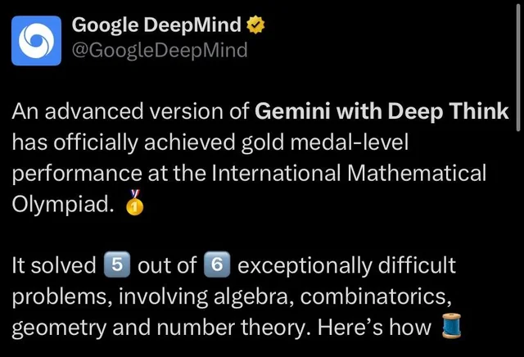

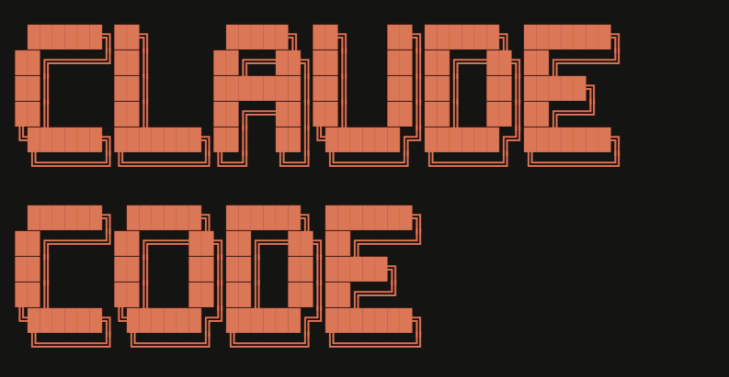
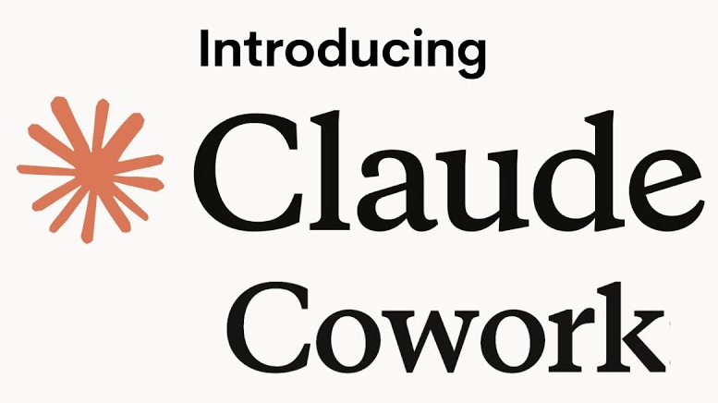

Successes of AI Agents
source
source
source
source
source
Notes:
Reinforcement learning agents have achieved remarkable successes in games and math
RL techniques applied to LLMs have led to agents with general problem solving capabilities

Slide 3





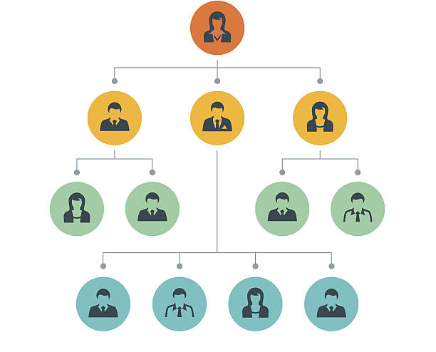


AI agents exist in the world with other agents.
Cooperation has driven human progress, enabling solving problems that no individual can solve alone .
Teaching/learning (source)
Cooperation (source)
Notes:
We compete against each other, cooperate in a team, and learn from one another.

Slide 4
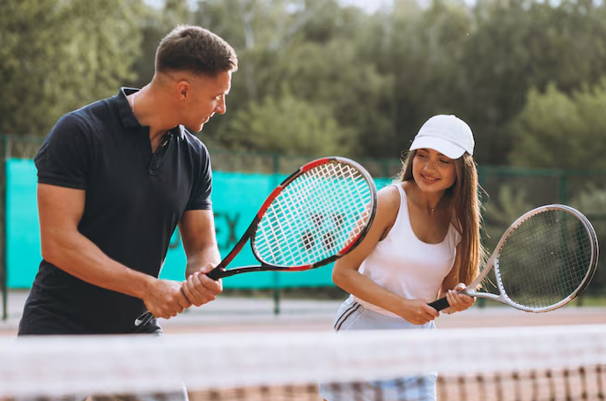
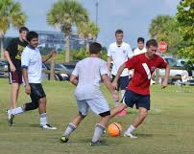
Thesis Question
How can reinforcement learning agents that operate in a cooperative context with other agents, learn from and with those agents, to efficiently solve shared tasks?
Agents Learning From Other Agents
(Dimension 1)
Agents Learning With Other Agents
(Dimension 2)
source
source
source

Slide 5
Dissertation Outline
Completed
Ongoing at Proposal
Contribution | Learning From | Learning With
1️⃣ D-Shape [AAMAS23] | ✔
2️⃣ DM² [AAAI23] | ✔ | ✔
3️⃣4️⃣ N-agent ad hoc teamwork; POAM [NeurIPS25] | ✔ | ✔
5️⃣6️⃣ Open-ended ad hoc teamwork; ROTATE [preprint/under submission] |  | ✔
7️⃣ JaxAHT [preprint/under submission] |  | ✔

Slide 6
Dissertation Outline
Completed
Ongoing at Proposal
Contribution | Learning From | Learning With
1️⃣ D-Shape [AAMAS23] | ✔
2️⃣ DM² [AAAI23] | ✔ | ✔
3️⃣4️⃣ N-agent ad hoc teamwork; POAM [NeurIPS25] | ✔ | ✔
5️⃣6️⃣ Open-ended ad hoc teamwork; ROTATE [preprint/under submission] |  | ✔
7️⃣ JaxAHT [preprint/under submission] |  | ✔

Slide 7
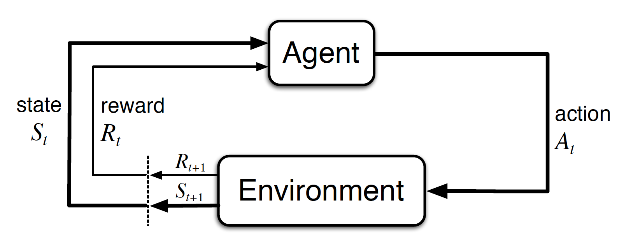
Single-Agent Reinforcement Learning
Objective: maximize sum of rewards

Slide 8


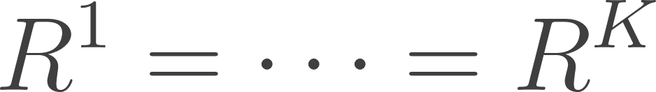
Cooperative Multi-Agent Reinforcement learning
agents
Fully Cooperative Scenarios: ___________
Objective: maximize sum of rewards
Notes:
I study agents within the framework of reinforcement learning.

Slide 9
Ad Hoc Teamwork
agents
Cooperative Scenarios: ___________
Objective: maximize sum of rewards with previously unseen teammates

Slide 10
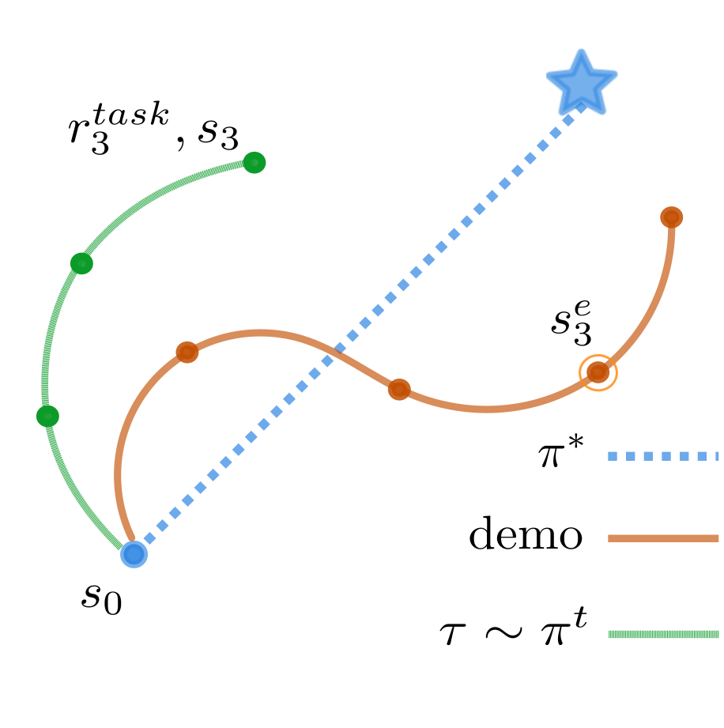
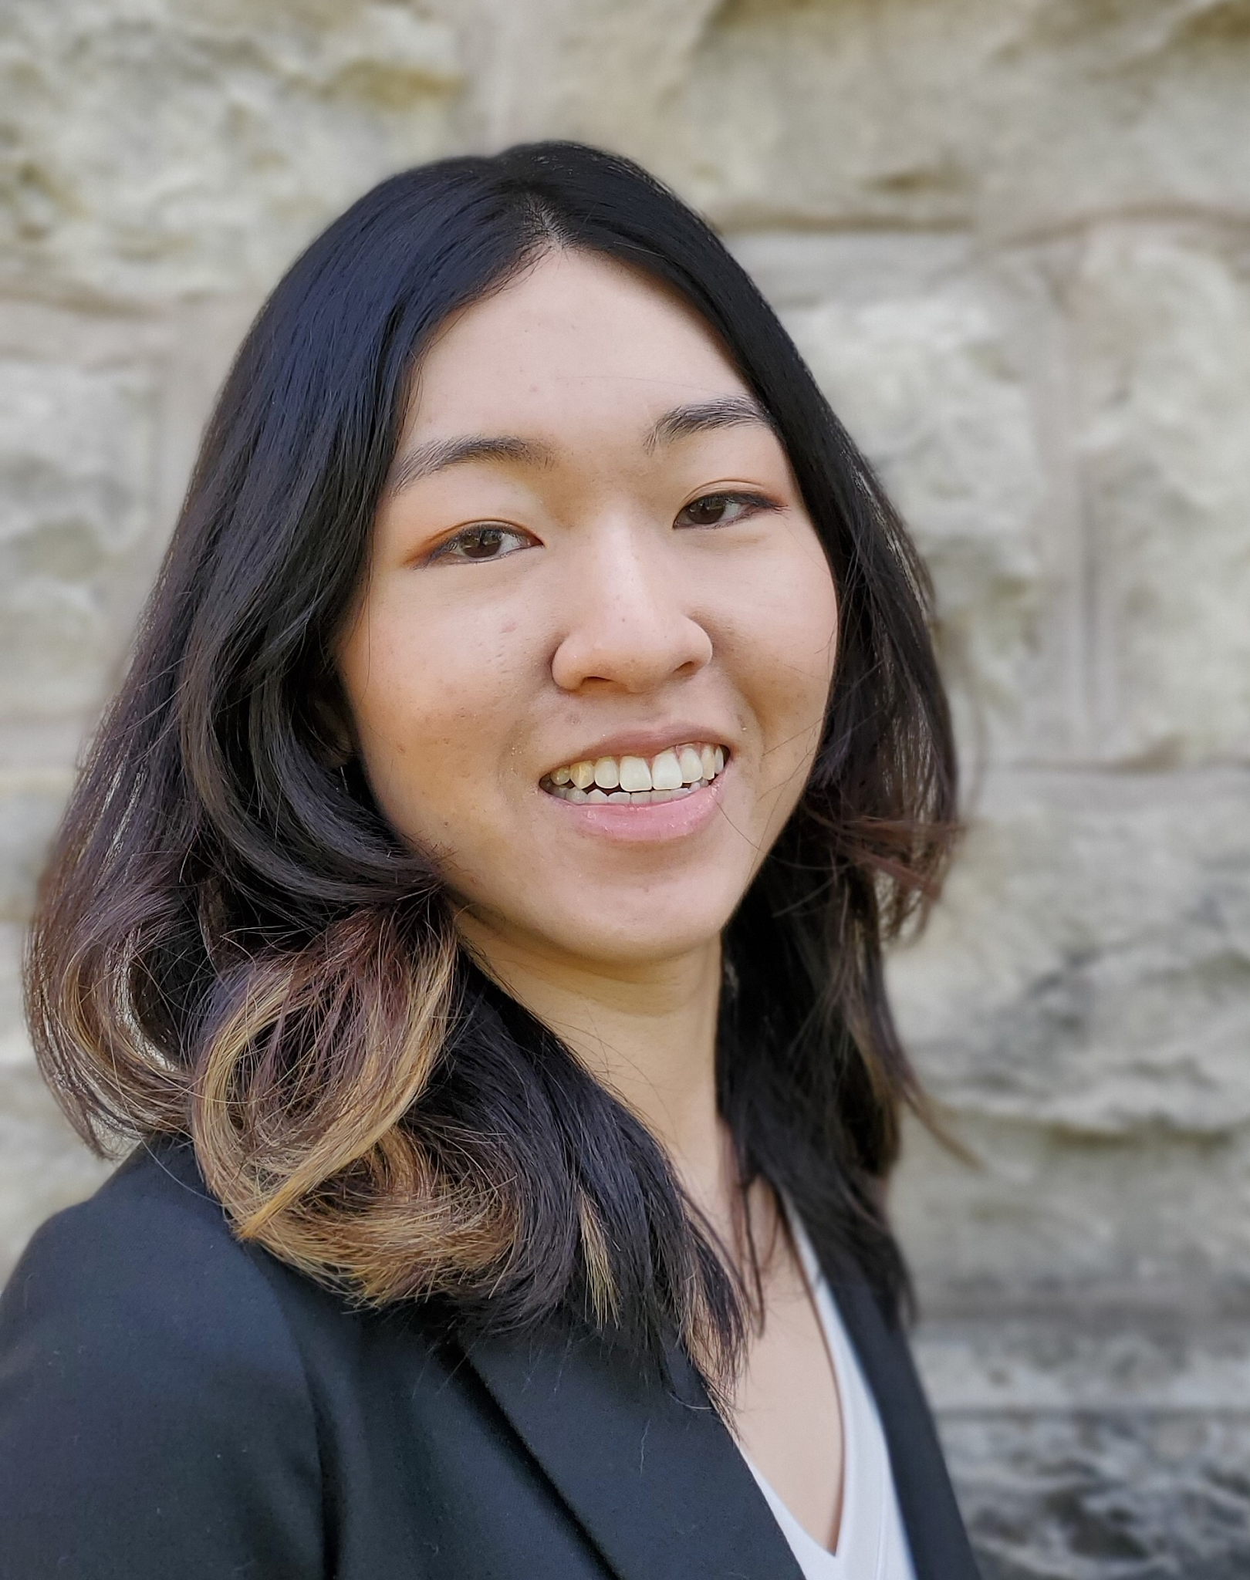
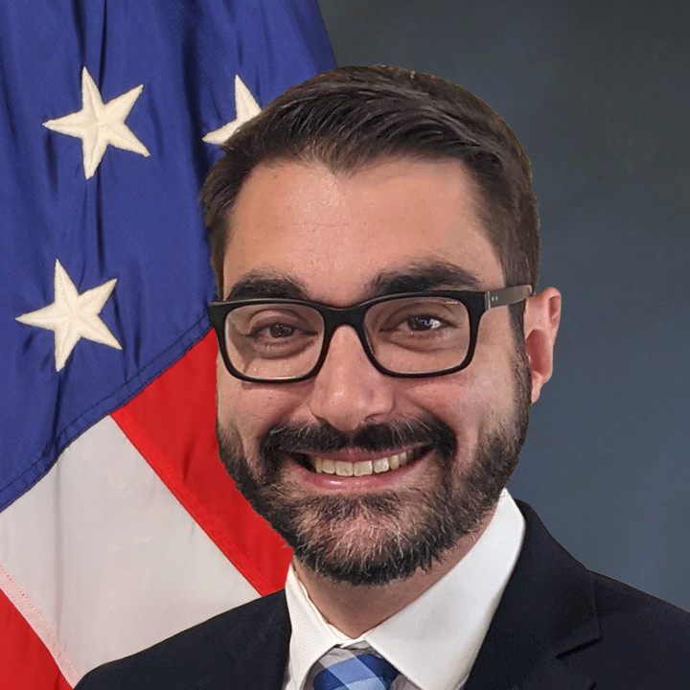
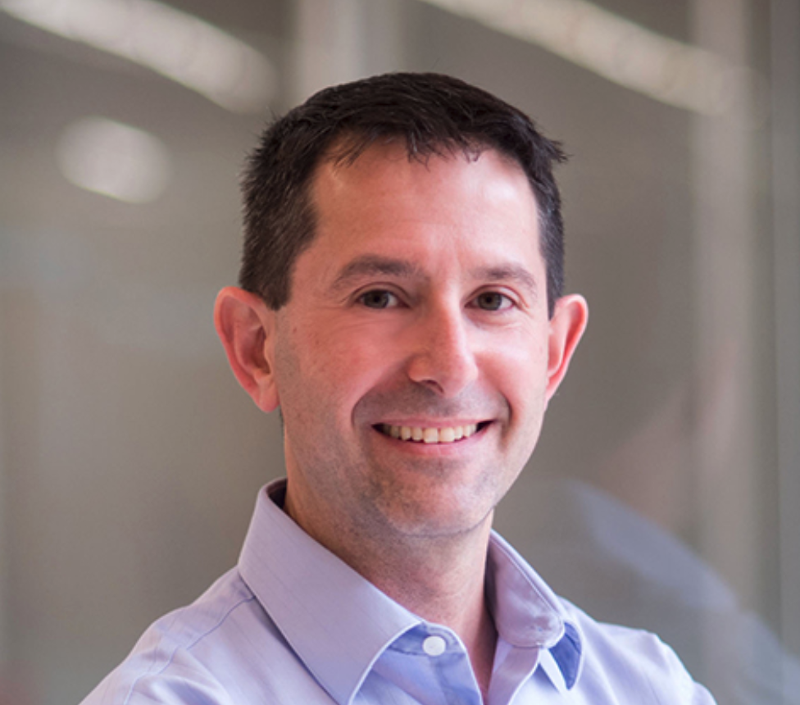
Demonstration Shaped Reinforcement Learning via Goal-Conditioning
Question: Given access to a single, suboptimal, state-only demonstration trajectory, can we improve the sample efficiency of reinforcement learning while preserving optimality guarantees?
[Contribution 1; Learning From]
Wang, C., Warnell, G., P. Stone. D-Shape: Demonstration-Shaped Reinforcement Learning via Goal Conditioning. AAMAS 2023.
Caroline Wang
Garrett Warnell
Peter Stone
Notes:
D-shape: poster, slides, paper

Slide 11
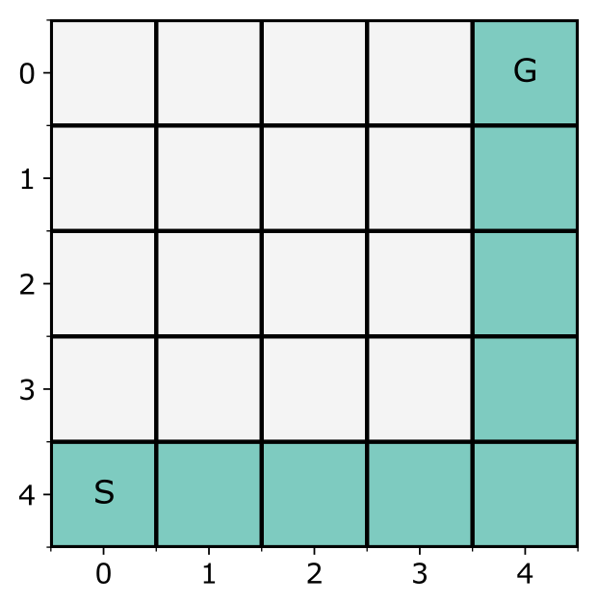
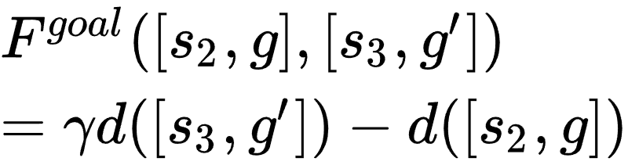
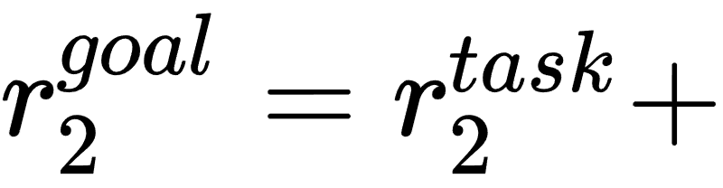
D-Shape: Demonstration-Shaped Reinforcement Learning
Key idea: shape exploration of reinforcement learner towards demonstration trajectory by treating demonstration states as goals
Augment state space with goals^{[1, 2]}
Goal-reaching potential-based reward function^{[3]}
Hindsight relabelling^{[4]}: treat achieved states as goals
[1] Schaul et al., Universal value function approximators, ICML 2015.
[2] Kaelbling, Learning to achieve goals, IJCAI 1993.
[3] Ng et al., Policy invariance under reward transformations, ICML 1999.
[4] Andrychowicz et al, Hindsight experience replay, Neurips 2017

Slide 12
D-Shape: Demonstration-Shaped Reinforcement Learning
Key idea: shape exploration of reinforcement learner towards demonstration trajectory by treating demonstration states as goals

Slide 13
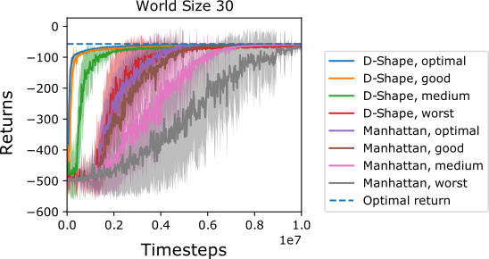
D-Shape: Demonstration-Shaped Reinforcement Learning
Key idea: shape exploration of reinforcement learner towards demonstration trajectory by treating demonstration states as goals

Slide 14
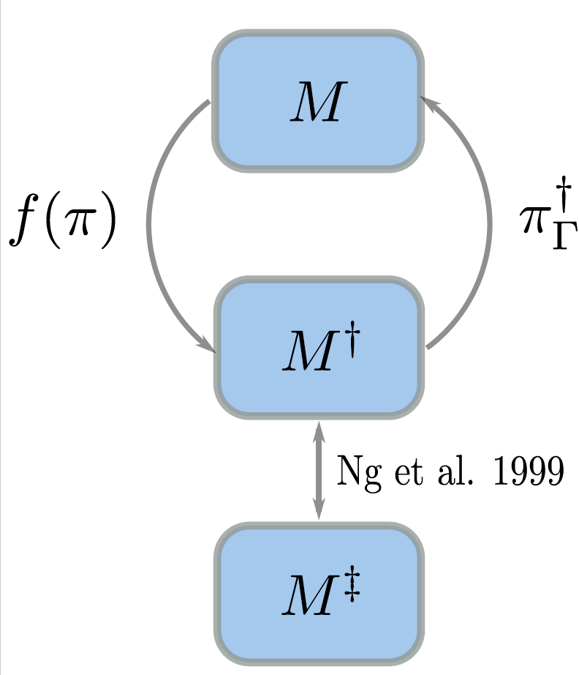
D-Shape: Demonstration-Shaped Reinforcement Learning
Key idea: shape exploration of reinforcement learner towards demonstration trajectory by treating demonstration states as goals
Theorem 1 (Policy Invariance): An optimal goal-conditioned policy learned by D-Shape can be optimally executed with any sequence of goals.
Notes:
To gain some insight into how D-Shape is improving sample efficiency,
we visualize a D-Shape agent’s state visitation when trained with the optimal demonstrations, for a 20x20 gridworld, during training.
The left figure here is the provided demonstration, which starts in the lower left and follows the bottom and right edges to get to the goal state.
(Animation) We can observe that D-Shape is biasing exploration towards the demonstration trajectory, as desired.

Slide 15
Contribution 1: D-Shape
First algorithm to show how a single, suboptimal, state-only demonstration can be used to improve sample efficiency of RL with theoretical guarantees
Notes:
D-Shape addresses the first dimension of the thesis question by casting learning from other agents as a problem of learning from a single, potentially suboptimal demonstration.

Slide 16
Summary of Contributions
Contribution | Learning From | Learning With
1️⃣ D-Shape [AAMAS23] | ✔
2️⃣ DM² [AAAI23] | ✔ | ✔
3️⃣4️⃣ N-agent ad hoc teamwork; POAM [NeurIPS25] | ✔ | ✔
5️⃣6️⃣ Open-ended AHT; ROTATE [preprint/under submission] |  | ✔
7️⃣ JaxAHT [preprint/under submission] |  | ✔
Notes:
D-Shape addresses the first dimension of the thesis question by casting learning from other agents as a problem of learning from a single, potentially suboptimal demonstration.

Slide 17
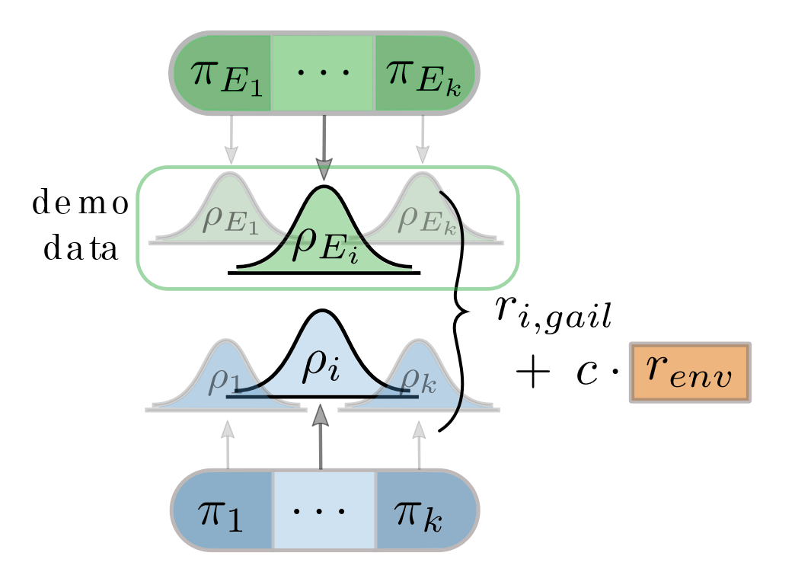
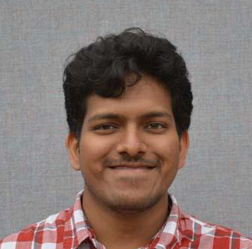
DM²: Decentralized Multi-Agent Reinforcement Learning via Distribution Matching
Question: What can decentralized teams use as a coordination signal to improve sample efficiency of MARL?
[Contribution 2; Learning From and With]
*Wang, C., *Durugkar, I., *Liebman, E., Stone, P. DM²: Decentralized Multi-Agent Reinforcement Learning via Distribution Matching. AAAI 2023.
Caroline Wang
Ishan Durugkar
Elad Liebman
Peter Stone
Notes:
DM2: slides, poster, paper, long slides

Slide 18

Challenge: nonstationarity
Can team demonstrations act as a coordination signal for decentralized learning?
π₁
π₂
π_{K}
D₁
D₂
D_{K}
Expert Team Demo
Notes:
The result is DM^2, a MARL algorithm that enables cooperation in the decentralized setting without explicit communication. It does so by using the idea of distribution matching, and using demonstrations from coordinated policies to give a target for each individual agent to strive towards, while also maximizing the environment reward.

Slide 19
Method: DM²
Theoretical Results
Multi-agent Independent Imitation Learning: Individual distribution matching converges to the corresponding expert policies
Mixed Task and Imitation Rewards: Expert policies are a Nash equilibrium if experts maximize task reward
Notes:
Our theoretical analysis has two main results:
First, we show that individual distribution matching….
Next, that the expert policies …
These results support the practical algorithm we propose, DM^2.

Slide 20
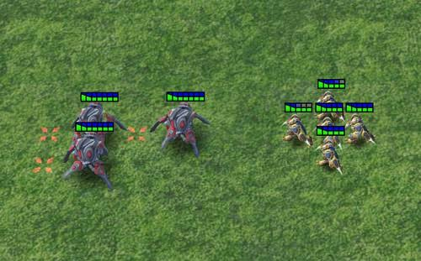
Experimental Results: DM²
StarCraft II: 3s vs 4z

Slide 21
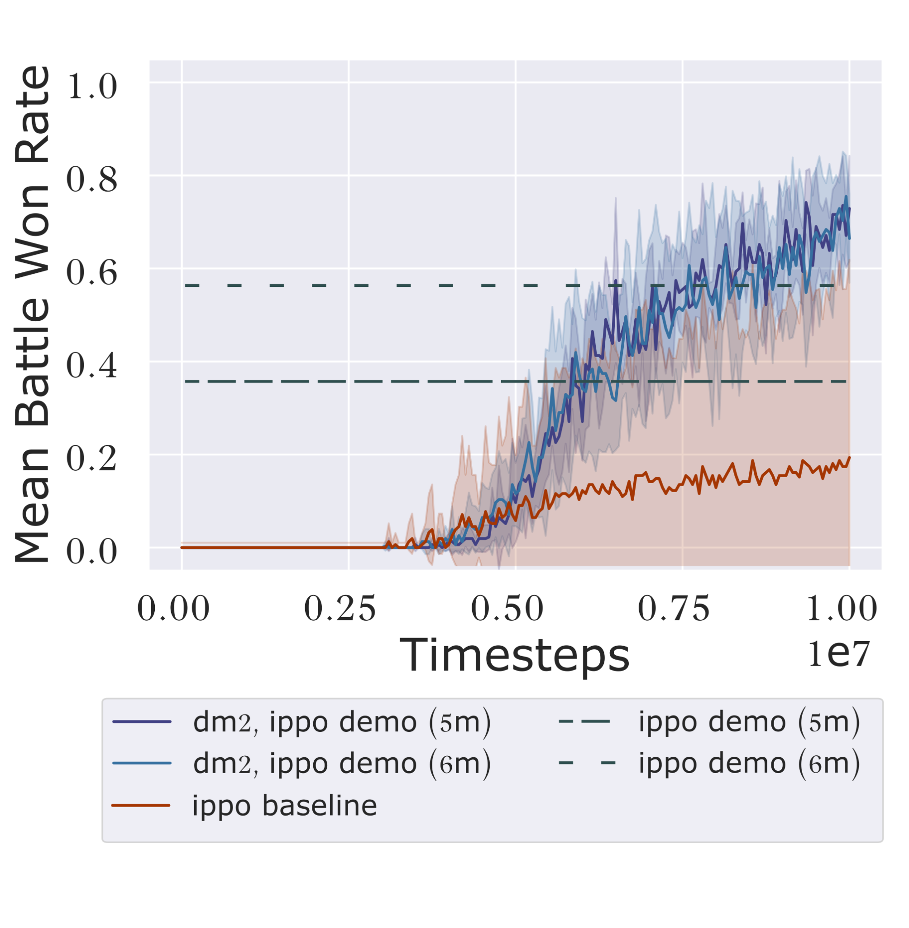
Experimental Results: DM²
StarCraft II: 3s vs 4z

Slide 22
Contribution 2: DM²
First decentralized MARL method to use team demonstrations as a coordination signal for improving learning efficiency

Slide 23
Dissertation Outline
Contribution | Learning From | Learning With
1️⃣ D-Shape [AAMAS23] | ✔
2️⃣ DM² [AAAI23] | ✔ | ✔
3️⃣4️⃣ N-agent ad hoc teamwork; POAM [NeurIPS25] | ✔ | ✔
5️⃣6️⃣ Open-ended AHT; ROTATE [preprint/under submission] |  | ✔
7️⃣ JaxAHT [preprint/under submission] |  | ✔
Notes:
D-Shape addresses the first dimension of the thesis question by casting learning from other agents as a problem of learning from a single, potentially suboptimal demonstration.

Slide 24
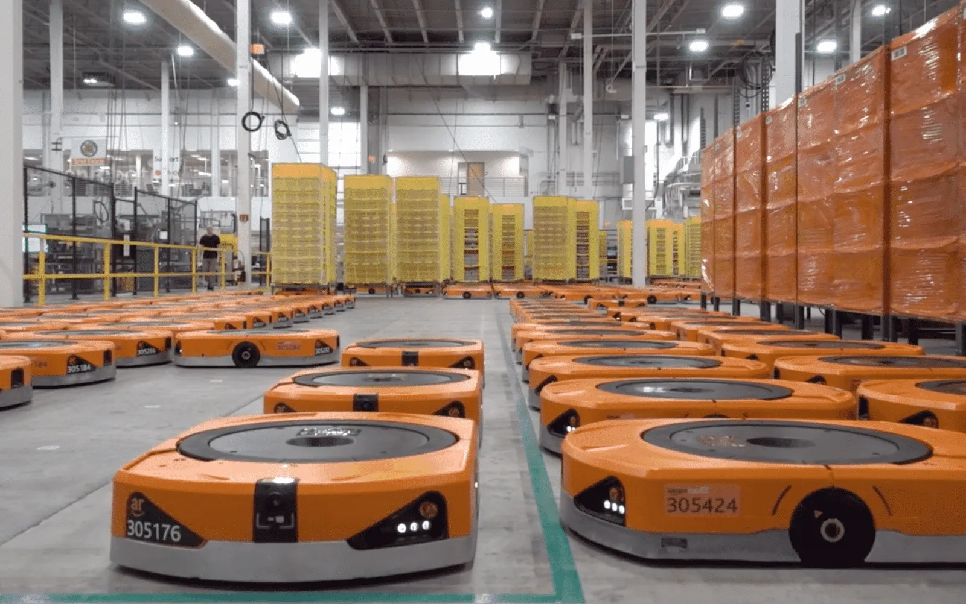
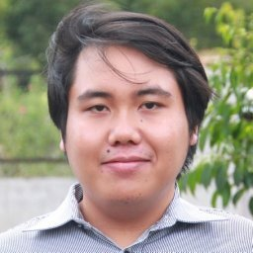
N-Agent Ad Hoc Teamwork
In a cooperative scenario, can we design an algorithm to control dynamically varying subteams of agents that have never met one another?
[Contributions 3 and 4; Learning From and With]
Wang, C., Rahman, A., Durugkar, I., Liebman, E., Stone, P. N-Agent Ad Hoc Teamwork. NeurIPS 2024.
source
Caroline Wang
Arrasy Rahman
Ishan Durugkar
Elad Liebman
Peter Stone
Notes:
NAHT Links: paper, 5 min slides, 10 min slides

Slide 25
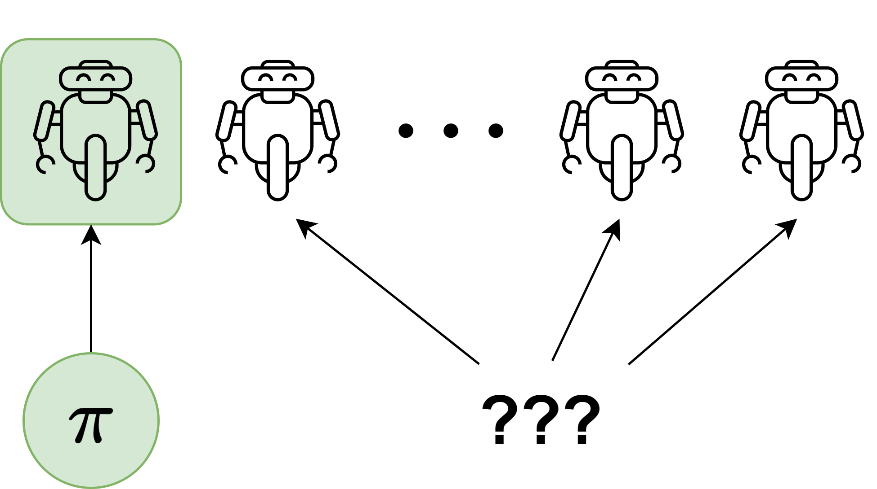
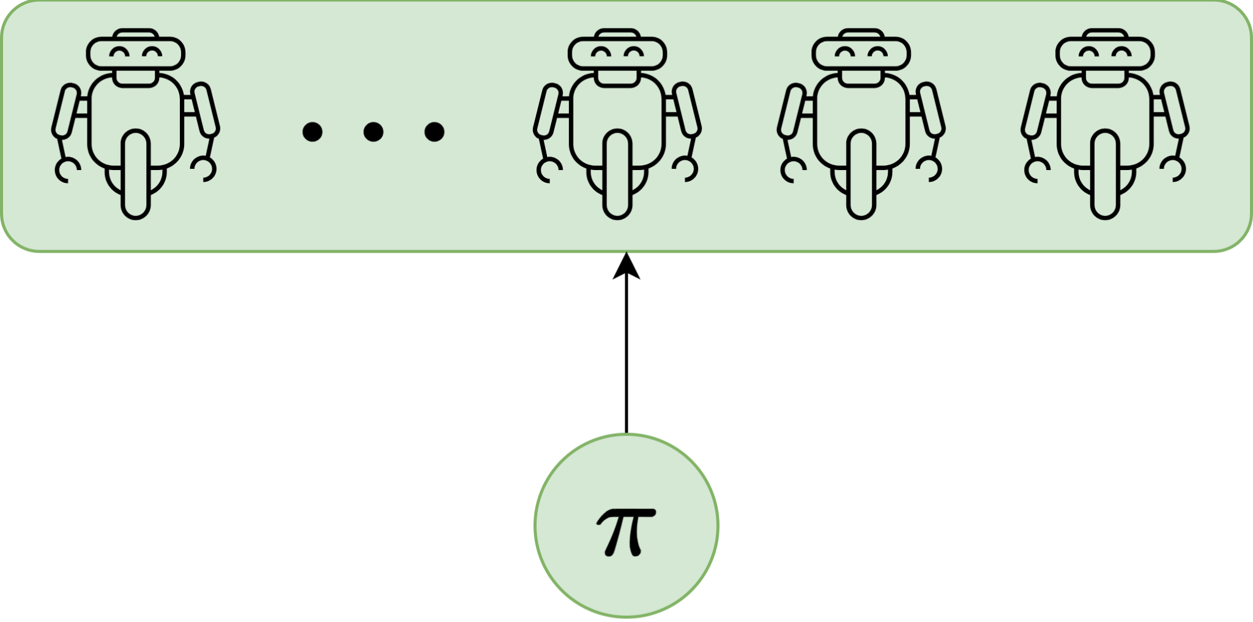
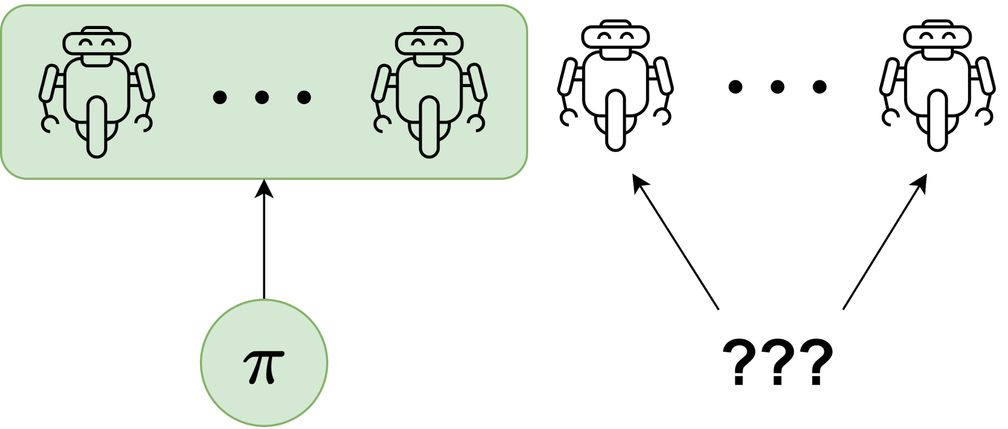
Current multi-agent learning paradigms are not flexible enough
Cooperative Multi-Agent Reinforcement Learning^{[1]} (CMARL) assumes all agents are under control of learning algorithm
Ad Hoc Teamwork^{[2]} (AHT) & Zero Shot Coordination^{[3]} (ZSC): assumes a fixed subset of team under control of learning algorithm
[1] Sunehag et al., Value Decomposition Networks for Cooperative Multiagent learning, AAMAS 2018.
[2] Mirsky et al. A Survey of Ad Hoc Teamwork Research. EUMAS 2022.
[3] Hu et al. “Other-Play” for Zero-Shot Coordination. ICML 2020
Notes:
However, we argue that current multi-agent learning paradigms are not flexible enough to deal with such scenarios
Cooperative MARL
This paradigm enables efficiently training complex individual and team behaviors from scratch
However, it assumes all agents are under the control of the learning algorithm, and doesn't address the possibility of non- controlled agents at all,
Another paradigm for multi-agent learning is AHT and ZSC.
The objective of these method actually is to enable generalization to noncontrolled or potentially unseen teammates
However, in practice, ZSC and AHT methods assume that there's only one agent under the control of the learning method, and all other agents in the team are unknown.
We show in the paper that when this assumption is violated, non-optimal policies can be learned.

Slide 26
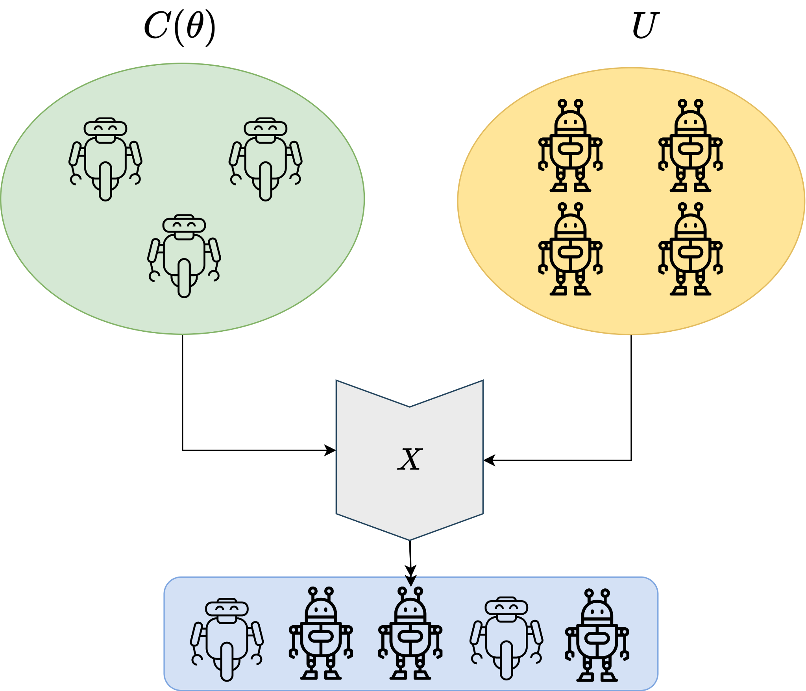
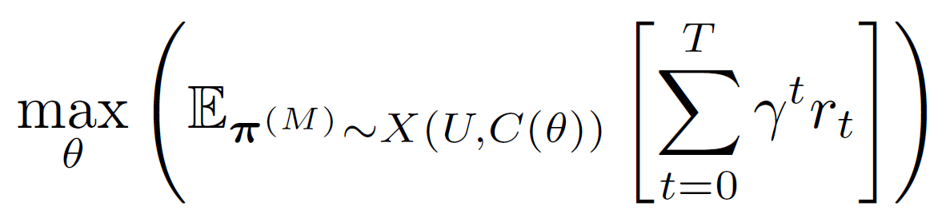
N-Agent Ad Hoc Teamwork Problem Formulation
C(𝜃) - set of controlled agents, parameterized by 𝜃
U - set of non-controlled agents
X - team sampling procedure
Objective:
Challenges:
Generalization: coordinating with non-controlled and potentially unknown teammates
Openness: coping with an unknown number of controlled teammates
Notes:
C, parameterized by theta, is the set of controlled agents
U is the set of uncontrolled agents
X is some team sampling procedure, which samples agents from C and U to form a team.
Given the above, the objective is to maximize the expected return under C, U, and X.
The key challenges of the NAHT problem are:
Generalizing to potentially unknown and uncontrolled agents
Openness: the controlled agents must deal with the fact that there is a changing number of familiar teammates.

Slide 27
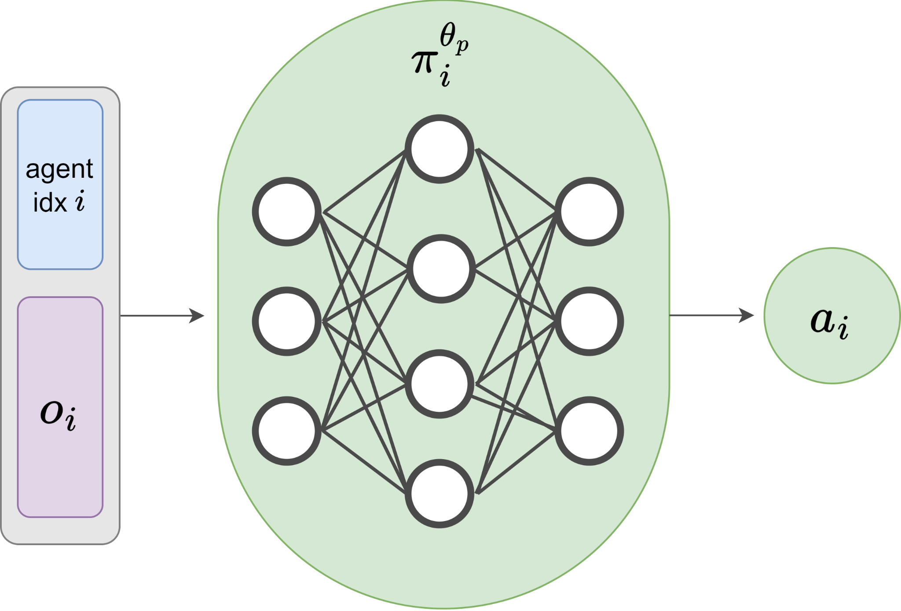
Policy Optimization with Agent Modeling (POAM)
Key Ideas
Independent PPO with parameter sharing

Slide 28
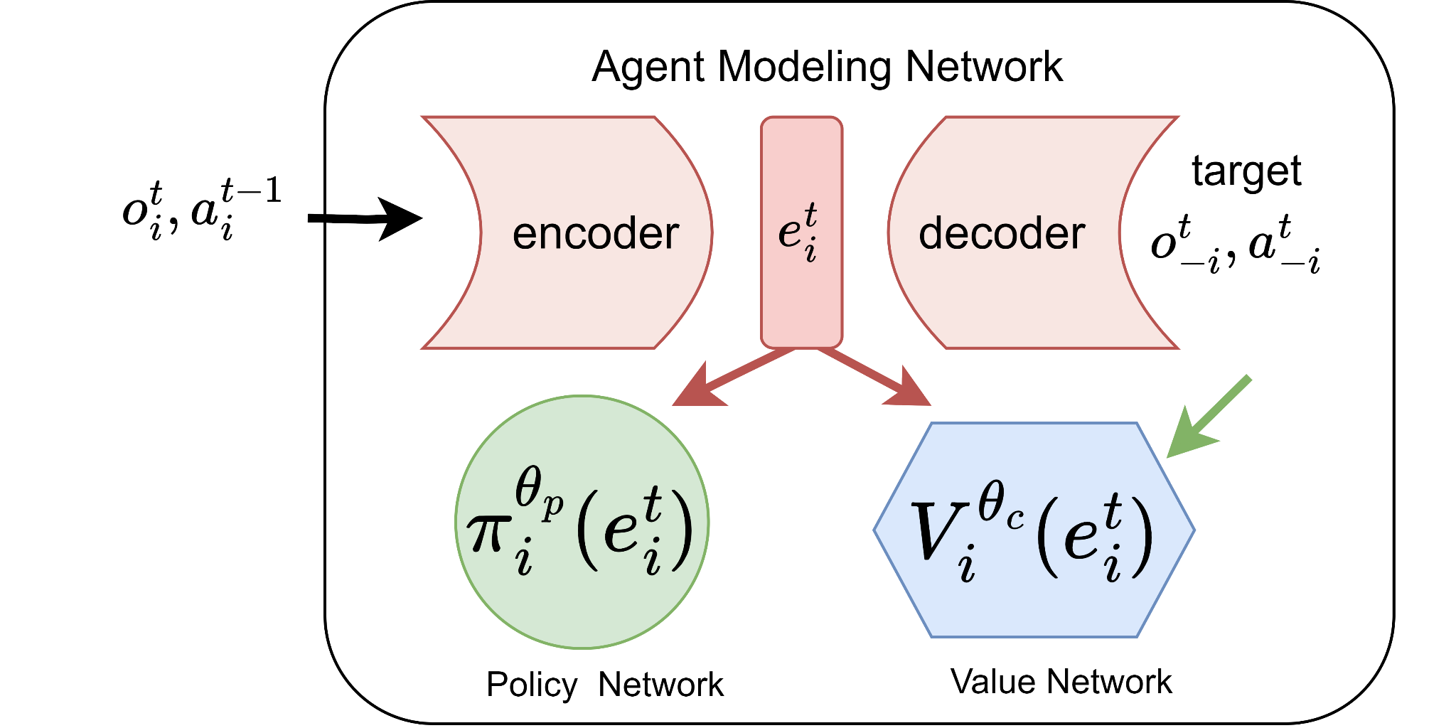
Policy Optimization with Agent Modeling (POAM)
Key Ideas
Independent PPO with parameter sharing
Recurrent agent modeling

Slide 29
Policy Optimization with Agent Modeling (POAM)
Key Ideas
Independent PPO with parameter sharing
Recurrent agent modeling
Controlled agents learn from uncontrolled agent data

Slide 30
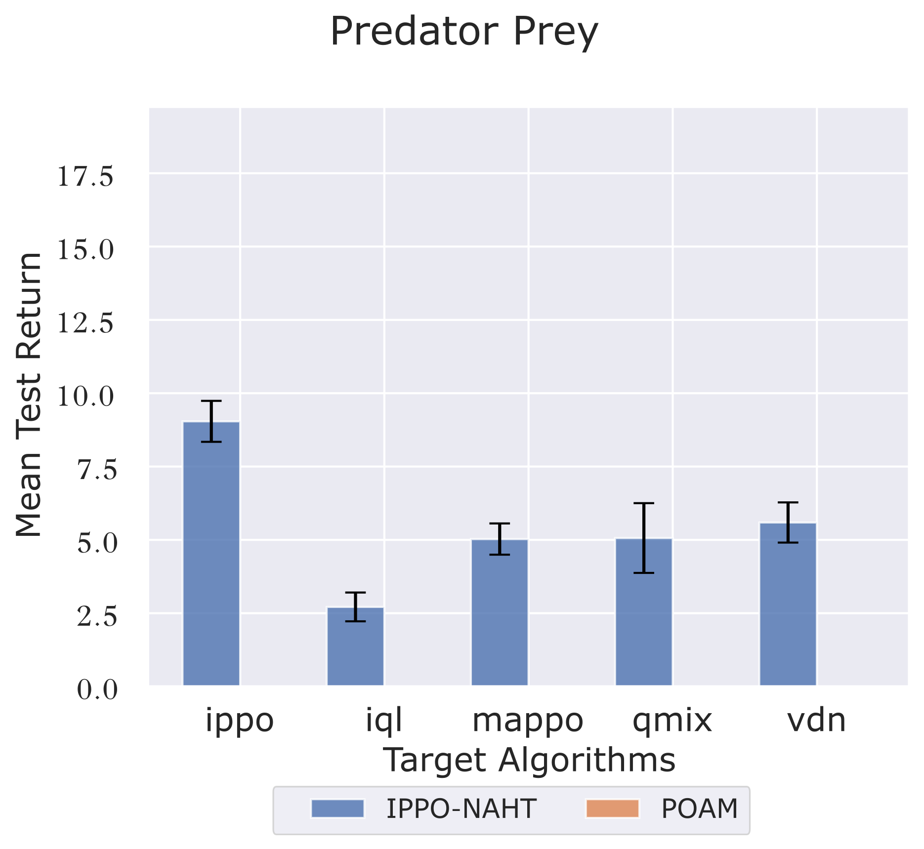
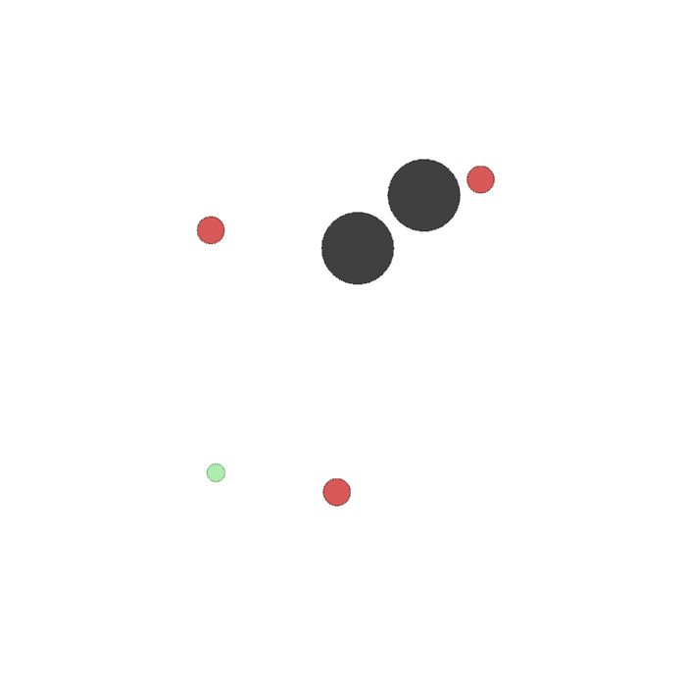
Policy Optimization with Agent Modeling (POAM)
Baseline: IPPO-NAHT
Task: Predator Prey (MPE)
Uncontrolled teammates types: IPPO, QMIX, VDN, IQL, MAPPO
MPE (source)

Slide 31
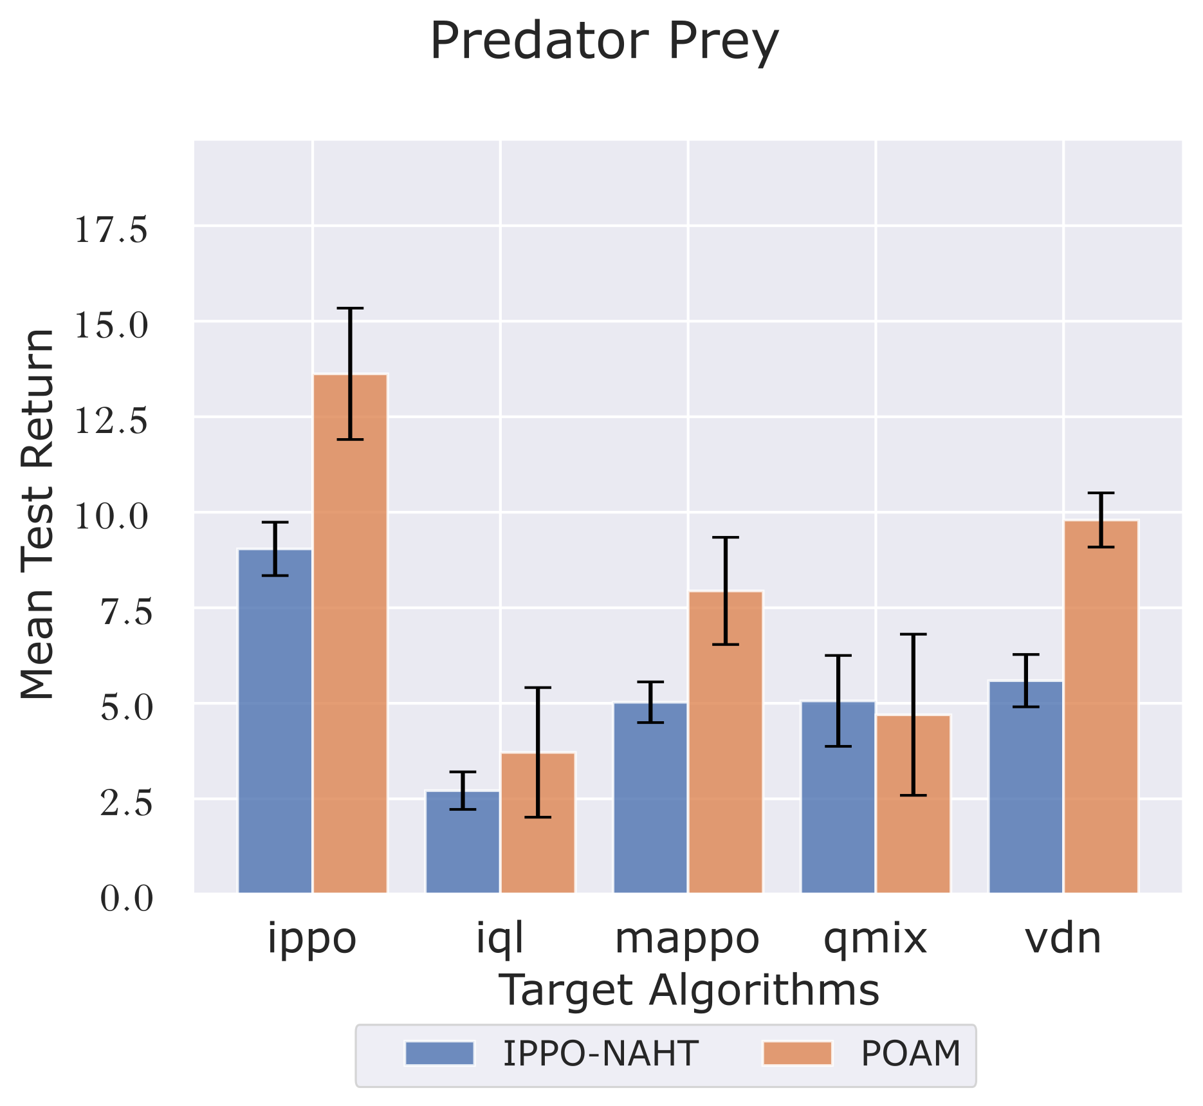
Policy Optimization with Agent Modeling (POAM)
Baseline: IPPO-NAHT
Task: Predator Prey (MPE)
Uncontrolled teammates types: IPPO, QMIX, VDN, IQL, MAPPO
MPE (source)

Slide 32
Contributions 3 and 4: NAHT and POAM
First to formalize the NAHT problem and specify how it differs from AHT
First algorithm for NAHT

Slide 33
Dissertation Outline
Contribution | Learning From | Learning With
1️⃣ D-Shape [AAMAS23] | ✔
2️⃣ DM² [AAAI23] | ✔ | ✔
3️⃣4️⃣ N-agent ad hoc teamwork; POAM [NeurIPS25] | ✔ | ✔
5️⃣6️⃣ Open-ended AHT; ROTATE [preprint/under submission] |  | ✔
7️⃣ JaxAHT [preprint/under submission] |  | ✔
Notes:
D-Shape addresses the first dimension of the thesis question by casting learning from other agents as a problem of learning from a single, potentially suboptimal demonstration.

Slide 34
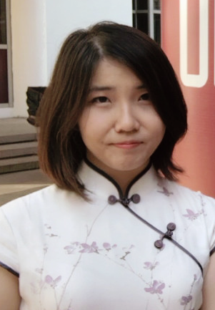

AHT as Open-Ended Learning
Most AHT methods consider fixed teammate distributions with limited coverage of teammate strategies.
[Contributions 5 and 6; Learning With]
*Wang, C., *Rahman A., Cui, J., Sung, Y., Stone, P. ROTATE: Regret-driven Open-ended Training for Ad Hoc Teamwork. arXiv 2025.
Open-Ended AHT
Teammates
Tea
Teammate
Generation
AHT Learning
Caroline Wang
Arrasy Rahman
Benjamin Nativi
Jiaxun Cui
Yoonchang Sung
Peter Stone
Notes:
Slides, paper

Slide 35

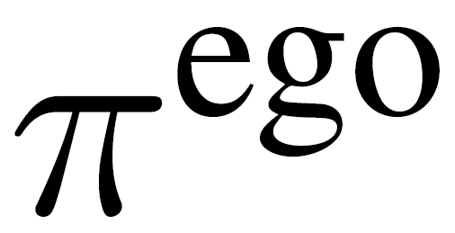

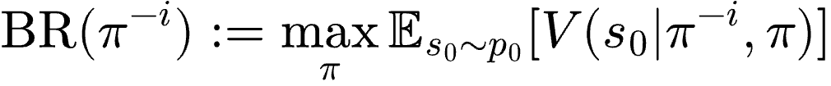

Background: The Ad Hoc Teamwork Problem
Goal : to design an AHT agent to coordinate with a set of
unknown but competent teammates^{[1]}
Dec-MDP
AHT/ego agent
Teammate
Best Response
[1] Stone et al., Ad Hoc Autonomous Agent Teams: Collaboration without Pre-Coordination, AAAI 2018.
Notes:
Dec-MDP: $$ \langle K, \mathcal{S}, \{\mathcal{A^i}\}_{i=1}^K, T, p_0, R, \gamma \rangle $$
AHT/ego agent $$\pi^\text{ego}$$
Teammates $$\pi^{-i} \in \Pi$$
Best Response (BR): $$\text{BR}(\pi^{-i}) := \underset{\pi}{\max} \mathbb{E}_{s_0 \sim p_0} [V(s_0 | \pi^{-i}, \pi)]$$

Slide 36

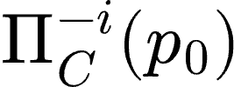
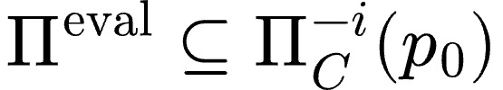
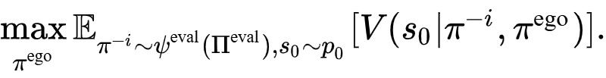
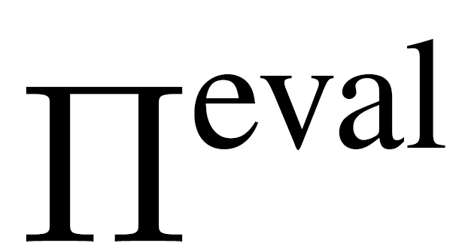
Background: The Ad Hoc Teamwork Problem
Goal : to design an AHT agent to coordinate with a set of
unknown but competent teammates^{[1]}
Definition: a teammate is -competent if
Let denote the set of -competent teammates
Evaluation teammates are competent:
Objective:
Key Challenge: is unknown
[1] Stone et al., Ad Hoc Autonomous Agent Teams: Collaboration without Pre-Coordination, AAAI 2018.
Notes:
Competent Set: $$\Pi^{-i}_C (p_0)$$
Pieval is a subset of competent set: $$\Pi^\text{eval} \subseteq \Pi^{-i}_C (p_0)$$

Slide 37
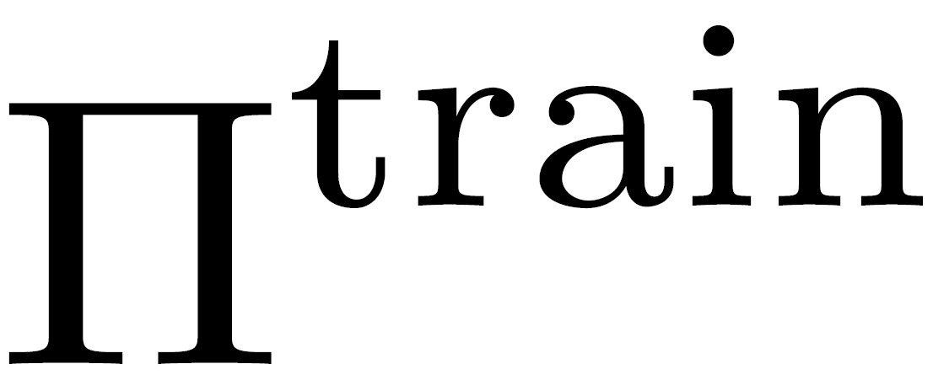
Subproblems of Ad Hoc Teamwork
Two-Stage AHT
Teammates
Training an AHT Agent ^{[1, 2, 3, 4, 5]:}
Train a to coordinate with a pre-specified
  Challenging to construct a good training set
  Generalization is inherently limited by
Teammate Generation ^{[6, 7, 8, 9]}
Generate diverse such that generalizes to
  Unclear how diversity maximization heuristics connect to AHT objective
Tea
Teammate
Generation
AHT Learning
[1] Barrett et al., Making friends on the fly: Cooperating with new teammates. Artificial Intelligence, 242:143-171, 2017
[2] Ravula et al., Ad Hoc Teamwork With Behavior Switching Agents. IJCAI 2019.
[3] Macke et al., Expected Value of Communication for Planning in Ad Hoc Teamwork. AAAI 2021.
[4] Papoudakis et al., Agent Modelling under Partial Observability for Deep Reinforcement Learning. NeurIPS 2021.
[5] Rahman et al., Towards Open Ad Hoc Teamwork Using Graph-based Policy Learning. ICML 2021.
[6] Strouse et al., Collaborating with Humans without Human Data. NeurIPS 2021.
[7] Lupu et al., Trajectory Diversity for Zero-Shot Coordination. ICML 2021.
[8] Zhao et al., Maximum Entropy Population-Based Training for Zero-Shot Human-AI Coordination. AAAI 2023.
[9] Sarkar et al., Diverse Conventions in Human-AI Collaboration. NeurIPS 2023.
Notes:
motivation/problem we’re solving

Slide 38
Subproblems of Ad Hoc Teamwork
Two-Stage AHT
Teammates
Two-stage Framework for AHT
Challenging to specify how many teammates to generate
Limits consideration of how teammates influence ego agent learning
Tea
Teammate
Generation
AHT Learning
Notes:
motivation/problem we’re solving

Slide 39
Open-Ended Ad Hoc Teamwork
Teammates
Can we frame AHT as an open-ended^{[1]}, interactive learning process between a teammate generator and an ego agent?
Tea
Teammate
Generation
AHT Learning
[1] Dennis et al., Emergent Complexity and Zero-Shot Transfer via Unsupervised Environment Design. NeurIPS 2020.
Notes:
Teammate generator should…
Represent diverse cooperative conventions
Generate teammates that act in good faith
Address ego agent’s cooperative weaknesses
AHT learner should…
Approximate the best response policy for newly generated teammates without forgetting how to cooperate with previous teammates
Within an interaction, identify and play a best response behavior against an unseen teammate

Slide 40
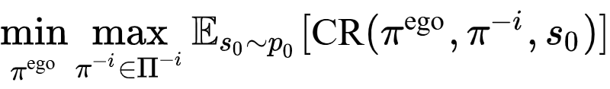
Problem Formulation: Open-Ended AHT
Open-Ended AHT
Minimax Regret Objective:
Cooperative Regret^{[1]}:
Teammates
Ego Learner
Teammate generator
Tea
Teammate
Generation
AHT Learning
[1] Erlebach and Cook, RACCOON: Regret-based Adaptive Curricula for Cooperation, CoCoMARL@RLC 2024.
Notes:
Cooperative regret: provides a starting point to define the notion of a “good” teammate.
Inspired by UED, we formulate AHT as a 2-player zero sum game between the teammate generator and the ad hoc agent.
how the minimax regret game is theoretically connected to the original AHT objective?
Key Challenge: how to optimize the minimax regret objective without generating teammates that are too adversarial?

Slide 41
From the AHT Objective to Minimax Coop. Regret
Cooperative Regret^{[1]}:
AHT Objective:
worst case assumption
Minimax Regret Objective:
[1] Erlebach and Cook, RACCOON: Regret-based Adaptive Curricula for Cooperation, CoCoMARL@RLC 2024.
Notes:
Cooperative regret: provides a starting point to define the notion of a “good” teammate.
Inspired by UED, we formulate AHT as a 2-player zero sum game between the teammate generator and the ad hoc agent.
how the minimax regret game is theoretically connected to the original AHT objective?
Key Challenge: how to optimize the minimax regret objective without generating teammates that are too adversarial?

Slide 42
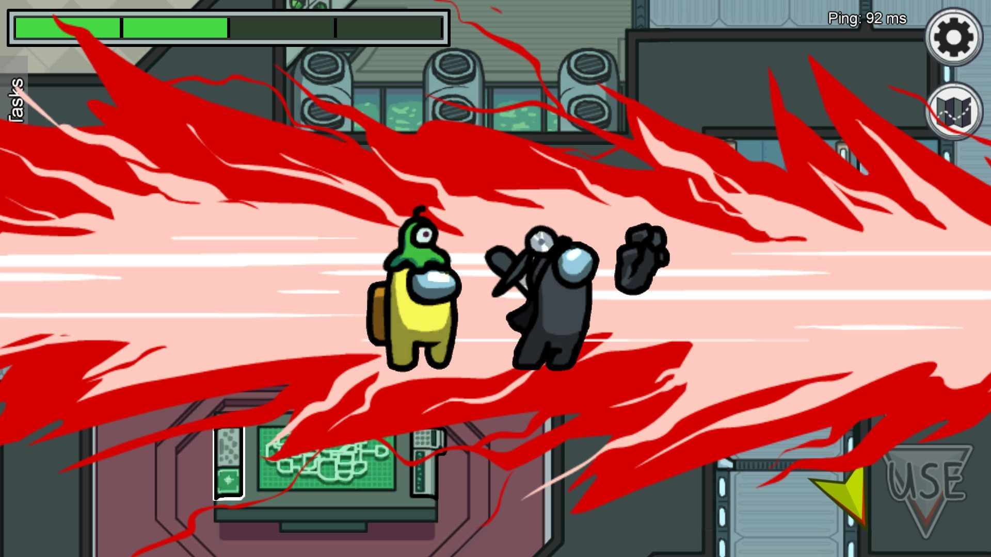



How should we generate regret-maximizing teammates?
Key challenge of naive regret maximization is sabotage^{[1, 2, 3]}
We provide a new definition of sabotage based on competence and motivate why it improves over previous definitions
We provide a constrained regret maximization objective with bounds
source
NOTATION
SP (self-play): Interactions between
XP (cross-play): Interactions between
V^{SP}: V^{XP}:
[1] Sarkar et al., Diverse Conventions in Human-AI Collaboration. NeurIPS 2023.
[2] Rahman et al., Generating Teammates for Training Robust Ad Hoc Teamwork Agents via Best Response Diversity. TMLR 2023.
[3] Charakorn et al. Diversity Is Not All You Need: Training A Robust Cooperative Agent Needs Specialist Partners. NeurIPS 2024.

Slide 43
Regret Maximizing Teammates Encourage Ego Agent to Learn New Conventions
Regret Computation:
V^{SP}(H) - V^{XP}(H) = 1 - 1 = 0
V^{SP}(T) - V^{XP}(T) = 1 - 0 = 1
EXAMPLE 1
(MATCHING PENNIES)
 | H | T
H | 1 | 0
T | 0 | 1
NOTATION
SP (self-play): Interactions between
XP (cross-play): Interactions between
V^{SP}: V^{XP}:
*Ego is row player; teammate is column player
Notes:
Build intuition on why regret maximization can lead to convention discovery
Example 1: Matching pennies:
This game has two conventions: (H, H) and (T, T)
Suppose the ego plays H. A regret-maximizing teammate would play T

Slide 44
Regret Maximization Can Also Lead to Sabotage
*Ego is row player; teammate is column player
Regret Computation:
V^{SP}(A) - V^{XP}(A) = 5 - 5 = 0
V^{SP}(B) - V^{XP}(B) = 0.01 - 0 = 0.01
EXAMPLE 2
 | A | B
A | 5 | 0
B | 5 | 0.01
Ego agent must now learn to deal with teammates playing B, which we don’t expect to encounter at evaluation time because they are incompetent
Prior work has called this teammate behavior sabotage, and defined it as the teammate minimizing the returns of the ego agent during XP interactions.^{[1, 2, 3]}
NOTATION
SP (self-play): Interactions between
XP (cross-play): Interactions between
V^{SP}: V^{XP}:
[1] Sarkar et al., Diverse Conventions in Human-AI Collaboration. NeurIPS 2023.
[2] Rahman et al., Generating Teammates for Training Robust Ad Hoc Teamwork Agents via Best Response Diversity. TMLR 2023.
[3] Charakorn et al. Diversity Is Not All You Need: Training A Robust Cooperative Agent Needs Specialist Partners. NeurIPS 2024.
Notes:
Example 2
This game has 2 cooperative conventions/Nash equilibriums: (A, A) and (A, B). Intuitively, we’d like regret maximizing teammates to discover all 3.
Suppose the ego plays A. A regret-maximizing teammate would always play B. But B isn’t actually compatible with one of our desired cooperative conventions.
Takeaway: Regret maximization can lead to teammate behaviors that aren’t helpful.
Competent Teammates Would Only play A.

Slide 45
Sabotage Should Not be Characterized as XP Return Minimization
Regret Computation:
V^{SP}(H) - V^{XP}(H) = 1 - 1 = 0
V^{SP}(T) - V^{XP}(T) = 1 - 0 = 1
EXAMPLE 1
(MATCHING PENNIES)
 | H | T
H | 1 | 0
T | 0 | 1
NOTATION
SP (self-play): Interactions between
XP (cross-play): Interactions between
V^{SP}: V^{XP}:
*Ego is row player; teammate is column player
Notes:
Returning to matching pennies example -
This teammate plays the opposite convention from the ego, as desired.
But if we define sabotage as return minimization during XP, then this teammate has learned to sabotage the ego agent!
Takeaway: sabotage should not be characterized by return minimization

Slide 46
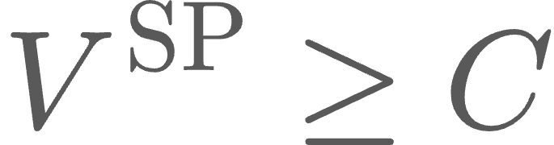

Competence-bounded Regret Maximization
Definition: a teammate is -competent if
EXAMPLE 1
(MATCHING PENNIES)
EXAMPLE 2
 | H | T
H | 1 | 0
T | 0 | 1
 | A | B
A | 5 | 0
B | 5 | 0.01
V^{SP}(A) - V^{XP}(A) = 5 - 5 = 0
V^{SP}(B) - V^{XP}(B) = 0.01 - 0 = 0.01
V^{SP}(H) - V^{XP}(H) = 1 - 1 = 0
V^{SP}(T) - V^{XP}(T) = 1 - 0 = 1
V^{SP}(A) - V^{XP}(A) = 5 - 5 = 0
V^{SP}(B) - V^{XP}(B) = 0.01 - 0 = 0.01
C =1
C > 0.01
*Ego is row player; teammate is column player
Notes:
How can we retain the benefits of regret maximization while defining and avoiding its pitfalls?
Our answer is competence-bounded regret maximization!
Recall that by definition, teammates are assumed to be competent!
Competence can be defined on a per-game basis
Under this framework, we identify sabotage as incompetence
(We still haven’t fully achieved a satisfactory definition of sabotage yet but for the time being, it is at least clear that we do not want incompetent teammates to be generated during training)

Slide 47

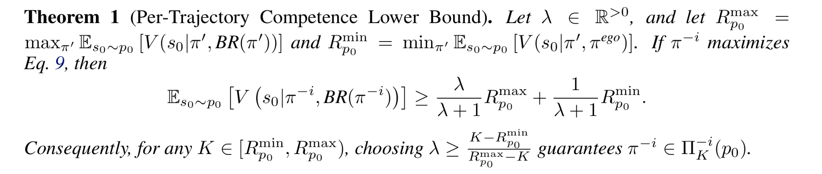
Generalizing to Dec-MDP Scenarios
Objective: Competence-bounded per-trajectory regret
Intuition: generate regret-maximizing teammates subject to the constraint that teammates are -competent.
Consequence: for any desired competence level C, we can choose a λ to guarantee the teammate is -competent at level C.
Notes:
All of our examples have been about single-state matrix game examples. How do we correctly generalize these ideas to MDPs?
Intuition:
Maximize cooperate regret subject to a constraint that all teammates

Slide 48



Sabotage Can Still Occur Under Competence-Bounded Per-Trajectory Regret
minimize V^{XP}( )
Key Issue: -competence constrains teammate behavior with its BR from only.
Handshake Conventions^{[1]}: a teammate can seek to identify whether it is at a state encountered during SP or XP. If at XP state, act incompetently.
Harms learnability: incompetence at XP states lowers the return achievable by any partner from those states
XP
SP
maximize (1 + 𝜆)V^{SP}( )
Obj = CR( ) + 𝜆V^{SP}( )
Cross Play (XP)
Self Play (XP)
[1] Sarkar et al., Diverse Conventions in Human-AI Collaboration. NeurIPS 2023.

Slide 49
Sabotage As Incentivizing Per-State Incompetence
Solution: constrain teammate behavior on a per-state basis!
Definition (Sabotage): an objective incentivizes sabotage if a teammate can increase the objective by becoming incompetent starting from states visited during XP (teammate-ego) interactions.

Slide 50


ROTATE Teammate Generation Objective
Objective: Competence-bounded per-state regret
Intuition: maximize competence-bounded regret starting from all states seen during SP and XP.
minimize V^{XP}( )
XP
maximize (1 + 𝜆₁)V^{SXP}( )
SXP
XSP
minimize V^{XSP}( )
SP
maximize (1 + 𝜆₂)V^{SP}( )
Obj = 2CR( ∪ ) + 𝜆₁V^{SXP}( ) + 𝜆₁V^{XSP}( )
Cross Play (XP)
Self Play (XP)
Self Play from Cross Play States (SXP)
Cross Play from Self Play States (XSP)
Notes:
Learnability perspective: From each state, encourage there to be at least one better action that the ego agent could have taken

Slide 51
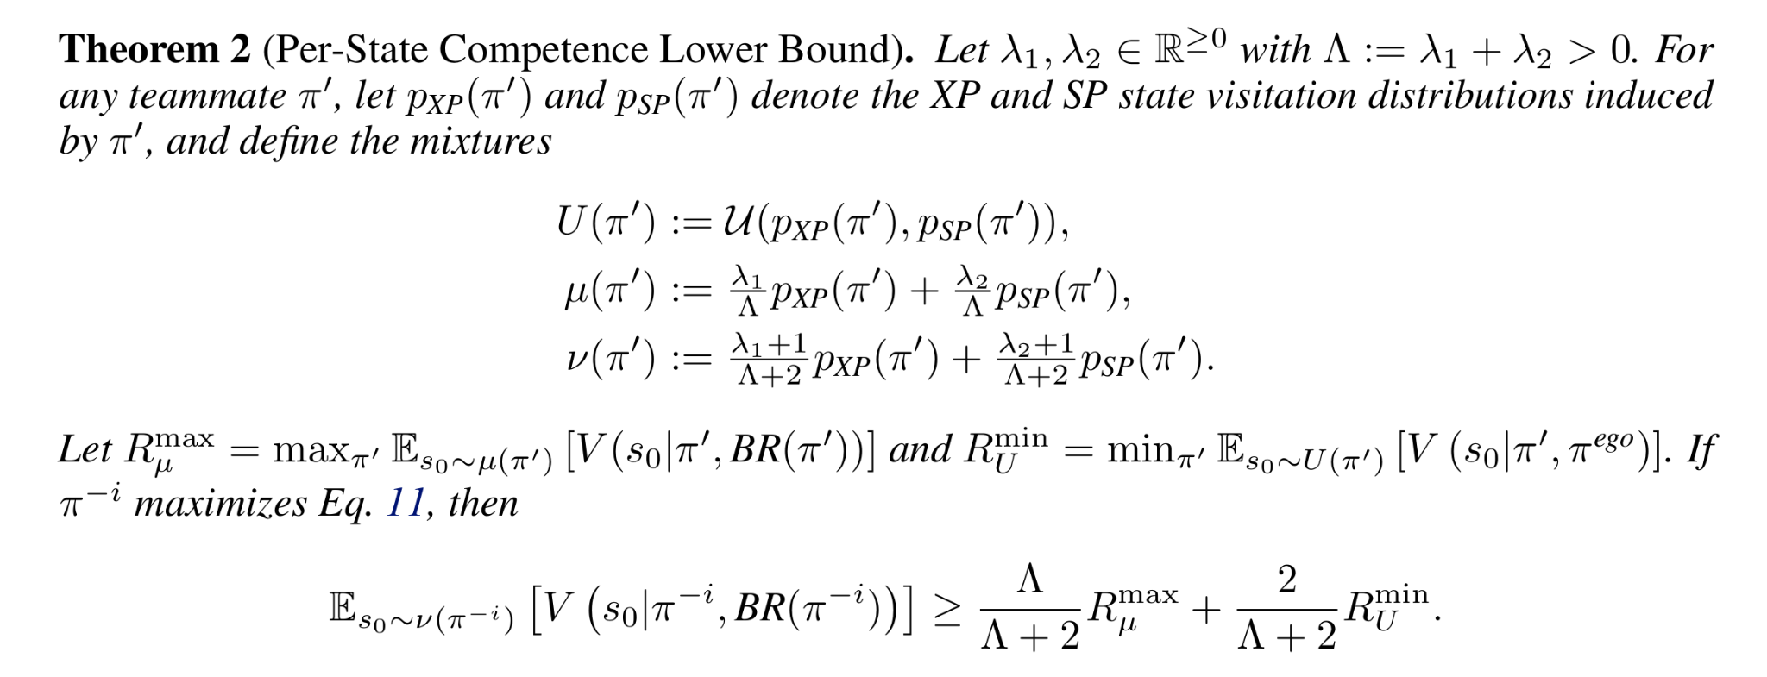
Competence-Bounded Per-State Regret

Slide 52




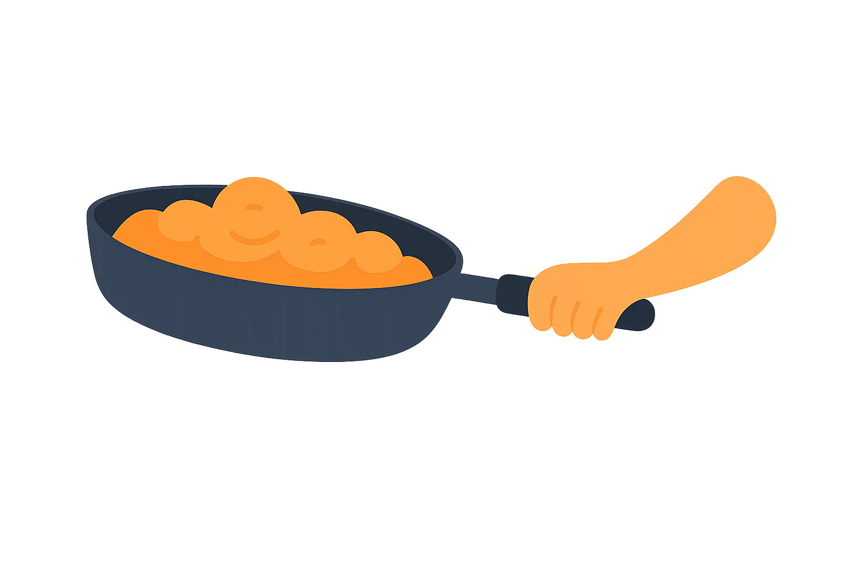



ROTATE: Regret-driven Open-ended Training for AHT
2. Best Response
cooperates with
the generated teammate
1. Teammate Generator
generates teammates for training that the AHT Agent is not yet able to cooperate with
Train Partner
Train Partner
3. Learning AHT Agent
i=0
i=1
learning iterations
i=N

Slide 53
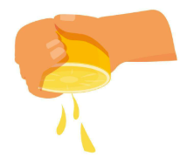
ROTATE: Ego Agent Training
How can we train a regret-minimizing ego agent?
Generated teammate policies are added to a population buffer
Recurrent actor-critic architecture^{[1]} , optimized using PPO^{[2]}
i=0
i=1
i=2
learning iterations
[1] Lu et al., Structured State Space Models for In-Context Reinforcement Learning. NeurIPS 2023.
[2] Schulman et al., Proximal Policy Optimization Algorithms. arXiv:1707.06347 2017.

Slide 54
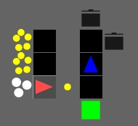
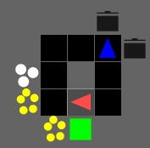



Experiments
Tasks
5 Overcooked layouts^{[1, 2]}
7x7 LBF^{[3]}
Illustrative matrix game
Evaluation Teammates
8-14 unseen agents per task
Reward shaping+PPO, heuristic agents; BRDIV
Metric: BR-normalized return
Overcooked
[1] Rutherford et al., JaxMARL: Multi-Agent RL Environments and Algorithms in JAX. NeurIPS 2024.
[2] Carroll et al., On the Utility of Learning about Humans for Human-AI Coordination. NeurIPS 2019.
[3] Albrecht and Ramamoorthy, A Game-Theoretic Model and Best-Response Learning Method for Ad Hoc Coordination in Multiagent Systems. AAMAS 2013.
Level-based foraging

Slide 55

Main Result: ROTATE vs Baselines
Baselines
UED: PAIRED^{[1]}, Minimax Return^{[2]}
AHT (Teammate Generation): FCP^{[3]}; BRDiv^{[4]}; CoMeDi^{[5]}
AHT (Open-Ended): COLE^{[6]}
[1] Dennis et al., Emergent Complexity and Zero-Shot Transfer via Unsupervised Environment Design. NeurIPS 2020.
[2] Morimoto and Doya, Robust Reinforcement Learning. Neural Computation, 17(2):335-339, 2005.
[3] Strouse et al., Collaborating with Humans without Human Data. NeurIPS 2021.
[4] Rahman et al., Generating Teammates for Training Robust Ad Hoc Teamwork Agents via Best Response Diversity. TMLR 2023.
[5] Sarkar et al., Diverse Conventions in Human-AI Collaboration. NeurIPS 2023.
[6] Li et al. Cooperative Open-ended Learning Framework for Zero-Shot Coordination. ICML 2023.
Notes:
The left figure compares ROTATE to all baselines (2 UED baselines and 3 teammate generation) on all tasks
The tasks consist of the 5 standard Overcooked maps and 1 level-based foraging map.
The metric is the mean normalized return of each ego agent evaluated with a set of 8-14 unknown evaluation teammates. 1.0 represents our empirical approximation of the best response return with each teammate. Importantly, the evaluation teammates were never seen during the training process, and consist of a mix of RL generated and manually designed teammates to ensure coverage of the behavior space.
Main finding: ROTATE outperforms all baselines on all tasks.
Secondary findings: The adversarially robust baseline (Minimax) performs worst on all maps except for Asymmetric Advantages, where agents can complete the task (suboptimally) even if the teammate acts fully adversarially.
Right figure: breaks down the performance of all methods for each evaluation teammate on Counter Circuit map.
Main finding: ROTATE (purple) has best ‘all-around’ coverage. Some of the baselines are either substantially suboptimal against all teammates (PAIRED), or are particularly good/bad with certain teammates (FCP).

Slide 56

Main Result: ROTATE vs Baselines
Baselines
UED: PAIRED^{[1]}, Minimax Return^{[2]}
AHT (Teammate Generation): FCP^{[3]}; BRDiv^{[4]}; CoMeDi^{[5]}
AHT (Open-Ended): COLE^{[6]}
[1] Dennis et al., Emergent Complexity and Zero-Shot Transfer via Unsupervised Environment Design. NeurIPS 2020.
[2] Morimoto and Doya, Robust Reinforcement Learning. Neural Computation, 17(2):335-339, 2005.
[3] Strouse et al., Collaborating with Humans without Human Data. NeurIPS 2021.
[4] Rahman et al., Generating Teammates for Training Robust Ad Hoc Teamwork Agents via Best Response Diversity. TMLR 2023.
[5] Sarkar et al., Diverse Conventions in Human-AI Collaboration. NeurIPS 2023.
[6] Li et al. Cooperative Open-ended Learning Framework for Zero-Shot Coordination. ICML 2023.
Notes:
The left figure compares ROTATE to all baselines (2 UED baselines and 3 teammate generation) on all tasks
The tasks consist of the 5 standard Overcooked maps and 1 level-based foraging map.
The metric is the mean normalized return of each ego agent evaluated with a set of 8-14 unknown evaluation teammates. 1.0 represents our empirical approximation of the best response return with each teammate. Importantly, the evaluation teammates were never seen during the training process, and consist of a mix of RL generated and manually designed teammates to ensure coverage of the behavior space.
Main finding: ROTATE outperforms all baselines on all tasks.
Secondary findings: The adversarially robust baseline (Minimax) performs worst on all maps except for Asymmetric Advantages, where agents can complete the task (suboptimally) even if the teammate acts fully adversarially.
Right figure: breaks down the performance of all methods for each evaluation teammate on Counter Circuit map.
Main finding: ROTATE (purple) has best ‘all-around’ coverage. Some of the baselines are either substantially suboptimal against all teammates (PAIRED), or are particularly good/bad with certain teammates (FCP).

Slide 57

Conventions Learned by ROTATE Teammates

Slide 58






Conventions Learned by ROTATE Teammates
onion specialist + pass to self
onion specialist
(left path, clockwise)
onion specialist + pass to teammate
handoff receiver + delivery
independent (left path)
independent + occasional passer (clockwise)
Notes:
Red - teammate
Blue - best response

Slide 59
ROTATE vs Baselines: Radar Chart
Counter Circuit (CC)

Slide 60
Contributions 5 and 6: Open-ended AHT and ROTATE
Open-Ended AHT
Teammates
Formalized connection between AHT objective and constrained minimax regret
Novel perspective on sabotage as incompetence
Practical algorithm for open-ended AHT with theoretical support
Tea
Teammate
Generation
AHT Learning

Slide 61
ROTATE: Progress Since Proposal
What’s New
New perspective of sabotage as incompetence
Theoretical support for ROTATE objective
Proposal Time:
Extension to N-agent scenarios via parameter sharing ^{[1]}
Extension to partially observable scenarios via belief model based approaches ^{[2]}
✅
✅
[1] Gerstgrasser et al., Selectively Sharing Experiences Improves Multi-Agent Reinforcement Learning. AAMAS 2023.
[2] Hu et al., Off-Belief Learning. ICML 2021.

Slide 62
Dissertation Outline
Contribution | Learning From | Learning With
1️⃣ D-Shape [AAMAS23] | ✔
2️⃣ DM² [AAAI23] | ✔ | ✔
3️⃣4️⃣ N-agent ad hoc teamwork; POAM [NeurIPS25] | ✔ | ✔
5️⃣6️⃣ Open-ended AHT; ROTATE [preprint/under submission] |  | ✔
7️⃣ JaxAHT [preprint/under submission] |  | ✔
Notes:
D-Shape addresses the first dimension of the thesis question by casting learning from other agents as a problem of learning from a single, potentially suboptimal demonstration.

Slide 63




JaxAHT: A JAX-Based Library for Ad Hoc Teamwork
The first open-source, JAX-accelerated library and benchmark for ad hoc teamwork research.
[Contribution 7; Learning With]
Preprint: Wang, C., Fernandez, R., Mustafaoglu, Z., Kundan, M., Cui, J., Xiao, L., Wang, Z., Shi, D. Y., Madhan, A, Liu, J., Rahman, A., Stone, P. JaxAHT: A JAX-Based Library for Ad Hoc Teamwork. arXiv 2026.
Caroline Wang
Rolando Fernandez
Lain Mustafaoglu
Montek Kundan
Jiaxun Cui
Lingyun Xiao
Zhihan Wang
Aditya Madhan
Johnny Liu
Arrasy Rahman
Peter Stone
Notes:
poster

Slide 64

Bottlenecks of AHT Research
Computational cost
Non-standardized evaluation limits comparison across publications
Orchestration complexity→high barrier to entry
Notes:
Computational cost
Generation of diverse teammates for evaluation
RL-based optimization procedures
Non-standardized evaluation limits comparison across publications
No standardized evaluation teammates
Orchestration complexity→high entry barrier
No standard algorithm implementations
No unification between different paradigms of AHT
No unification of environments

Slide 65
Contributions
JAX-accelerated, unified implementations of the full AHT research lifecycle
Standardized implementations of commonly used AHT algorithms and environments
Standardized datasets of diverse evaluation teammates (including human proxy teammates)
The first comprehensive benchmark study of AHT methods to identify critical limitations of current methods

Slide 66
Related Work
Library | JAX | Multiple Envs | Ego Agent Algorithms | Teammate Generation Algorithms | Diverse Evaluation Teammates | Human Proxy Teammates
JaxAHT | ✓ | ✓ | ✓ | ✓ | ✓ | ✓
ZSCEval^{[1]} |  | ✓ |  | ✓ | ✓ | ✓
AH2AC2^{[2]} | ✓ |  |  |  |  | ✓
SocialJax^{[3]} | ✓ | ✓ | ✓
[1] Wang et al., ZSC-Eval: An Evaluation Toolkit and Benchmark for Multi-agent Zero-shot Coordination. NeurIPS 2024.
[2] Dizdarević et al., Ad-Hoc Human-AI Coordination Challenge. ICML 2025.
[3] Guo et al. SocialJax: An evaluation suite for multi-agent reinforcement learning in sequential social dilemmas. ICLR 2026.

Slide 67





Overview: JaxAHT Library and Evaluation Dataset

Slide 68

Library: Algorithms and Environments
Category | Algorithm
MARL | IPPO (Yu et al., 2022)8
Ego Agent | PPO (Schulman et al., 2017)
 | LIAM (Papoudakis et al., 2021)
 | MeLIBA (Zintgraf et al., 2021)
Teammate Generation | FCP (Strouse et al., 2021)
 | BRDiv (Rahman et al., 2023)
 | LBRDiv (Rahman et al., 2024)
 | CoMeDI (Sarkar et al., 2023)
Unified | COLE (Li et al., 2023)
 | TrajeDi (Lupu et al. 2021)
 | ROTATE (Wang et al., 2025)
Hanabi (Full, Mini)
Level-Based Foraging
(7x7, 12x12)
Overcooked v1
Notes:
(Done) What algorithms? What environments?
(Future work) What algorithms? What environments?

Slide 69
Library: Speedup from JAX
Algorithm | # Seeds | Original (Pytorch) | JAX
LIAM | 1 | 40m 27s | 8m 22s
BRDiv | 1 | 44m 18s | 1m 46s
LIAM | 3 | - | 9m 10s
LIAM | 10 | - | 12m 17s
LIAM | 300 | - | 126m
~95x speedup over original!
Experiment conducted on Nvidia A6000 GPU with 48gB VRAM

Slide 70


Dataset: Diverse Evaluation Teammates

Slide 71


Dataset: Diverse Evaluation Teammates
CROSS-PLAY MATRICES
T-SNE ON CLASSIFIER REPRESENTATIONS
Teammates
Best Responses
Points correspond to behavior trajectories.
*Task: Coord Ring
Notes:
Results shown on Coord Ring
XP matrices - return-based diversity diagnostic
TSNE visualization of classifier representations - helps diagnose behavioral diversity

Slide 72
Benchmark Study: Procedure
STEP 01
STEP 02
Hyperparameter Search
Large-scale hyperparameter search (140x configs)
Best hyperparameter selected by mean normalized return on validation teammates
Evaluation
Benchmark all algorithms on JaxAHT evaluation teammates.
Algorithms evaluated by mean normalized return
EVALUATION TASKS & ENVIRONMENTS:
LBF (7x7 & 12x12) | Mini Hanabi | Overcooked (Cramped Room & Coord Ring)

Slide 73

Benchmark Study: Ego Agent Algorithms
Finding: agent modeling is sometimes harmful to generalization

Slide 74

Benchmark Study:
Teammate Generation & Unified Algorithms
Teammate generation
Unified
Finding 1: No algorithm performs best
Finding 1: TrajeDi surprisingly competitive
*Teammate generation algorithms paired with PPO ego agents

Slide 75

Finding: Underestimation of BR Returns

Slide 76
JaxAHT: Progress Since Proposal
Library Development
Evaluation Teammates
Benchmark Study
New algorithm: TrajeDi^{[1]}
New environment: Hanabi^{[2]} (mini, full)
Extension of some algorithms to N-agent scenarios
Teammate development
Diversity validation for developed teammates
Human gameplay collection for LBF only
Hyperparameter study
Comparison of all algorithms across all tasks
✅
✅
✅
✅
✅
✅
✅
✅
[1] Lupu et al., Trajectory Diversity for Zero-Shot Coordination. ICML 2021.
[2] Bard et al., The Hanabi challenge: A new frontier for AI research. Artificial Intelligence, Vol. 280, 103216. 2020.

Slide 77
Contributors
Library Development
Evaluation Teammates
Benchmark Study
Algorithms
Teammate development
Hyperparameter study
Environments
Diversity validation
Comparative Study
N-Agent Extension
Human gameplay collection
Direction & Supervision

Slide 78
Dissertation Outline
Contribution | Learning From | Learning With
1️⃣ D-Shape [AAMAS23] | ✔
2️⃣ DM² [AAAI23] | ✔ | ✔
3️⃣4️⃣ N-agent ad hoc teamwork; POAM [NeurIPS25] | ✔ | ✔
5️⃣6️⃣ Open-ended AHT; ROTATE [preprint/under submission] |  | ✔
7️⃣ JaxAHT [preprint/under submission] |  | ✔
Notes:
D-Shape addresses the first dimension of the thesis question by casting learning from other agents as a problem of learning from a single, potentially suboptimal demonstration.

Slide 79
Conclusion
How can reinforcement learning agents that operate in a cooperative context with other agents, learn from and with those agents, to efficiently solve shared tasks?
Novel Algorithms: D-Shape, DM², POAM, ROTATE
Novel Problem Formulations: N-Agent Ad Hoc Teamwork, Open-Ended AHT
Novel Library and Dataset: JaxAHT

Slide 80
Future Directions: Short Term
Curating teammates for ROTATE ego agent
i=0
i=1
i=2
learning iterations

Slide 81








Future Directions: Short Term
Curating teammates for ROTATE ego agent
Regret as an evaluation framework
EVALUATION WITH FIXED TEAMMATES
REGRET-BASED EVALUATION
❌
❌
❌

Slide 82
Future Directions: Short Term
Curating teammates for ROTATE ego agent
Regret as an evaluation framework
Efficient and scalable BR estimation
BEST RESPONSES
TEAMMATES
i=0
i=1
learning iterations
i=N

Slide 83


Future Directions: Long Term
Expanding AHT beyond homogeneous, non-adaptive, fully cooperative scenarios
HOMOGENEOUS
FIXED
FULLY COOPERATIVE
HETEROGENEOUS
ADAPTIVE TEAMMATES
MIXED MOTIVE
Commons Cleanup, source

Slide 84


Future Directions: Long Term
Expanding AHT beyond homogeneous, non-adaptive, fully cooperative scenarios
Open-ended generation of co-players and environments within generative world models
Genie 3

Slide 85

Future Directions: Long Term
Expanding AHT beyond homogeneous, non-adaptive, fully cooperative scenarios
Open-ended generation of co-players and environments within generative world models
Realistic and diverse human proxy agents from LLMs
Human-AI Interactive Scenarios
Interactive data is scarce
source

Slide 86










Acknowledgements
Peter Stone
Risto Miikkulainen
Elias Stengel-Eskin
Natasha Jaques
Garrett Warnell
Elad Liebman
Ishan Durugkar
Jiaxun Cui
Arrasy Rahman
Yoonchang Sung
Benjamin Nativi
Steven Shi
Johnny Liu
Aditya Madhan
Lingyun Xiao
Zhihan Wang
Rolando Fernandez
Montek Kundan
Kanishk Sama
Lain Mustafaoglu
Daniel Kasenberg
Kim Stachenfeld
Pablo Samuel Castro

Slide 87


Acknowledgements

Slide 88
Questions?
Contribution | Learning From | Learning With
1️⃣ D-Shape [AAMAS23] | ✔
2️⃣ DM² [AAAI23] | ✔ | ✔
3️⃣4️⃣ N-agent ad hoc teamwork; POAM [NeurIPS25] | ✔ | ✔
5️⃣6️⃣ Open-ended AHT; ROTATE [preprint/under submission] |  | ✔
7️⃣ JaxAHT [preprint/under submission] |  | ✔
Notes:
D-Shape addresses the first dimension of the thesis question by casting learning from other agents as a problem of learning from a single, potentially suboptimal demonstration.

Slide 89
Appendix.

Slide 90






Decision-Making Framework: Dec-POMDP
Dec-POMDP^{[1]}
  Number of agents
  State space
  Action space
  Initial state distribution
  Per-agent observation space
  Transition function
  Reward function
  Discount factor
Per-agent policy
[1] Bernstein et al. (2002). The complexity of decentralized control of Markov decision processes. Mathematics of Operations Research, 27(4), 819-840.

Slide 91
Related Work: Improving RL Efficiency with Prior Data
Imitation Learning: BC (Bain&Sammut 1999), DAGGER (Ross et al. 2011), IRL (Abbeel and Ng 2004), GAIL (Ho and Ermon 2016),
Combining RL with IL Reward: IL auxiliary reward (Zhu et al. 2018, Guo et al. 2019), annealing IL reward (Ding et al. 2019), adjust weighting automatically (Zolna et al. 2019), PBRS (Brys et al. 2015, Suay et al. 2016, Wu et al. 2021)
Pretraining: pretrain policy or value networks (Price & Boutilier 2003, Hester et al. 2018, Taylor et al. 2011)
Demonstration states: subgoals (Pavse et al. 2020, Paine et al. 2018), reset points (Salimans and Chen 2018)
Offline Learning: Levine et al. 2020, Kumar et al. 2020
Offline to Online: Nakamoto et al. 2023, Ball et al. 2023, Zhong et al. 2025

Slide 92
Related Work: Cooperative MARL
Independent Learning: IQL (Tan 1993), JAL (Claus and Boutilier 1998), decentralized evolution (Yong and Miikkulainen 2009), relative overgeneralization problem — optimism as a solution (Panait and Luke 2005, Wei and Luke 2016; Lauer and Riedmiller 2000), IPPO (de Witt et al. 2020), IPPO theory (Sun et al. 2023), model-based methods (Jiang and Lu 2022)
Joint Action Learning: JAL (Claus and Boutilier 1998), Nash Q-learning (Hu and Wellman 2003), WoLF (Bolwing and Veloso 2002)
CTDE: MADDPG (Lowe et al. 2017), VDN (Sunehag et al. 2018), QMIX (Rashid et al. 2018), QTRAN / IGM condition (Son et al. 2019), Coordination graphs (Boehmer et al. 2020), COMA (Foerster et al. 2018), MAPPO (de Witt et al. 2020, Yu et al. 2022)
Sequential Update Schemes: HATRPO / HAPPO (Kuba et al. 2022, Wang et al. 2022), MAT (Wen et al 2022)
Parameter Sharing: Christianos et al. 2021

Slide 93
Related Work: AHT
AHT Agent Learning
Agent Modeling: LIAM (Papoudakis et al. 2021), ODITS (Gu et al. 2022), MeLIBA (Zintgraf et al. 2021)
Type-Based: PLASTIC (Barret et al. 2017)
Curation:
  Regret-Based: GOAT (Chaudhary et al. 2025), RACCOON (Erlebach et al. 2024),
  Adversarial: MEP (Zhao et al. 2023), Minimax Bayes (Villin et al. 2025)
Lifelong learning: Nekoei et al. 2021, MACOP (Yuan et al 2023)
AHT Teammate Generation
Adversarial diversity: SpecTRL (Charakorn et al. 25), CoMeDi (Sarkar et al. 23), ADVERSITY (Cui et al.23 ), RPG (Lauffer et al. 25)
Trajectory Diversity Methods: TrajeDi (Lupu et al. 21), MAZE (Xue et al. 23)
Entropy-based Diversity: MEP (Zhao et al. 23)
Open-ended methods:
AHT: MACOP (Yuan et al. 23), COLE (Li et al. 23)
Partners and Environments: MAESTRO (Samvelyan et al. 22), UPD (Ruhdorfer et al. 2026)
Related Paradigms
ZSC: Other Play (Hu et al. 2020)
Cooperative Coevolution: generalist agents (Bryant & Miikkulainen 2018), MAZE (Xue et al. 2023)

Slide 94
ROTATE: Alternative Definitions of Sabotage
Name | Definition | Solution | Problem
ADVERSITY (Cui et al. 23) | “...policies that simply identify whether they are playing in self-play (SP, with themselves) or in cross play (XP), with another agent. In the latter case, they purposely “sabotage” the game by selecting actions that minimize return, such as playing unplayable cards in the card game Hanabi.” | Prevent identification of SP/XP by randomizing ego/BR at each step | Does not require teammate to be competent Ego//BR mixture policy has limited ability to learn differentiated behaviors
CoMeDi (Sarkar et al. 23) | “policies optimized with pure cross-play often take illogical actions that would actively harm the task reward when they are in a cross-play setting while still performing well in self-play. This sabotaging behavior is also observed in concurrent work in Hanabi” | “Mixed play” - same as above | Does not require teammate to be competent
SpecTRL (Charakorn et al. 25) | “... generated partners are incentivized to learn to identify the current partner and use the partner’s identity to decide to cooperate (maximize return) or sabotage (minimize return).” | Distilling return-maximizing teammates from XP-min teammates | Unclear if distilling from sabotaging teammates -> convention discovery
RPG (Lauffer et al. 25) | “When the optimization problem results in policies with irrational behavior, behavior that causes an agent to act against its own incentive in the underlying game, we call this self-sabotage.” | Require teammates to be a BR to at least 1 policy | Does not require teammate to be competent

Slide 95

3. Ablations
(1) State augmentation (2) Goal Relabelling (3) PBRS
Notes:
Order to present results:
DShape alone
Two ablations

Slide 96

Sensitivity of Manhattan to Reward Coefficient

Slide 97

2. Learning with suboptimal demonstrations
Suboptimality Type II : demonstration trajectory does not decrease distance to goal at some time step
Notes:
Order to present results:
From optimal to least optimal

Slide 98

2. Learning with suboptimal demonstrations
Suboptimality Type III: demonstration trajectory is missing information
Notes:
Order to present results:
From optimal to least optimal

Slide 99
D-Shape Related Work
RL+IL
  Constructing rewards with demonstrations
    Annealing hybrid rewards: Ding et al. 2019; Zolna et al. 2019.
  Plan based reward shaping w/demos: Brys et al. 2015; Suay et al. 2016; Wu et al. 2021.
  Optimizing only the task reward:
    State augmentation: Pavse et al. 2020; Paine et al. 2018.
    Resetting: Salimans and Chen 2018; Ecoffet et al. 2021; Nair et al. 2018.
    Initializing with demonstration information: Hester et al. 2018; Taylor et al. 2011.
Accelerating goal-conditioned RL with demonstrations
  Nair et al. 2018; Paul et al. 2019.

Slide 100
DM²

Slide 101


Sample efficiency of DM² vs baselines

Slide 102
Ablation: coordination of expert demonstrations
1️⃣
Question: How can we check whether improved learning results from coordination signal provided by coordinated demonstrations, or from the task knowledge provided in the demonstrations?
Observation: team demonstrations are coordinated because they are concurrently sampled from jointly trained expert policies
2️⃣
3️⃣
4️⃣
5️⃣
concurrent
nonconcurrent
6️⃣
7️⃣
joint
DM² | ablation
ablation | ablation
8️⃣
not joint
Notes:
Next, we present an ablation experiment that examines how exactly the set of expert demonstrations ought to be coordinated
We examine two axes
Concurrently sampled, meaning that demonstrations are sampled from K experts acting simultaneously in the same environment
Jointly trained, meaning that the expert policies were trained together to achieve high team reward.
We compare all four possible combinations.

Slide 103







Ablation: coordination of expert demonstrations
1️⃣
2️⃣
3️⃣
4️⃣
5️⃣
6️⃣
7️⃣
8️⃣
legend
concurrent
nonconcurrent
joint
DM² | ablation (1)
ablation(2) | ablation (3)
not joint
Notes:
This experiment is conducted on the 5v6 domain, where the plot on the left is with a lower-quality IPPO demonstration and the right is with a higher-quality IPPO demonstration.
DM2, shown in blue, uses demonstrations that are both concurrently sampled and originate from jointly trained experts.
Ablation 1 uses demonstrations that were not concurrently sampled, but were jointly trained. We can see that its very similar to DM2.
Ablation 2 uses demonstrations that were concurrently sampled, but come from separately trained experts, and is much worse than DM2
Finally, the last ablation’s demonstrations are neither concurrently sampled nor from jointly trained experts.
We see that the most important property for the expert demonstrations is that they originate from co-trained experts, and being concurrently sampled does not appear to matter as much.
This again supports our hypothesis that the improvements of DM2 result from the expert demonstrations enabling cooperation between agents, rather than agents simply independently copying the successful behaviors shown in the demonstrations themselves

Slide 104
NAHT.

Slide 105
Background: Challenges of Cooperative MARL
Agents learning simultaneously makes the environment nonstationary.
π₁
π₂
π_{K}
π₁
π₂
π_{K}
π
π₁
π₂
π_{K}
Q
Decentralized Actors with Communication Channel
Fully Centralized
Centralized Critic Decentralized Actors (CTDE)
Fully Decentralized

Slide 106
Problem Statement
1️⃣
2️⃣
N-agent ad hoc teamwork (NAHT):
To create a set of autonomous agents that are able to efficiently and robustly collaborate with previously unknown teammates on tasks to which they are all individually capable of contributing as team members.
3️⃣
4️⃣
5️⃣
6️⃣
7️⃣
8️⃣
[1] Stone et al., Ad Hoc Autonomous Agent Teams: Collaboration without Pre-Coordination, AAAI 2018.
Notes:
Drawing from the original AHT problem problem by Stone et al., we propose a generalization of AHT, called N-agent Ad Hoc Teamwork

Slide 107

Sample Efficiency
1️⃣
2️⃣
3️⃣
4️⃣
5️⃣
6️⃣
7️⃣
8️⃣
Notes:
POAM has better sample efficiency than all baselines (results are shown with training set of teammates)

Slide 108

Ablation: Training on Uncontrolled Agent Data
1️⃣
2️⃣
3️⃣
4️⃣
5️⃣
6️⃣
7️⃣
8️⃣

Slide 109

Policy Optimization with Agent Modeling (POAM)
Key Ideas
Independent PPO with parameter sharing
Recurrent agent modeling
Controlled agents learn from uncontrolled agent data

Slide 110
ROTATE.

Slide 111

Population Ablations

Slide 112

Per-State vs Per-Traj Regret

Slide 113

Iterated Sabotage Matrix Game: Per-State vs Per-Trajectory Regret
 | H | T | S
H | 1 | 0 | -1
T | 0 | 1 | -1
S | -1 | -1 | -1
Payoff matrix for iterated sabotage game. Game is repeated for 5 iterations.

Slide 114
Iterated Matrix Game: Influence of Lambda Parameter

Slide 115

ROTATE: Open-Ended System

Slide 116
Theorem 1

Slide 117
Theorem 2

Slide 118

CoMeDi

Slide 119
JaxAHT.

Slide 120


Benchmark Study: Hyperparameter Search
EGO AGENT ALGORITHMS
UNIFIED ALGORITHMS
TEAMMATE GENERATION ALGORITHMS
*Task: Cramped Room

Slide 121

Evaluation Teammate Summary

Slide 122
LLM-Based Human Proxies: Aims and Challenges
Aim: explore various methods for recovering realistic yet diverse playstyles that align with those shown in human gameplay datasets
Realism: human-regularized RL^{[1]}; inverse reinforcement learning + RLHF
Diversity: latent variable modeling to recover human gameplay styles; return-based diversity metrics like those explored in teammate generation
Challenges
RL fine tuning may collapse diversity^{[2]}
Understanding interaction between prompt-based proxy generation techniques and fine-tuning based methods
[1] Jacob et al., Modeling Strong and Human-Like Gameplay with KL-Regularized Search. ICML 2022.
[2] Yao et al., Diversity-Aware Policy Optimization for Large Language Model Reasoning. NeurIPS 2025.

Slide 123

Strategic Differences between Humans and LLMs
Setting: Iterated rock-paper-scisors
Key Findings:
Frontier LLMs identify and exploit strategic regularities faster than humans.
Humans display shallower opponent modeling capabiliities than frontier LLMs
Wang, C., Kasenberg, D., Stachenfeld, K., Castro, P. S. Discovering Differences in Strategic Behavior Between Humans and LLMs. ICML 2026.
Caroline Wang
Daniel Kasenberg
Kim Stachenfeld
Pablo Samuel Castro

