Slide 1
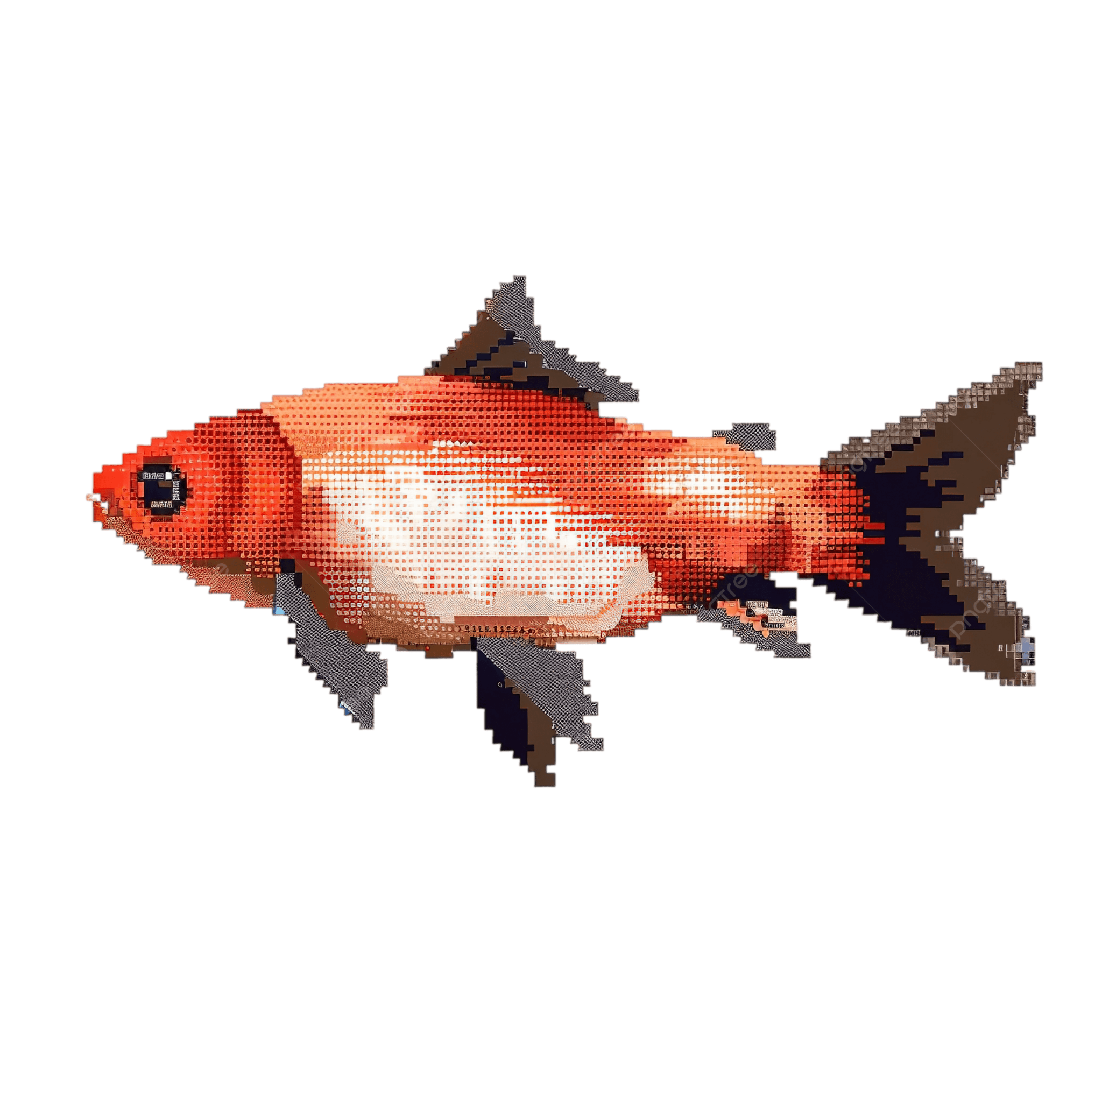
Fishing
Making Caroline’s Dream a Reality

Slide 2
Goals
Should be quick and simple to engage with
Should provide interesting depth and meta gameplay
Should tie back to core loop
Should be cozy and relaxing

Slide 3
Basic Loop
At any time the player may choose to go fishing as Kat at fishing points in town (ocean pier for v1, consider river/lake later)
The cost to fish is free but you may also equip optional Lures to buff your fishing game
Lures can be crafted with jellies/coins/gems or given out as prizes across the game
Fish come in a variety of species with different rarities and Time of Day constraints. Catch them all to fill up your collection!
Catch the same type of fish multiple times to learn more about it, ie we parcel out information in the collections menu based on the number of times you’ve caught this fish, thus providing a second progression map for completing the collection
Use fish for crafting, gifting, quests, or just sell them for coins

Slide 4
Fishing Gameplay
Introduce a cozy game mode where Kat sits quietly on the pier playing a fishing animation.
Occasionally (every 10-30s) a fish will bite, triggering a pick over Kat’s head
If the player taps Kat while the pick is active she’ll reel in a fish
If the player misses the window Kat has a 50% chance to catch the fish automatically
Kat will continue fishing until player exits game mode, a summary is provided at the end showing all the fish caught

Slide 5
Lures
Fishing is free but the player may optionally equip lures as a buff
Player can have 1 lure equipped at a time, lures expire after X fish are caught (number varies per lure)
Lures can be purchased and equipped while in the fishing game mode, and can be given out as rewards throughout the game
Example buffs:
Increase fish spawn rate (shorter cooldown between fish)
Increase passive catch rate (chance to catch a fish with no input)
Increase rare fish spawn rate (roll rarer loot table when catching a fish)
Some rarer fish can only be caught while a rare lure is equipped
Time of Day modifier (eg catch night fish during the day)

Slide 6
Expanded Ideas
Player could eventually unlock fishing nets to place in the water which will automatically catch a fish every X hours
Can spend a lure to bump chance of rare fish here as well
Bonus hours/weather where certain fish are more common
Eg only spawn at night or dusk/dawn, only spawn in the rain, only spawn in winter, etc

Slide 7
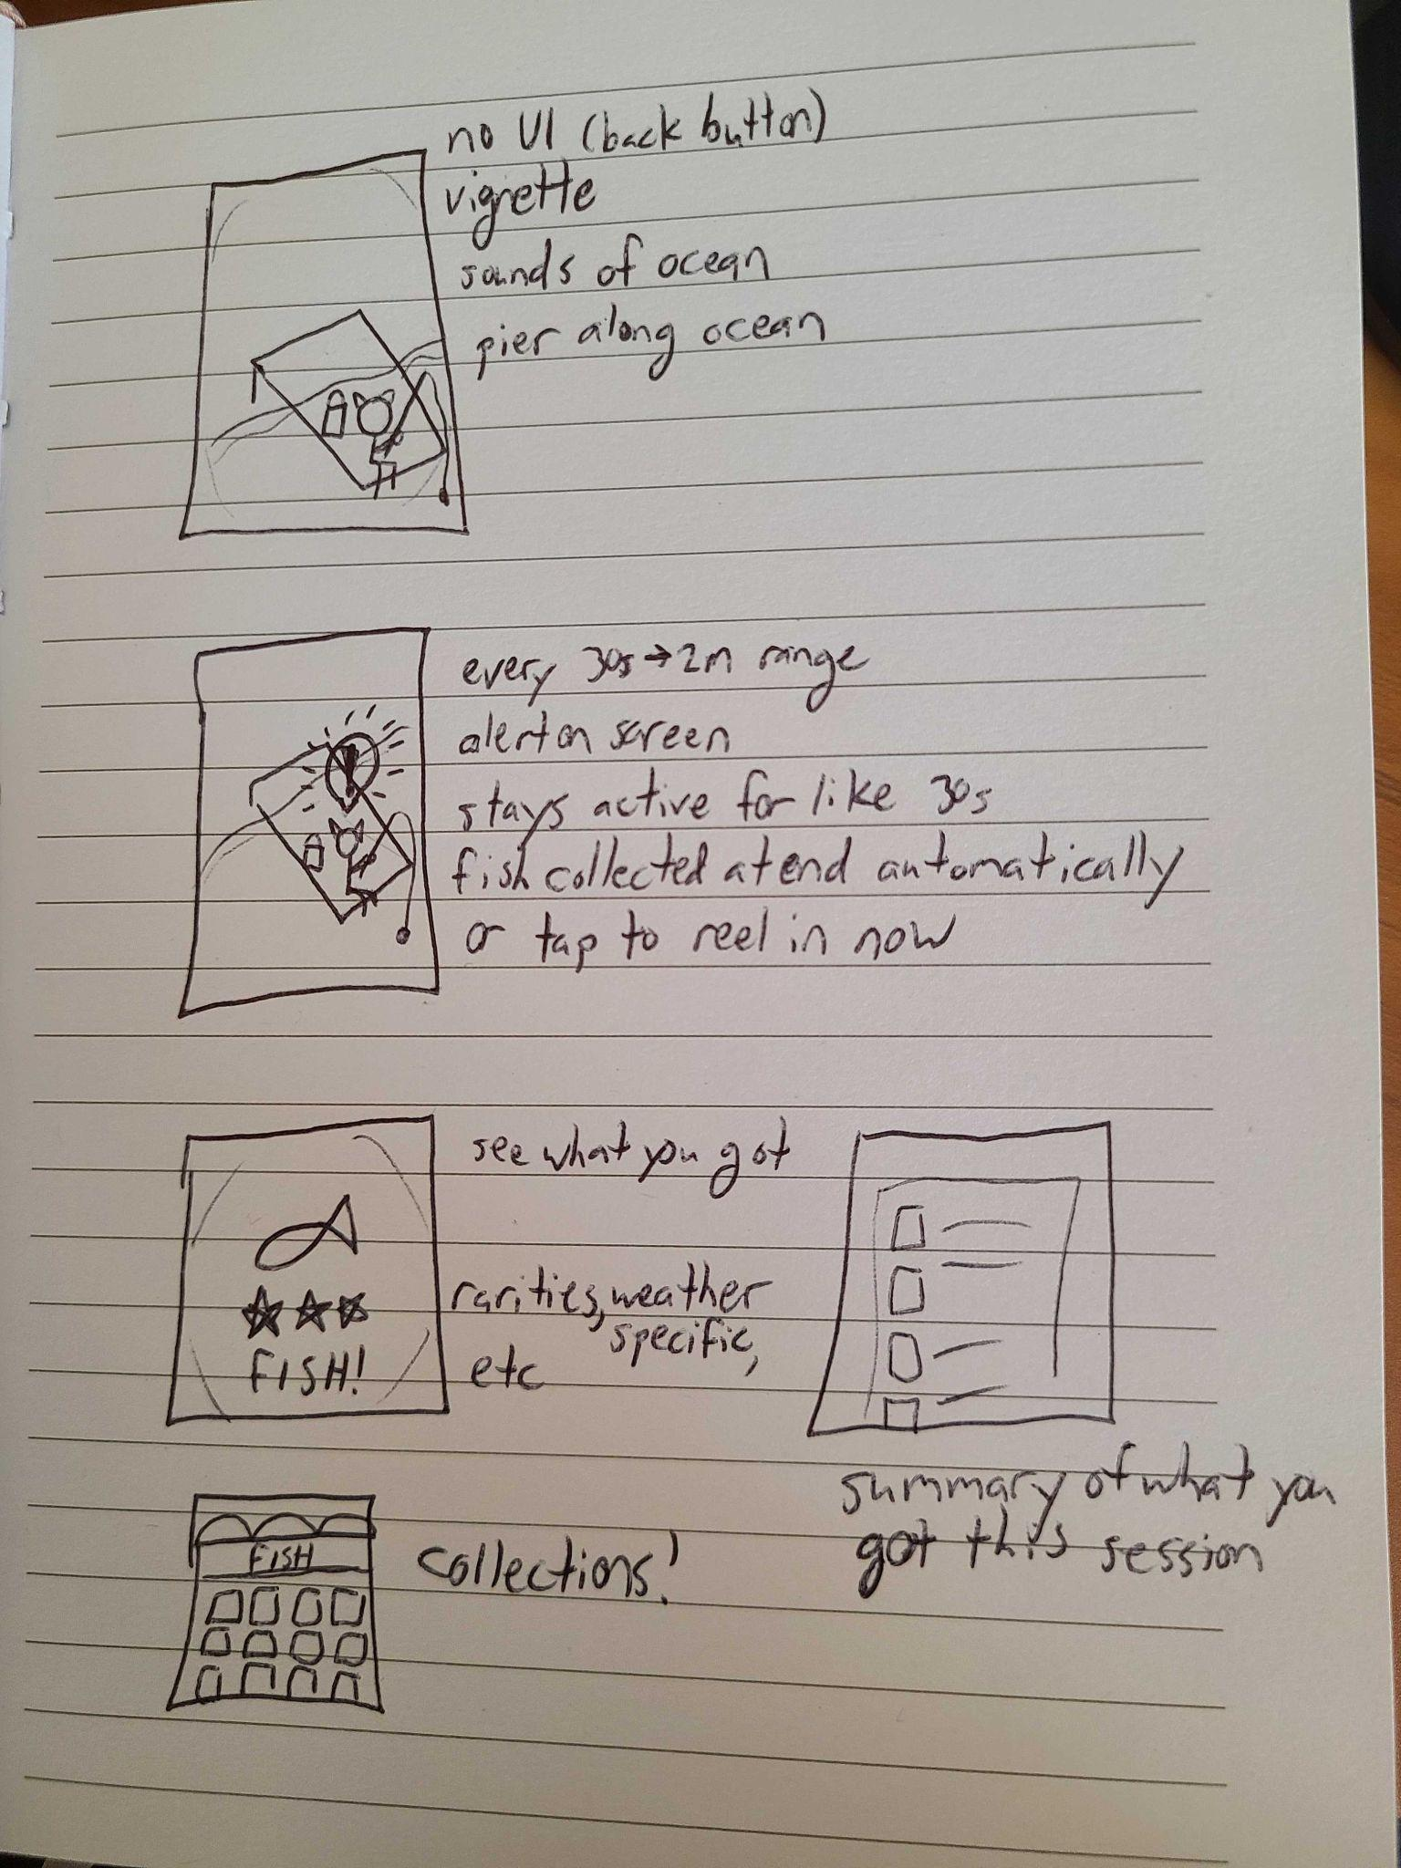
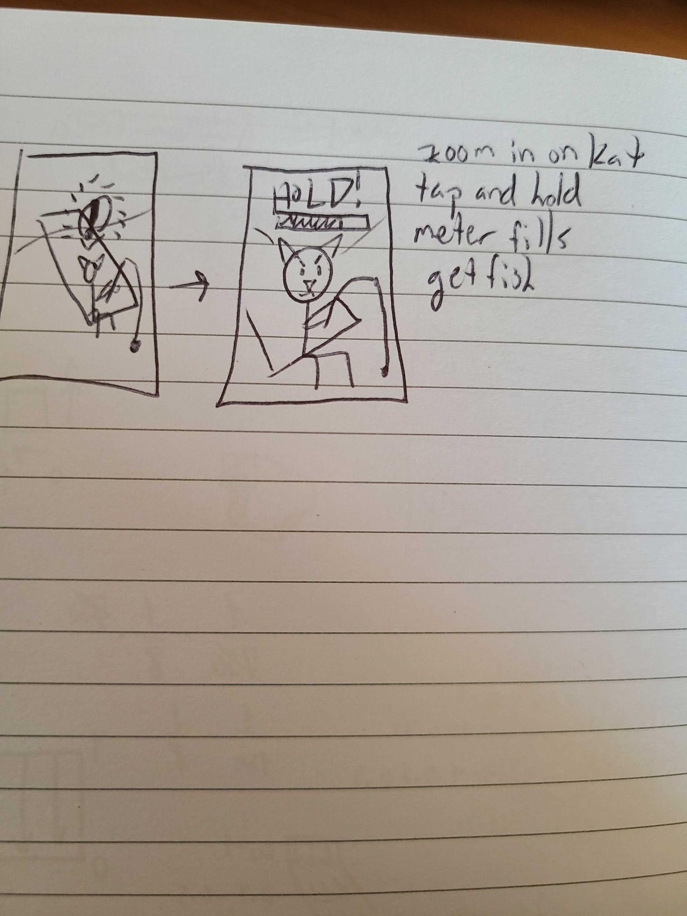
Rough Mock

Slide 8
Art Requirements
Animation
Kat fishing idle
Kat fishing reacting to bite
Kat reeling in fish
Fish swimming around in water?
UI/Art
Around 20 fish sprites, based on real or fantasy fish, similar to our farm crops
Can scale down initial number for v1 but this feels about comparable to our book collection
3-4 lure sprites based on how many we include in v1
Fish biting pick art
Info dialog like Morgaine’s event info
Fishing complete screen (optional?) showing a summary of everything caught during fishing session
Lure crafting dialog (very similar to deco crafting or seed purchasing)
Town
Fishing pier building over the ocean

Slide 9
2/26 Art Tasks
Fishing pier/dock in town. This should be a visible area by the water (probably with a sign that says Fishing) where it is clear the main purpose is fishing. Maybe there’s an empty chair there with a fishing rod and a bucket, or similar. We want it to look very cozy.
Concepting for the cozy game mode: This is a separate screen (though it can maybe look like a zoomed in version of the pier over water..? We can concept a few options) that is meant to be cozy, idyllic and almost meditative. It’s sort of a mini-game where the player can either tap when there’s a fish on the line to reel in the fish, or the player can even just do nothing (leave phone open as meditative background art) and there’s a 50% chance the fish will get reeled in or lost.
Fish art (TBD)
Kat Animation art (TBD)

