Slide 1
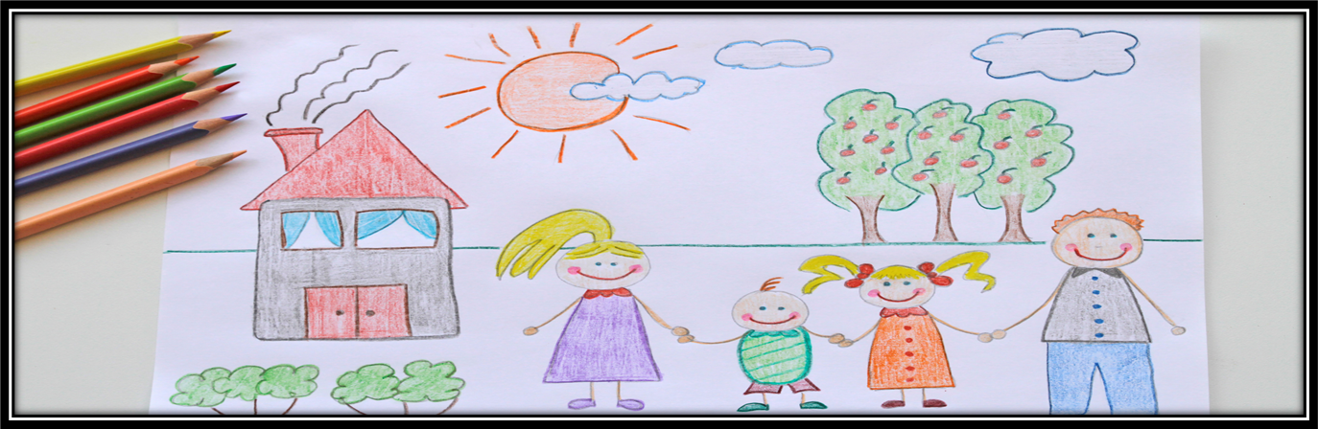
My Analysis of Family
Name:
SOC-213
Sociology of the Family

Slide 2

Section One: Family as a Social Institution
Choose one (Remove this Content-it is there to guide not a part of your project)
Create a family snapshot showing structure, roles, residence, authority, kinship, or chosen family.
Compare an earlier family generation with family life today and connect the change to policy, technology, work, education, or a major event.
Explain how culture and racial or ethnic diversity shape family practices without treating difference as deficiency.
Possible concepts: social institution, socialization, fictive kin, authority, residence, ideal culture, real culture, intersectionality.

Slide 3

Section Two: Studying Families
Choose one (Remove this Content-it is there to guide not a part of your project)
Turn a family topic into a research question and select the best method, sample, and evidence.
Improve a biased, unreliable, or invalid survey question about families.
Apply one micro-level and one macro-level theory to the same family pattern, showing what each reveals.
Possible concepts: reliability, validity, sample, correlation, causation, ethics, symbolic interactionism, conflict theory, functionalism, feminist theory.

Slide 4
Section Three: Socialization and Gender
Choose one (Remove this Content-it is there to guide not a part of your project)
Trace one gender message through family, school, and media and explain whether the sources reinforce or challenge one another.
Analyze how gender roles influence household labor, caregiving, identity, opportunity, or power.
Use a historical or public case to distinguish biological variation, gender identity, gender expression, and society’s classifications.
Possible concepts: sex traits, gender, gender socialization, stereotype, ideology, gender spectrum, patriarchy, stratification.

Slide 5
Section Four: The Economy & Family Life
Choose one (Remove this Content-it is there to guide not a part of your project)
Show how inflation, housing, childcare, healthcare, education, or technology costs affect a household budget and family choices.
Analyze how social class and wealth—not income alone—shape family opportunity and security.
Compare U.S. family supports with another industrialized country and explain what taxes provide in return.

Slide 6
Section Five: Relationships and Communication
Choose one (Remove this Content-it is there to guide not a part of your project)
Use filter theory to explain how social location and opportunity shape who is likely to meet and form a relationship.
Apply love styles or communication patterns to a fictional, public, or personal relationship.
Explain why relationship satisfaction may change across the life course and identify realistic strategies for a demanding stage.
Possible concepts: singlehood, cohabitation, homogamy, propinquity, filter theory, love styles, conflict pattern, marital satisfaction.

Slide 7
Section Six: Family Formation, Parenting & Development
Choose One (Remove this Content-it is there to guide not a part of your project)
Compare two legitimate family-formation pathways, including resources, opportunities, policies, and ethical questions.
Apply one child-development theory and one parenting or attachment concept to a realistic example.
Explain how biology and social experience interact in development without treating genes or environment as destiny.
Possible concepts: reproductive justice, kinship care, attachment, parenting styles, Mead, Erikson, Piaget, Bronfenbrenner, Bandura, epigenetics.

Slide 8
Section Seven: Family Challenges, Stress, Abuse, & Violence
Choose one (Remove this Content-it is there to guide not a part of your project)
Use the Double ABC-X or family-resilience framework to show how demands, meanings, and supports shape a family crisis.
Explain how social institutions can reduce stress for a family managing disability, mental-health needs, caregiving, or postpartum illness.
Analyze where a harmful cycle can be interrupted through safety, accountability, treatment, skills, policy, and community support.
Possible concepts: stressor pile-up, appraisal, resilience, role overload, coercive control, trauma-informed support, social learning, cycle breaking.

Slide 9
Section Eight: Family Change Across the Life Course
Choose one (Remove this Content-it is there to guide not a part of your project)
Map how divorce, remarriage, or stepfamily formation changes roles, boundaries, residence, and kinship.
Apply a later-life theory to retirement, grandparenting, caregiving, social activity, or continuity of identity.
Identify an ageist assumption and explain how attitudes can become institutional discrimination.
Possible concepts: life-course theory, linked lives, stepfamily, kin keeper, activity theory, continuity theory, disengagement theory, social exchange, ageism.

Slide 10
Key Takeaways
Two Key Takeaway Section One:
Two Key Takeaway Section Two:
Two Key Takeaway Section Three:
Two Key Takeaway Section Four:
Two Key Takeaway Section Five:
Two Key Takeaway Section Six:
Two Key Takeaway Section Seven:
Two Key Takeaway Section Eight:

Slide 11
References
Hodgson, C. & Norwood, J. (2026). Understanding the family in modern society: How families guide, protect, and prepare the next generation. https://understanding-the-family-soc213.carollhodgson.chatgpt.site/

