Slide 1
machine learning project milestone 2
fraud detection in medicare providers- project presentation/ dr. nouran khalid
Name: salma elhossiny Id: 13003991
Name: carol tamer Id: 13006418
Name: salma gouda Id: 13001720
Name: farah sherif Id: 13005911

Slide 2


medicare fraud detection
project goal:
Identify providers who may be involved in fraudulent billing.
Help reduce financial loss in Medicare.
Build a machine learning model to flag suspicious behavior

Slide 3
we used 4 training datasets
Beneficiary data
Inpatient claims
Outpatient claims
Provider fraud labels

Slide 4
important keys
Provider → used to link all claims to fraud labels
BeneID → used to link claims to patient info

Slide 5
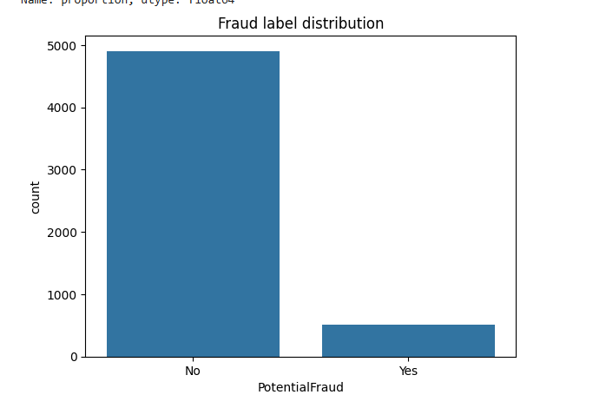
fraud detection
Fraud cases are very rare (around 8–10%).
This means the dataset is imbalanced.
We used metrics like PR-AUC and ROC-AUC.

Slide 6
feature engineering
We created provider-level features:
Inpatient claim stats
Outpatient claim stats
Beneficiary info (coverage months, chronic conditions)
Total claims, total beneficiaries
Inpatient/Outpatient ratio

Slide 7
models tested
Logistic Regression
Random Forest
Gradient Boosting
Used class weights to handle imbalance

Slide 8
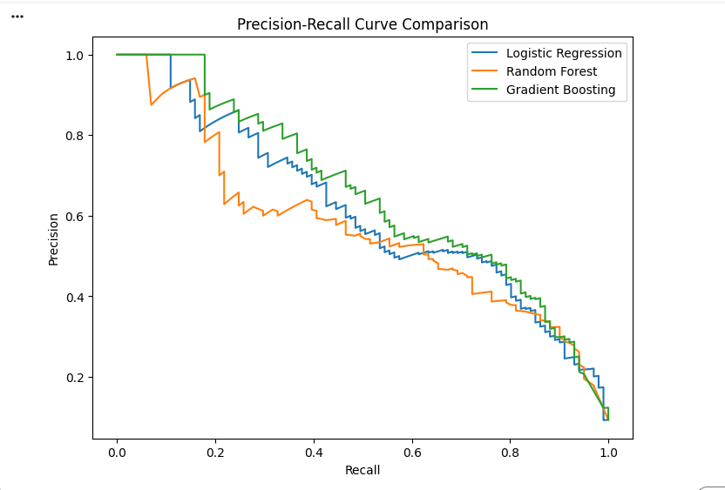
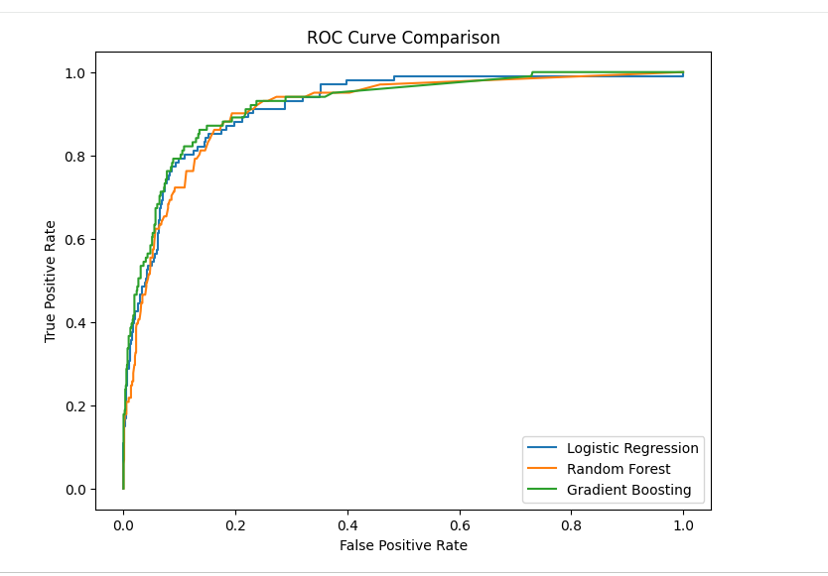
models comparison
Logistic Regression: Good recall
Random Forest: Best overall
Gradient Boosting: Good balance
-Metrics to add:
ROC-AUC
PR-AUC

Slide 9
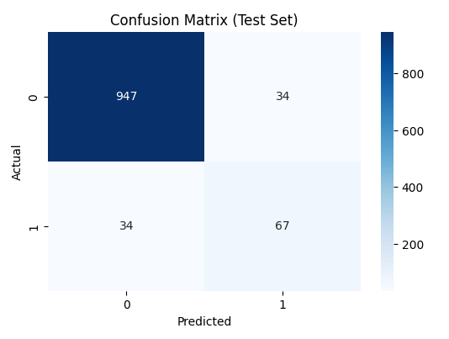
final model results(random forest)
Fraud precision: 0.66
Fraud recall: 0.66
Accuracy: 0.94
ROC-AUC: 0.95
PR-AUC: 0.73

Slide 10
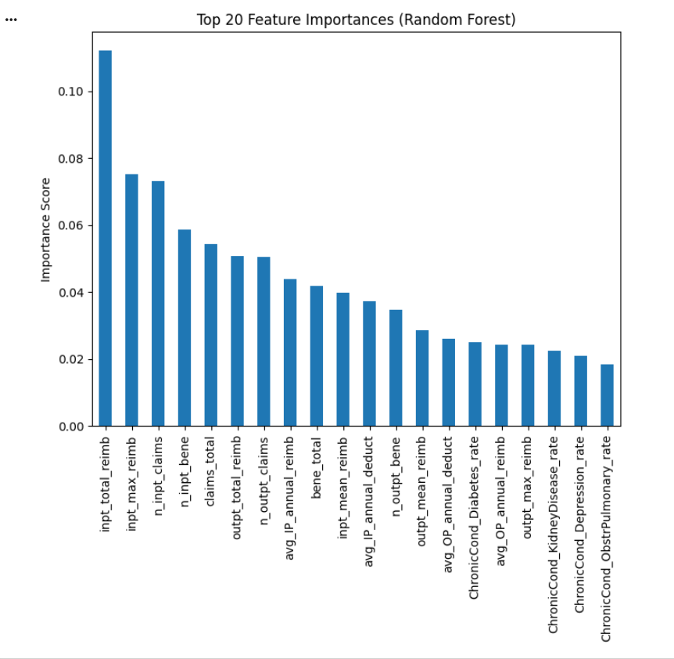
feature importance
The model relied heavily on:
Total reimbursements
Total claim counts
Beneficiary chronic condition rates
Claim ratios

Slide 11
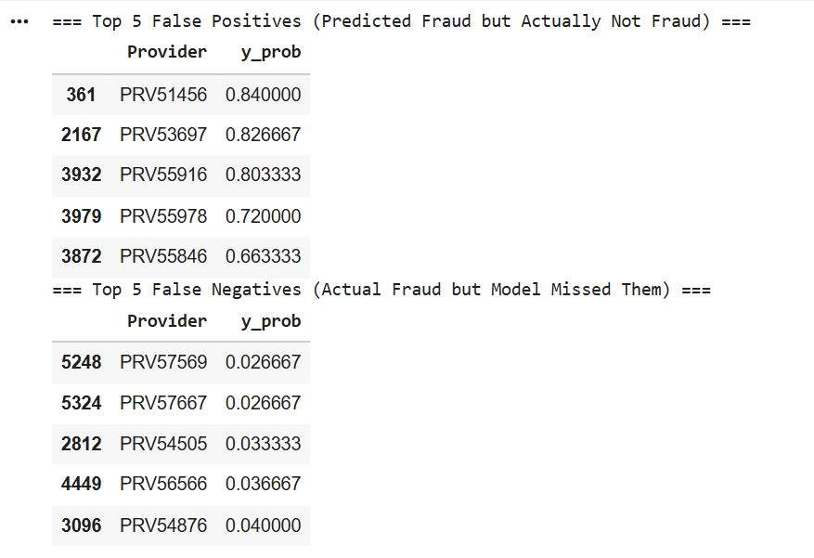
error analysis
False Positives:
Looked like fraud (high claims) but were not.
False Negatives:
Actual fraud cases that were hard
to detect.
Low claim activity

Slide 12
conclusion
Random Forest performed best.
Model can help investigators focus their time.
Improvements could include:
Boosting models (XGBoost)
Oversampling
Adding time-based features

Slide 13
Thank you

