Slide 1



Insights de vendas
View in Power BI
Last data refresh:
22/03/2022 16:04:15 UTC
Downloaded at:
22/03/2022 16:06:28 UTC

Slide 2
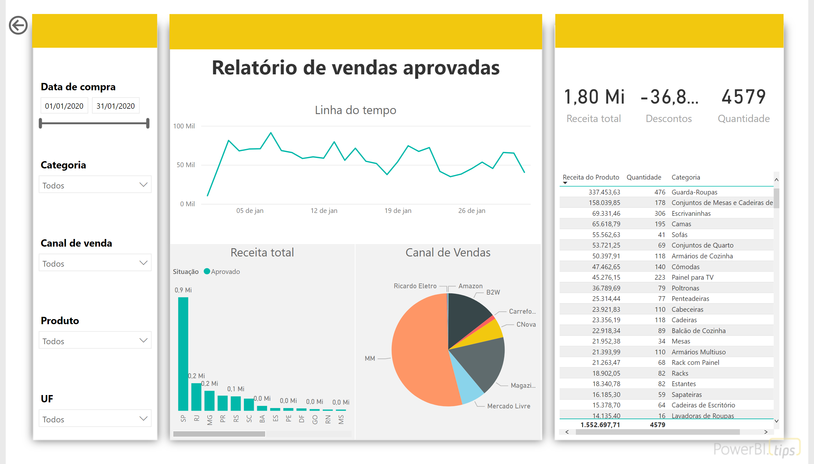
Vendas Aprovadas
Notes:
Date Slicer
No alt text provided
Slicer 1
No alt text provided
Slicer 2
No alt text provided
Slicer 3
No alt text provided
Slicer 4
No alt text provided
Linha do tempo
No alt text provided
Receita total
No alt text provided
Card 1
No alt text provided
Card 2
No alt text provided
Card 3
No alt text provided
Table
No alt text provided
Left Column Color
No alt text provided
Middle Column Color
No alt text provided
Right Colomun Color
No alt text provided
actionButton
No alt text provided
Canal de Vendas
No alt text provided
textbox
No alt text provided

Slide 3
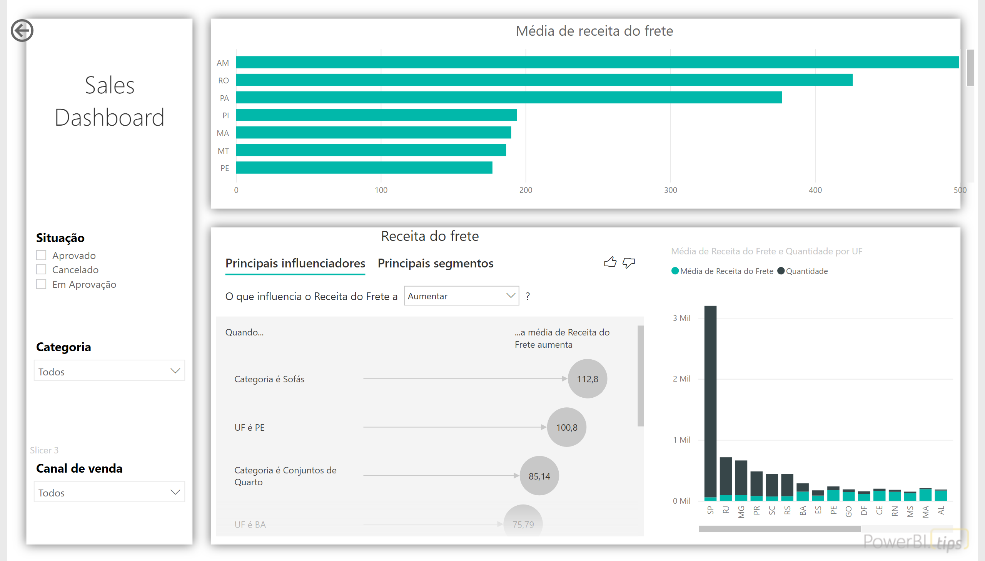
Custo de frete
Notes:
Slicer 1
No alt text provided
Receita do frete
No alt text provided
Média de receita do frete
No alt text provided
Logo Placeholder
No alt text provided
Slicer 2
No alt text provided
Slicer 3
No alt text provided
columnChart
No alt text provided
actionButton
No alt text provided

Slide 4
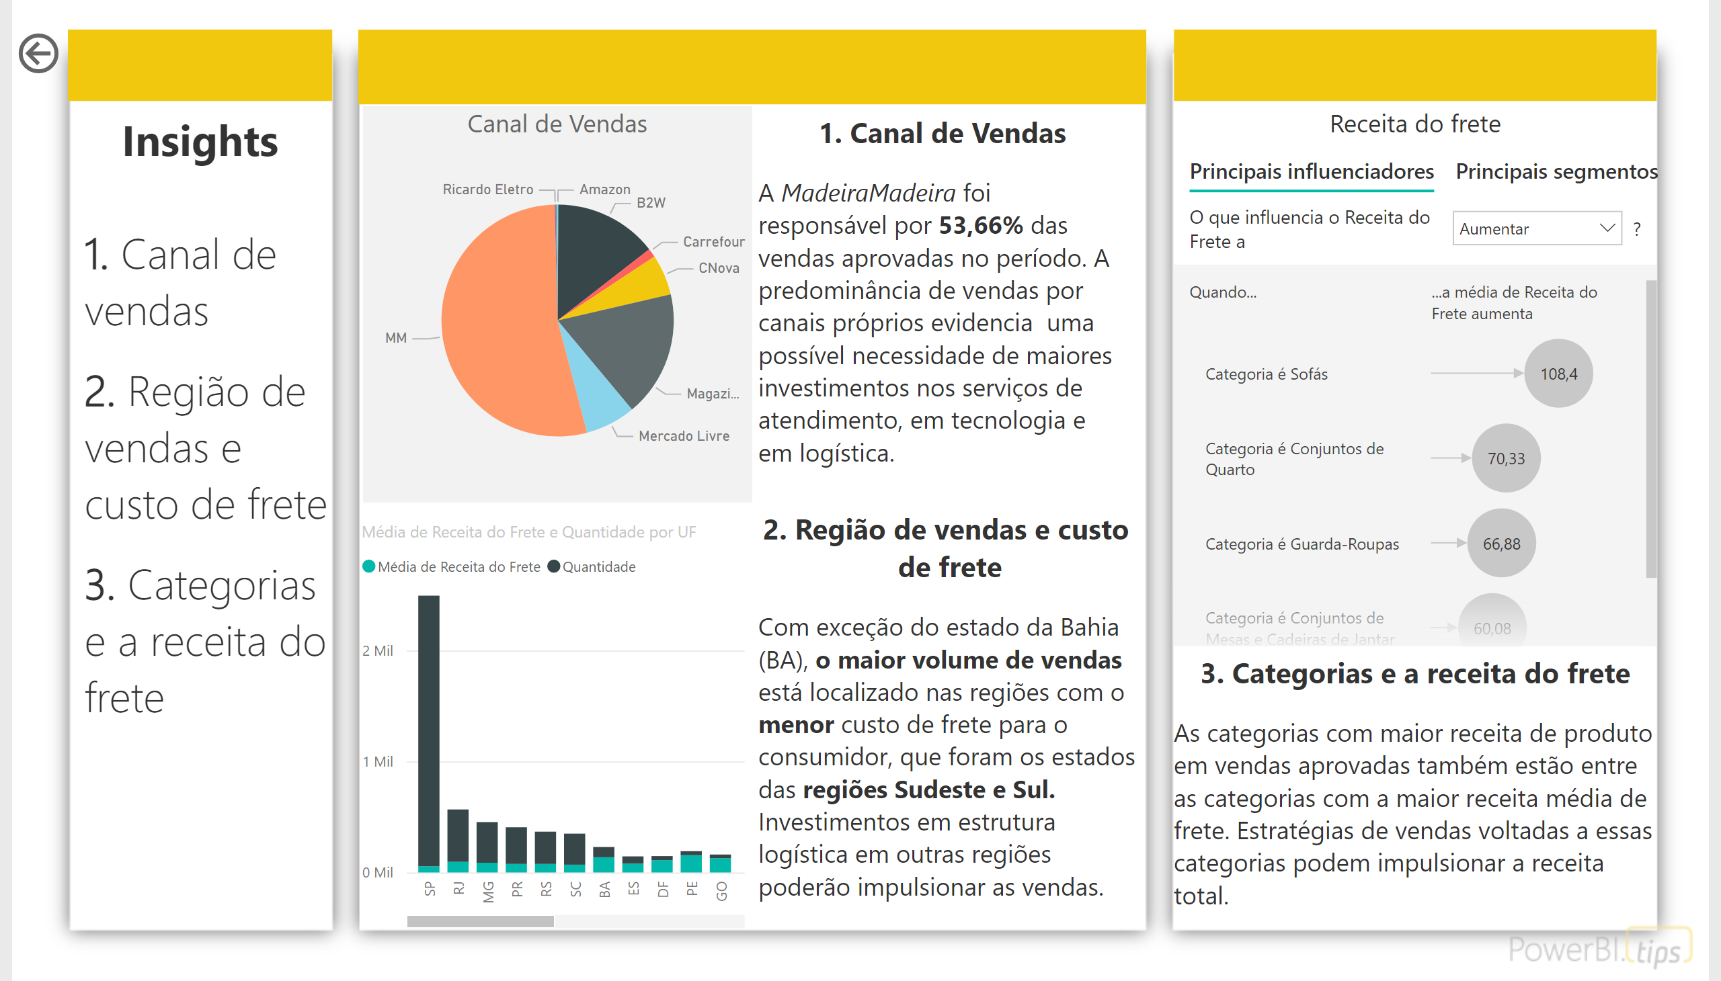
Insights
Notes:
Left Column Color
No alt text provided
Middle Column Color
No alt text provided
Right Colomun Color
No alt text provided
actionButton
No alt text provided
Canal de Vendas
No alt text provided
textbox
No alt text provided
textbox
No alt text provided
textbox
No alt text provided
columnChart
No alt text provided
textbox
No alt text provided
Receita do frete
No alt text provided
textbox
No alt text provided

