Slide 1

MLDP Project 70%
Carolyn Mohanty | 2102332J | P01

Slide 2
Introduction
Proposed problem statement:
To diagnostically predict whether a female patient has diabetes or not based on certain characteristics
Dataset of choice:
Dataset contains data of 768 female patients at least 21 years old of Pima Indian Heritage
Dataset includes eight features - pregnancy, glucose, blood pressure, skin thickness, insulin, BMI, diabetes pedigree function, and age
To express the result for the column ‘Outcome’ 1 represents Yes and 0 represents No

Slide 3
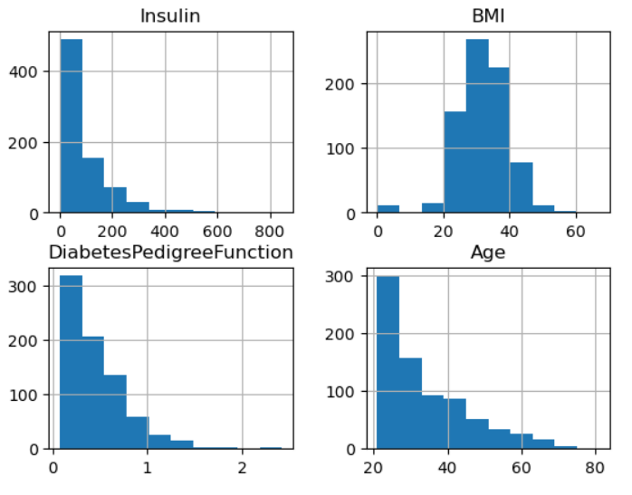
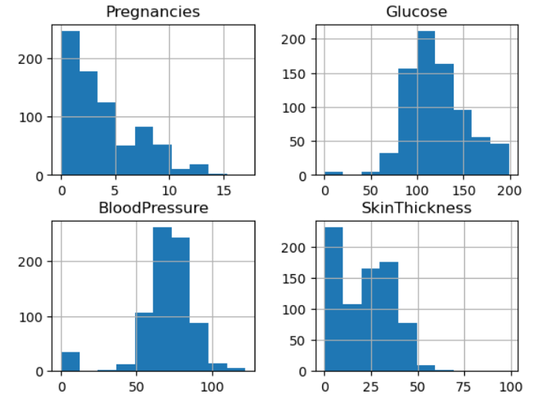
Data Exploration and Pre-processing of data
Checking of missing values (isna() method)
Checking of any duplicate rows (duplicated() method)
Visualizing data through charts
Pie chart to represent proportion of patients who have diabetes and who do not have diabetes
Scatter plot to visualize correlation between different columns
Boxplot to summarize distribution showing the median, quartiles, and outliers of data
Histogram to observe skewness of columns (iloc method to get selected columns)

Slide 4
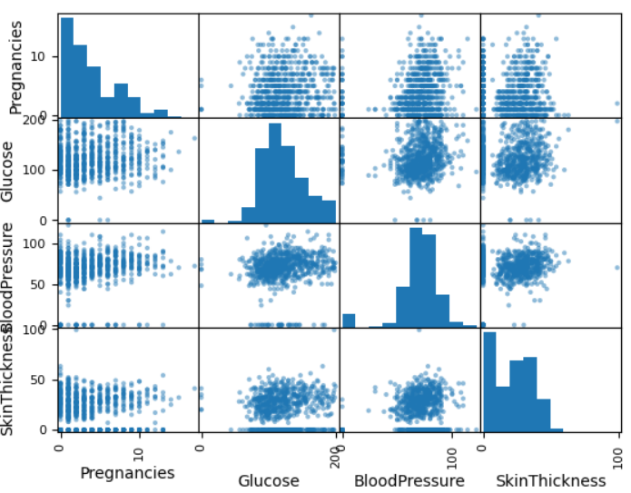
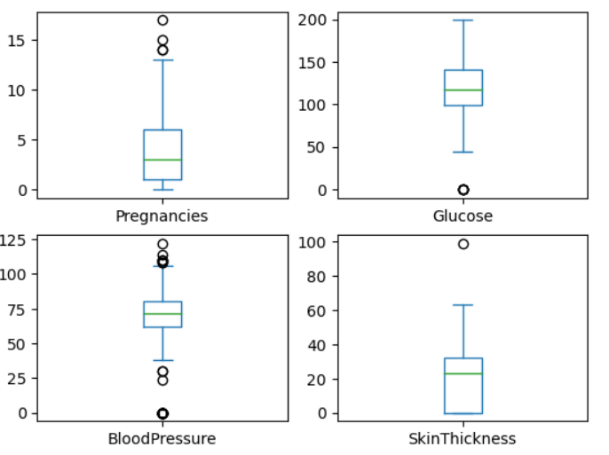
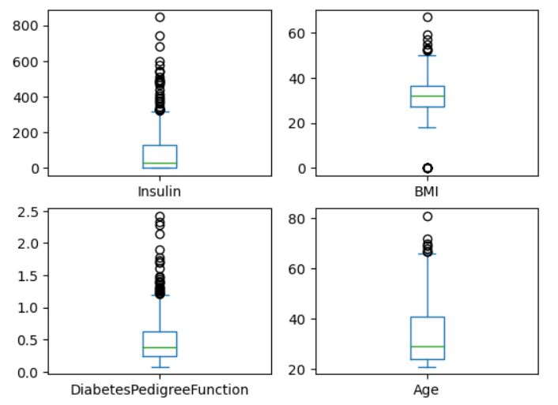
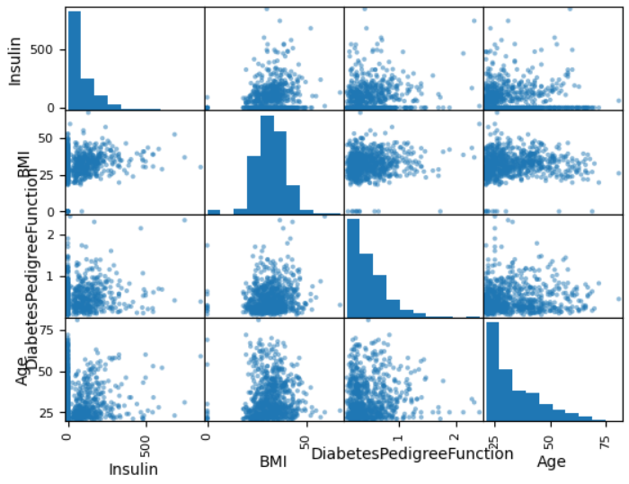
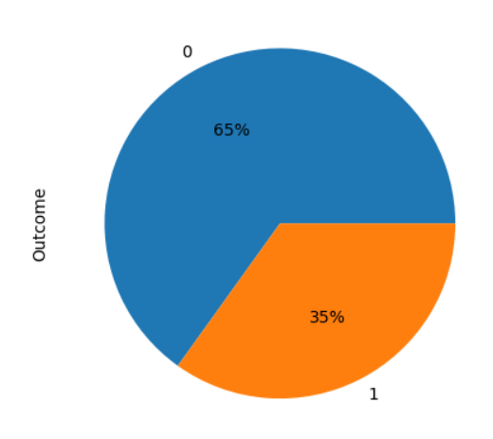
Images of other charts used

Slide 5
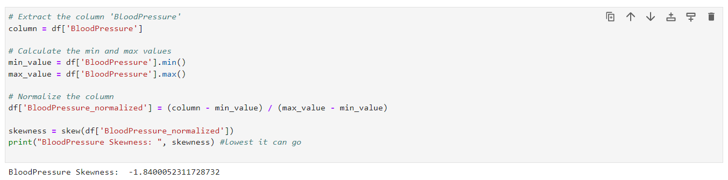
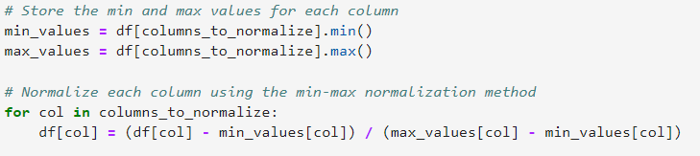
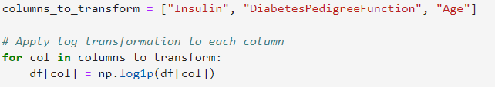

Data Exploration and Pre-processing of data
Checking skewness of each column (skew method)
Normalizing columns and using normalized values
Min-max normalization
Log transformation
Square root transformation

Slide 6
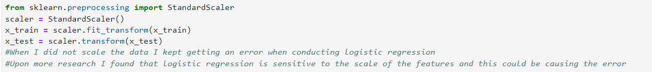
Data Exploration and Pre-processing of data
Scaling data using Standard Scaler
Standardizing the scale of the features can ensure that features have a similar impact on model and avoid any bias towards features that have larger scales

Slide 7
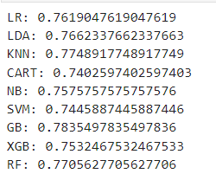
Models Training
Accuracy score before tuning
Models I have trained/explored:
Logistic Regression
Linear Discriminant Analysis
K Nearest Neighbors Classifier (KNN)
Decision Tree Classifier
Gaussian Naive Bayes Classifier (GNB)
Support Vector Machine Classifier (SVM)
Extreme Gradient Boosting Classifier (XGBoost)
Gradient Boosting Classifier
Random Forest Classifier

Slide 8
Advanced techniques:
Grid search on all models to find best hyper parameters
Extreme gradient boosting classifier had highest accuracy score after hyper parameter tuning
Before tuning: 0.75 (2 d.p.)
After tuning: 0.79 (2 d.p.)
Performed feature selection and improved model’s accuracy from 0.79 to 0.80 (2 d.p.)
Calculated feature_importance of each column
Experimented with columns with feature importance less than 10%
Deleted BloodPressure_normalized column with lowest feature_importance

Slide 9
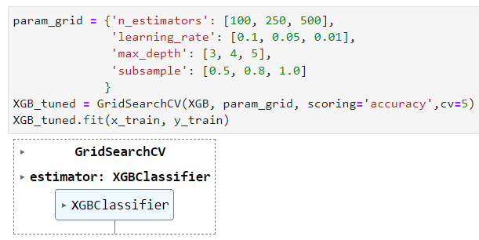
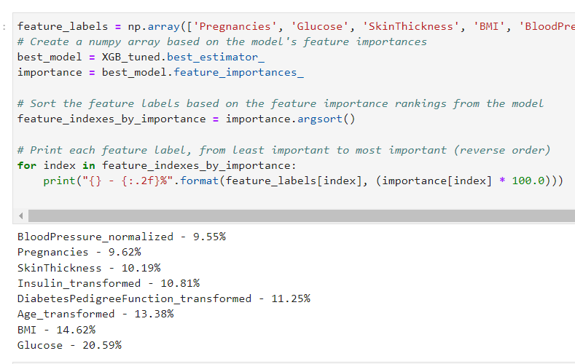
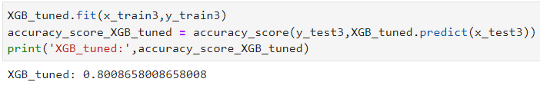
Images applying Advanced techniques:
Hyper-parameter tuning
Accuracy score after deleting BloodPessure_normalized
Feature importance of all columns in data frame

Slide 10
References
Dataset: https://www.kaggle.com/datasets/akshaydattatraykhare/diabetes-dataset
Logistic Regression: https://scikit-learn.org/stable/modules/generated/sklearn.linear_model.LogisticRegression.html
Linear Discriminant Analysis: https://scikit-learn.org/stable/modules/generated/sklearn.discriminant_analysis.LinearDiscriminantAnalysis.html
K Nearest Neighbors Classifier (KNN): https://scikit-learn.org/stable/modules/generated/sklearn.neighbors.KNeighborsClassifier.html
Decision Tree Classifier: https://scikit-learn.org/stable/modules/generated/sklearn.tree.DecisionTreeClassifier.html
Gaussian Naive Bayes Classifier (GNB): https://scikit-learn.org/stable/modules/generated/sklearn.naive_bayes.GaussianNB.html
Support Vector Machine Classifier (SVM): https://scikit-learn.org/stable/modules/generated/sklearn.svm.SVC.html
Extreme Gradient Boosting Classifier (XGBoost): https://xgboost.readthedocs.io/en/latest/
Gradient Boosting Classifier: https://scikit-learn.org/stable/modules/generated/sklearn.ensemble.GradientBoostingClassifier.html
Random Forest Classifier: https://scikit-learn.org/stable/modules/generated/sklearn.ensemble.RandomForestClassifier.html

Slide 11
References
pandas.plotting.scatter_matrix: https://pandas.pydata.org/pandas-docs/stable/reference/api/pandas.plotting.scatter_matrix.html
matplotlib.pyplot: https://matplotlib.org/stable/api/pyplot_summary.html
sklearn.model_selection: https://scikit-learn.org/stable/modules/classes.html#module-sklearn.model_selection
sklearn.metrics.classification_report: https://scikit-learn.org/stable/modules/generated/sklearn.metrics.classification_report.html
sklearn.metrics.confusion_matrix: https://scikit-learn.org/stable/modules/generated/sklearn.metrics.confusion_matrix.html
sklearn.metrics.accuracy_score: https://scikit-learn.org/stable/modules/generated/sklearn.metrics.accuracy_score.html
sklearn.model_selection.GridSearchCV: https://scikit-learn.org/stable/modules/generated/sklearn.model_selection.GridSearchCV.html
scipy.stats.skew: https://docs.scipy.org/doc/scipy/reference/generated/scipy.stats.skew.html
numpy: https://numpy.org/doc/stable/
joblib: https://joblib.readthedocs.io/en/latest/

