Slide 1
Introducing ASP.NET Core 1.0
A new platform for building web applications
May 25, 2016

Slide 2
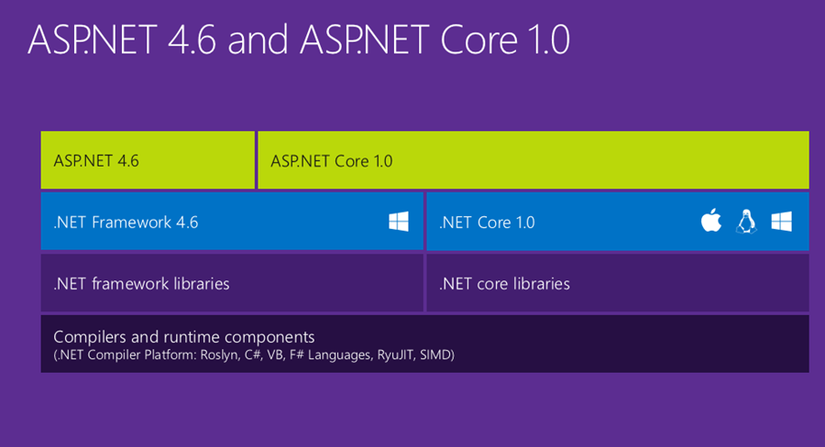
ASP.NET Core 1.0 is designed for cross operability

Slide 3
Json files are used for configuration
global.json sets the sdk version
project.json holds the information that the .csproj file used to contain
appsettings.json contains information that the web.config AppSettings used to contain
bower.json holds the configuration information for client side plugins
package.json holds information necessary for deployment

Slide 4
Entry point for ASP.NET Core 1.0
The entry point for an ASP.NET Core 1.0 application is a Main method
The Main method instantiates the Startup class
The Configure method is used to configure the HTTP request pipeline
ConfigureServices is used to used to add services to the container
Only the services you need are added

Slide 5
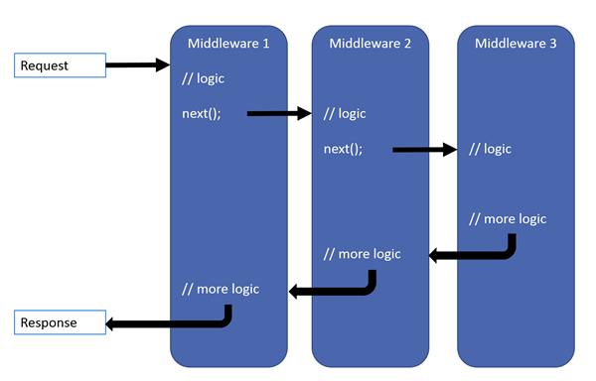
The Http Request pipeline

Slide 6
Middleware
Middleware are software components that are assembled into an application pipeline to handle requests and responses
Each component chooses whether to pass the request on to the next component in the pipeline, and can perform certain actions before and after the next component is invoked in the pipeline

Slide 7
What else is new is ASP.NET Core 1.0
The new Razor syntax introduces tag helpers
<label asp-for="Birthday" />
<input asp-for="Birthday" asp-format="{0:yyyy-MM-dd}" />
<select asp-for="Country" asp-items="ViewBag.Countries"> <option selected="selected" value="">Choose Country</option> </select>
<a asp-controller="Album" asp-action="Details" asp-route-id="@a.AlbumId">Details</a>
C# 6.0 introduces a shortcut for String.Format
$"Artist: {ArtistName}"

Slide 8
Session
It is necessary to serialize and deserialize Session
This can be done with a generic class SerializationLogic<T>
It has methods
public static byte[] Serialize(T m)
public static T Deserialize(byte[] bytes)
These methods are called by
byte[] bytes;
var ret = HttpContext.Session.TryGetValue("cartItems", out bytes);
var bytes = BusinessMethods.SerializationLogic<List<CartItemModel>>.Serialize(cartItems);
HttpContext.Session.Set("cartItems", bytes);

Slide 9
Resources
http://www.hanselman.com/blog/NETCore10RC2UpgradingFromPreviousVersions.aspx
https://github.com/carolynlschroeder/CoreDemoApp
http://carolynlschroederblog.com/category/home/
http://schroederconsulting.org

