Slide 1
Image Gallery With SignalR
A way to get real time communication
June 21, 2016

Slide 2
Displaying the images
The goal of this presentation is to present an image gallery where users can like images
Thumbnails are created dynamically for the gallery
ASP.NET Core Middleware can be used to present these in an intuitive way
This is not so intuitive in MVC 5

Slide 3
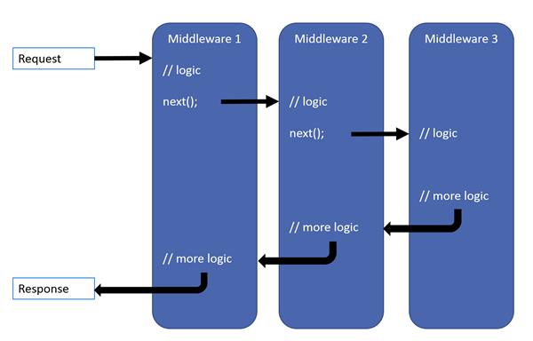
ASP.NET Core Middleware

Slide 4
Middleware for displaying images
Create a middleware extension on IApplicationBuilder
The extension handles the result if the request path has a particular format
Otherwise it passes the request to the next piece of middleware
The middleware is added to the Configure method of the Startup file
app.GetGalleryImage(env);
The image is displayed by setting the img src tag to @Url.Action("GetGalleryImage", "Gallery", new {id = @Model[j].ImageName})

Slide 5
Using signal4 in mvc 5 with .Net 4.6.1
Start by adding the NuGet package Microsoft.AspNet.SignalR
Next create a hub
A hub enables communication between all users of the application
It is a class derived from Hub
Here a method called LikeImage is called whenever a user likes an image
The hub broadcasts this information to users

Slide 6
authentication
Authentication is required to produce a Facebook like experience
In the Configuration class of Startup we need
app.MapSignalR();
GlobalHost.HubPipeline.RequireAuthentication();
Here app is the parameter IAppBuilder

Slide 7
Calling the hub
The Hub is called through javascript
Two JavaScript files must be added:
<script src="~/Scripts/jquery.signalR-2.2.0.min.js"></script>
<script src="~/signalr/hubs"></script>
A reference is made to the Hub
var demoHub = $.connection.signalRDemoHub;
The $.connection.hub.start().done function hooks up the Like button event to a call to demoHub.server.likeImage(userId, imageId);

Slide 8
Receiving the broadcast message
In this case the Hub broadcasts to all client
It calls the method AddNewMessageToPage
It is picked up in javascript by a function demoHub.client.addNewMessageToPage
This method hides the Like button for the user who liked the image
It adds 1 to the total image Likes for all clients of the application

Slide 9
Resources
https://github.com/carolynlschroeder/MiddlewareDemo
https://github.com/carolynlschroeder/SignalRDemo4_6_1
http://schroederconsulting.org/Presentations

