Slide 1

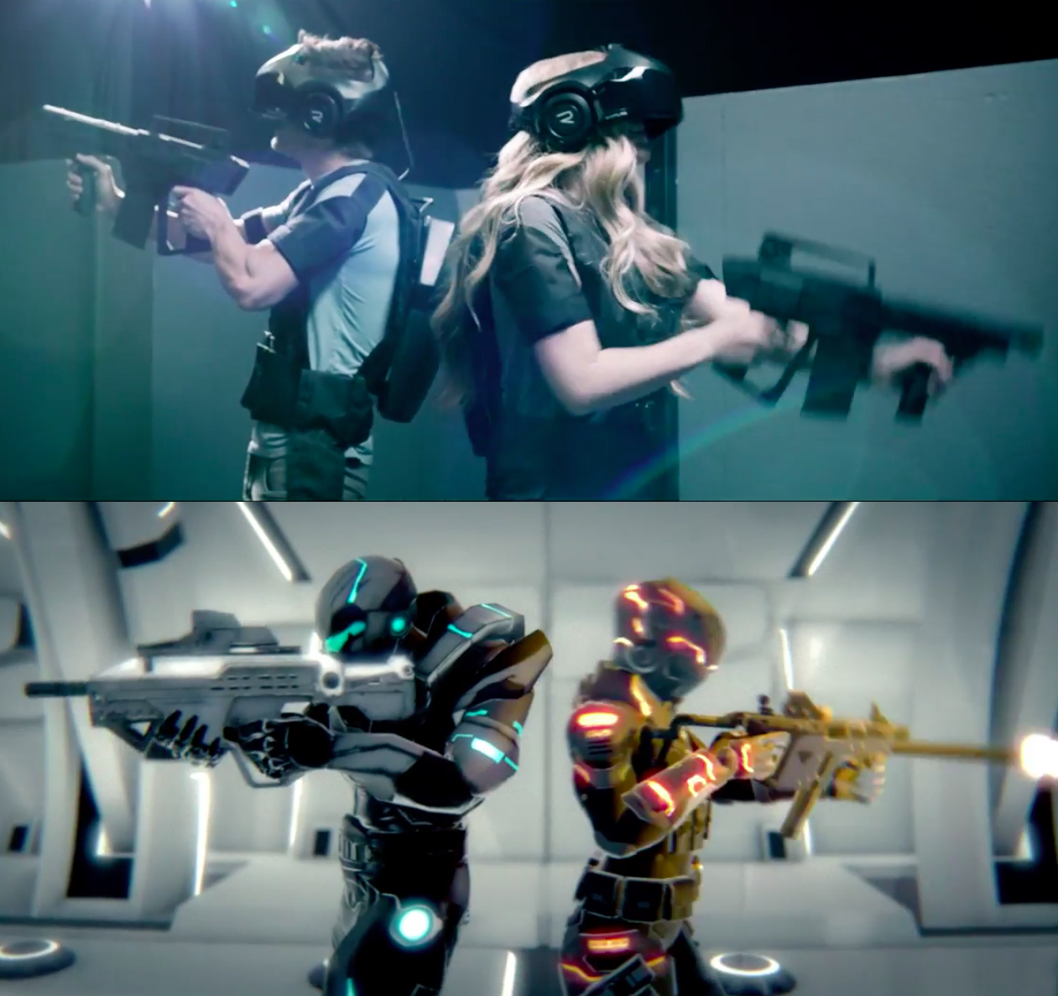
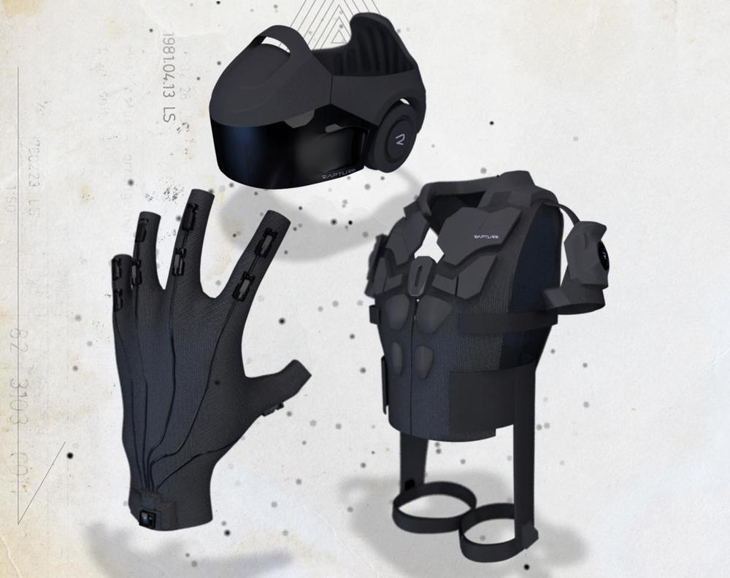

Slide 2

the Vision of infinite Dimensions
whole body, fully immersive VR experience, the scene changes differently in every turn.

Slide 3
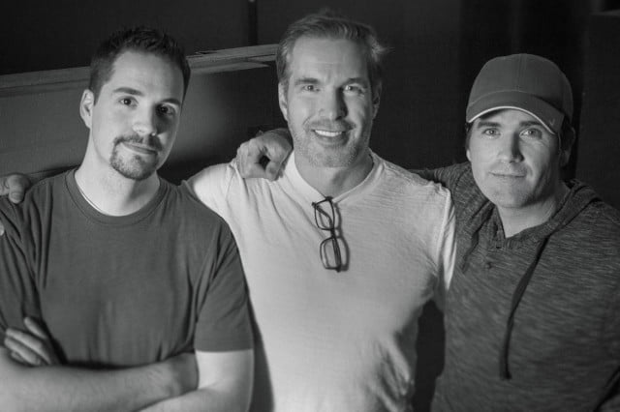
History of The Void
The Void was co-founded by Ken Bretschneider, Curtis Hickman and James M.Jensen. Bretschneider focused on developing the void after he decided to stop Evermore project.

Slide 4
Where is it used? What are best suited applications?
The system is designed to allow the users to freely walk through and explore a virtual world.
For playing, education-oriented experience like police tranning and nature exploration.

Slide 5
How does it work?
The void simulated the interior of a spaceship utilizing an Oculus Rift developer kit which used for position tracking. The vest system utilized an Oculus Rift Devlopment Kit2, Beats by Dr. Dre headphones and a Leap Motion unit for hand tracking.

Slide 6
Why is it a good use of VR? Why is it unique? What’s cool about it?
The void built in LAN environment avoiding latency issues and provide physical feedback.
It is unique cause it has hyperreality experience hinge on a VR environment.
The void can use a combination of virtual reality hardware with motion tracking.

Slide 7
Critique on strengths and weaknesses/issues such as tesign flaws or technical flaws. Is there still more to do?
Now there are just two experience -an exploration adventure set in a jungle temple, and an action romp in the Ghostbust universe.

Slide 8
0: Normal (no motion sickness at all)
5: Average (lead to dizziness) -> can not use it for more than a few minutes
10: Max (can be dangerous)
0

Slide 9
What are the similar/related applications?
Oculus Rift
PS VR

Slide 10
Reference
https://www.technologyreview.com/s/544096/inside-the-first-vr-theme-park/
https://www.wired.com/2017/02/the-void-vr-game/
https://www.digitaltrends.com/computing/how-the-void-plans-to-put-reality-back-in-virtual-reality/

