Slide 1







Technology Trends & Analysis Presentation
Carolina Pontes
October, 2023

Slide 2



OUTLINE
Executive Summary
Introduction
Methodology
Results
Visualization – Charts
Dashboard
Discussion
Findings & Implications
Conclusion
Appendix

Slide 3

EXECUTIVE SUMMARY
Identify trends in the programming languages and databases
Analyze the Demographic survey
Programming usage between Countries and its gap
Gender differences in the programming and database World

Slide 4

INTRODUCTION
Goal: Analyzing trends on the software development department
Purpose
What are the programming languages currently in demand?
What are the programming languages that will be the future trend?
What skills do programmers need to require?

Slide 5

METHODOLOGY
Collecting Data Sources
Stack Overflow Developers 2019 Survey
GitHub Job Postings
Programming Languages Annual Salary
Data Exploration
Data Cleaning
Data Visualization
Presentation

Slide 6
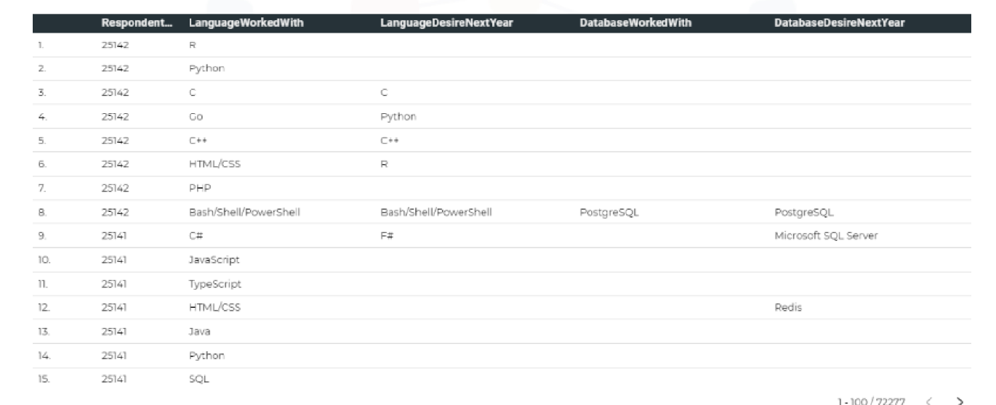
RESULTS

Slide 7
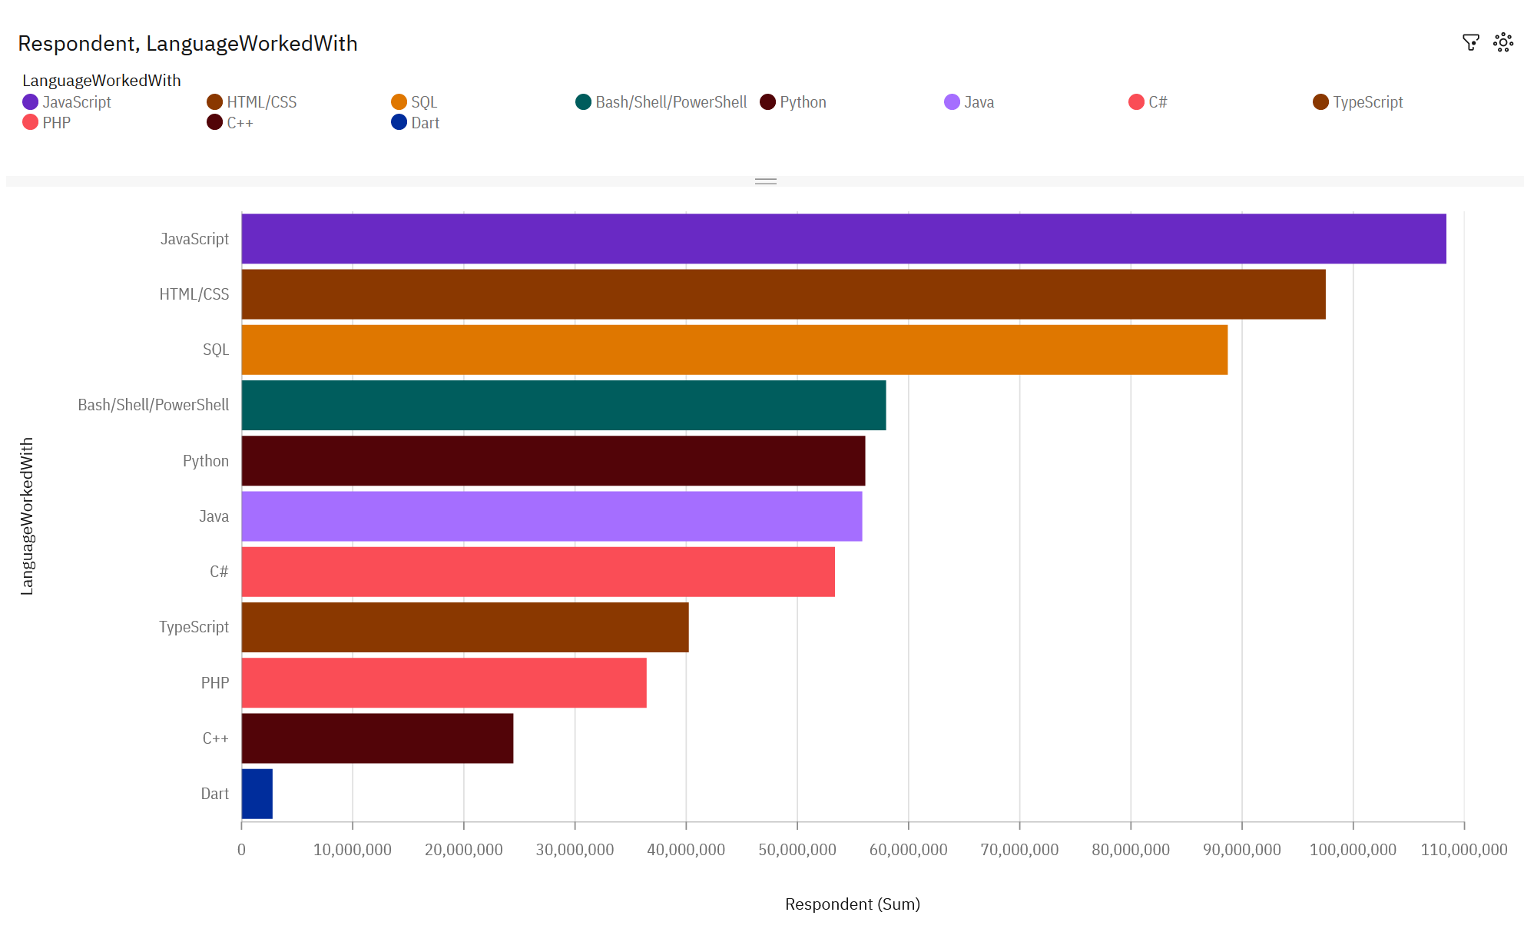
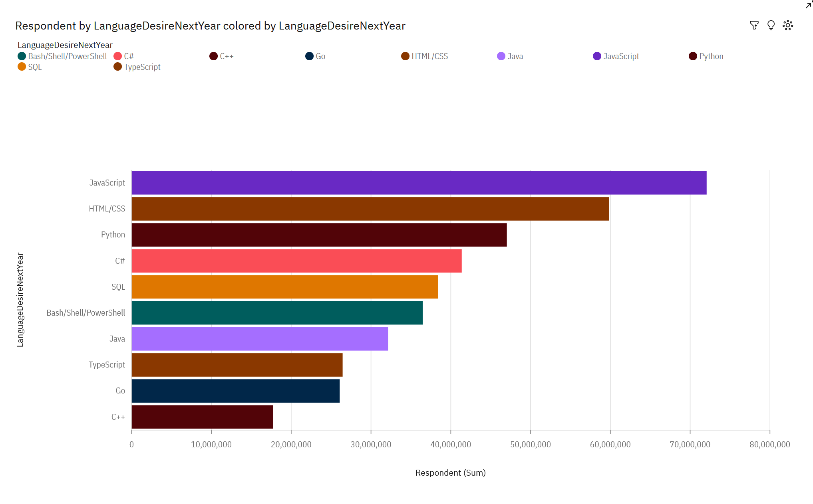
PROGRAMMING LANGUAGE TRENDS
Current Year
Next Year

Slide 8
PROGRAMMING LANGUAGE TRENDS - FINDINGS & IMPLICATIONS
Findings
JavaScript, HTML/CSS, SQL are the top 3 most used languages this year
Python and Typescript are growing in popularity
PowerShell is losing popularity in the top 10 most used programming languages
Implications
Web development will remain in demand
Companies that use Big Data still require SQL programmers
The rise of Python is due to the demand for AI and Machine Learning

Slide 9
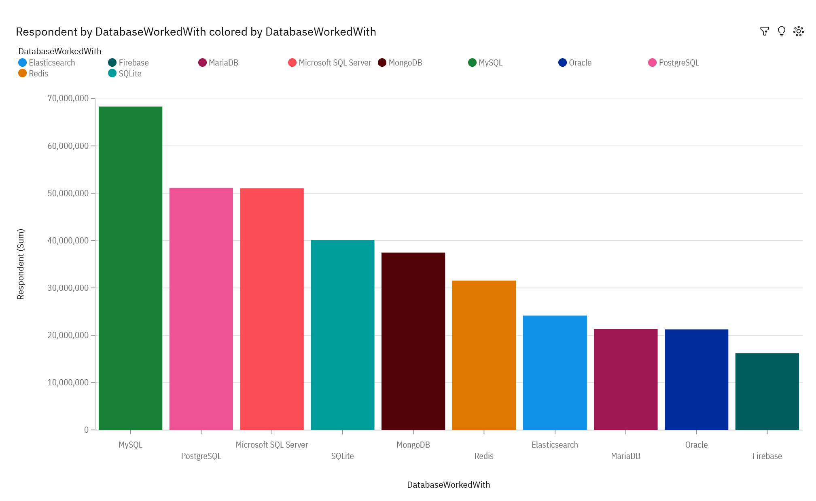
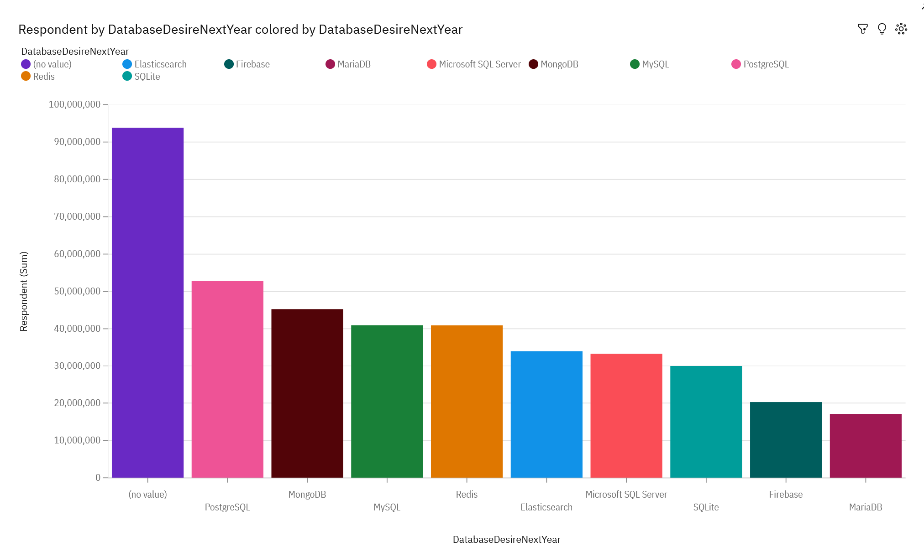
DATABASE TRENDS
Current Year
Next Year

Slide 10
DATABASE TRENDS - FINDINGS & IMPLICATIONS
Findings
MySQL, Microsoft SQL and PostgreSQL are the most popular
MongoDB is growing in popularity
Implications
Open source databases are still preferable

Slide 11

DASHBOARD
https://eu2.ca.analytics.ibm.com/bi/?perspective=dashboard&pathRef=.my_folders%2FDataAnalysisCapstone&action=view&mode=dashboard&subView=model0000018b3de5f847_00000002

Slide 12
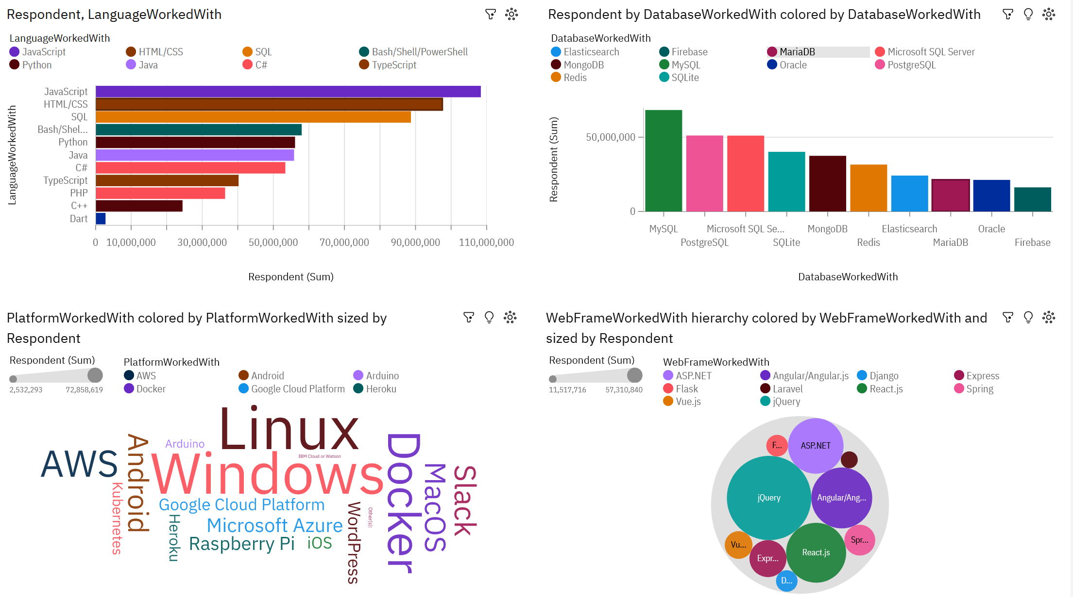
DASHBOARD TAB 1

Slide 13
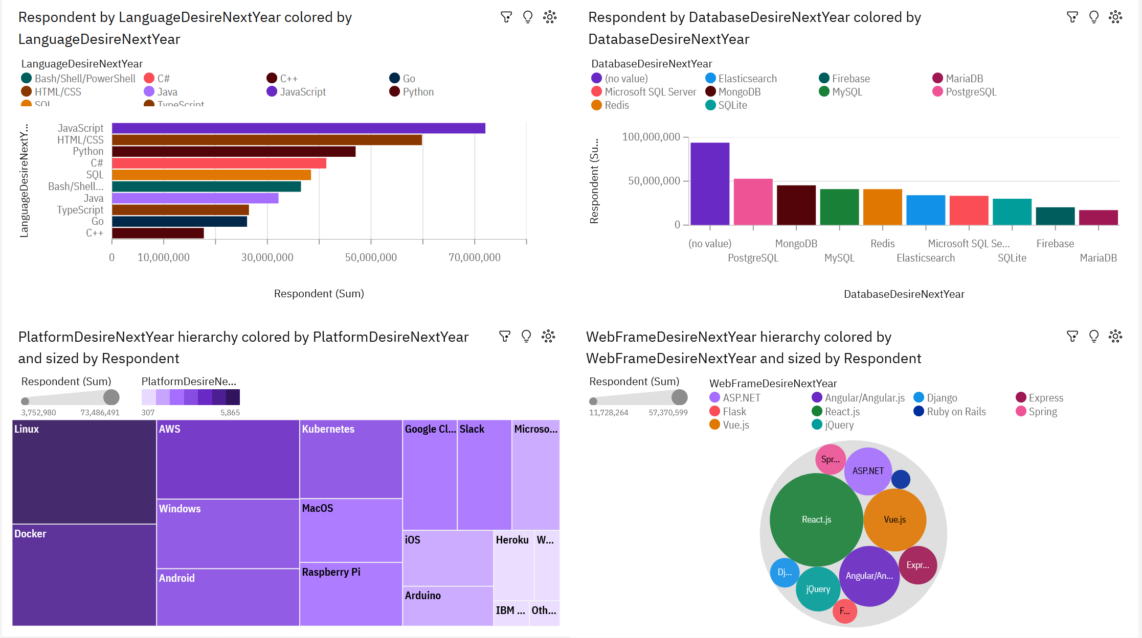
DASHBOARD TAB 2

Slide 14
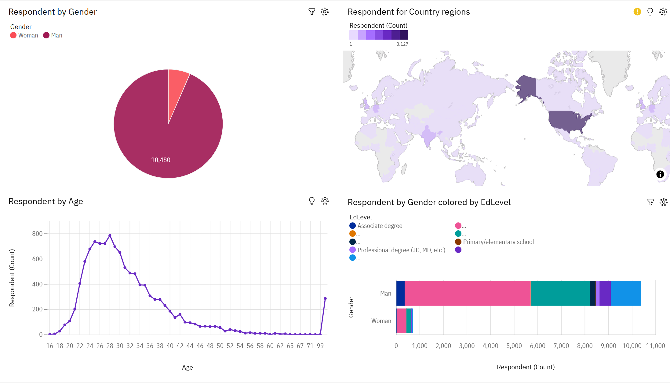
DASHBOARD TAB 3

