Slide 1

Malware detection through Image Processing
w w w . c r y s y s . h u
Arora Chaitanya
BSc. Training Project Laboratory
Supervisor: Levente Buttyán

Slide 2
Background and motivation
Re-iteration of an approach with the intersection of Cybersecurity and Artificial Intelligence.
Predicting of malware files with the help of Image processing through a convolutional neural network.
IOT devices being a prey to everyday hackers posses a great threat to the usage and acceptance of the IOT devices in the market. Lack of security of IOT devices posses a big gap which needs to be solved.

Slide 3
Background and motivation - walking down memory lane:
In 2016 three Distributed Denial of Service attacks were launched on the DNS provider Dyn.
The activities are believed to have been executed through a botnet consisting of many Internet connected devices—such as printers, cameras, gateways and baby monitors that had been infected with the Mirai malware.
Top vendors that contained the most infected devices were identified as Dahua, Huawei, ZTE, Cisco, ZyXEL and MikroTik.
Instances like this shows that there is imperative need to focus on the security of IOT devices from malware.

Slide 4
Problem statement and objectives
The classification of IOT malware using Image processing with the usage of CNN model
The objective of the project is to come up with a model which can guarantee a high accuracy model in segregating malware with benign files.
Application as a light weight classification inside in the IOT devices for a preliminary testing of files.
Can be used in the algorithms used by Antivirus to identify if a file is harmful and quarantine them.

Slide 5
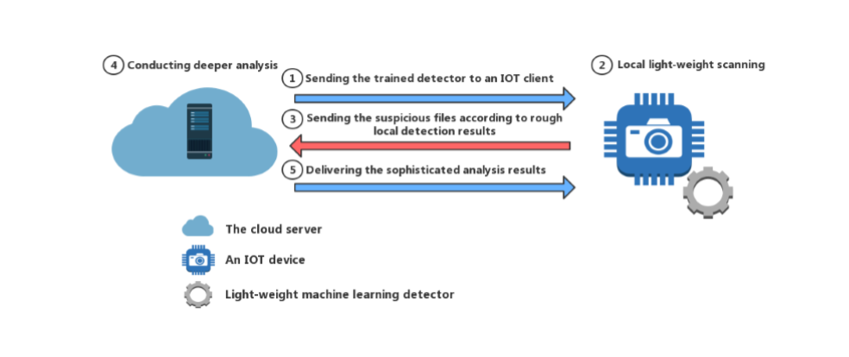
Problem statement and objectives

Slide 6
Results
The implementation has been divided into 3 parts:
Preparation of Dataset (Malware files)
Neural Network
Evaluation
For implementation ease ability we used python3. TensorFlow, Keres for pre-processing and model implementation, standard data manipulation files - NumPy and Pandas and Pillow for image creation.
We used a dataset of 3200X2X2 malware and benign files of MIPS and ARM architecture. The dataset have been divided into:
80% for training
20% for testing

Slide 7
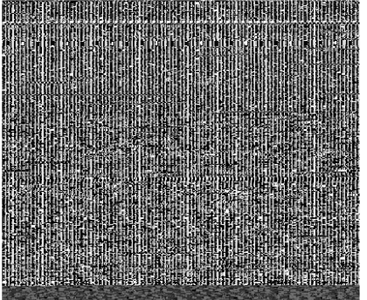
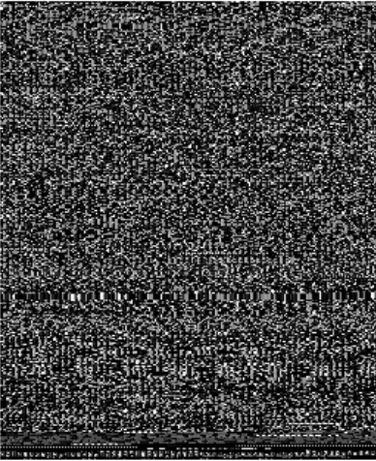
Results – The Dataset Preparation
The malware files predominantly exist at binary files which are a combination of zeros and ones.
Plan: To convert the existing binary files to grey scale images and use them as a data set for the CNN model.
A malware binary can be reformatted as an 8-bit string sequence, and therefore the entire sequence represents the grey scale image using the pillow library.
We scale the images to 64X64 to be feed in the CNN model

Slide 8
Results – The CNN model
The CNN model has been kept simple to keep it lightweight in order to be installed in the IOT devices.
The model
layers.Input (shape = input shape)
convolution layer (kernel = 3 , stride =1 , depth 32)
max pooling layer (kernel = 2, stride = 2)
convolution layer (kernel = 3 , stride =1 , depth 72)
max pooling layer (kernel = 2, stride 2)
Fully connected layer (size = 256)
softmax classifier

Slide 9
Evaluation
Systems | Approach Followed
Accuracy | 94%
Classifier | CNN
Number of Layers | 2
Number of Nodes | 104
Fully Connected Layer | 256
Preprocess | Re-organizing Binary
Input Dimension | 64X64
MIPS
Accuracy | Training Time | Validation Accuracy
92.23% | 90.427 sec | 89.50%
ARM
Accuracy | Training Time | Validation Accuracy
84.11% | 100.230 sec | 90.5%

Slide 10
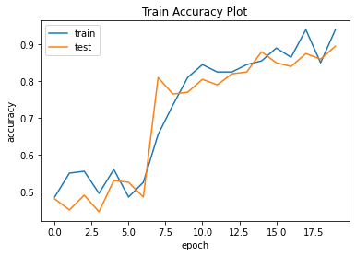
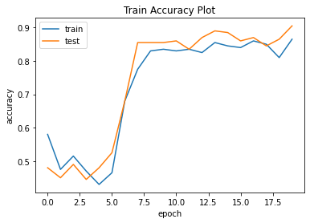
Evaluation
ARM
Malware (400) | True Positive (174) | False Positive (226)
Benign (400) | False Negative (153) | True Negative (247)
MIPS
Malware (400) | True Positive (163) | False Positive (237)
Benign (400) | False Negative (166) | True Negative (234)

Slide 11
Related work
Novel way of performing malware classification is to analyse their converted binary images [Nataraj, L., Karthikeyan, S., Jacob, G. and Manjunath, B.S., 2011, July. Malware images: visualization and automatic classification. In Proceedings of the 8th interna- tional symposium on visualization for cyber security (p. 4). ACM.]
Dahl, G.E., Stokes, J.W., Deng, L. and Yu, D., 2013, May. Large-scale malware classification using random projections and neural networks. In Acoustics, Speech and Signal Processing (ICASSP), 2013 IEEE International Conference on (pp. 3422- 3426). IEEE.
Simonyan, K. and Zisserman, A., 2014. Very deep convolutional networks for large-scale image recognition. arXiv preprint arXiv:1409.1556.
Yue, S., 2017. Imbalanced Malware Images Classification: a CNN based Approach. arXiv preprint arXiv:1708.08042

Slide 12
Conclusion and future work
Laid ground for the lightweight approach which can be implemented as a preliminary classifier for the malware files.
Evaluation parameters like is confusion matrix, time focus on the viability of the solution in real world.
The future work in this sector can focus in increasing the accuracy this can be achieved by:
Creating distinctions in different malware families
Applying new approaches like feature extraction
Bringing in the use of parameters like the image texture as new features.

