Slide 1


Chess snake puzzles
Reinforcement Learning
Group:
Carolina Cintra – up201906845
Marta Mariz – up201907020
Sara Sá – up201804838

Slide 2
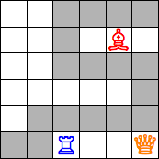
The game as a machine learning problem
Chess Snake Puzzles is a puzzle that mixes the game Snake and the rules of attack of Chess pieces.
The rules are the following:
  The snake can only move orthogonally.
  The snake cannot cross a chess piece.
  The snake cannot touch itself (even diagonally).
  In the result, each piece must attack an equal number of segments of the snake.
Our work involves trying to win this game by applying reinforcement learning algorithms to contribute for the agent’s knowledge of its environment and the rewards it can obtain by taking a specific action in a specific state.
We will start with a simplified version of the game (4x4 board, only trying to get to the final position) and progress to its complete and final version – including all rules and the appropriate size for the board.

Slide 3
Formulation of the problem as a reinforcement learning problem
State Representation:
  Pieces have a bitmap with the positions where it can attack the snake
  The Snake itself has a bitmap of the positions it already passed
  The board for each level of difficulty is stored in a dictionary in Python
Algorithms:
  Q-Learning
  SARSA
Rewards:
  +10 when reaching the final position while all the pieces attack the same number of positions
  -20 when reaching the end of the game (no possible moves) in a position that is not final
Operators:
  Up
  Down
  Left
  Right

Slide 4
References
https://www.youtube.com/watch?v=qhRNvCVVJaA
https://www.youtube.com/watch?v=mo96Nqlo1L8
https://deeplizard.com/l
https://www.geeksforgeeks.org/sarsa-reinforcement-learning/earn/video/mo96Nqlo1L8
https://www.youtube.com/watch?v=kaDEw5qMTLs&ab_channel=TheLastCode-Bender
https://www.gymlibrary.ml/#

Slide 5
Description of the work and tools
Jupyter Notebook: for iteractive computing
OpenAI Gym: for a user-friendly representation of the interaction of the actor and the environment during the development of the algorithms
PyGame: for a user-friendly representation of the puzzle
Q-Learning: to learn the value of an action in a particular state
SARSA: to learn a Markov decision process policy

Slide 6
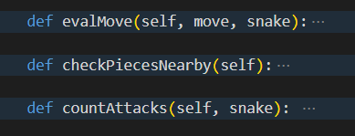
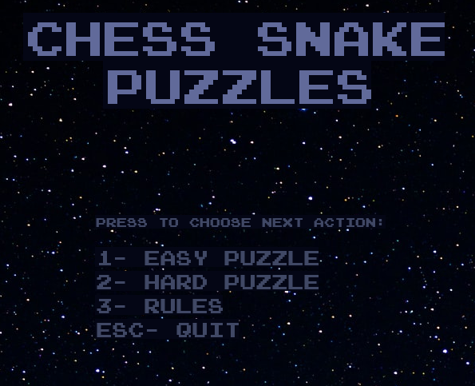
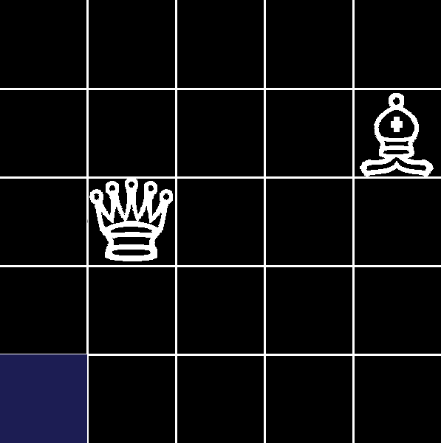
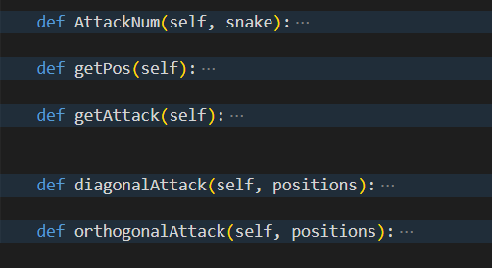
Work implemented
As we have already worked with this puzzle, we have the game logic implemented in Python.
The user interface is also already implemented with Pygame.

