Slide 1
FINAL PROJECT · VIBE CODING CEDIA 2026
Minería LATAM
Weekly press monitoring of illegal mining in Latin America
Carolina Viola Reyes · UTE, FDCAS · Santiago Joel Jumbo · UTPL, Exact and Natural Sciences
Project guide 03
Narration generated with an AI voice (ElevenLabs) and reviewed by the authors.
Vibe Coding CEDIA 2026 · Universidad UTE · UTPL
1 / 10
Notes:
COVER
NARRATION · ≈15 s · 30–40 words in English
Introduce the tool by name, say who is in the subgroup and which universities, and in one sentence what it solves.
Minería Latam monitors the press every week for news on illegal, informal and artisanal mining in Latin America. We are Carolina Viola Reyes and Santiago Jumbo, from U T E and U T P L in Ecuador.

Slide 2
FINAL PROJECT · VIBE CODING CEDIA 2026
The problem
News scattered across dozens of outlets, classified by hand with no shared criteria.
A CONCRETE EXAMPLE
“Informal mining” returned a story about employment.
Vibe Coding CEDIA 2026 · Universidad UTE · UTPL
2 / 10
Notes:
PART A · PRESENTATION (3 min in total)
THE PROBLEM · NARRATION · ≈35 s · 80–90 words
Describe the real task, who struggles with it and what it costs today. A concrete example beats a general figure.
Press coverage of illegal mining is scattered across dozens of outlets in several countries. Researchers spend many hours every week searching, reading and copying stories into a spreadsheet. Each person classifies them in their own way. The results cannot be compared and the work is hard to repeat. The search also brings noise. In our first week the Spanish keyword for informal mining returned a story about informal employment. This problem affects teachers, researchers and students who analyze the news media.

Slide 3
FINAL PROJECT · VIBE CODING CEDIA 2026
The tool
WHO USES IT
WHAT GOES IN
WHAT COMES OUT
Qualitative media research teams
36 keywords, 40 news sites
Coded CSV, dashboard and score
Vibe Coding CEDIA 2026 · Universidad UTE · UTPL
3 / 10
Notes:
THE TOOL · NARRATION · ≈30 s · 70–80 words
Who uses it, what goes in and what comes out. Name the project guide it builds on.
The tool is designed for teams doing qualitative media analysis. It is based on project guide three of the course. It receives thirty six keywords and a weekly date window. It searches only a list of forty authorized news sites. It delivers a file with each story coded in twelve variables. It also builds an interactive dashboard. And it keeps a history of precision scores for each keyword and each outlet.

Slide 4
FINAL PROJECT · VIBE CODING CEDIA 2026
How it works
1 · INPUT
2 · AI
3 · REVIEW
4 · RESULT
Weekly search
Claude Code codes
Person checks discards
Dashboard and score
A person decides.
Vibe Coding CEDIA 2026 · Universidad UTE · UTPL
4 / 10
Notes:
HOW IT WORKS · NARRATION · ≈40 s · 95–105 words
Walk through the four steps. Make clear what the AI does and what a person always decides.
The workflow has four steps. First a Python program searches and downloads the news of the week. It never downloads a known story twice. Then Claude Code reads each story from start to finish. It decides relevance, country, scope and themes according to our codebook. When it is unsure it records the doubt and explains why. Next the researcher reviews the discarded stories, the doubtful cases and the duplicates. Finally a program validates the file and builds the interactive dashboard. The A I recommends changes to the search. Only a person decides whether to apply them.

Slide 5
FINAL PROJECT · VIBE CODING CEDIA 2026
Evidence
30
6/6
0/2
stories coded, two weeks
discards hand-checked
useful for “mining Peru”
Pending: review of the 24 relevant stories.
Vibe Coding CEDIA 2026 · Universidad UTE · UTPL
5 / 10
Notes:
EVIDENCE · NARRATION · ≈35 s · 80–90 words
Figures from your own tests. Separate what was checked from what is still a proposal.
We tested the system over two weeks. We coded thirty news stories from twelve outlets. Twenty four were relevant. Six were discarded as noise, each with a written reason. Our team checked those six discards by hand. The precision score detected concrete noise. The keyword mining Peru brought two stories and neither was about illegal mining. This much is verified. The twenty four relevant stories have not yet been compared with a human review. No keyword exceeds five stories per week. That is why confidence is still low.

Slide 6
FINAL PROJECT · VIBE CODING CEDIA 2026
Limits and responsible use
WHAT IT DOES NOT DO
DATA AND PRIVACY
NEXT STEP
No replacement for researchers
Published news only
More weeks, early classifier
Vibe Coding CEDIA 2026 · Universidad UTE · UTPL
6 / 10
Notes:
LIMITS AND RESPONSIBLE USE · NARRATION · ≈25 s · 55–65 words
What it does not do, how it protects data and the next step (Moodle or another LMS, or the next AI-native level).
The tool does not replace the judgment of the researcher. It does not search beyond the forty authorized sites. Some sites with paywalls return empty text. It works only with published news. No access key is stored in public files. As a next step we propose adding more weeks of data and testing an early relevance classifier.

Slide 7
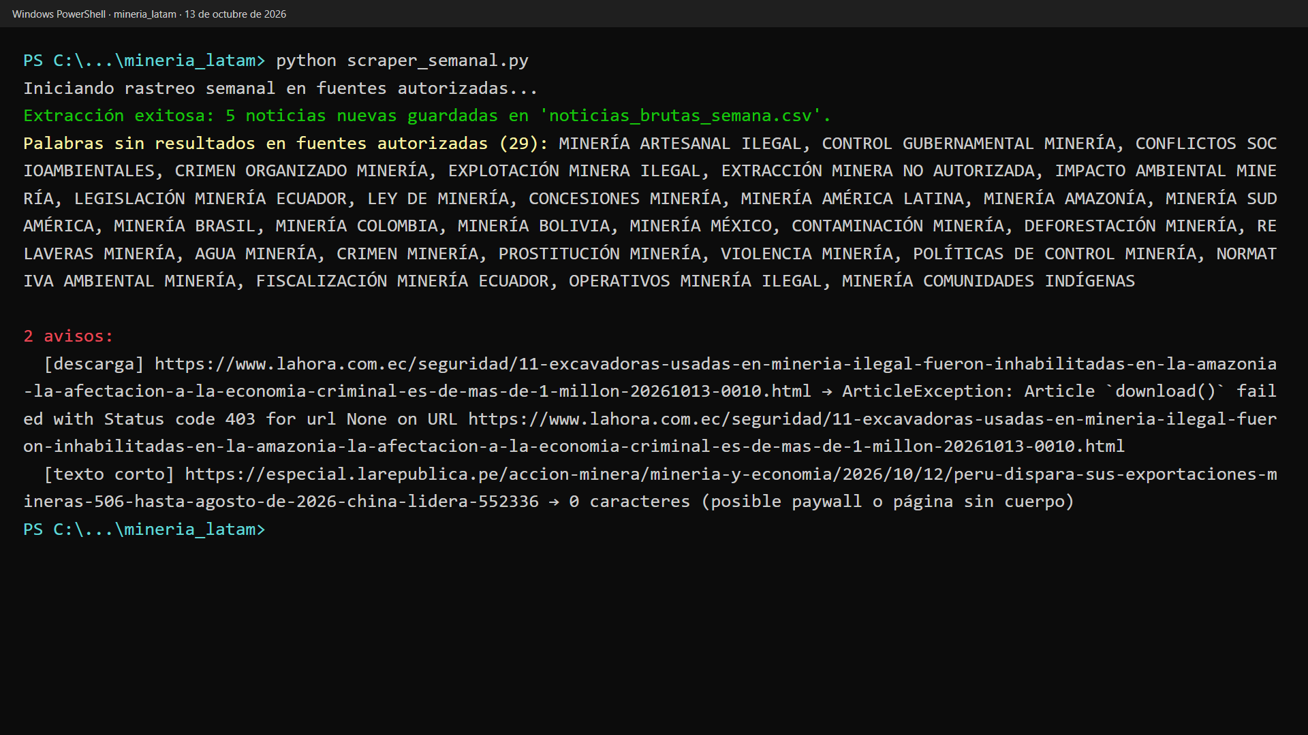
FINAL PROJECT · VIBE CODING CEDIA 2026
Demo · Input
Real run on October 13: 5 new stories (Spanish interface)
Vibe Coding CEDIA 2026 · Universidad UTE · UTPL
7 / 10
Notes:
PART B · DEMO (2 min in total)
NARRATION · ≈30 s · 70–80 words in English
Show the start or input screen. Say what the person enters and why.
Now let us see the tool on screen. The interface and the data are in Spanish. The researcher runs the search program with a single command. The program goes through the thirty six keywords across the forty authorized sites. This is a real run from October thirteenth. It saved five new stories. Then it lists the keywords that returned no results. It also shows each error with its cause, such as a site that blocked the download.

Slide 8
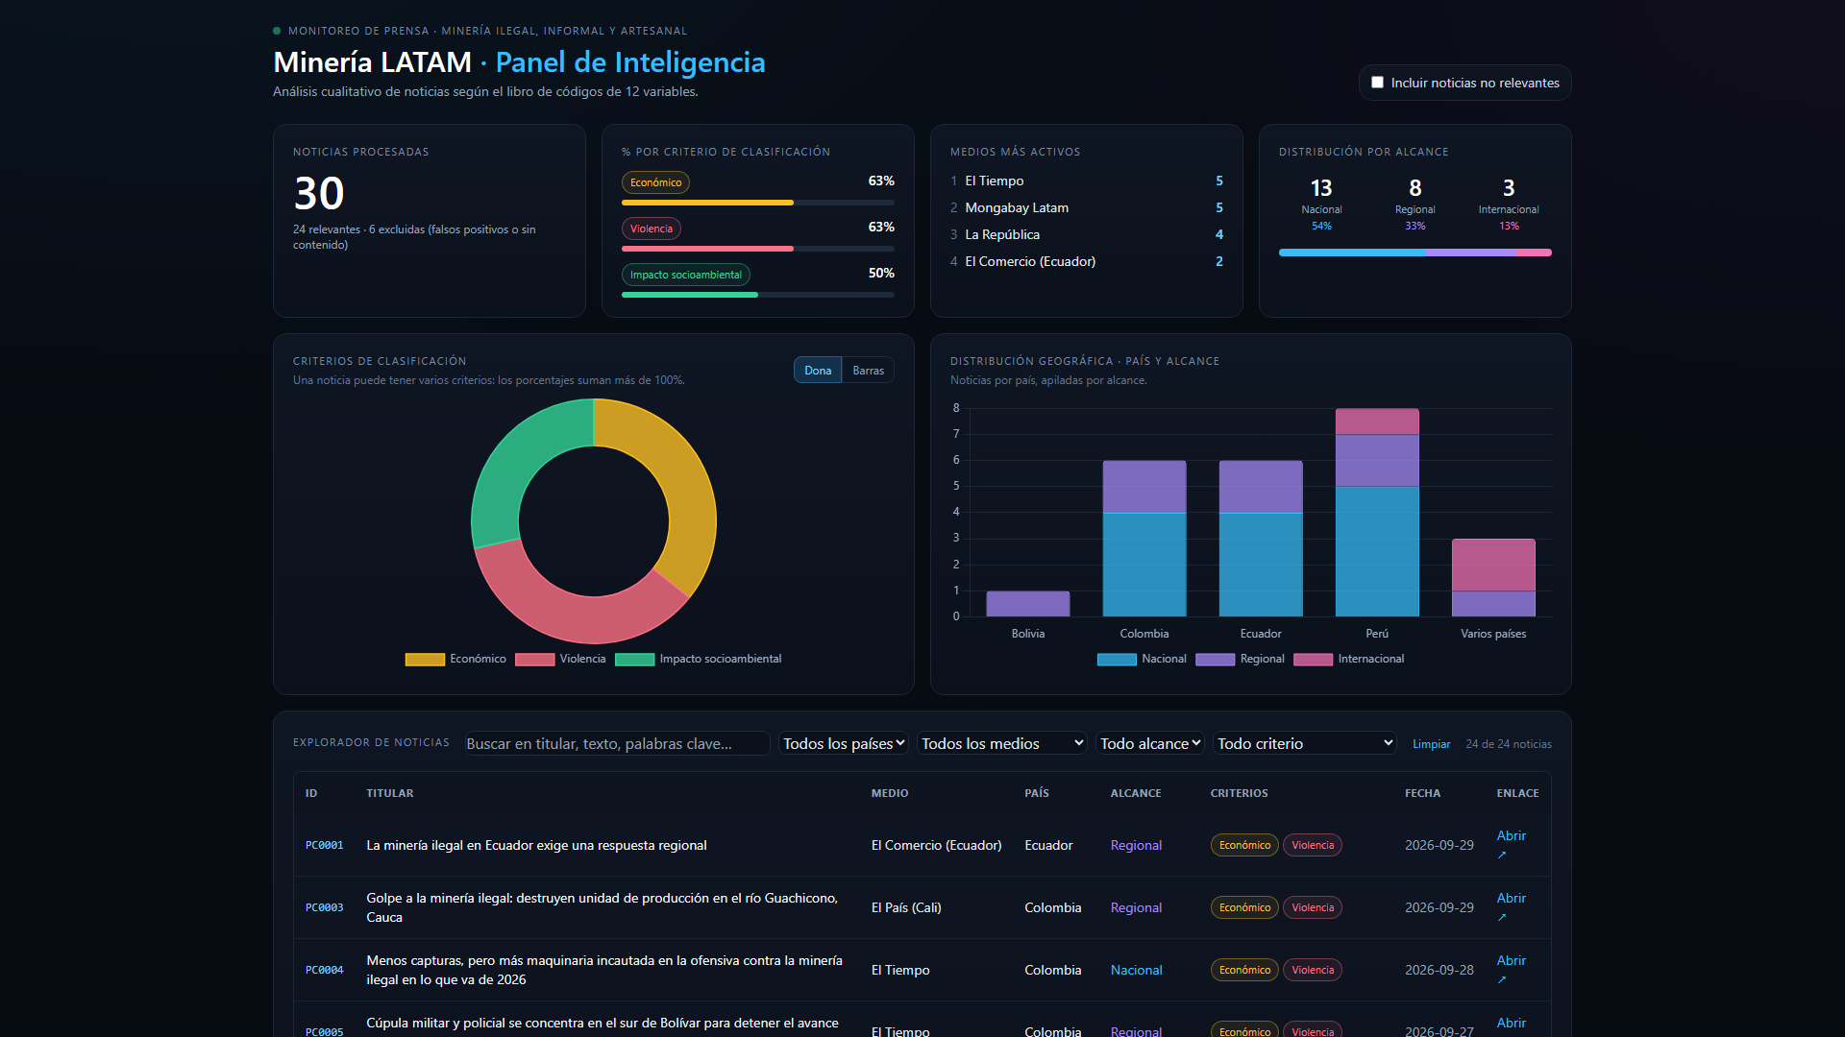
FINAL PROJECT · VIBE CODING CEDIA 2026
Demo · Result
Dashboard: themes, outlets and countries of 24 relevant stories
Vibe Coding CEDIA 2026 · Universidad UTE · UTPL
8 / 10
Notes:
NARRATION · ≈35 s · 80–90 words in English
Show the main result. Point to where to look on the screenshot and what it means.
This is the main result. The dashboard summarizes the relevant stories from the two weeks. At the top you see the total, the share of each theme and the most active outlets. The economic and violence themes each appear in fifteen stories. The social and environmental impact theme appears in twelve. The country chart shows that Peru leads with eight stories. Ecuador and Colombia follow with six each. Clicking any row opens all twelve variables and the full text of the story.

Slide 9
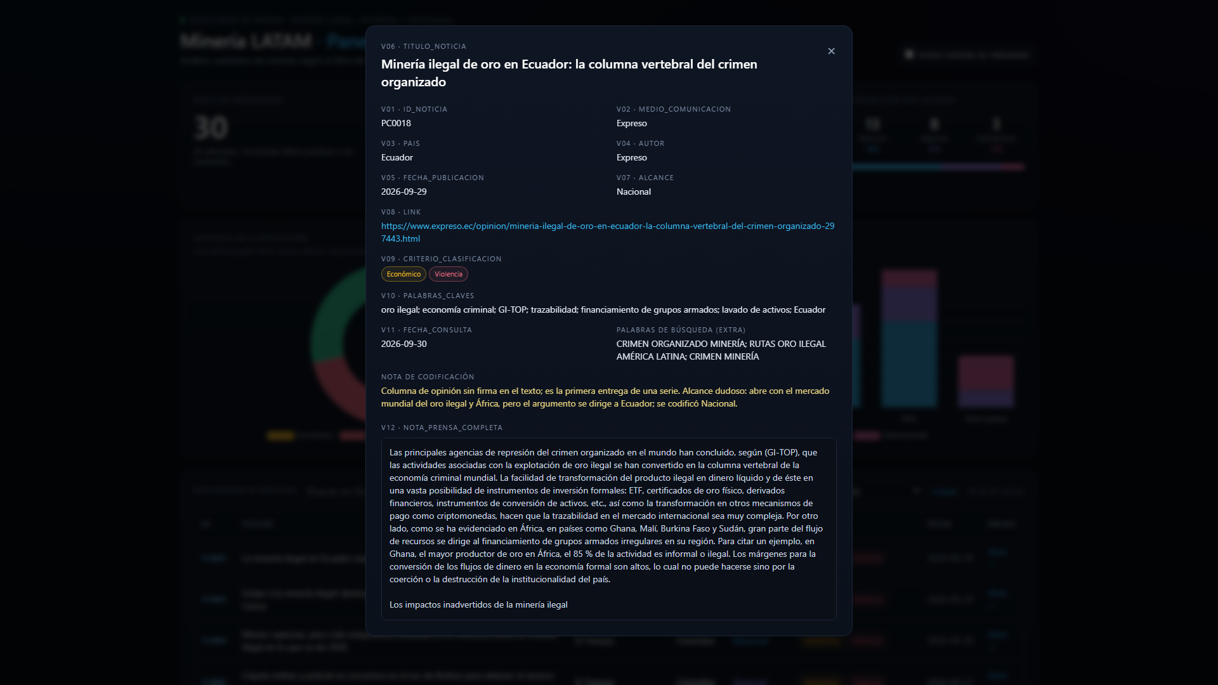
FINAL PROJECT · VIBE CODING CEDIA 2026
Demo · Review and delivery
Story record: 12 variables and coding note
Vibe Coding CEDIA 2026 · Universidad UTE · UTPL
9 / 10
Notes:
NARRATION · ≈30 s · 70–80 words in English
Show where the person reviews, approves or exports. Close the demo with the test that backs it.
This is where review and decisions happen. Each story keeps a coding note with the reason for every doubtful decision. Here the A I was unsure about the scope and explained why. The researcher reads the note and can correct the file. If a cell is empty or a link is repeated the dashboard is not generated. Then the system reports precision by keyword and by outlet. It proposes five changes at most. None is applied without human approval.

Slide 10
FINAL PROJECT · VIBE CODING CEDIA 2026
Comparable coding and a search that improves
Next step: more weeks and other topics.
caroviola79-gif.github.io/vibe-coding-proyecto-final
Carolina Viola Reyes · UTE, FDCAS · Santiago Joel Jumbo · UTPL, Exact and Natural Sciences
Vibe Coding CEDIA 2026 · Universidad UTE · UTPL
10 / 10
Notes:
CLOSE · NARRATION · ≈25 s · 55–65 words
What changes in the subgroup's work, the next step and a short invitation. End on a complete sentence.
With this tool press monitoring becomes less manual and more comparable. Each week we get stories coded with the same criteria and a search that is reviewed with data. Our next step is to add more weeks to build confidence. We invite you to adapt it to another topic, such as illegal logging or illegal fishing. Thank you.

