Slide 1
Evaluation
2018/03/08

Slide 2
Why evaluation is to be needed
Evaluation for inter-model
Performance of the model
Finding optimal hyper-parameter
Evaluation for intra-model(Each algorithm)
To show your model is not overfitted, you can use cross validation
Compare with mean testing accuracy among each algorithm.

Slide 3


Performance evaluation

Slide 4
Performance evaluation measures
Accuracy
Sensitivity
Specificity
Precision
F-1 score(precisio과 recal의 관계)
ROC curve(x축은 1-specificity y축 sensitivitiy)
AUC = random case까지의 면적

Slide 5
Performance evaluation
Confusion matrix
Prediction Class
 | Class = 0 | Class = 1
Class = 0 | TP | FN
Class = 1 | FP | TN
Actual
Class

Slide 6
Data split
Training set
Validation set
Test set
7
3

Slide 7
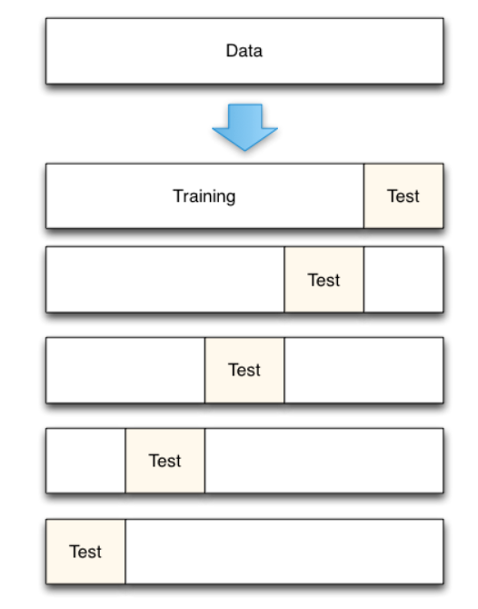
Cross Validation
5-Fold cross validation
For each iteration, test data is changed and calculate each test accuracy
e.g.
1-iter : fold 5 is test data
2-iter : fold 4 is test data…
we get averaging each test accuracy for final test accuracy

Slide 8
Data split
Training set : train for model
Validation set : Optimize or test for model before applying model to test set
Test set : test for model -> Don’t use this data before calculating test accuracy!

Slide 9
Caution!
Cross validation is always not give a best solution
It only helps to find general(robust) parameter when you choose hyper-parameter, but it is not always optimal.

