Slide 1
Regression
Day 3
2018/03/12

Slide 2
Objective
Regression is a statistical processes for estimating the relationships among variables

Slide 3
Linear Regression

Slide 4
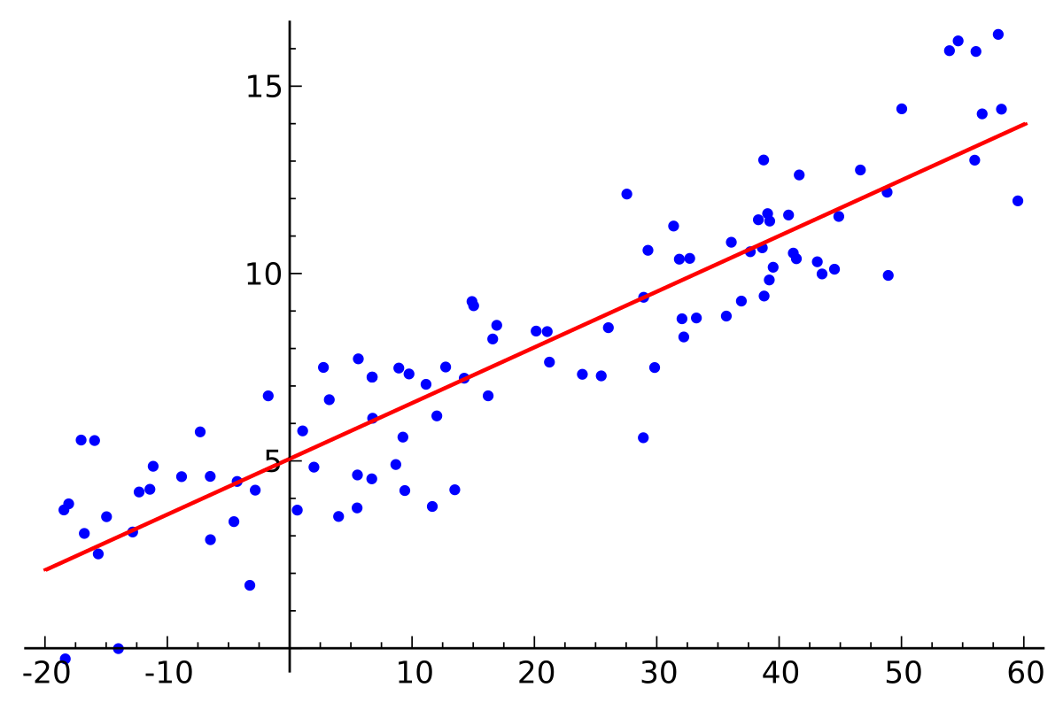
Linear regression
It has continuous input and output value
It shows the relationship between the dependent and independent variable(s)
It doesn’t have a hyper-parameter

Slide 5
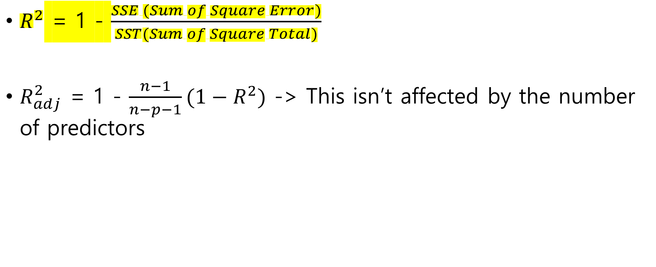
Performance measure
$R^{2}$ = 1 - $\frac{SSE (Sum of Square Error)}{SST(Sum of Square Total)}$
$R_{adj}^{2}$ = 1 - $\frac{n−1}{n−p−1}(1−R^{2})$ -> This isn’t affected by the number of predictors

Slide 6
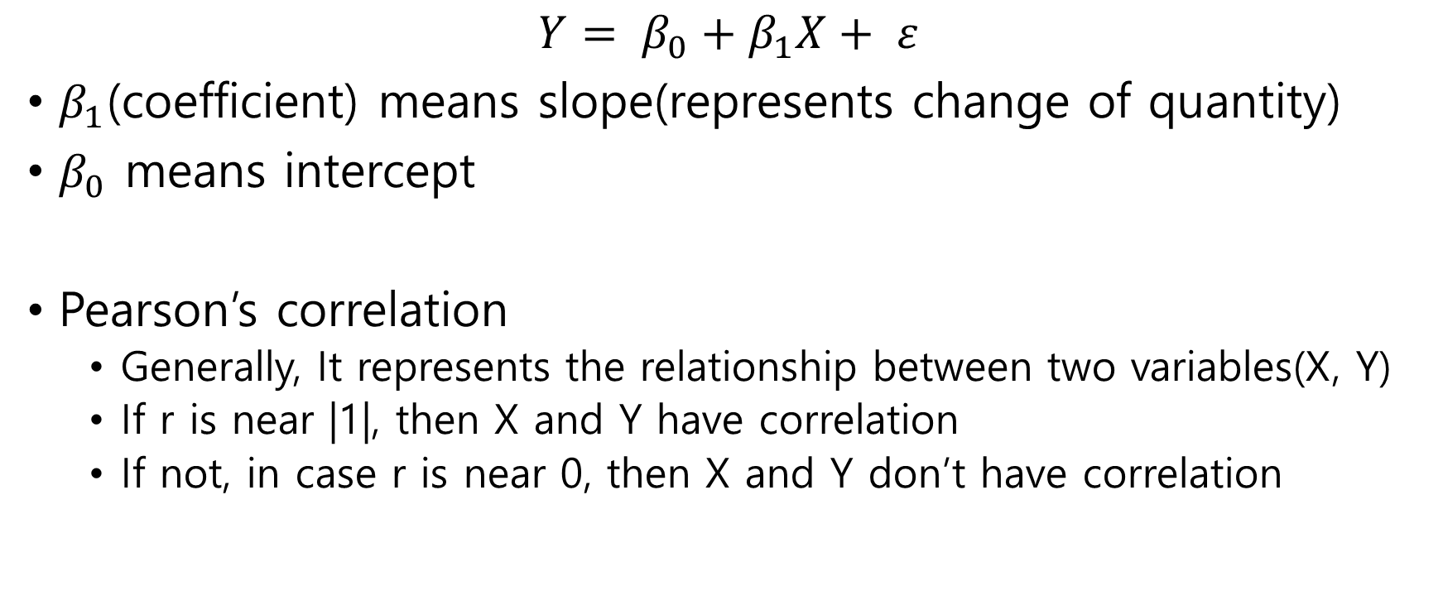
Interpretation
$$Y= β_{0}+β_{1}X+ ε$$
$β_{1}$(coefficient) means slope(represents change of quantity)
$β_{0}$ means intercept
Pearson’s correlation
Generally, It represents the relationship between two variables(X, Y)
If r is near |1|, then X and Y have correlation
If not, in case r is near 0, then X and Y don’t have correlation

Slide 7
Logistic Regreesion

Slide 8
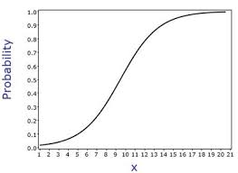
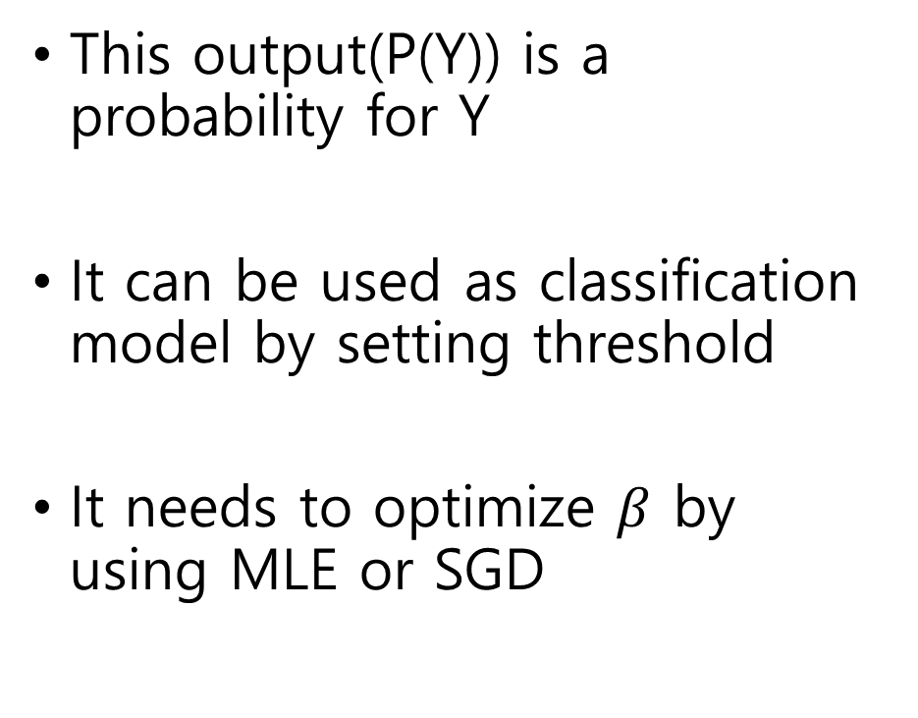
Logistic regression
This output(P(Y)) is a probability for Y
It can be used as classification model by setting threshold
It needs to optimize $β$ by using MLE or SGD

Slide 9
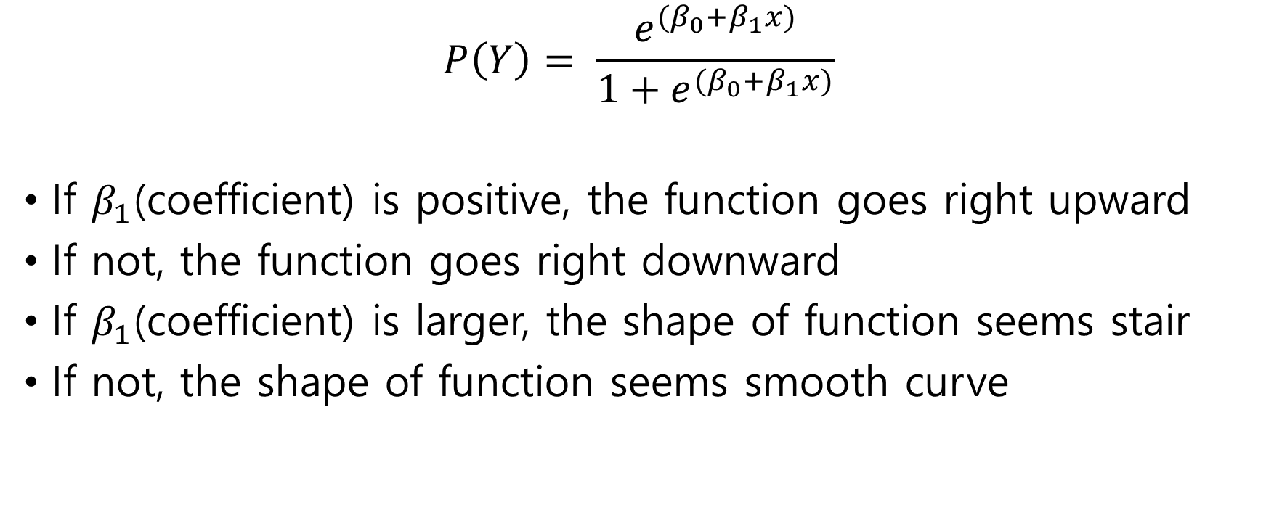
Interpretation
$$P\left(Y\right)= \frac{e^{(β_{0}+β_{1}x)}}{1+e^{(β_{0}+β_{1}x)}}$$
If $β_{1}$(coefficient) is positive, the function goes right upward
If not, the function goes right downward
If $β_{1}$(coefficient) is larger, the shape of function seems stair
If not, the shape of function seems smooth curve

