Slide 1
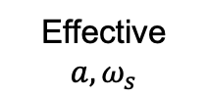
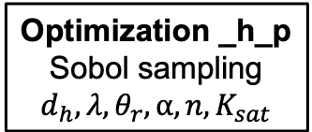
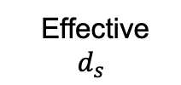
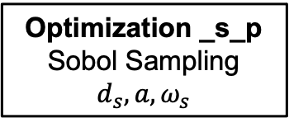
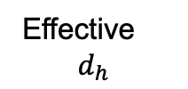
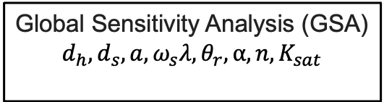
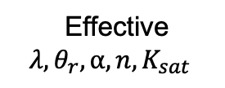
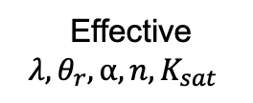
Optimization _h_p
Sobol sampling
$$d_{h}, {λ, θ}_{r}, α, n,K_{sat}$$
Optimization _c_np
HYDRUS internal optimization
Effective $$d_{h}$$
Effective
$${λ, θ}_{r}, α, n,K_{sat}$$
Effective
$${λ, θ}_{r}, α, n,K_{sat}$$
Optimization _s_p
Sobol Sampling $$d_{s}, a, ω_{s}$$
Effective $$a, ω_{s}$$
Effective $$d_{s}$$
Application to _h_np
no pumping, same parameters
Application to _s_np
no pumping, same parameters
Global Sensitivity Analysis (GSA)
$$d_{h},d_{s}, a, ω_{s}{λ, θ}_{r}, α, n,K_{sat}$$
Model performance (NSE, RMSE, KGE, p-value) and visual assessment

Slide 2
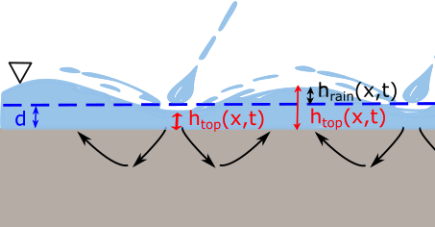
(a)
(b)

