Slide 1
Instruction
Fetch
Instr. Decode
Reg. Fetch
Execute
Addr. Calc
Memory
Access
Write
Back
Stall Controller
stall control
IF/ID
ID/EX
EX/MEM
Stage MEM
MEM/WB
Stage IF
Stage ID
Stage EX
PC Reg
I-Cache
Register
File
D-Cache
ALU
Memory
data forwarding
5-Stage Pipeline of RISC-V CPU by Zhou Fan

Slide 2
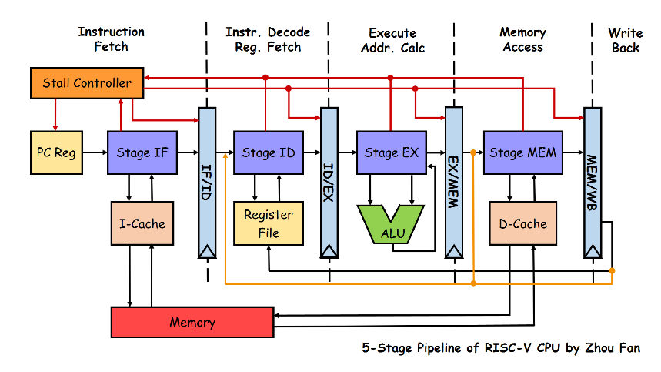
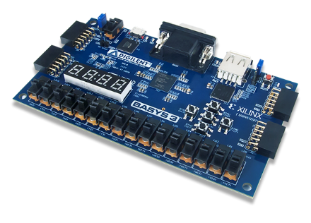

Memory
Simulator
UART
Communication
Module
USB Cable
FPGA
PC

Slide 3
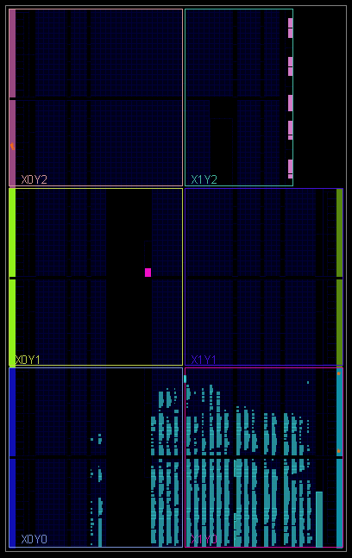
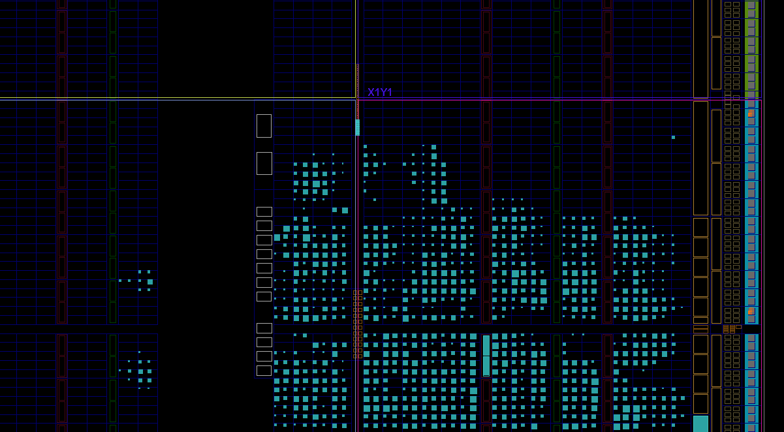
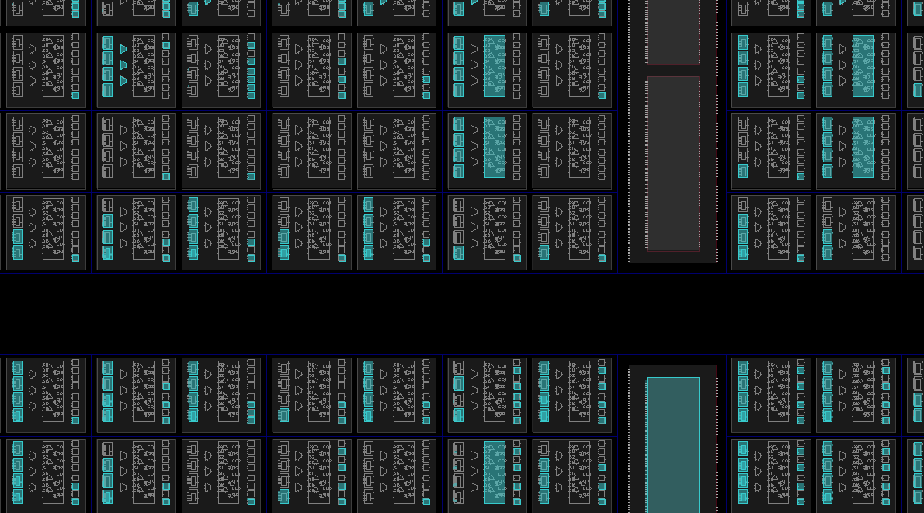

Slide 4
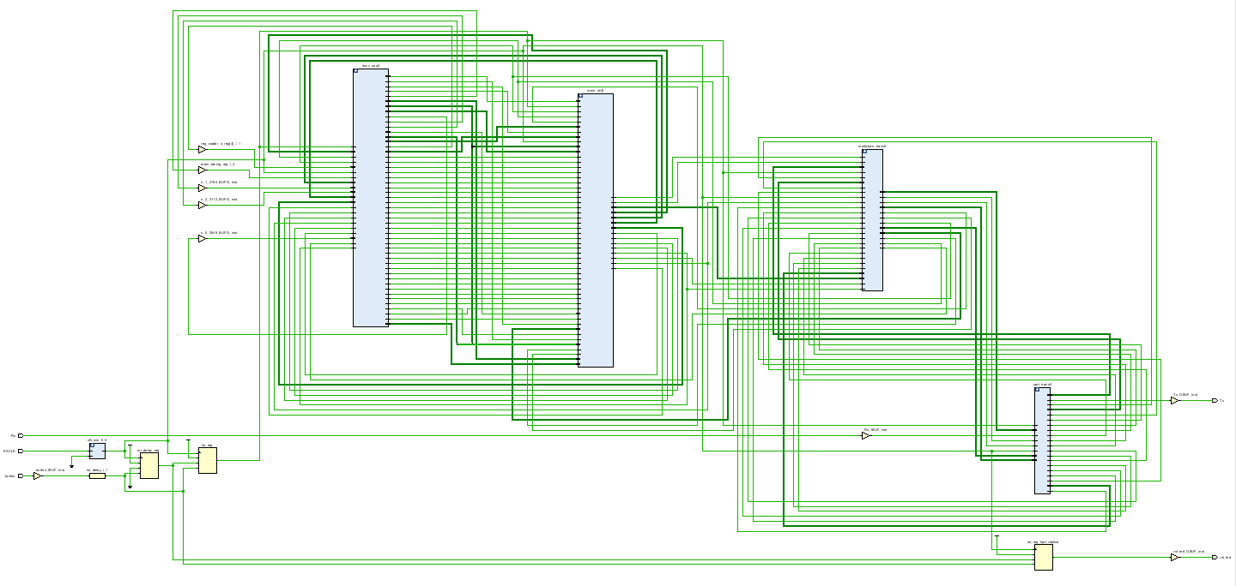
CPU
Message
Decoder
Encoder
Memory Controller
UART Module

