Slide 1
ECE369A LAB1 Verilog Recap

Slide 2
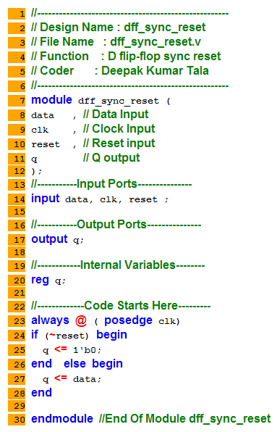
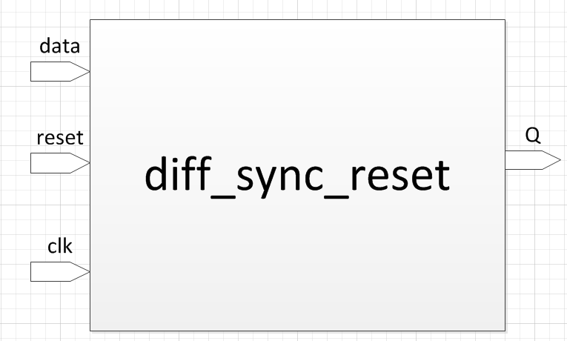
Verilog
Hardware Description Language
C-like syntax
Used for building digital circuits.

Slide 3



Verilog Basics (Inputs/Outputs/Wires)
Declaration
Length
Type

Slide 4
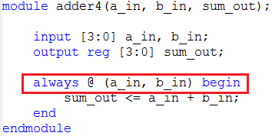
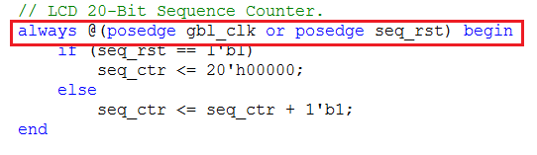
Verilog Basics (Sensitivity List)
What is the module sensitive to? -- Its inputs.
Async/Sync, combinational/sequential

Slide 5
Verilog Basics (Assignments)
Blocking (Use this except for assign)
A <= 1;
Non-Blocking
A = 1;

Slide 6
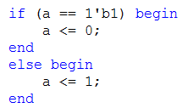
Verilog Basics (Conditional)
if (condition) begin
statements;
end

Slide 7
Verilog Basics (Testbench)
Testbench is a dummy module that does not have inputs/outputs.
Testbench instantiates the module to be tested.
The input and timing is specified in testbench.
The output can be viewed in ISIM wave viewer or by $display function.

Slide 8
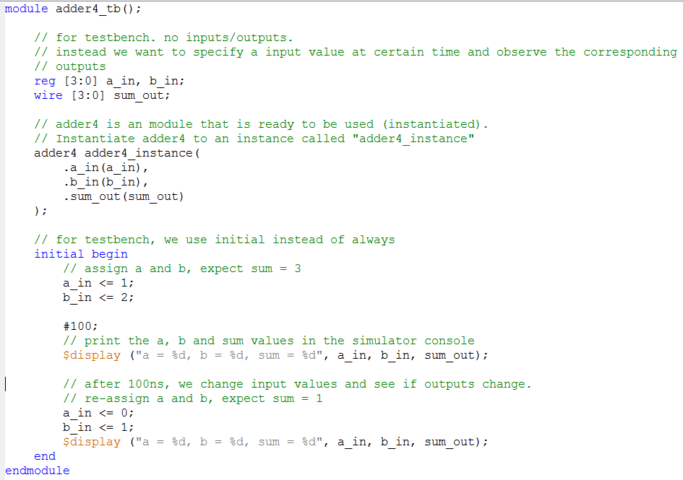
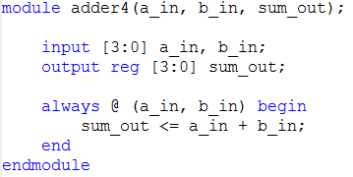
Testbench Example
Instantiate adder4
Test inputs

Slide 9
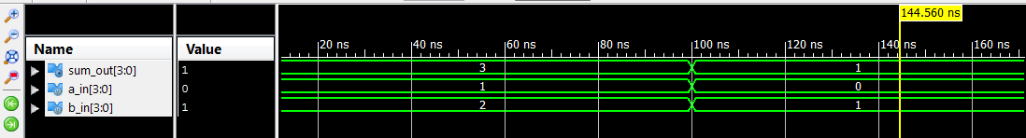
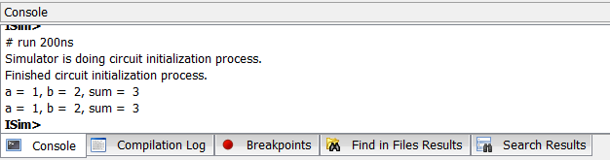
Testbench Example

