Slide 1
Functional Neuroimaging Analysis in Python
Goals:
Understand how neuroimaging data is stored and how it helps us perform analysis
Gain familiarity with the issues surrounding fMRI and how we combat it in pre-processing and analysis
Learn how to analyze neuroimaging data working from beginning to end
Get comfortable with Python as a tool for analysis and visualization of data

Slide 2
Objective
To perform an intra-network functional connectivity analysis of the Default Mode Network in individuals with Schizophrenia and compare them to Controls

Slide 3
The Plan
Part 1: Working with Neuroimaging Files in Python
Part 2: The UCLA Phenomics Dataset and BIDS
Part 3: Data Pre-processing
Part 4: Introduction to Nilearn and Image Manipulation
Part 5: Confounds in your Data
Part 6: Parcellating your Data
Part 7: Functional Connectivity Analysis

Slide 4
Ask Questions!

Slide 5
Data Organization
Neuroimaging requires working with a large amount of files with important but extremely variable metadata:
Data Modality
T1, T2, DWI, Resting/Task, Field Maps, QSM, ASL …
Acquisition Characterization
T2 FLAIR, Multi-shell, Single-shell, TOPUP, GRAPPA,
IPAT, Multi-shot, phase encoding, partial fourier, TR, TE, TI,
EES, total readout time, voxel spacing, voxel dimensions, FoV,
manufacturer, MR model, slice timing, flip angle, slice thickness,
dwell time, phase encoding steps, multi-channel coil configuration,
magnetic field strength, multi-band acceleration, # gradients, b-value shells,
Echo planar, spin echo, gradient echo and MORE ...
Notes:
Somehow we’re expected to manage all this information held on by the images we acquire and at the same time run multiple analysis through this data. In addition you might want to share this data with other researchers if you’re into open science or with colleagues. Or you might be in a position where you get data from someone else, how do you manage?
This becomes especially problematic when sharing data or coming back to your data months later if organization was not a priority upon obtaining the data…

Slide 6
Data Organization
Brain Imaging Data Structure (BIDS)
Standardization of imaging data organization
Maintains important meta-data related to analysis
Tools available that take advantage of this structure
Notes:
Luckily with a bit of work there’s a solution for this sort of problem called BIDS.
BIDS is an organizational principle that provides a template for storing your data in a principled manner while also providing structure for storing all the metadata listed earlier.

Slide 7
The BIDS Hierarchy - Quick Glance
Dataset
*_bold.json
sub-001
sub-002
sub-01_*_bold.json
ses-01
ses-02
ses-03
sub-01_ses-01*_bold.json
anat
func
fieldmap
dwi
1_bold.nii.gz
2_bold.nii.gz
1_bold.json
2_bold.json
Notes:
I won’t bore you with too much of the details here, but the general idea is there is a hierarchy of organization. If you structure your data this way then it’s much easier to identify files and in addition there’s this thing called BIDSAPPS which use data formatted in this structure to run sophisticated pipelines very easily.

Slide 8
BIDS-apps
Containerized applications that run on BIDS data structures:
FMRIPREP
MRIQC
CIFTIFY-FMRIPREP
SPM
MRTrix
Freesurfer
And more…!
Notes:
One of the biggest advantages of the BIDS data structure is the existence of BIDS-apps. These are applications which are ‘containerized’ meaning with just a piece of software called docker you can run complex pipelines without installing additional tools like freesurfer/fsl/afni/mrtrix/slicer - meaning you won’t break your system by accident.
All these software pipelines assume you have a dataset in the BIDS structure. I could talk about BIDS for awhile but it’s meaningless unless you actually get to play around in a dataset. So we’ll be walking through an actual BIDS dataset and using a python-based tool called PyBIDS to easily explore our dataset using Python.

Slide 9
Pre-processing

Slide 10
One more step: Pre-processing
Data needs to be harmonized before analysis
Issues we need to account for:
We have whole head images, we just want the brain
fMRI image and T1 image are not aligned
fMRI is distorted due to changing magnetic field in some areas of brain
Participants move in scanners, fMRI image isn’t aligned to itself
Movement actually influences the fMRI signal, we want “brain signals” not motion signals!
All subject images aren’t aligned to each-other, need to warp images to a template (we need some sort of normalization)
Notes:
So great you’ve acquired some nice MR images, put in some work organizing your data into a BIDS dataset. Now you finally want to play around with some data and get some science done.
However there is one more step before we actual perform analysis. That is, pre-processing our data so that it’s ready to analyze.
Explain list of issues
This seems like a lot of issues to account for, here’s a visual for what it takes to get the data ready for analysis.

Slide 11
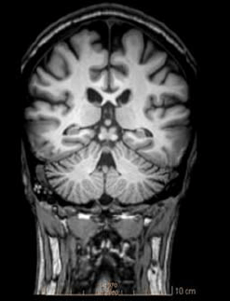
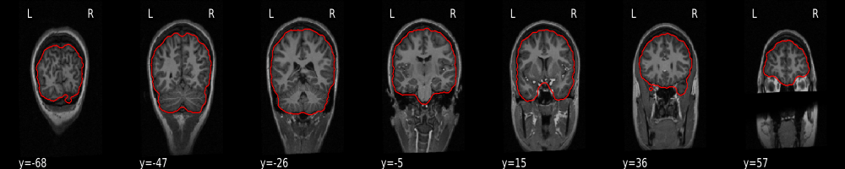
Visual Guide to Pre-processing (T1/fMRI)
Normalization (MNI152)
T1 Image
Brain Extraction
T1 Pre-processing
Notes:
fMRI pre-processing must include:
EPI skull strip/brain mask
Motion correction
SDC
EPI → T1 registration
EPI → MNI Normalization
Confound regression
Next slide should talk a bit about confound regression.

Slide 12
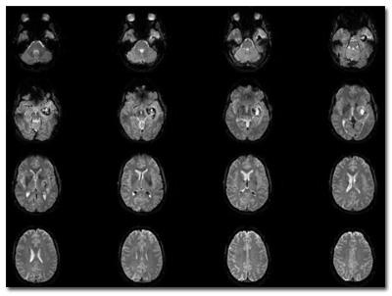
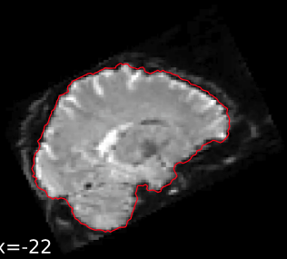
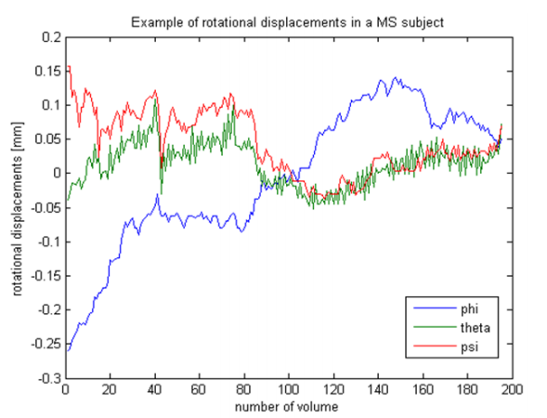
Brain Extraction
Motion Correction
Raw fMRI
fMRI
Preprocessing
HOW I DO?
Susceptibility Distortion Correction
Alignment to T1 image
Confound Regression
MNI152 Transformation

Slide 13
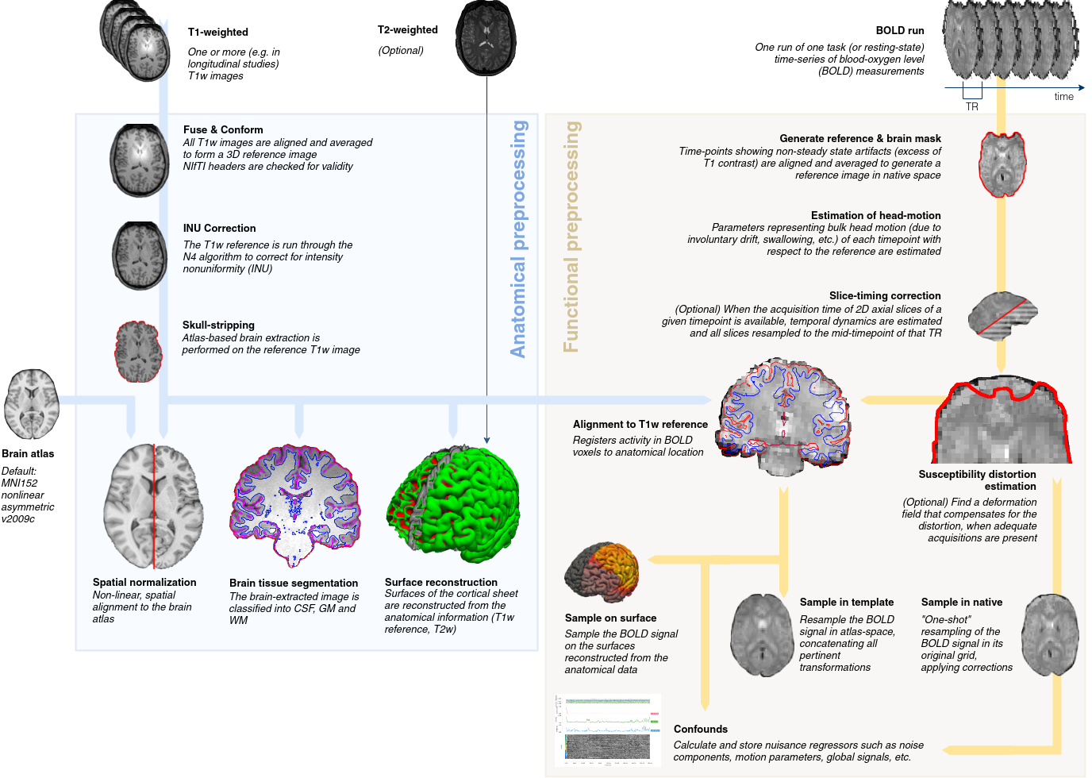
FMRIPREP
If your data is in a BIDS structure (it better be)...
Notes:
Luckily for you this isn’t a pre-processing course, so we won’t dive into detail, but instead we’ll rely on a BIDS-app called FMRIPREP.
FMRIPREP does all of the above steps (minus the confound regression which you have control over) for you using the most up to date techniques.
We won’t run FMRIPREP here from scratch since that takes around 24hrs per person, but instead we will use pre-generated outputs, since thats what we’ll perform analysis on.
Does everything AND MORE!!!

Slide 14
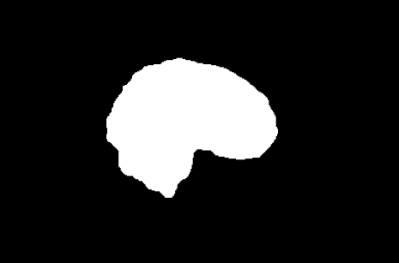
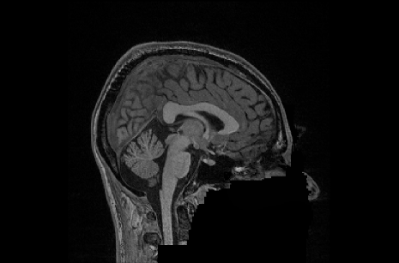
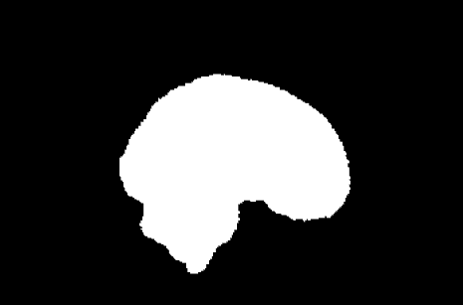
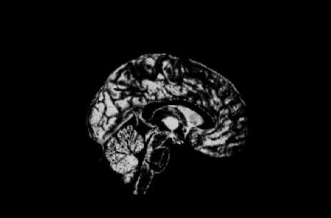
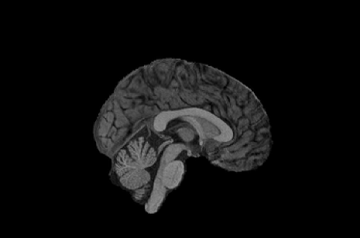
FMRIPREP volumetric outputs (anatomical)
Native (T1w) Space
sub-xxxxx_T1w_brainmask.nii
sub-xxxxx_T1w_preproc.nii
MNI (Normalized) Space
sub-xxxxx_T1w_space-
MNI152Lin2009cAsym_
brainmask.nii.gz
sub-xxxxx_T1w_space-
MNI152NLin2009cAsym_
class-(CSF/GM/WM)_
probtissue.nii.gz
sub-xxxxx_T1w_space-
MNI152Lin2009cAsym
_preproc.nii
Additional File:
sub-xxxxx_T1w_..._warp.h5
Notes:
These are the base outputs to fmriprep

Slide 15
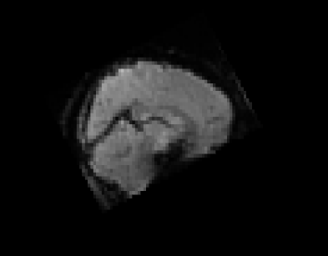
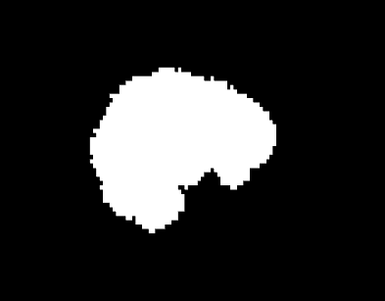
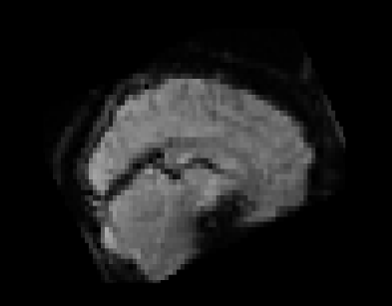
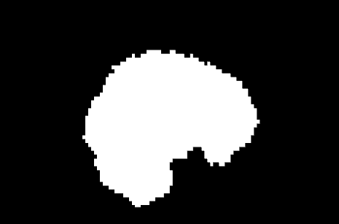
FMRIPREP volumetric outputs (functional)
Native (T1w) Space
Sub-xxxxx_task-xxxx_
bold_space-T1w_
preproc.nii.gz
Sub-xxxxx_task-xxxx_bold
_space-T1w_
brainmask.nii.gz
MNI (Normalized) Space
Sub-xxxxx_task-xxxx_
bold_
space-MNI152NLin2009cAsym_
preproc.nii.gz
Sub-xxxxx_task-xxxx_
bold_
space-MNI152NLin2009cAsym_
brainmask.nii.gz
Additional File:
sub-xxxxx_task_..._confounds.tsv

Slide 16
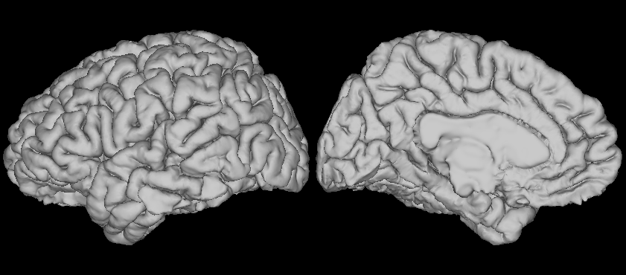
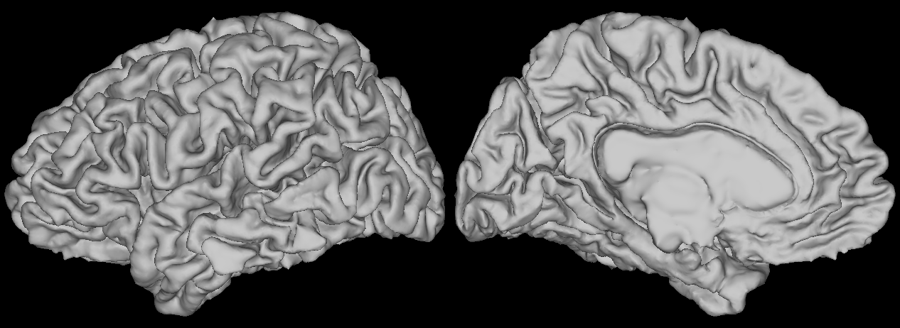
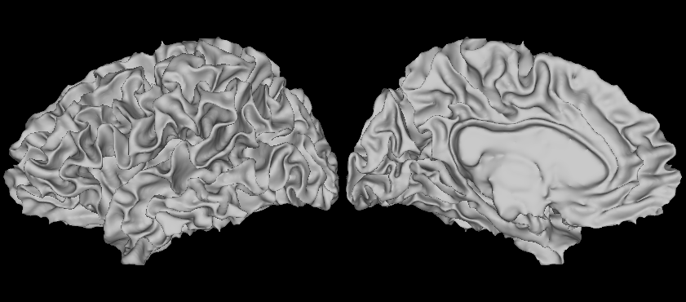
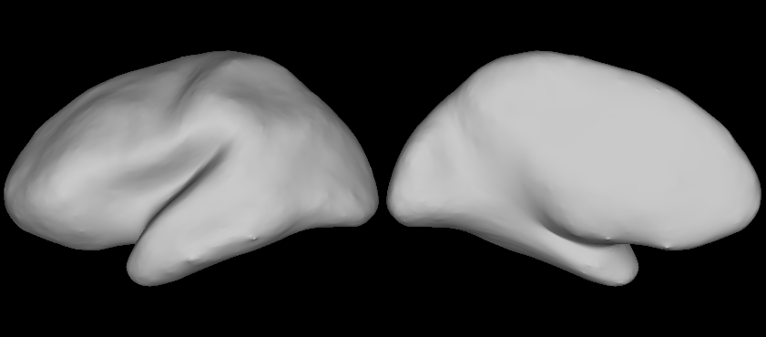
FMRIPREP surface outputs (anatomical)
sub-xxxxx_T1w_pial.(L/R).surf.gii
sub-xxxxx_T1w_midthickness.(L/R).surf.gii
sub-xxxxx_T1w_smoothwm.(L/R).surf.gii
sub-xxxxx_T1w_inflated.(L/R).surf.gii
Notes:
These outputs are very relevant once you get into more sophisticated analysis, however for the purposes of our course we’ll use them for visualization purposes but not actual analysis.
We also won’t get into functional outputs for surface files since those are outside the scope of our workshop and open up a new world of imaging file-types like CIFTI/GIFTI/shape files/metric files etc.. but if you’re interested check out the connectome-workbench project!

Slide 17
Confounds

Slide 18
CONFOUND IT ALL!!!
Movement is the enemy of neuroimagers:
In task-based fMRI, if participants move during task-relevant moments
Get a huge false task-related signal that’s actually due to motion!
In resting-state fMRI, movement can induce false correlations between brain regions
Solving for this involves modelling our fMRI signal to be comprised of true brain signal and confounder signals.
Our goal is to remove the confounder signals and hopefully acquire something closer to the true signal.
Notes:
One more step before we get into actual analysis of our data, and that is confound regression or nuisance regression.
Ideally when we analyze our fMRI data we’d like our data to represent the BOLD signal which is hopefully proxy to the underlying activation of neurons.
However, fMRI is a rather slow process, it takes around 2 seconds to acquire a single image, and during those 2 secondsish people can move and smear the signal around. This is a problem and shows up in two different ways in our analyses:
Task → false activations
Rest → false correlations
So it’d be nice to remove this confound from our data before we analyze it and we can do this through confound/nuisance regression.

Slide 19


