Slide 1
Better research by better sharing
Introduction to Open Science,
FAIR and Research Data Management
Tomasz Zieliński and Andrew Romanowski bio_rdm@ed.ac.uk

Slide 2
Open Science
Open science is the movement to make scientific research (including publications, data, physical samples, and software) and its dissemination accessible to all levels of an inquiring society, amateur or professional.
Open science is transparent and accessible knowledge that is shared and developed through collaborative networks.
Open Science represents a new approach to the scientific process based on cooperative work and new ways of diffusing knowledge by using digital technologies and new collaborative tools

Slide 3
Open Science
Transparency in experimental methodology, observation, and collection of data
Public availability and reusability of scientific data
Public accessibility and transparency of scientific communication
Using web-based tools to facilitate scientific collaboration

Slide 4
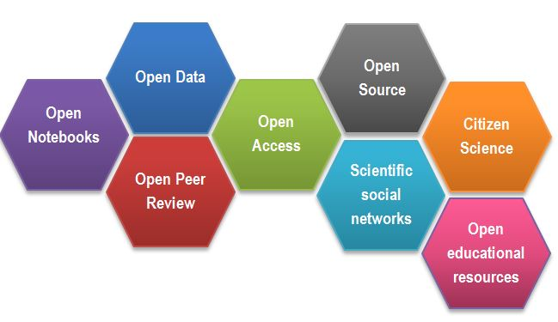
Open Science

Slide 5
Open Science Motivation: Money
Scientific knowledge is a product of social collaboration and its ownership belongs to the community.
From an economic point of view, scientific outputs generated by public research are a public good that everyone should be able to use at no cost.
€10.2bn lost every year cause of not accessible data (plus addition 16 bn if accounting for re-use and research quality)

Slide 6

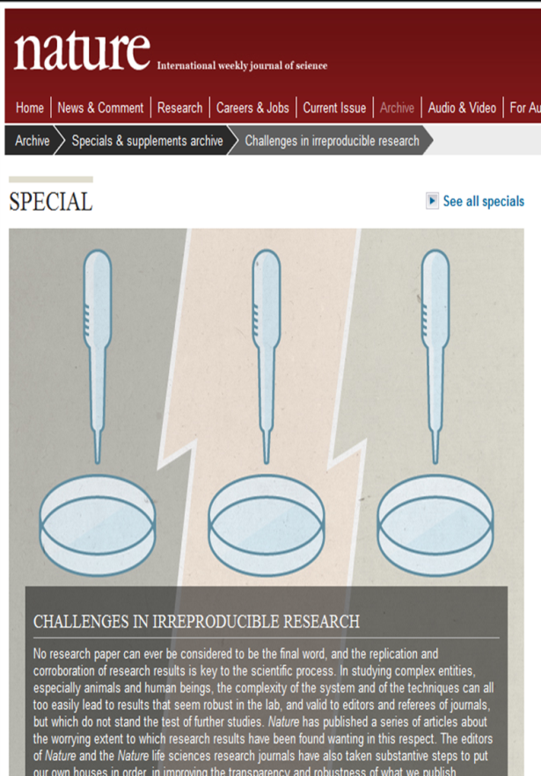
Open Science Motivation: Reproducibility

Slide 7
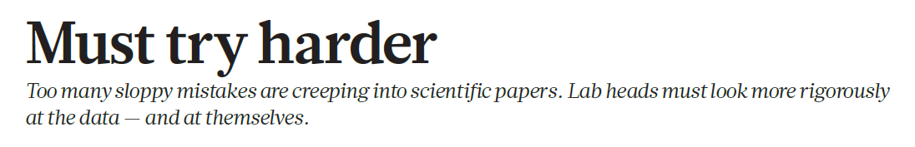
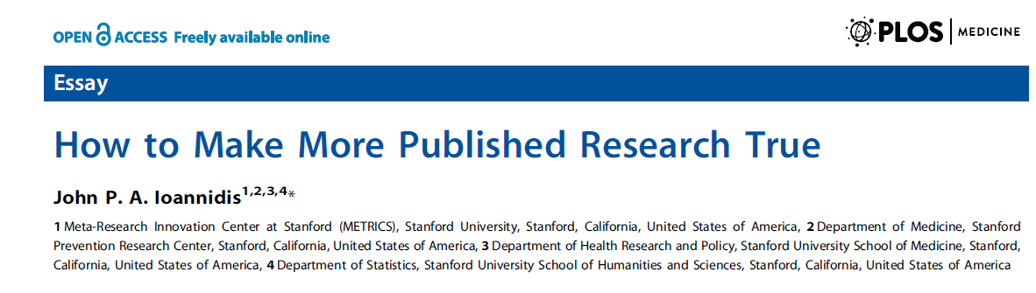
Open Science Motivation: Reproducibility

Slide 8
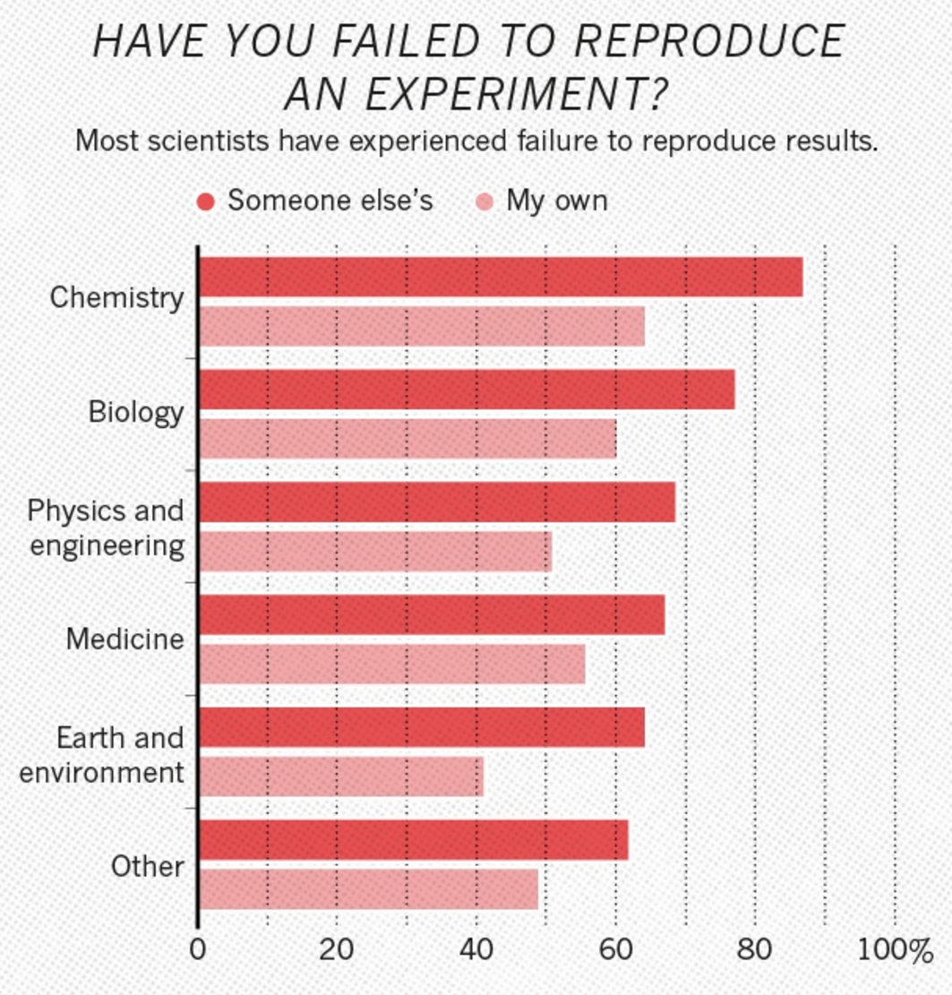
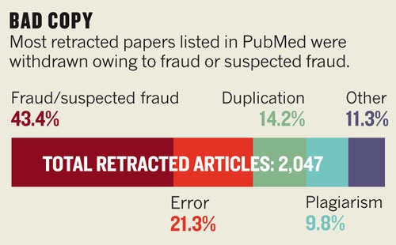
Open Science Motivation: Reproducibility

Slide 9
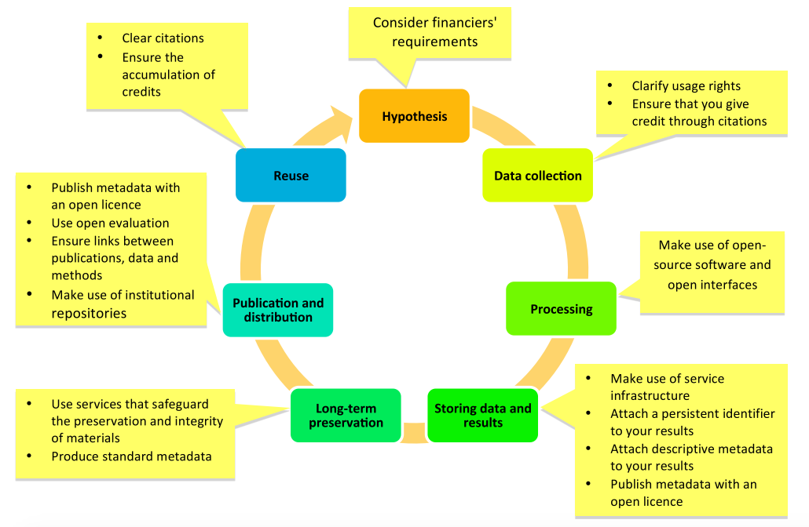
Open Science Life cycle

Slide 10

Not open but FAIR

Slide 11
Not open but FAIR
Citable
Track & Countable
Intelligible
Reproducible

Slide 12
Not open but FAIR
Findable: Easy to find the data and the metadata for both humans and computers. Automatic and reliable discovery of datasets and services depends on machine-readable persistent identifiers (PIDs) and metadata.
Accessible: The (meta)data retrievable by their identifier using a standardized and open communications protocol (including authentication and authorisation). Metadata should be available even when the data are no longer available.
Interoperable: The data should be able to be combined with and used with other data or tools. The format of the data should be open and interpretable for various tools. It applies both to the data and metadata, the (meta)data should use vocabularies that follow FAIR principles.
Re-usable: FAIR aims at optimizing the reuse of data. Metadata and data should be well-described so that they can be replicated and/or combined in different settings. The reuse of the (meta)data should be stated with clear and accessible license(s)

Slide 13
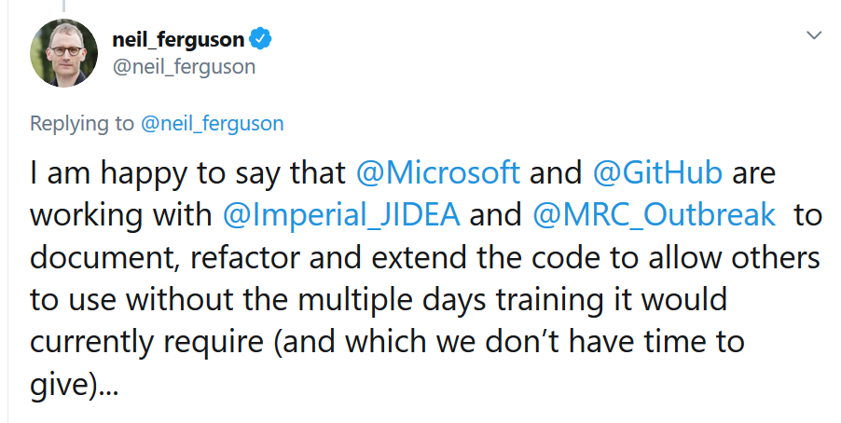
Why FAIR matters … COVID stories
Findable & Accessible: Spanish regional daily infection data distributed by various channels: emails, attachments to news briefings, twitter, regional pages.
Interoperable: Pdf documents instead of numerical spreadsheets.
Re-usable:
Different countries report/count differently cases, confirmed cases, deaths caused by virus.
N. Ferguson model for control measures:
thousands of lines of undocumented C code
developed originally for flue over 13 years ago

Slide 14
Why FAIR matters … COVID stories
Findable & Accessible & Interoperable, Re-usable:
Official Italian data in github:
https://github.com/pcm-dpc/COVID-19

Slide 15
FAIR in practice
Findable & Accessible
Deposition to external, public repositories.
Repositories provide permanent identifiers, catalogue options, metadata searching, download stats.
Repositories can also host private data or provide embargo period.
Interoperable
Using common formats (csv xls for numerical data), convert proprietary binary formats to the open ones (e.g. Snapgene to Genbank, microscopy multistack images to OME-TIFF)
Re-usable
Follow Minimum Information Standards, link to paper if exists, readme, descriptive column headers in excel. User creative Commons Licenses, e.g. CC BY

Slide 16
FAIR in practice
Findable & Accessible
Deposition to external, public repositories.
Repositories provide permanent identifiers, catalogue options, metadata searching, download stats.
Repositories can also host private data or provide embargo period.
Interoperable
Using common formats (csv xls for numerical data), convert proprietary binary formats to the open ones (e.g. Snapgene to Genbank, microscopy multistack images to OME-TIFF)
Re-usable
Follow Minimum Information Standards, link to paper if exists, readme, descriptive column headers in excel. User creative Commons Licenses, e.g. CC BY
Providing good, detailed metadata is a real challenge
and a barrier for general adoption

Slide 17
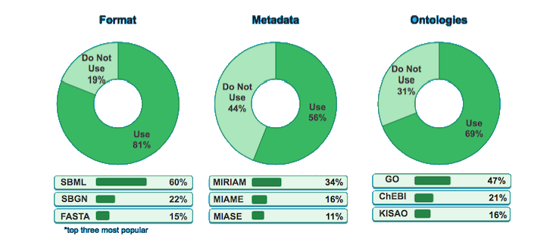
FAIR in practice
Formats
Metadata reporting guidelines
Metadata
Ontologies
*top three most popular

Slide 18
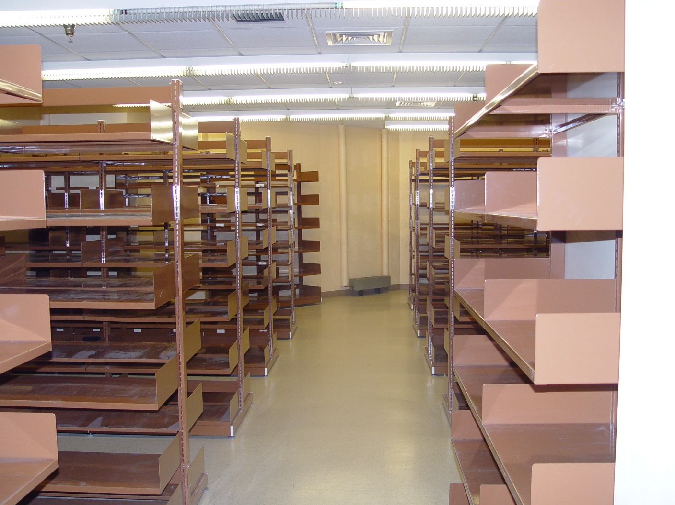
Being FAIR is hard

Slide 19

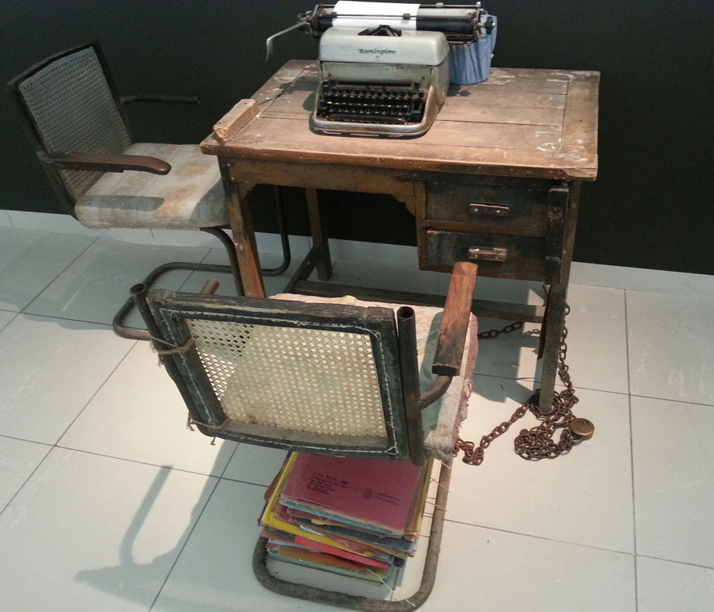
Being FAIR is hard
Encouragement from funders, lab head, etc…

Slide 20
Being FAIR is hard
No one likes describing data for repositories

Slide 21
Tipping the balance

Slide 22
Tipping the balance
Current, personal incentives …
Become pioneers
Have gained valuable experience
Distinguish from the crowd
Plan successful research proposals
Receive higher citations
Know how to comply with funders’ policies
Comply with funders’ policies
Demonstrate research and societal impact

Slide 23
Data Management as part of the workflow
CREATING DATA
RE-USING DATA
PROCESSING DATA
Time and effort
ACCESS
TO DATA
ANALYSING DATA
PRESERVING DATA
Notes:
Metadata at the point of preservation is a barrier/hard/time consuming…

Slide 24
Data Management as part of the workflow
CREATING DATA
RE-USING DATA
PROCESSING DATA
Time and effort
ACCESS
TO DATA
ANALYSING DATA
PRESERVING DATA
Time and effort
Notes:
Acquire description at earlier stages, split over the stages

Slide 25
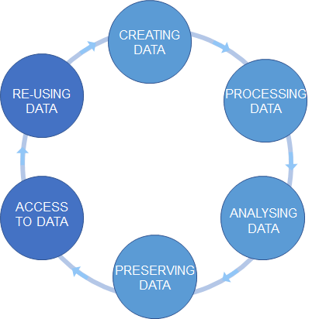
PLANNING
CREATING DATA
RE-USING DATA
PROCESSING DATA
ACCESS
TO DATA
ANALYSING DATA
PRESERVING DATA

Slide 26
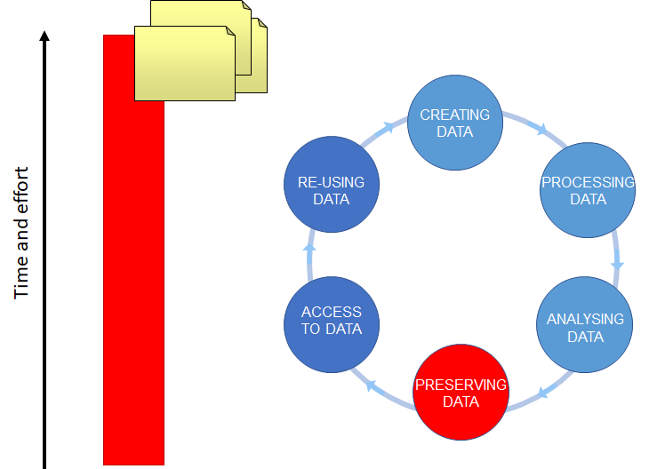
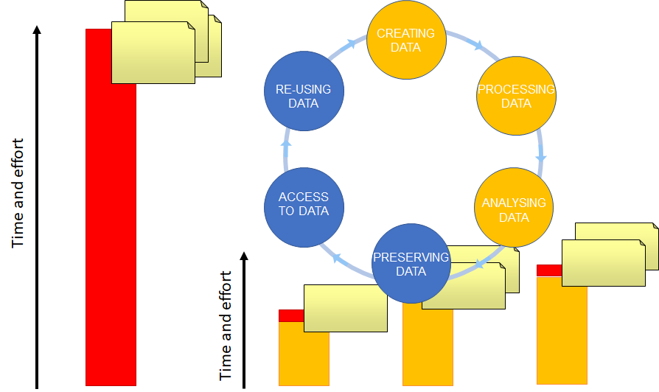
Option A: waiting till the last minute
Option B: throughout the project

Slide 27
Data Management as part of the workflow
Transform your data into an electronic form ASAP
Adopt metadata templates and formats
Deposit your data into a suitable repository ASAP
Find repositories/systems that solve your problems, improve your producibility, save you the time

Slide 28
What should you do now
Discuss lab books and data management with your supervisor before you start – “Data Management Plan”
Explore Electronic Lab Notebooks (ELNs)
Decide (now!) where all of your diverse data will be kept, where backed-up, and how to point to it from lab book.
Organise everything for the 3rd person

Slide 29
Open Science is a New way of working
You are the future, you are the children of Internet era
Your PI may not care but it should not stop you
Check the existing lab culture, remember evolution not revolution
The tools are not there yet, the early adopters had bad experiences, check for yourself how the systems work are
Ask for advice and help: bio_rdm@ed.ac.uk

Slide 30
University resources for data management

Slide 31
University resources for data management
UoE DataStore
a network drive (500GB per student)
accessible from all computers
off-side backup and versioning/history of the files
sharing within the University
\\csce.datastore.ed.ac.uk\csce\biology\users\YOUR_LOGIN
https://www.ed.ac.uk/information-services/computing/desktop-personal/connect-uni-file-storage

Slide 32
University resources for data management
UoE DataStore
slower than physical drive
does not work offline
possible downtimes
needs VPN off the campus
\\csce.datastore.ed.ac.uk\csce\biology\users\YOUR_LOGIN
https://www.ed.ac.uk/information-services/computing/desktop-personal/connect-uni-file-storage

Slide 33
University resources for data management
UoE DataStore
slower than physical drive
does not work offline
possible downtimes
needs VPN off the campus
\\csce.datastore.ed.ac.uk\csce\biology\users\YOUR_LOGIN
https://www.ed.ac.uk/information-services/computing/desktop-personal/connect-uni-file-storage
Please Use DataStore

Slide 34
University resources for data management
Sharepoint / OneDrive
https://uoe-my.sharepoint.com
Excellent for collaborative work on shared documents
Online versions of Word / Excel

Slide 35
University resources for data management
UoE WIKI
https://www.wiki.ed.ac.uk
For making notes, organize files, a simple ELN
https://www.wiki.ed.ac.uk/display/RDMS

Slide 36
University resources for data management
UoE DataShare
https://datashare.is.ed.ac.uk/
for sharing public datasets (possible embargo period)
unlimited, free storage
DOI
automatically created records in UoE PURE

Slide 37
University resources for data management
UoE DataVault
https://datavault.ed.ac.uk/
for long term archiving (10 years)
DOI and records in PURE
can be paid upfront
retrieves files from the DataStore
works with files bundles == deposits

Slide 38
University resources for data management
UoE Git
https://git.ecdf.ed.ac.uk/
Version control system (e.g. for source codes)
Free, private, collaborative repositories

Slide 39
University resources for data management
Protocols.io
https://www.protocols.io/institutions/uoe
For sharing and working on SOPs
Machine readable protocols

Slide 40
University resources for data management
Public OMERO
https://publicomero.bio.ed.ac.uk
For public sharing of microscopy images
Specialized resource that “understands” microscopy images

Slide 41
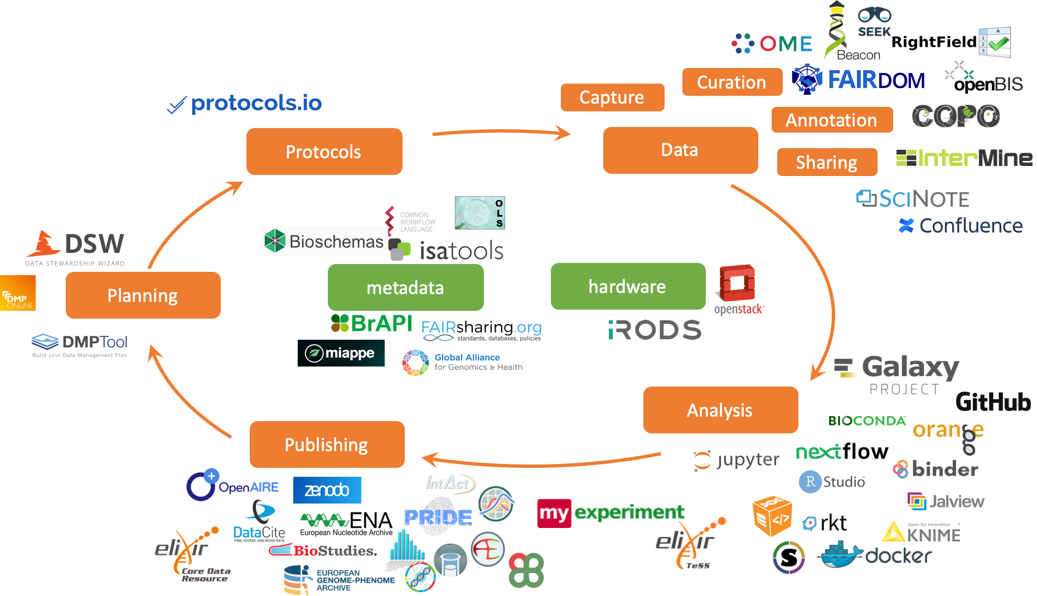
Public resources for data management

Slide 42
Public resources for data management
Check our wiki for a list of public repositories
https://www.wiki.ed.ac.uk/display/RDMS/Suggested+data+repositories

Slide 43
Where to find help
https://www.ed.ac.uk/information-services/research-support/research-data-service
Research Data Management Service Coordinator
Kerry Miller (Kerry.Miller@ed.ac.uk)
BioRDM team
bio_rdm@ed.ac.uk

Slide 44
Credits
To be added

