Slide 1
Tools for overlords
How tools for research data management
can assist in
project and people management

Slide 2

Jupyter notebooks for data analysis

Slide 3
Reusable ad-hoc analysis with jupyter
Notebooks shine
in orchestrating „short”, step by step operations in R, python, shell (notebooks can use all 3 at the same time)
capturing parameters
adding interpretations
acting as a „flexible” user interface

Slide 4
Plotting in R (Python)
Natural starting point for learning programming
More „powerful” / „professional” scientific plots than ones available in Excel
Easier to recreate
Easier to adjust for specific dimensions/formats/styles

Slide 5
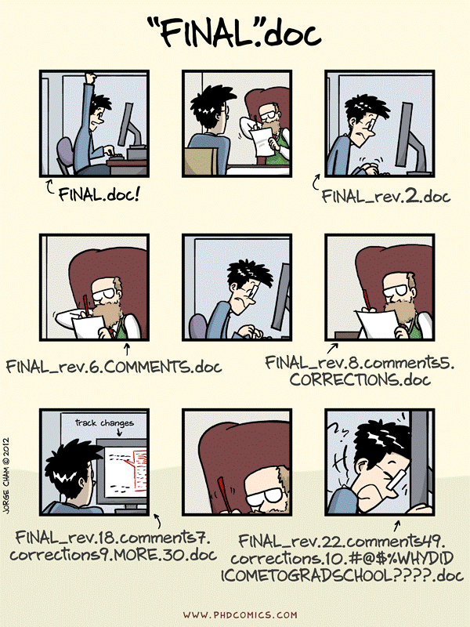
Keeping track of changes

Slide 6
Projects are not static, and actions introduce changes.
add new files
add data entries to files
modify manuscripts / methods
reformat / reorganize data tables
reanalyse data / update figures
experiment with data cleaning / processing / visualization
share and co-edit data or text file

Slide 7
Changes create issues
I have fifteen versions of this file - which one do I use?
I have several copies of the same directory because I'm worried about breaking something
You remember seeing a data file but cannot find it anymore: is it deleted? Moved away?
I came to an old project and forgot where I left/saved it
My directory is polluted with a lot of unused/temporary/old folders because I'm afraid of losing something important

Slide 8
Version control systems == Git/GitHub
Addressing those issues by tracking changes is called version control. .
With version control, file names do not reflect their versions.
Information about versions and changes are kept separate from the files.

Slide 9
GitHub live

Slide 10
Benchling live

Slide 11
Tools and the management

Slide 12
Learning curve
Where the things are online
How to create accounts – join/remove group members
How to find your group or group members data
How to check who did what
How to access records/files online
Consuming content is much easier than creating it!!!

