Slide 1
Being FAIR
Open https://pad.carpentries.org/fair-4-leaders-begins-20YY-MM-DD

Slide 2



What is research data?
"Research data [is] collected, observed or generated for the purpose of analysis, to produce and validate original research results [.. ie] whatever is necessary to verify or reproduce research findings, or to gain a richer understanding of them"
Research Data MANTRA, University of Edinburgh
Data does not only mean Excel files or readings from a machine. Data also includes:
images, not only from microscopes
information about biological materials, like strain or patient details
recipes, laboratory and measurement protocols
models
scripts, analysis procedures, and custom software are also considered data

Slide 3
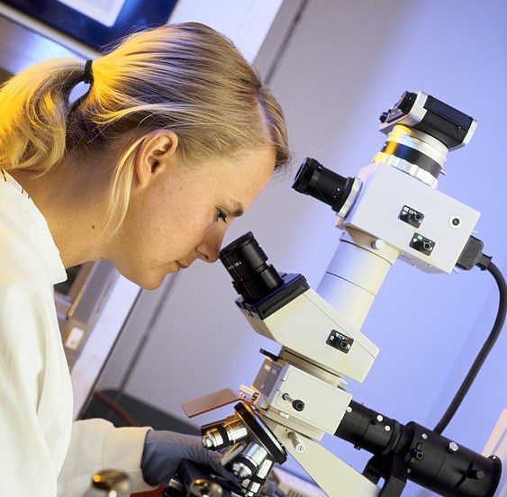
Data from publications
We're going to do an exercise looking at some real research data.
Image: See Credits [2]

Slide 4
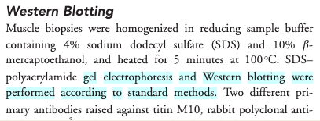
Exercise 1a: Impossible protocol
Notes:
Please see webpage or etherpad for the detailed instructions for exercise 1a.
This example is from a real reference given on the antibody supplier website citing the Meng Yu paper:
https://www.sigmaaldrich.com/GB/en/product/sigma/sab1400284

Slide 5
Exercise 1b: Impossible average
Difficult to find the right data table and column
Numerical data in pdf not suitable for calculations

Slide 6
Common problems
the protocol was difficult to find (the loops)
the protocol was difficult to access (pay wall)
and not reusable as it lacked the necessary details (dead-end)
In the second example
the data were in a wrong format (not interoperable)
The data were not clearly described (not reusable)

Slide 7
Common problems
Only averaged data available
No numerical data available
Data tables as PDF files in supporting information
Vendor specific file formats
Links to non existing group websites / databases
Data / Code “on request”

Slide 8

FAIR principles
Image: See Credits [3]

Slide 9
FAIR principles
Findable:
persistent identifiers pointing to the data
descriptions that allow discovery by both humans and computers
Accessible:
(meta)data retrieval by standard protocols (http)
metadata available even when the data are not
Interoperable:
(meta)data saved in open/common format (interpretable for various tools)
(meta)data should use vocabularies that follow FAIR principles.
Re-usable:
data should be well-described so that they can be replicated and/or combined in different settings
conditions of the reuse should be stated with a clear license

Slide 10
FAIR in biological practice
Findable & Accessible
Deposit data to an external, reputable public repository.
Repositories provide persistent identifiers (PIDs), catalogue options, advanced metadata searching, and download statistics.
Some repositories can also host private data or provide embargo periods, meaning access to all data can be delayed.

Slide 11
Persistent identifiers (PIDs)
A persistent identifier is a long-lasting reference to a digital resource.
Digital Object Identifier (DOI) (prefix doi.org in the web links).
https://doi.org/10.1038/sdata.2016.18 resolves to the FAIR paper
Repositories often maintain web addresses in a stable form (permalinks) http://<repository.address>/<identifier>.
http://identifiers.org/SO:0000167 defines promoter role

Slide 12
Interoperable
Use standard(common) or open-source file formats where possible (domain specific)
Use .csv or .xlsx files for numerical data. Never share data tables as word or .pdf
Provide underlying numerical data for all plots and graphs
Convert proprietary formats to open and/or standard ones, and convert binary formats to plain text. Whenever practicable, without losing the meaning of the data. For example convert Snapgene to Genbank/SBOL, microscopy multistack images to OME-TIFF .

Slide 13

Reusable
Describe your data well (good metadata)
write a README file describing the data
provide as many details as possible (prepare good metadata)
use descriptive column headers for the data tables
tidy data tables, make them analysis friendly
Use standard (meta)data formats (e.g. SBML, SBOL)
follow Minimum Information Standards
(e.g. MIAME -Minimum Information About a Microarray Experiment)

Slide 14
Reusable
Attach license files. Licenses explicitly declare conditions and terms under which data and software can be re-used.
We recommend:
for data: Creative Commons Attribution (CC BY) license
for code: a permissive open source license such as the MIT, BSD, or Apache license.

Slide 15
Exercise 2 – Public record FAIR elements
Dataset: https://doi.org/10.5281/zenodo.5045374
What makes it FAIR?

Slide 16
Exercise 2 – Public record FAIR elements
F: PID (DOI), metadata for discoverability (keywords and subject, title, description)
A: Data can be downloaded; access to stats on downloads and views
I: Common file formats (.csv, .tif, .nd2)
Metadata elements can be exported in different metadata standard formats
R: well described (README), clear license, links that associates with other related resources (where it is published and related works)

Slide 17
FAIR and You
Citable
Track & Countable
Intelligible
Reproducible
Image: See Credits [3]

Slide 18
FAIR vs Open Science
FAIR ≠ Open
The data record can be FAIR but the data itself can remain hidden
FAIR data can easily be made public and become Open
Open data which are not FAIR have limited value

Slide 19

FAIR quiz
Answer the quiz questions on the webpage.

Slide 20
Credits
Research data MANTRA ('Research Data Management training') – Research data in context, University of Edinburgh https://mantra.ed.ac.uk
Lab microscope photo image - CSIRO, CC BY 3.0, via Wikimedia Commons https://commons.wikimedia.org/wiki/File:CSIRO_ScienceImage_435_Scientist_using_microscope.jpg
FAIR logo - SangyaPundir, CC BY-SA 4.0 via Wikimedia Commons https://upload.wikimedia.org/wikipedia/commons/thumb/a/aa/FAIR_data_principles.jpg/800px-FAIR_data_principles.jpg
FAIR Principles, GO FAIR Initiative www.go-fair.org/fair-principles

