Slide 1
FAIR for leaders
Open https://pad.carpentries.org/fair-4-leaders-begins-20YY-MM-DD

Slide 2
Better research by better sharing

Slide 3
Better research by better sharing
why you should know about Open Science, FAIR and data management
how adoption of these practices benefits your group/organization by:
improving productivity
speeding up inductions
helping with your managerial responsibilities

Slide 4
Who we are and what we do

Slide 5
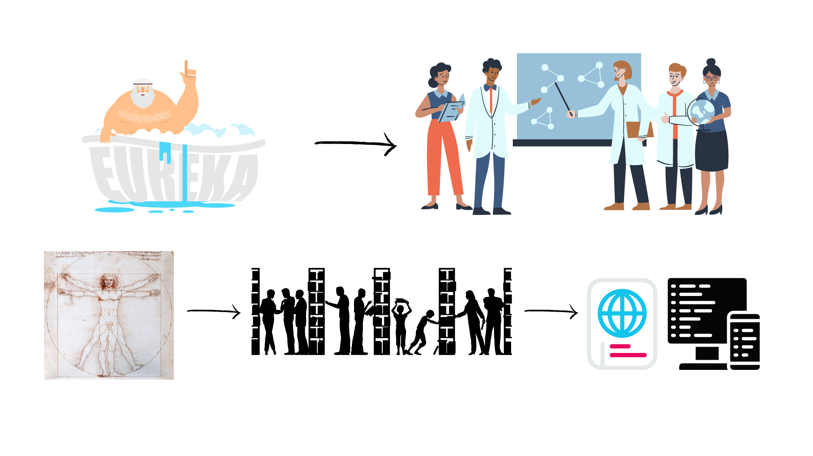
Evolution of Research
Level of openness in research

Slide 6






Open Science
Open science is the movement to make scientific research accessible to all levels of society
general public
amateurs
professionals
students
teachers
publications
data
physical samples
software
Digital technologies for diffusing knowledge

Slide 7
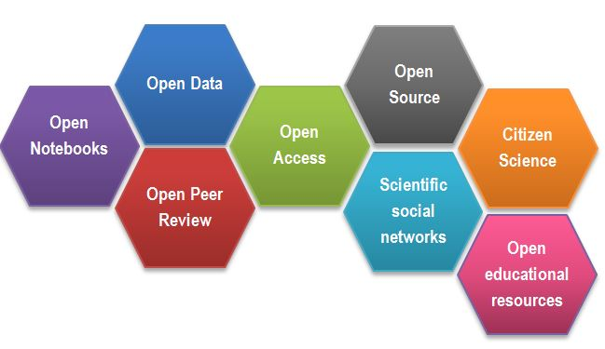
Open Science
CREDITS [1] CC BY

Slide 8

Why we are not doing Open Science / Data Sharing
….

Slide 9
Why we are not doing Open Science / Data Sharing
lack of expertise
sensitive data
misuse (fake news)
lack of confidence (the fear of critics)
the costs in $ and in time
IP

Slide 10
Sharing as part of the workflow
CREATING DATA
RE-USING DATA
PROCESSING DATA
Time and effort
SHARING
DATA
ANALYSING DATA
PRESERVING DATA
work necessary to make outputs suitable for sharing

Slide 11
Sharing as part of the workflow
CREATING DATA
RE-USING DATA
PROCESSING DATA
Time and effort
SHARING
DATA
ANALYSING DATA
PRESERVING DATA
work necessary to make outputs suitable for sharing
standard research operations

Slide 12
Why you should know it

Slide 13


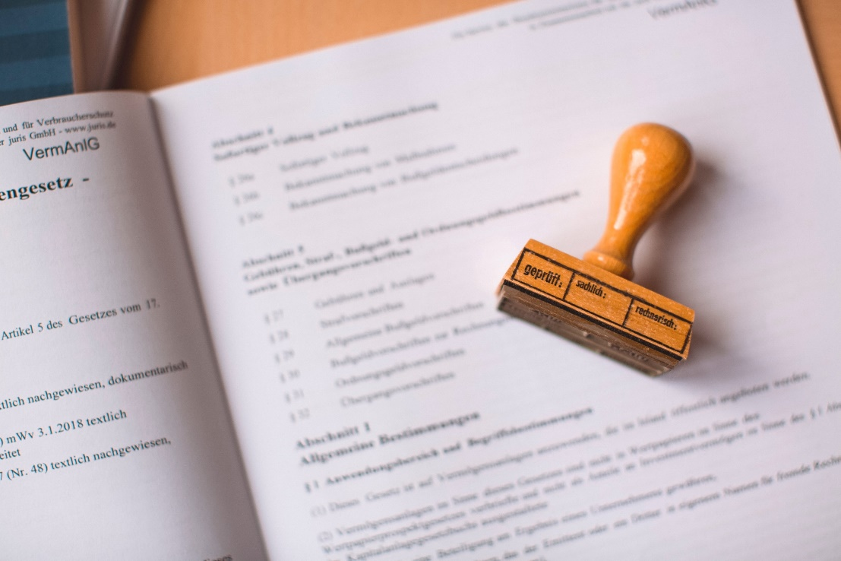

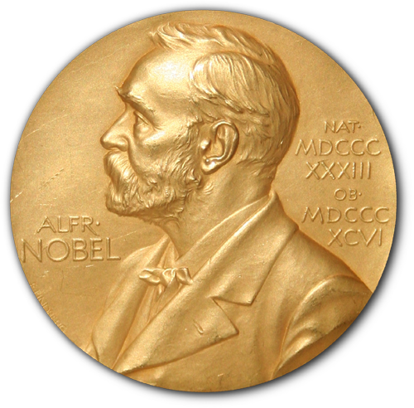
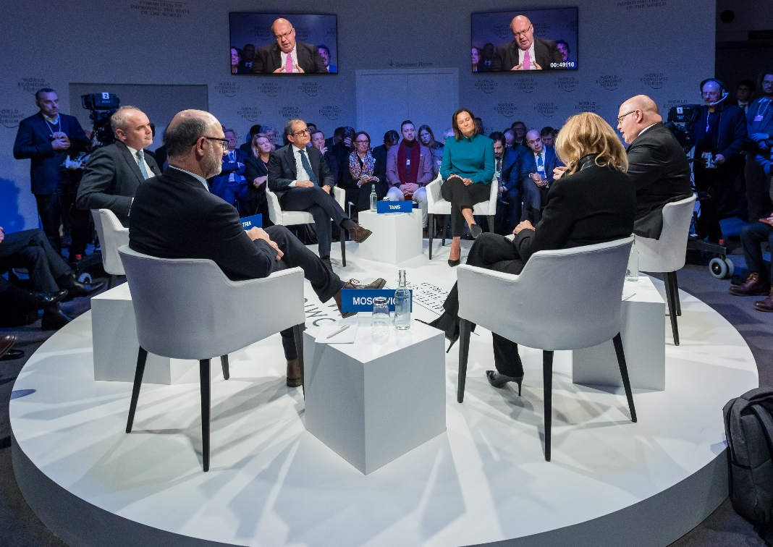
Power figures
CREDITS [2, 3] CC BY

Slide 14

Responsible for your minions
Why you should know it
CREDITS [4] CC BY

Slide 15

DORA
Declaration on Research Assessment
the need to eliminate the use of journal-based metrics, such as Journal Impact Factors, in funding, appointment, and promotion considerations;
the need to assess research on its own merits rather than on the basis of the journal
the need to capitalise on the opportunities provided by online publication (such as relaxing unnecessary limits … exploring new indicators of significance and impact)
CREDITS [5] CC BY

Slide 16
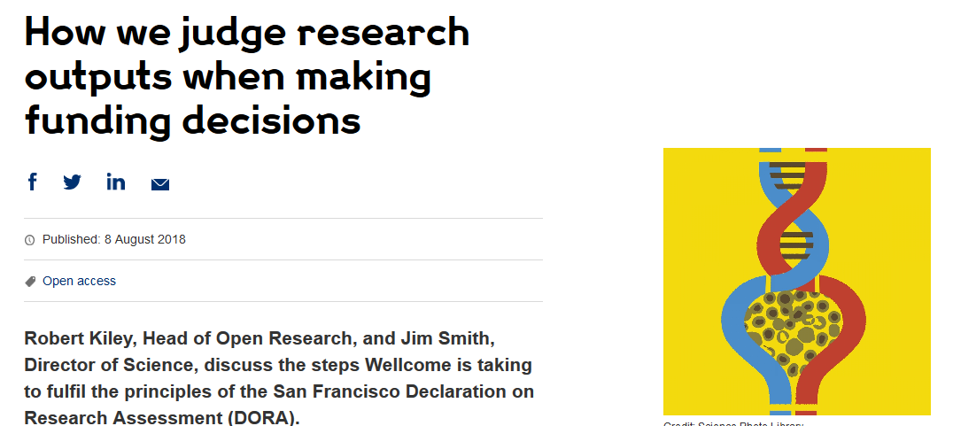
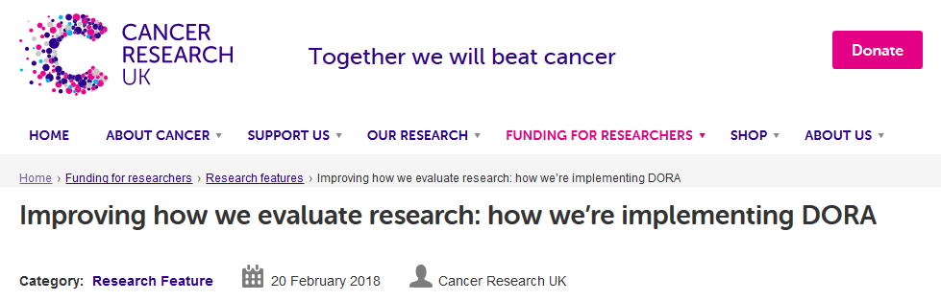
DORA: Funders adoption
Wellcome
London, United Kingdom
Cancer Research UK
London, UK
Application includes:
List of research outputs
Summary of 3-5 achievements
Space to describe other measures of impact
Reminds peer reviewers and committee
members of DORA principles throughout
funding process
Application includes:
List of research outputs
Contributions to mentorship
Output sharing plan to advance potential health benefits
Plans for public engagement
Guidance provided to advisory panel members
CREDITS [5] CC BY
Notes:
Wellcome example: https://wellcome.ac.uk/news/how-we-judge-research-outputs-when-making-funding-decisions
Cancer Research UK example: https://www.cancerresearchuk.org/funding-for-researchers/research-features/2018-02-20-improving-research-evaluation-dora

Slide 17
Narrative CV
Generation of Knowledge
Development of Individuals and Collaborations
Supporting Broader Society and the Economy
Supporting the Research Community

Slide 18
Narrative CV
A broad definition of ‘output’ is used, such as datasets, patents and software.
Special attention is paid to Open Science, which outputs are openly available.
New metrics: retweets, online views and downloads, discussions, presence in mass media technology platforms

Slide 19
It is easier to be prepared than to fake it
It takes time to make the outputs public
The quality of open outputs is easy to assess
Timestamps

Slide 20
Why you should do it

Slide 21
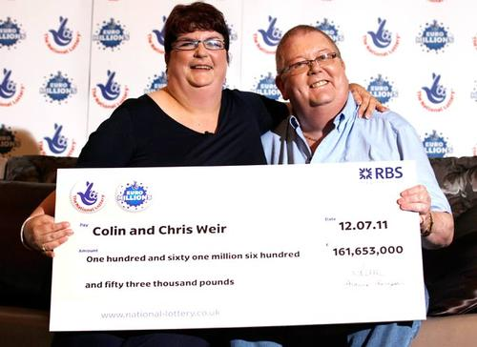
Exercise – lottery winner
Notes:
Colin and Chris Weir are a Scottish couple who won a life-changing sum of money in the national lottery. Would your postdoc come back into work if they hit the jackpot?

Slide 22
Lottery winner exercise - conclusions
Good data management:
improves productivity
assures safety of your research
speeds up induction
makes it easier to generate public outputs

Slide 23
Agenda
Being FAIR
Tools for oracles and overlords
Public repositories
It is all about planning
Wrap up

Slide 24
Credits
[1] Gema Bueno de la Fuente, “What is Open Science? Introduction”, https://www.fosteropenscience.eu/content/what-open-science-introduction
[2] Photos Unsplash by: Evangeline Shaw https://unsplash.com/photos/nwLTVwb7DbU Alexei Scutar https://unsplash.com/photos/5Zg64OwXJg8 Markus Spiske https://unsplash.com/photos/7PMGUqYQpYc
[3] Photo Jonathunder, Medal: Erik Lindberg (1873-1966) - NobelPrize.JPG, PD-US, https://en.wikipedia.org/w/index.php?curid=58432969
[4] Photo Unsplash by: Wyron A https://unsplash.com/photos/6ZR-f5bkrGE
[5] DORA https://sfdora.org/resource/dora-slide-presentations/
Funding
Ed-DaSH is a Data Science training programme for Health and Biosciences. This work was supported by UK Research and Innovation [grant number MR/V039075/1].
https://edcarp.github.io/Ed-DaSH/

