Slide 1
Being FAIR
Open https://pad.carpentries.org/fair-4-leaders-begins-20YY-MM-DD

Slide 2



What is research data?
"Research data [is] collected, observed or generated for the purpose of analysis, to produce and validate original research results [.. ie] whatever is necessary to verify or reproduce research findings, or to gain a richer understanding of them"
Research Data MANTRA, University of Edinburgh
Data does not only mean Excel files or readings from a machine. Data also includes:
images, not only from microscopes
information about biological materials, like strain or patient details
recipes, laboratory and measurement protocols
models
scripts, analysis procedures, and custom software are also considered data

Slide 3
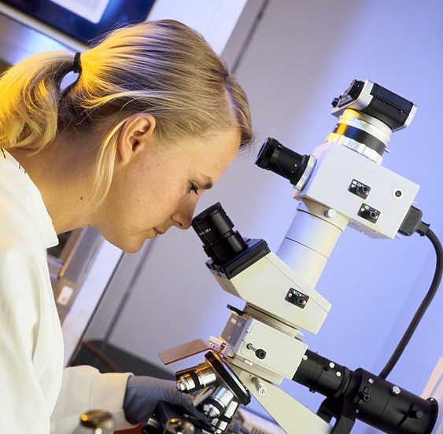
Data from publications
We're going to do an exercise looking at some real research data.
Image: See Credits [2]

Slide 4
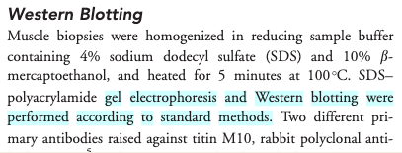
Exercise 1a: Impossible protocol
Notes:
Please see webpage or etherpad for the detailed instructions for exercise 1a.
This example is from a real reference given on the antibody supplier website citing the Meng Yu paper:
https://www.sigmaaldrich.com/GB/en/product/sigma/sab1400284

Slide 5
Exercise 1b: Impossible average
Difficult to find the right data table and column
Numerical data in pdf not suitable for calculations

Slide 6
Common problems
Only averaged data available
No numerical data available
Data tables as PDF files in supporting information
Vendor specific file formats
Links to non existing group websites / databases
Data / Code “on request”

Slide 7
Common problems
the protocol was difficult to find (the loops)
the protocol was difficult to access (pay wall)
and not reusable as it lacked the necessary details (dead-end)
In the second example
the data were in a wrong format (not interoperable)
The data were not clearly described (not reusable)

Slide 8

FAIR principles
Image: See Credits [3]

Slide 9
FAIR principles
Findable: Metadata and data should be easy to find for both humans and computers. Automatic and reliable discovery of datasets and services depends on machine-readable persistent identifiers (PIDs) and metadata.
Accessible: (Meta)data should be retrievable by their identifiers using a standardised and open communications protocol (including authentication and authorisation). Metadata should be available even when the data are no longer available.
Interoperable: Data should be able to be combined with and used with other data or tools. The format of the data should be open and interpretable for various tools. This principle, just like the others, applies both to data and metadata; (meta)data should use vocabularies that follow FAIR principles.
Re-usable: FAIR aims to optimise the reuse of data. Metadata and data should be well-described so that they can be replicated and/or combined in different settings. The conditions attached to reuse of (meta)data, or the absence of conditions, should be stated with a clear and accessible license(s).
Credits[4]
Notes:
Findable -> means that the data can be discovered by both humans and machines
Accessible -> means that the data are archived in long-term storage and can be made available using standard technical procedures
Interoperable -> data can be exchanged and used across different applications and systems
Reusable -> means that the data are well documented and curated and provide rich information about the context of data creation

Slide 10
Findable & Accessible
TOP TIP: Deposit your data in a trustworthy public repository!
Repositories provide persistent identifiers (PIDs), controlled vocabularies for efficient cataloguing, advanced metadata searching and download statistics. Some repositories can also host supported curation, digital preservation, private data or provide embargo periods, meaning access to all data can be delayed or restricted.
There are general “data agnostic” repositories such as Zenodo, or domain specific ones such as Genbank. We will delve into more detail in a later episode.
Notes:
Removed, because of duplication with the repositories episode:
There are general “data agnostic” repositories, for example:
Dryad, Zenodo, FigShare, Harvard Dataverse.
Or domain specific, for example:
UniProt, GenBank, MetaboLights.

Slide 11
Persistent identifiers (PIDs)
A persistent identifier is a long-lasting reference to a digital resource.
Digital Object Identifier (DOI) (prefix doi.org in the web links).
https://doi.org/10.1038/sdata.2016.18 resolves to the FAIR paper
Repositories often maintain web addresses in a stable form (permalinks) http://<repository.address>/<identifier>.
http://identifiers.org/SO:0000167 defines promoter role

Slide 12
Interoperable
Use standard or open-source file formats where possible (domain specific)
Use .csv or .xlsx files for numerical data. Never share data tables as word or .pdf
Provide underlying numerical data for all plots and graphs
Convert proprietary formats to open and/or standard ones, and convert binary formats to plain text. Whenever practicable, without losing the meaning of the data. For example convert Snapgene to Genbank/SBOL, microscopy multistack images to OME-TIFF .

Slide 13

Reusable
Describe your data well (good metadata)
write a README file describing the data
provide as many details as possible (prepare good metadata)
use descriptive column headers for the data tables
tidy data tables, make them analysis friendly
use (meta)data formats (e.g. SBML, SBOL)
follow Minimum Information Standards

Slide 14
Reusable
Attach license files. Licenses explicitly declare conditions and terms under which data and software can be re-used.
We recommend:
for data: Creative Commons Attribution (CC BY) license
for code: a permissive open source license such as the MIT, BSD, or Apache license.

Slide 15
FAIR and You
Citable
Track & Countable
Intelligible
Reproducible
Image: See Credits [3]

Slide 16
FAIR vs Open Science
FAIR != Open
The data record can be FAIR but the data itself can remain hidden
FAIR data can easily be made public and become Open
Open data which are not FAIR have limited value

Slide 17

FAIR quiz
Answer the quiz questions on the webpage.

Slide 18
Credits
Research data MANTRA ('Research Data Management training') – Research data in context, University of Edinburgh https://mantra.ed.ac.uk
Lab microscope photo image - CSIRO, CC BY 3.0, via Wikimedia Commons https://commons.wikimedia.org/wiki/File:CSIRO_ScienceImage_435_Scientist_using_microscope.jpg
FAIR logo - SangyaPundir, CC BY-SA 4.0 via Wikimedia Commons https://upload.wikimedia.org/wikipedia/commons/thumb/a/aa/FAIR_data_principles.jpg/800px-FAIR_data_principles.jpg
FAIR Principles, GO FAIR Initiative www.go-fair.org/fair-principles

