Slide 1
FAIR for leaders
Open https://pad.carpentries.org/fair-4-leaders-begins-20YY-MM-DD

Slide 2
Better research by better sharing

Slide 3
Better research by better sharing
why you should know about Open Science, FAIR and data management
how adoption of these practices benefits your group/organization by:
improving productivity
speeding up inductions
helping with your managerial responsibilities

Slide 4
Who we are and what we do

Slide 5
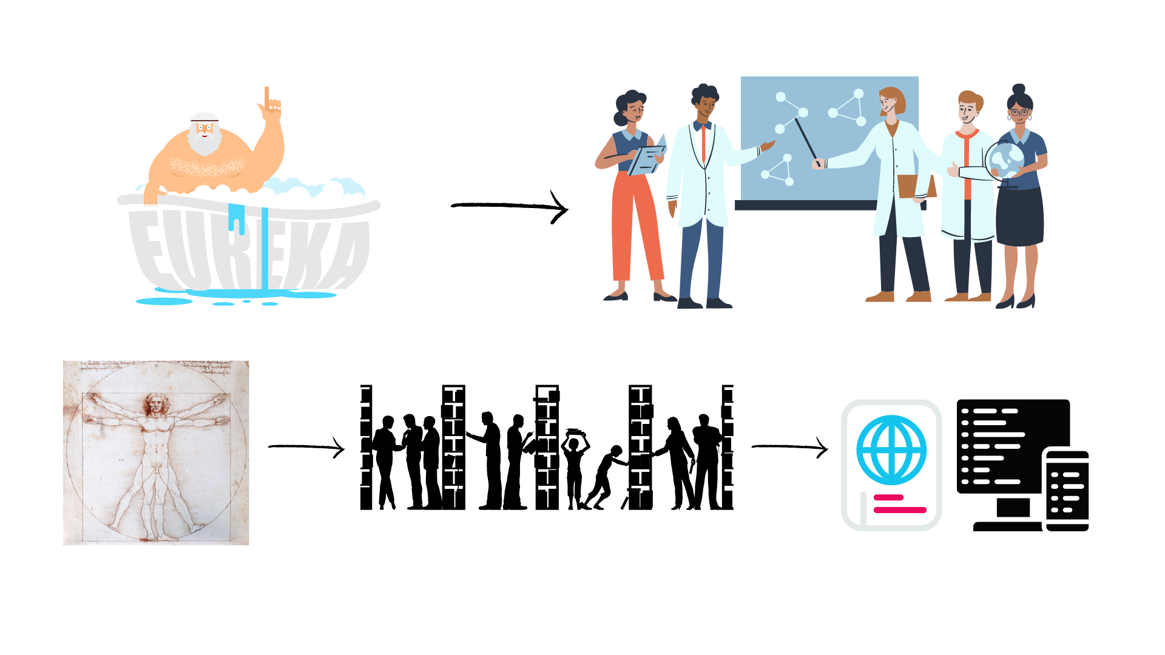
Evolution of Research
Level of openness in research

Slide 6






Open Science
Open science is the movement to make scientific research accessible to all levels of society
general public
amateurs
professionals
students
teachers
publications
data
physical samples
software
Digital technologies for diffusing knowledge

Slide 7
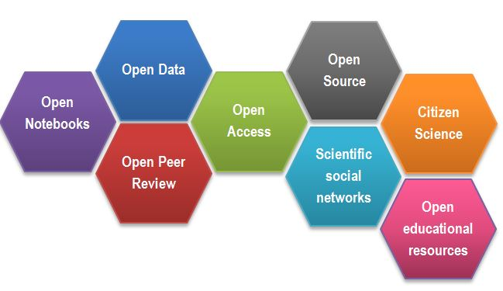
Open Science
CREDITS [1] CC BY

Slide 8
Success story – Open Access
The initiative to move to Open Access publishing is known as Plan S
Publications available immediately and under open licences, either in:
quality Open Access platforms or journals
as a copy deposited with your home institution.
Details of funding bodies requirements can be found at Plan S/cOAlition S.
cOAlition S journal checker tool to assess compliance
the Directory of Open Access Journals (DOAJ) helps finding OA journals

Slide 9
Outcomes of Openness
Open Access:
speed of work and knowledge distribution
levelling field for underfunded sites
increasing chance for collaboration, exposure & citations
new metrics of impact: views, downloads, tweets etc
access to work by lay audiences, thus increases social exposure of research

Slide 10

Outcomes of Openness
Collaboration
Speed
Unpublished/negative results
Re-use
Learn by example
Feedback

Slide 11

Why we are not doing Open Science / Data Sharing
….

Slide 12
Why we are not doing Open Science / Data Sharing
lack of expertise
sensitive data
misuse (fake news)
lack of confidence (the fear of critics)
the costs in $ and in time
IP

Slide 13
Sharing as part of the workflow
CREATING DATA
RE-USING DATA
PROCESSING DATA
Time and effort
SHARING
DATA
ANALYSING DATA
PRESERVING DATA
work necessary to make outputs suitable for sharing

Slide 14
Sharing as part of the workflow
CREATING DATA
RE-USING DATA
PROCESSING DATA
Time and effort
SHARING
DATA
ANALYSING DATA
PRESERVING DATA
work necessary to make outputs suitable for sharing
standard research operations

Slide 15
Why you should know it

Slide 16


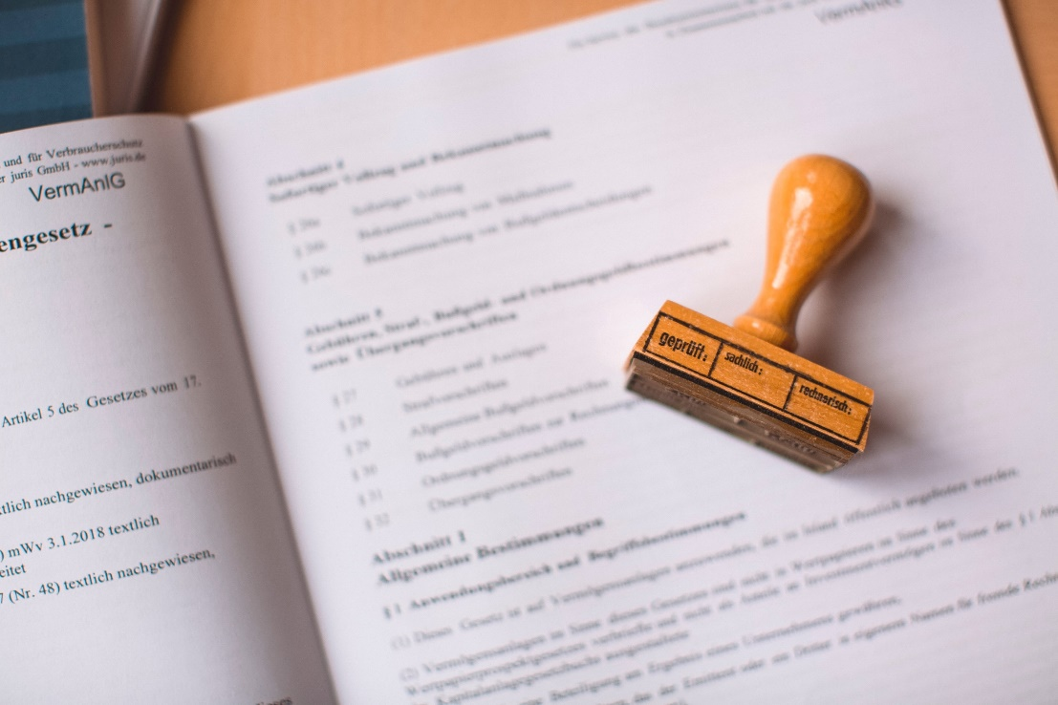

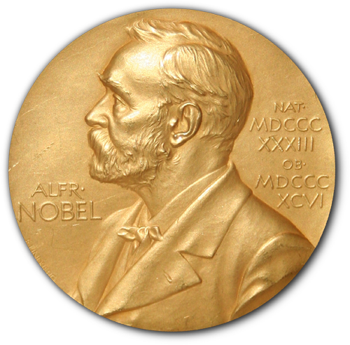

Power figures
CREDITS [2, 3] CC BY

Slide 17

Responsible for your minions
Why you should know it
CREDITS [4] CC BY

Slide 18

DORA
Declaration on Research Assessment
the need to eliminate the use of journal-based metrics, such as Journal Impact Factors, in funding, appointment, and promotion considerations;
the need to assess research on its own merits rather than on the basis of the journal
the need to capitalise on the opportunities provided by online publication (such as relaxing unnecessary limits … exploring new indicators of significance and impact)
CREDITS [5] CC BY

Slide 19
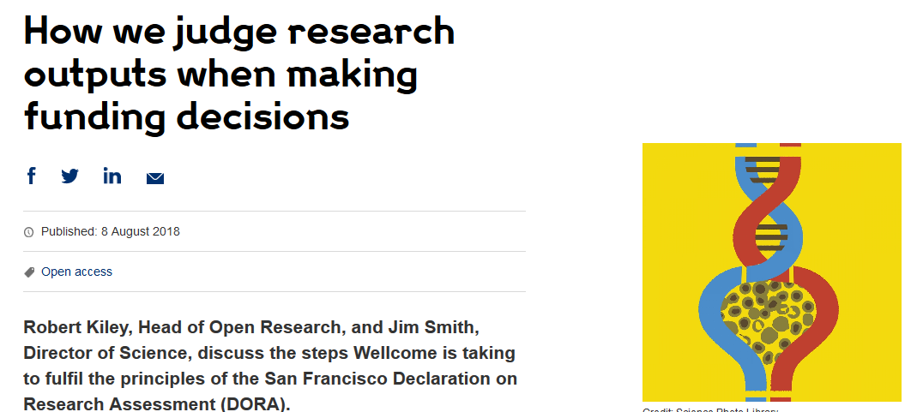
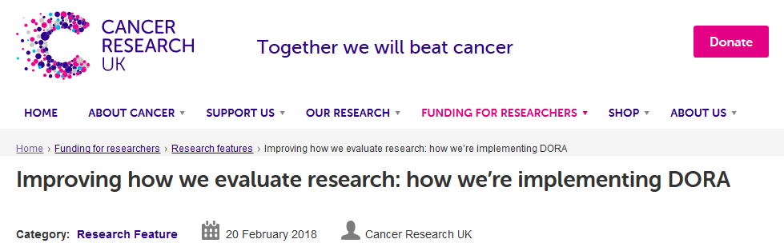
DORA: Funders adoption
Wellcome
London, United Kingdom
Cancer Research UK
London, UK
Application includes:
List of research outputs
Summary of 3-5 achievements
Space to describe other measures of impact
Reminds peer reviewers and committee
members of DORA principles throughout
funding process
Application includes:
List of research outputs
Contributions to mentorship
Output sharing plan to advance potential health benefits
Plans for public engagement
Guidance provided to advisory panel members
CREDITS [5] CC BY
Notes:
Wellcome example: https://wellcome.ac.uk/news/how-we-judge-research-outputs-when-making-funding-decisions
Cancer Research UK example: https://www.cancerresearchuk.org/funding-for-researchers/research-features/2018-02-20-improving-research-evaluation-dora

Slide 20
Narrative CV
Generation of Knowledge
Development of Individuals and Collaborations
Supporting Broader Society and the Economy
Supporting the Research Community

Slide 21
Narrative CV
A broad definition of ‘output’ is used, such as datasets, patents and software.
Special attention is paid to Open Science, which outputs are openly available.
New metrics: retweets, online views and downloads, discussions, presence in mass media technology platforms

Slide 22
It is easier to be prepared than to fake it
It takes time to make the outputs public
The quality of open outputs is easy to assess
Timestamps

Slide 23
Why you should do it

Slide 24

Exercise – lottery winner
Notes:
Colin and Chris Weir are a Scottish couple who won a life-changing sum of money in the national lottery. Would your postdoc come back into work if they hit the jackpot?

Slide 25
Lottery winner exercise - conclusions
Good data management:
improves productivity
assures safety of your research
speeds up induction
makes it easier to generate public outputs

Slide 26
Agenda
Being FAIR
Tools for oracles and overlords
Public repositories
It is all about planning
Wrap up

Slide 27
Credits
[1] Gema Bueno de la Fuente, “What is Open Science? Introduction”, https://www.fosteropenscience.eu/content/what-open-science-introduction
[2] Photos Unsplash by: Evangeline Shaw https://unsplash.com/photos/nwLTVwb7DbU Alexei Scutar https://unsplash.com/photos/5Zg64OwXJg8 Markus Spiske https://unsplash.com/photos/7PMGUqYQpYc
[3] Photo Jonathunder, Medal: Erik Lindberg (1873-1966) - NobelPrize.JPG, PD-US, https://en.wikipedia.org/w/index.php?curid=58432969
[4] Photo Unsplash by: Wyron A https://unsplash.com/photos/6ZR-f5bkrGE
[5] DORA https://sfdora.org/resource/dora-slide-presentations/
Funding
Ed-DaSH is a Data Science training programme for Health and Biosciences. This work was supported by UK Research and Innovation [grant number MR/V039075/1].
https://edcarp.github.io/Ed-DaSH/

