Slide 1
Public repositories

Slide 2
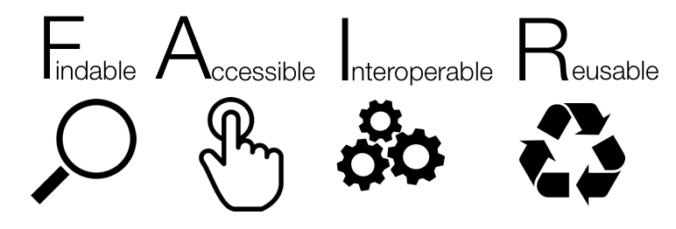
Notes:
IN A NUTSHELL:
Findable -> means that the data can be discovered by both humans and machines
Accessible -> means that the data are archived in long-term storage and can be made available using standard technical procedures
Interoperable -> data can be exchanged and used across different applications and systems
Reusable -> means that the data are well documented and curated and provide rich information about the context of data creation

Slide 3




Research data repositories are online databases that enable the preservation, curation and publication of research ‘products’:
datasets
code
protocols
description of biological materials

Slide 4
Repositories are crucial for
FINDABLE and ACCESSIBLE

Slide 5



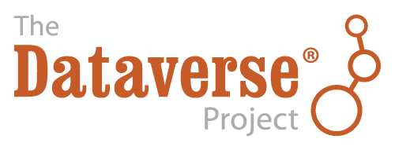

There are general “data agnostic” repositories
Dryad https://datadryad.org
Zenodo https://zenodo.org
FigShare https://figshare.com
Harvard Dataverse https://dataverse.harvard.edu
and your Institutional repository.
Notes:
Dryad is an international open-access repository of research data. It is a nonprofit organization that provides long-term access to its contents at no cost to users. The base DPC per data submission is $120 USD. Some journals will pay this cost. Access is free.
Zenodo built and operated by CERN and OpenAIRE to ensure that everyone can join in Open Science.
Figshare is an online open access repository where researchers can preserve and share their research outputs, including figures, datasets, images, and videos. It is free to upload content and free to access, in adherence to the principle of open data. Figshare is one of a number of portfolio businesses supported by Digital Science, a subsidiary of Springer Nature.
Dataverse is funded by Harvard with additional support from the Alfred P. Sloan Foundation, National Science Foundation, National Institutes of Health, Helmsley Charitable Trust, IQSS's Henry A. Murray Research Archive, and many others. There are over eighty repositories using the DataVerse project's repository software; the Harvard DataVerse repository accepts data from all researchers from any discipline.

Slide 6
Exercise 1. Public record
1a. Dataset description
https://doi.org/10.5281/zenodo.5045374

Slide 7
Exercise 1b. Dataset discovery
https://doi.org/10.5281/zenodo.5045374

Slide 8
Dataset discovery - Solution
Zenodo is a good place to keep your data separate from your paper. It gives access to all files, allowing you to cite the data as well (or instead of) the paper.
However, it is not (always) good for discovery, and does not enforce metadata standards, except that a very few metadata fields are mandatory!

Slide 9




“domain” (type) specific repositories
UniProt https://www.uniprot.org – protein data
GenBank https://www.ncbi.nlm.nih.gov/genbank – sequence data
GitHub https://github.com – for code
MetaboLights https://www.ebi.ac.uk/metabolights – metabolomics data

Slide 10
Advantages of domain specific repositories
Higher exposure
Data specific features (e.g. Visualization)
Enforced minimal metadata
API for data retrival / aggregation /searching
Curated data
Better searching
Interlinking between data types

Slide 11
Exercise 2. Domain specific repositories

Slide 12
Domain specific repositories
Some advantages are:
The repository is more relevant to your discipline than a generalist one.
Higher exposure (people looking for those specific types of data will usually first look at the specific repository).
Higher number of citations (see above).

Slide 13
Finding repositories – use recommendations
BioMed Central / Springer Nature - (https://www.springernature.com/gp/authors/research-data-policy/recommended-repositories)
eLife - (https://submit.elifesciences.org/html/elife_author_instructions.html#policies)
Elsevier - (https://www.elsevier.com/about/policies/research-data)
EMBO Press - (https://www.embopress.org/page/journal/14602075/authorguide#datadeposition)
F1000 Research - (https://f1000research.com/for-authors/data-guidelines)
GIGAscience - OUP - (https://academic.oup.com/gigascience/pages/instructions_to_authors)
PLoS - (https://journals.plos.org/plosbiology/s/recommended-repositories)
Scientific Data - Nature - (https://www.nature.com/sdata/policies/repositories)
Taylor and Francis - (https://authorservices.taylorandfrancis.com/data-sharing-policies/repositories/)
BBSRC - (https://bbsrc.ukri.org/research/resources/)
NERC - (https://nerc.ukri.org/research/sites/environmental-data-service-eds/policy/)
Royal Society - (https://royalsociety.org/journals/ethics-policies/data-sharing-mining/)
Wellcome Open Research - (https://wellcomeopenresearch.org/for-authors/data-guidelines)

Slide 14
Finding repositories
FAIRSharing.org – search engine
Repositories
Data standards
Policies
(too) many options for each type

Slide 15
Exercise 3. Finding a repository

Slide 16
Finding repository - Solution
Find a repo for genomics data:
GEO/SRA and ENA/ArrayExpress are good examples.

Slide 17
Evaluating a data repository
1. Who is behind it? What is its funding?
2. Quality of interaction/interface/process: Is the interaction for the purposes of data deposit or reuse efficient,
effective and satisfactory for you?
3. Take-up and impact:
What can I put in it? Is anyone else using it? Will others be able to find stuff deposited in it? Is the repository linked to other data repositories? Can others cite the data?
4. Policy and process: Does it help me to meet community standards, good practice and policies? Is it curated?

Slide 18
Exercise 4. Using repositories

Slide 19
Repositories Summary
Repository records are another form of scientific output!
Add a good Data Availability Statement to your papers and list all the public records
List data sets in your ORCID record

Slide 20
Repositories Summary
Find suitable repository(ies) as soon as data are generated
If the repository permits embargo, deposit your data as soon as they are obtained (especially if analysed by 3rd party)
Deposit simultaneously to a very specialized repo and a 'mainstream' one (for better findability)
Cross link repositories’ records

