Slide 1
Being FAIR

Slide 2
What is research data?
"Research data [is] collected, observed or generated for the purpose of analysis, to produce and validate original research results... [.. ie] whatever is necessary to verify or reproduce research findings, or to gain a richer understanding of them"
Research Data MANTRA - Research data in context, University of Edinburgh

Slide 3



What is research data?
Data does not only mean Excel files with recorded measurements from a machine.
Data also includes:
images, not only from microscopes
information about biological materials, like strain or patient details
recipes, laboratory and measurement protocols
models
scripts, analysis procedures, and custom software are also considered data

Slide 4
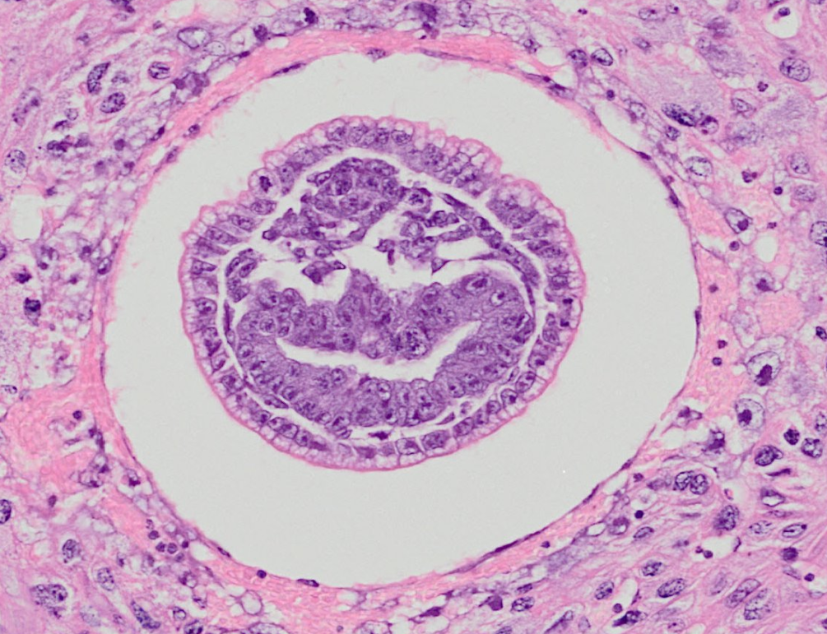
Data from publications
We're going to do an exercise looking at some real research data.
Image: Graham et al, (2015) DataShare

Slide 5
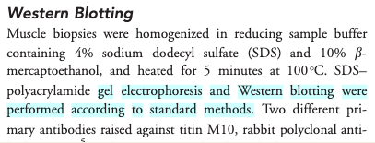
Impossible protocol

Slide 6
Impossible average
Difficult to find the right data table and column
Numerical data in pdf not suitable for calculations

Slide 7
Common problems
Only averaged data available
No numerical data available
Data tables as PDF files in supporting information
Vendor specific file formats
Links to non existing group websites / databases
Data / Code “on request”

Slide 8
Common problems
the protocol was difficult to find (the loops)
the protocol was difficult to access (pay wall)
and not reusable as it lacked the necessary details (dead-end)
In the second example
the data were in a wrong format (not interoperable)
The data were not clearly described (not reusable)

Slide 9

FAIR principles
Image: See Credits

Slide 10
FAIR principles
Findable: Easy to find the data and the metadata for both humans and computers. Automatic and reliable discovery of datasets and services depends on machine-readable persistent identifiers (PIDs) and metadata.
Accessible: The (meta)data retrievable by their identifier using a standardised and open communications protocol (including authentication and authorisation). Metadata should be available even when the data are no longer available.
Interoperable: The data should be able to be combined with and used with other data or tools. The format of the data should be open and interpretable for various tools. It applies both to the data and metadata, the (meta)data should use vocabularies that follow FAIR principles.
Re-usable: FAIR aims at optimising the reuse of data. Metadata and data should be well-described so that they can be replicated and/or combined in different settings. The reuse of the (meta)data should be stated with clear and accessible license(s)

Slide 11
Findable & Accessible
Deposit data to an external, reputable public repository.
Repositories provide persistent identifiers (PIDs), catalogue options, advanced metadata searching, and download statistics. Some repositories can also host private data or provide embargo periods, meaning access to all data can be delayed.
There are general “data agnostic” repositories, for example:
Dryad, Zenodo, FigShare, Dataverse.
Or domain specific, for example:
UniProt – protein data, GenBank – sequence data, MetaboLights – metabolomics data.

Slide 12
Persistent identifiers (PIDs)
A persistent identifier is a long-lasting reference to a digital resource.
Digital Object Identifier (DOI) (prefix doi.org in the web links).
https://doi.org/10.1038/sdata.2016.18 resolves to the FAIR paper
Repositories often maintain web addresses in a stable form (permalinks) http://<repository.address>/<identifier>.
http://identifiers.org/SO:0000167 defines promoter role

Slide 13
Interoperable
Use standard or open-source file formats where possible (domain specific)
Use .csv or .xlsx files for numerical data. Never share data tables as word or .pdf
Provide underlying numerical data for all plots and graphs
Convert proprietary binary formats to open ones. For example convert Snapgene to Genbank/SBOL, microscopy multistack images to OME-TIFF

Slide 14

Reusable
Describe your data well (good metadata)
write a README file describing the data
provide as many details as possible (prepare good metadata)
use descriptive column headers for the data tables
tidy data tables, make them analysis friendly
use (meta)data formats (e.g. SBML, SBOL)
follow Minimum Information Standards

Slide 15
Reusable
Attach license files. Licenses explicitly declare conditions and terms under which data and software can be re-used.
We recommend:
for data: Creative Commons Attribution (CC BY) license
for code: a permissive open source license such as the MIT, BSD, or Apache license.

Slide 16
FAIR and You
Citable
Track & Countable
Intelligible
Reproducible
Image: See Credits

Slide 17
FAIR vs Open Science
FAIR != Open
The data record can be FAIR but the data itself can remain hidden
FAIR data can easily be made public and become Open
Open data which are not FAIR have limited value

Slide 18

FAIR quiz
…

Slide 19
Credits
Research data MANTRA ('Research Data Management training'), University of Edinburgh https://mantra.ed.ac.uk
Histology image - Elizabeth Graham; Julie Moss; Nick Burton; Yogmatee Roochun; Chris Armit; Lorna Richardson; Richard Baldock. (2015). eHistology Kaufman Atlas Plate 04 image l, [image]. University of Edinburgh. College of Medicine and Veterinary Medicine. https://doi.org/10.7488/ds/423.
FAIR logo - SangyaPundir, CC BY-SA 4.0 via Wikimedia Commons https://upload.wikimedia.org/wikipedia/commons/thumb/a/aa/FAIR_data_principles.jpg/800px-FAIR_data_principles.jpg

