Slide 1
Tools for overlords
How tools for research data management
can assist in
project and people management

Slide 2

Jupyter notebooks for data analysis

Slide 3
Reusable ad-hoc analysis with jupyter
Notebooks shine
in orchestrating „short”, step by step operations in R, python, shell (notebooks can use all 3 at the same time)
capturing parameters
adding interpretations
acting as a „flexible” user interface

Slide 4
Plotting in R (Python)
Natural starting point for learning programming
More „powerful” / „professional” scientific plots than ones available in Excel
Easier to recreate
Easier to adjust for specific dimensions/formats/styles

Slide 5
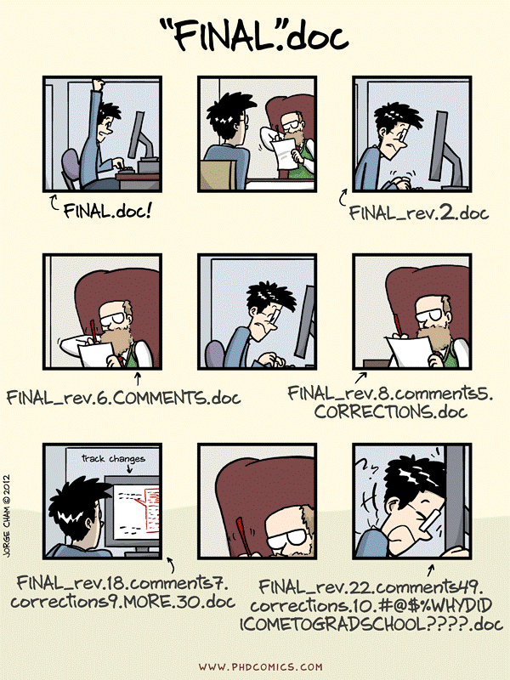
Keeping track of changes

Slide 6
Projects are not static, and actions introduce changes.
add new files
add data entries to files
modify manuscripts / methods
reformat / reorganize data tables
reanalyse data / update figures
experiment with data cleaning / processing / visualization
share and co-edit data or text file

Slide 7
Changes create issues
I have fifteen versions of this file - which one do I use?
I have several copies of the same directory because I'm worried about breaking something
You remember seeing a data file but cannot find it anymore: is it deleted? Moved away?
I came to an old project and forgot where I left/saved it
My directory is polluted with a lot of unused/temporary/old folders because I'm afraid of losing something important

Slide 8
Version control systems == Git/GitHub
Addressing those issues by tracking changes is called version control.
With version control, file names do not reflect their versions.
Information about versions and changes are kept separate from the files.

Slide 9
GitHub live

Slide 10
Benchling live

Slide 11
Tools and management

Slide 12
Learning curve

Slide 13
Learning curve
Where things are online
How to create accounts – join/remove group members
How to find your group or group members data
How to check who did what
How to access records/files online
Consuming/annotating content is much easier than creating it!!!

