Slide 1
Putting it all together

Slide 2

Exercise:
Which practices to introduce first

Slide 3
Collaborative environment for your group
Shared network storage for group data
Shared, online accessible protocols, lab notebooks
Standardise projects (folder structure, naming)
Standardise experiment descriptions (templates)
Git for sharing code/scripts

Slide 4

Exercise:
How to enforce good practices

Slide 5
How to sustain good practices
Be an active user of the tools
Ask for links to resources, not attachments
Use live data during meetings
Randomly check outputs / praise good work
“Pair programming”
Data curation days

Slide 6
Benefits of good DM
Saving time / work speed
Finding data / protocols
manuscript preparations / sharing
onboarding / project continuation
collaboration
Team building = group cohesion
Knowledge transfer
Accountability, “research integrity”

Slide 7
The research data life cycle
CREATING DATA
RE-USING DATA
PROCESSING DATA
Time and effort
SHARING
DATA
ANALYSING DATA
PRESERVING DATA
work necessary to make outputs suitable for sharing
standard research operations

Slide 8
There is a lot to learn
Practical recipes and guides:
https://faircookbook.elixir-europe.org/
https://rdmkit.elixir-europe.org/
Training
FAIR in (bio) practice
UoE RDS https://www.ed.ac.uk/information-services/research-support/research-data-service

Slide 9
FAIR in (bio) practice - workshop
Introduction to Open Science and FAIR
IP, Licensing and Openness
Metadata
Ontologies
(Meta)data in Excel
Record keeping
Working with files
Reusable analysis - Jupyter
Version control
Templates
Public repositories
Writing Data Management Plans

Slide 10
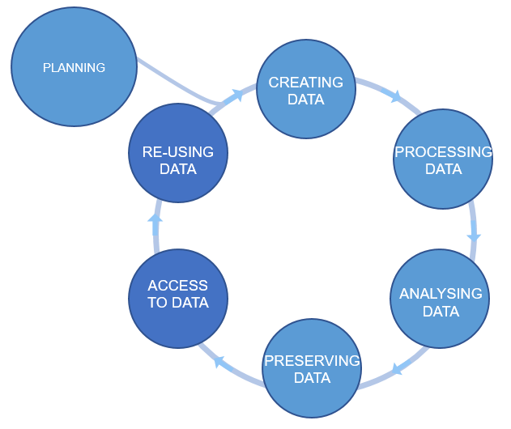
Plan ahead
data management plans
(DMPs)
Figure credits: Tomasz Zieliński and Andrés Romanowski

Slide 11
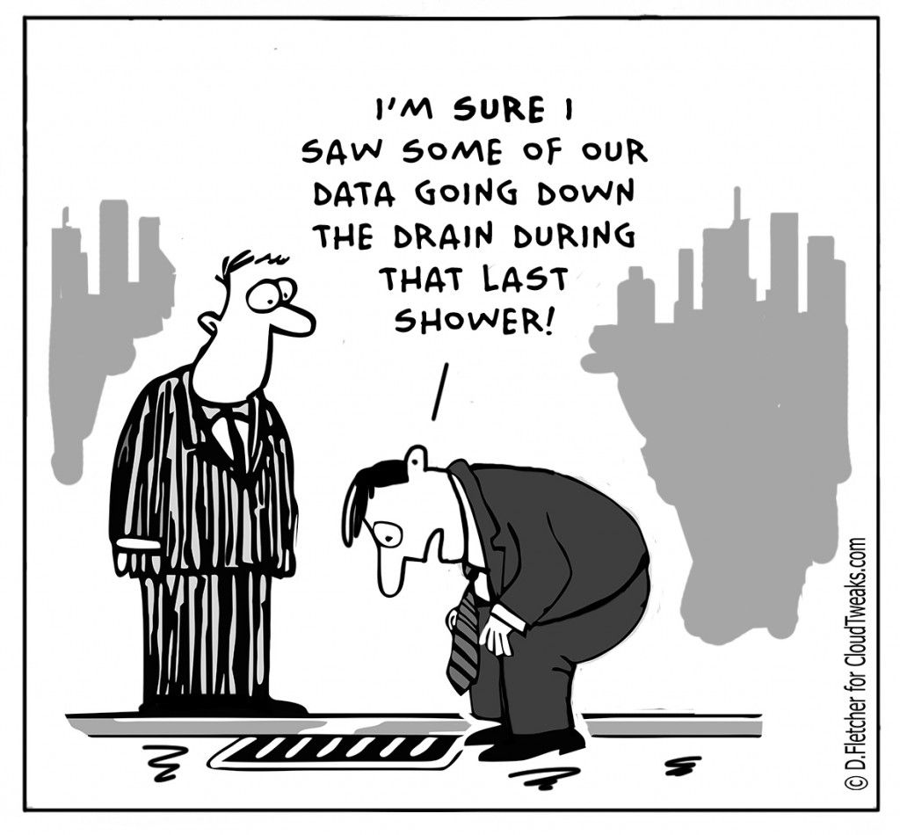
Why do we need Data Management Plans?
Data is the basis for research papers and theses.
Data is fragile and easily lost. Data needs to be backed up
Growing data management demands by funders.
There are costs involved in data management
It saves time and resources in the long run
A scientific paper is often written more than 1 year after the experiments were performed.

Slide 12
Two flavours of DMP: for Grants and Internal
Grant application DMP
focus on Reuse => FAIR
safety of the data
limitation to sharing
allocation of resources
Project DMP
focus on your productivity and achieving FAIR
safety of the data
technicalities: file naming conventions, folder structures, templates for experiments, how you link to ELN ….

Slide 13
What should we consider in a good DMP?
Good DMPs
Think about:
how you will store the data
how you will organize and describe your data
how you will grant access to your data
how you will share your data
how you will preserve your data
how others can use your data
how much it will all cost
Notes:
Most of the funders require that you present a DMP together with your grant applications. Some institutions ask eve their PhD students to prepare a DMP for their PhD project.
You should think how you are going to manage your data (our outputs, in general) for each of your projects (or even individual assay types). For individual project the main focus should be on: what data will be produced, how they will be stored and organized, how you are going to describe them and track them. For example what file formats will be generated, how you are going to name your files, and how you will link it to your laboratory notes.
For grant applications, DMP tend to be less technical, for example no need to discuss folder structures, but, they should emphasize the data safety (as preservation and access), data longevity, sharing, discovery and re-use.

Slide 14

Useful resource
https://dmponline.dcc.ac.uk/
Contains DMP templates for the different funders requirements and information on how to fill each section.

Slide 15

Question time

