Slide 1
Putting it all together

Slide 2

Exercise:
What to introduce first

Slide 3
Collaborative environment for your group
Shared network storage for group data
Shared, online accessible protocols, lab notebooks
Standardise projects (folder structure, naming)
Standardise experiments descriptions (templates)
Git for sharing code/scripts

Slide 4

Exercise:
How to enforce good practices

Slide 5
The research data life cycle
CREATING DATA
RE-USING DATA
PROCESSING DATA
Time and effort
SHARING
DATA
ANALYSING DATA
PRESERVING DATA
work necessary to make outputs suitable for sharing
standard research operations

Slide 6
There is a lot to learn
Practical recipes and guides:
https://faircookbook.elixir-europe.org/
https://rdmkit.elixir-europe.org/
Training
FAIR in (bio) practice
UoE RDS https://www.ed.ac.uk/information-services/research-support/research-data-service

Slide 7
FAIR in (bio) practice - workshop
Introduction to Open Science and FAIR
IP, Licensing and Openness
Metadata
Ontologies
(Meta)data in Excel
Record keeping
Working with files
Reusable analysis - Jupyter
Version control
Templates
Public repositories
Writing Data Management Plans

Slide 8
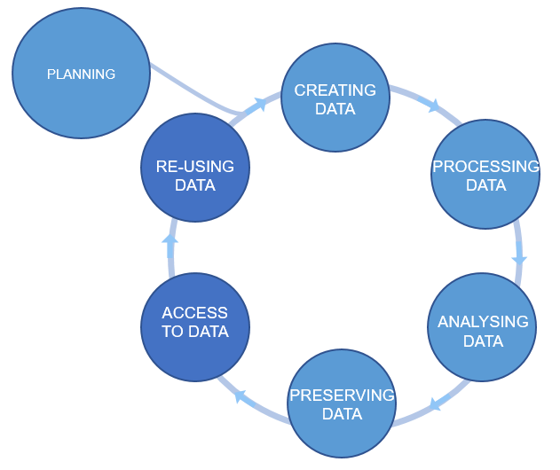
Plan ahead
data management plans
(DMPs)
Figure credits: Tomasz Zieliński and Andrés Romanowski

Slide 9
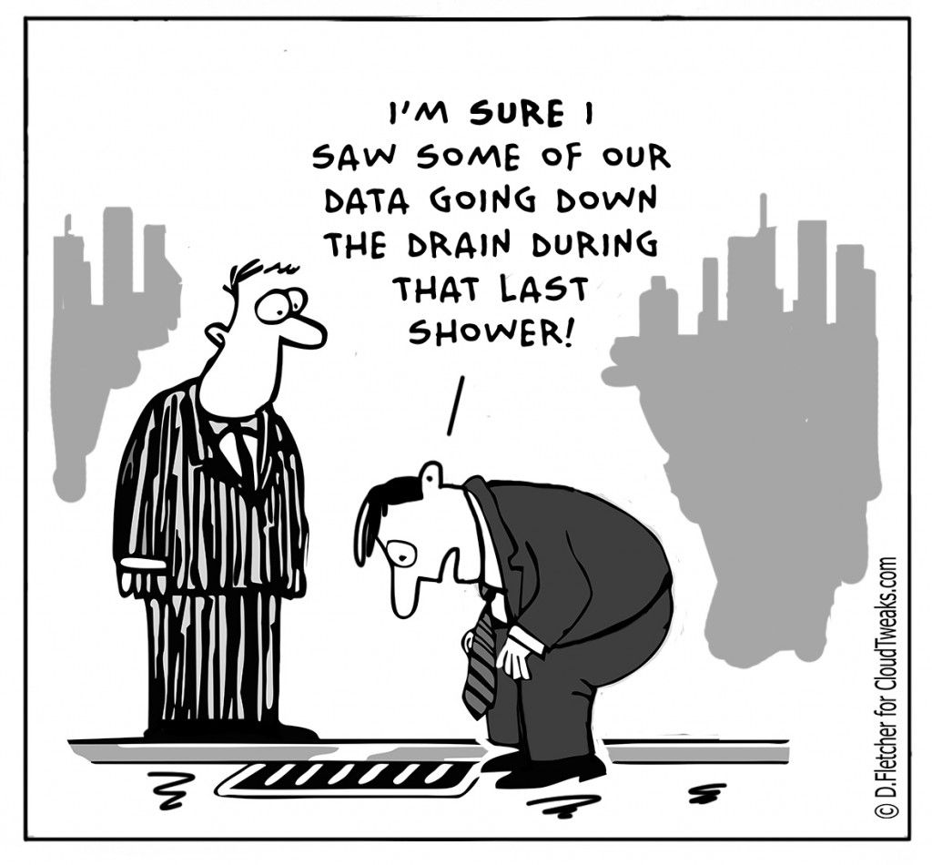
Why do we need Data Management Plans?
Data is the basis for research papers and theses.
Data is fragile and easily lost. Data needs to be backed up
Growing data management demands by funders.
There are costs involved in data management
It saves time and resources in the long run
A scientific paper is often written more than 1 year after the experiments were performed.

Slide 10
Two flavours of DMP: for Grants and Internal
Grant application DMP
focus on Reuse => FAIR
safety of the data
limitation to sharing
allocation of resources
Project DMP
focus on your productivity and achieving FAIR
safety of the data
technicalities: file naming conventions, folder structures, templates for experiments, how you link to ELN ….

Slide 11
What should we consider in a good DMP?
Good DMPs
Think about:
how you will store the data
how you will organize and describe your data
how you will grant access to your data
how you will share your data
how you will preserve your data
how others can use your data
how much it will all cost
Notes:
Most of the funders require that you present a DMP together with your grant applications. Some institutions ask eve their PhD students to prepare a DMP for their PhD project.
You should think how you are going to manage your data (our outputs, in general) for each of your projects (or even individual assay types). For individual project the main focus should be on: what data will be produced, how they will be stored and organized, how you are going to describe them and track them. For example what file formats will be generated, how you are going to name your files, and how you will link it to your laboratory notes.
For grant applications, DMP tend to be less technical, for example no need to discuss folder structures, but, they should emphasize the data safety (as preservation and access), data longevity, sharing, discovery and re-use.

Slide 12

Useful resource
https://dmponline.dcc.ac.uk/
Contains DMP templates for the different funders requirements and information on how to fill each section.

Slide 13
DMP example
https://www.wiki.ed.ac.uk/x/yesNGQ
What type of data will be acquire during the research
How will the data be stored
How will the data be shared === target repositories, standards

Slide 14
DMP example
Reusable paragraphs

Slide 15
Exercise: Be a reviewer
Working in groups evaluate DMP.
does it look as if the author(s) thought what they would do with their data or is it some ‘whatever’ copy pasted text
does it look as if the data will be stored in a secured way
does it look as if the data will be shared in a FAIR way
are there any standards that should be followed
does it look as if the data will be made accessible / findable to others for re-use
are the usage restrictions justifiable

Slide 16
Data Management Plans
Show that you are thinking about what will happen with the generated data during and after the project.
How the project data is going to be FAIR.
Data management & admin should be done throughout the project, not at the end!

Slide 17

Data Management Plan

