Slide 1
AI coding assistant ethics challenge (15 min)
List at least two potential risks or vulnerabilities that could arise from using an AI coding assistant in this project.
For each risk identified, propose a specific mitigation strategy. Explain how this strategy addresses the risk and aligns with the best practices discussed in the lesson.
Draft a set of at least 5 ethical guidelines for your team to follow when using the AI coding assistant. These should cover areas such as bias prevention, code review processes, and data privacy.
Outline a security protocol that includes at least three specific measures to protect sensitive data and ensure the integrity of the AI-assisted development process.
Design a collaborative code review process that leverages the strengths of both human developers and the AI assistant while mitigating potential risks.
Notes:
You’re leading a team that’s considering adopting an AI coding assistant for a new project involving sensitive user data. Your task is to create a comprehensive plan that addresses the ethical and security concerns discussed in the lesson.

Slide 2
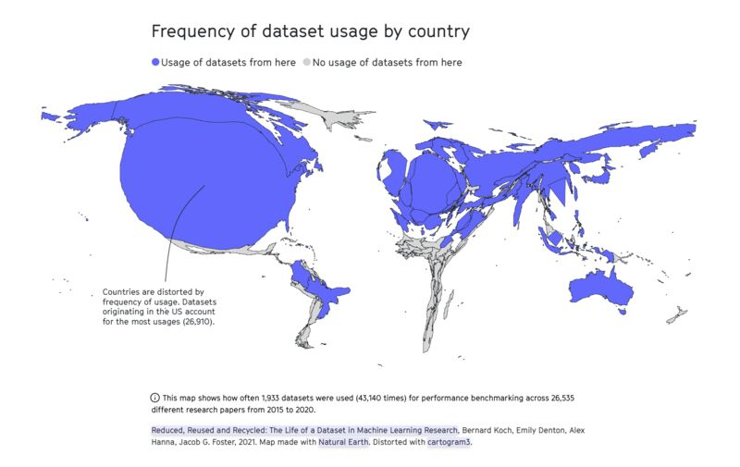
Ethical and data security considerations
AI-generated content is based on human choices, values, and flaws
Lack of diversity in training data

Slide 3
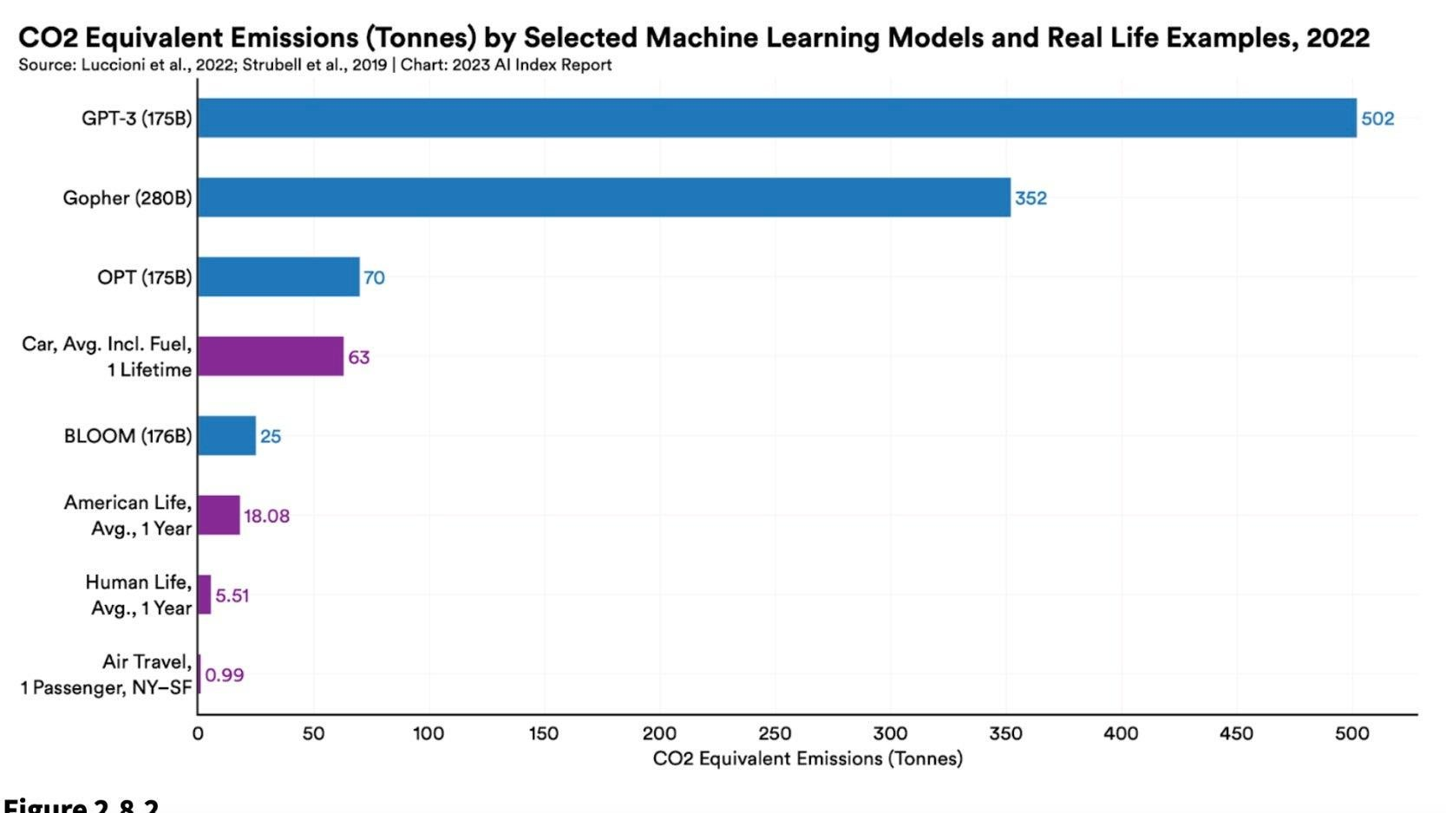
Ethical and data security considerations
Environmental costs of GenAI (energy and water use)
by 2027, the annual electricity usage of AI servers could equal the annual electricity usage of the Netherlands or Sweden.¹
LLM could use up to 500 ml of water per 5-50 prompts.²
Screenshot: “The AI Index 2023 Annual Report,” AI Index Steering Committee, Institute for Human-Centered AI, Stanford University, Stanford, CA
1. https://www.nytimes.com/2023/10/10/climate/ai-could-soon-need-as-much-electricity-as-an-entire-country.html
2. https://fortune.com/2023/09/09/ai-chatgpt-usage-fuels-spike-in-microsoft-water-consumption/?utm_source=www.joinsuperhuman.ai&utm_medium=newsletter&utm_campaign=ai-needs-a-lot-of-water

Slide 4
Ethical considerations
Exploitative labor to train GenAI models¹
'reinforcement learning through human feedback’ outsourced to low-wage employees in Kenya
Unequal accessibility
cost of tools is a barrier
the use of particular GenAI tools may be restricted due to government regulation or censorship
1. https://time.com/6247678/openai-chatgpt-kenya-workers/

Slide 5
Best practices for ethical use of AI assistants
Vigilant evaluation of results to identify and reduce potential biases
Transparency and accountability in AI use
Acknowledge and cite AI-generated output in your work
Following clear AI guidelines

Slide 6

Current AI regulations in the EU
Risk Categories
The AI Act (August 2024)
Purpose: Ensures AI is safe, respects fundamental rights, and supports democracy, the rule of law, and environmental standards.
Applies to public & private sectors within and outside the EU if AI impacts people in the EU.
Exemptions: Research, military/defense, and non-market prototypes.
Unacceptable Risk: Banned uses (e.g., social scoring, exploitative manipulation).
High-Risk: Systems impacting rights and safety (e.g., job screening, law enforcement).
Transparency Risk: Disclosures required for manipulation-prone applications.
Minimal Risk: General use with voluntary standards adherence.
Notes:
The AI Act (proposed in December 2023, approved on March 18
Purpose: Ensures AI is safe, respects fundamental rights, and supports democracy, the rule of law, and environmental standards.
Benefits & Risks: AI brings societal and economic benefits but also new safety and rights-related risks that could impact trust.
Applicability
Applies to public & private sectors within and outside the EU if AI impacts people in the EU.
Exemptions: Research, military/defense, and non-market prototypes.
Risk Categories
Unacceptable Risk: Banned uses (e.g., social scoring, exploitative manipulation).
High-Risk: Systems impacting rights and safety (e.g., job screening, law enforcement).
Transparency Risk: Disclosures required for manipulation-prone applications.
Minimal Risk: General use with voluntary standards adherence.
Compliance
High-Risk Obligations: Conformity assessments, data quality, transparency, cybersecurity.
Systemic Risks: Rules for general-purpose AI, including labeling requirements for generative outputs.
, 2024)

Slide 7
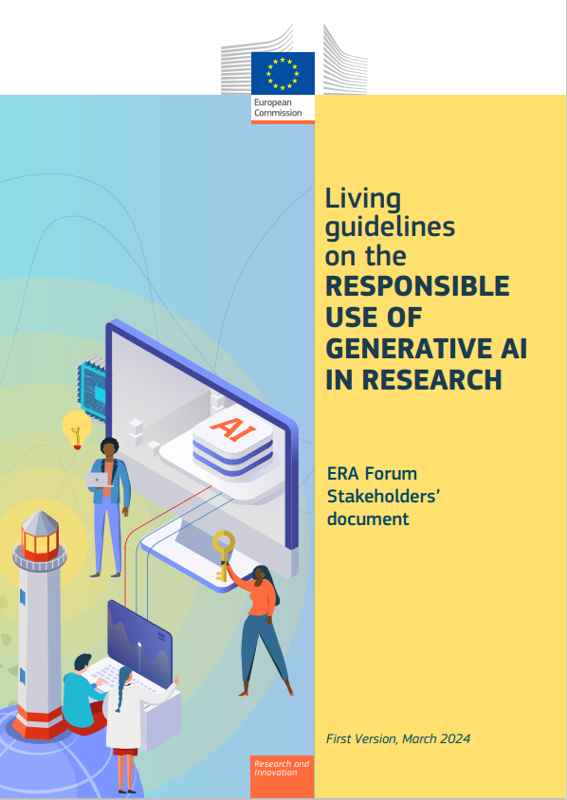
Current AI regulations in the EU
Living guidelines on the responsible use of generative AI in research by the European Commission (March 2024)
Researchers:
Responsibility for scientific output
Transparent GAI use
Privacy, confidentiality, and intellectual property rights
Legal and ethical standards
Refrain from using GAI substantially in sensitive activities

Slide 8
Current AI regulations in the EU
Living guidelines on the responsible use of generative AI in research by the European Commission (March 2024)
Research Organizations:
Monitor and evaluate the development and use of GAI systems
Reference or integrate GAI guidelines into general research guidelines
Implement local or cloud-based GAI tools with adequate data protection measures
Promote, guide, and support the responsible use of GAI

Slide 9
Data security
Random and systematic errors can undermine reliability
GitHub Copilot generated correct code only 46.3 percent of the time
Intellectual property issues
Do not enter copyrighted materials
Blurred boundaries of authorship and ownership → no clear-cut answers
Code review processes to evaluate AI-generated code for potential vulnerabilities and errors.

Slide 10
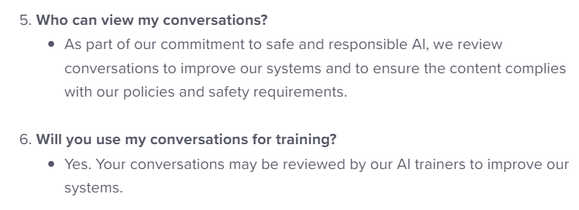
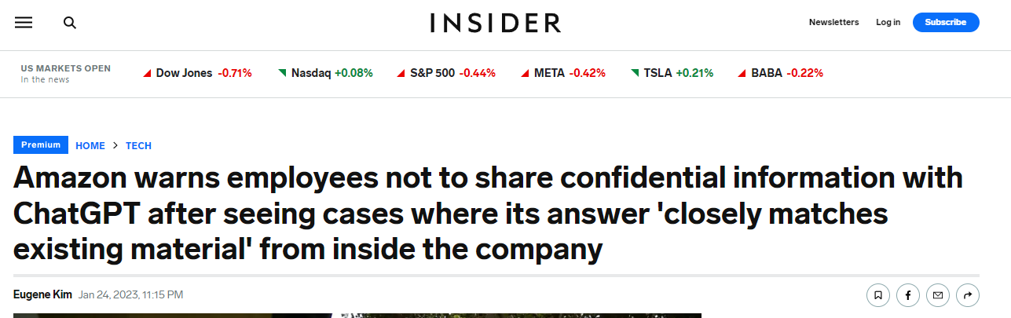
Data security
Dealing with sensitive research and personal data
your input will probably be used to further train the GenAI tools
data is processed and stored on US servers
Use offline AI tools
For projects involving proprietary or sensitive data
TabNine can be run locally without the need for Internet access
Training a LLaMA model locally, which allows for a customized coding assistant
https://help.openai.com/en/articles/6783457-chatgpt-general-faq
https://businessinsider.com/amazon-chatgpt-openai-warns-employees-not-share-confidential-information-microsoft-2023-1

Slide 11
Security measures
Access controls and data encryption to protect sensitive code bases
Prevents unauthorized access → reducing the risk of data breaches or malicious tampering.
Continuous monitoring and updates
Automate updates and ensure that the latest security practices are consistently applied → minimize the introduction of vulnerabilities
Collaborative Oversight
Regular code reviews can promote collective responsibility, enhancing code quality through diverse perspectives
Notes:
Collaborative Oversight
Multiple perspectives help identify potential flaws that an individual developer might overlook. Implementing regular code reviews can foster an environment of collective responsibility, enhancing code quality through diverse perspectives.

Slide 12
Key takeaways
Code generation and optimization using Chat, Command, and Autocomplete functions of Codeium
Follow best practices (e.g., always review generated code) and be cautious with sensitive data
Be aware of potential biases in AI-generated code and ensure ethical coding practices
Use AI as a tool to augment, not replace, your coding skills!
What are your questions?

Slide 13
Workshop feedback
Survey: here will be a QR code to a feedback form

Slide 14



Giulia Crocioni g.crocioni@esciencecenter.nl
The end!
Thanks
Olga Minaeva
o.minaeva@nwo-i.nl

