Slide 1
Carbon Awareness
Green software use on HPC

Slide 2
Questions
How does electricity generation affect GHG emissions?
What is carbon intensity of electricity generation and how does it vary geographically and temporally?
What techniques can I use to make my use of HPC greener and influence transition to low-carbon electricity generation?

Slide 3
Objectives
Understand the concept of carbon intensity in electricity generation.
Appreciate the level of variation in carbon intensity across the UK and the world.
Understand techniques for greener use of HPC: demand shifting and demand shaping.

Slide 4
What is carbon awareness?
Electricity is generated from various sources.
  Some sources emit no (or little) carbon, e.g., renewables.
  Other sources emit substantial quantities of carbon, e.g., fossil fuels.
The energy mix is the proportions of electricity contributed by each energy source.
  The actual proportions vary by place and by time
Carbon Awareness is about doing more work when electricity is being generated from low carbon sources and less when it is not
  Reducing the amount of carbon emitted for the same total work

Slide 5
Carbon Intensity
Carbon intensity (CI) measures how much carbon is emitted per kilowatt-hour (kWh) of electricity consumed.
  Units are gCO₂e / kWh , grams of carbon dioxide equivalent per kilowatt-hour.
If your computer is directly plugged into a wind farm, the electricity required to run the computer would have zero carbon intensity.
In actual fact, an HPC system is plugged into a national grid that is supplied with electricity from various sources.
  How much electricity is provided by each source is outside of the customer's control.

Slide 6
Carbon intensity

Slide 7
Carbon intensity varies by location (1)
This table shows the average carbon intensity for UK regions over 2024 (ref: electricityinfo.org regional carbon intensity history):
Type | Regions | Carbon Intensity (gCO₂e/kWh)
Low | N. Scotland, S. Scotland, N.E. England, N.W. England | 22 - 48
Low Medium | N. Wales | 77
Medium | E. England, London, W. Midlands, S.E. England, Yorkshire | 108 - 135
High Medium | S. England, E. Midlands | 186 - 203
High | S.W. England, S. Wales, | 242 - 255

Slide 8
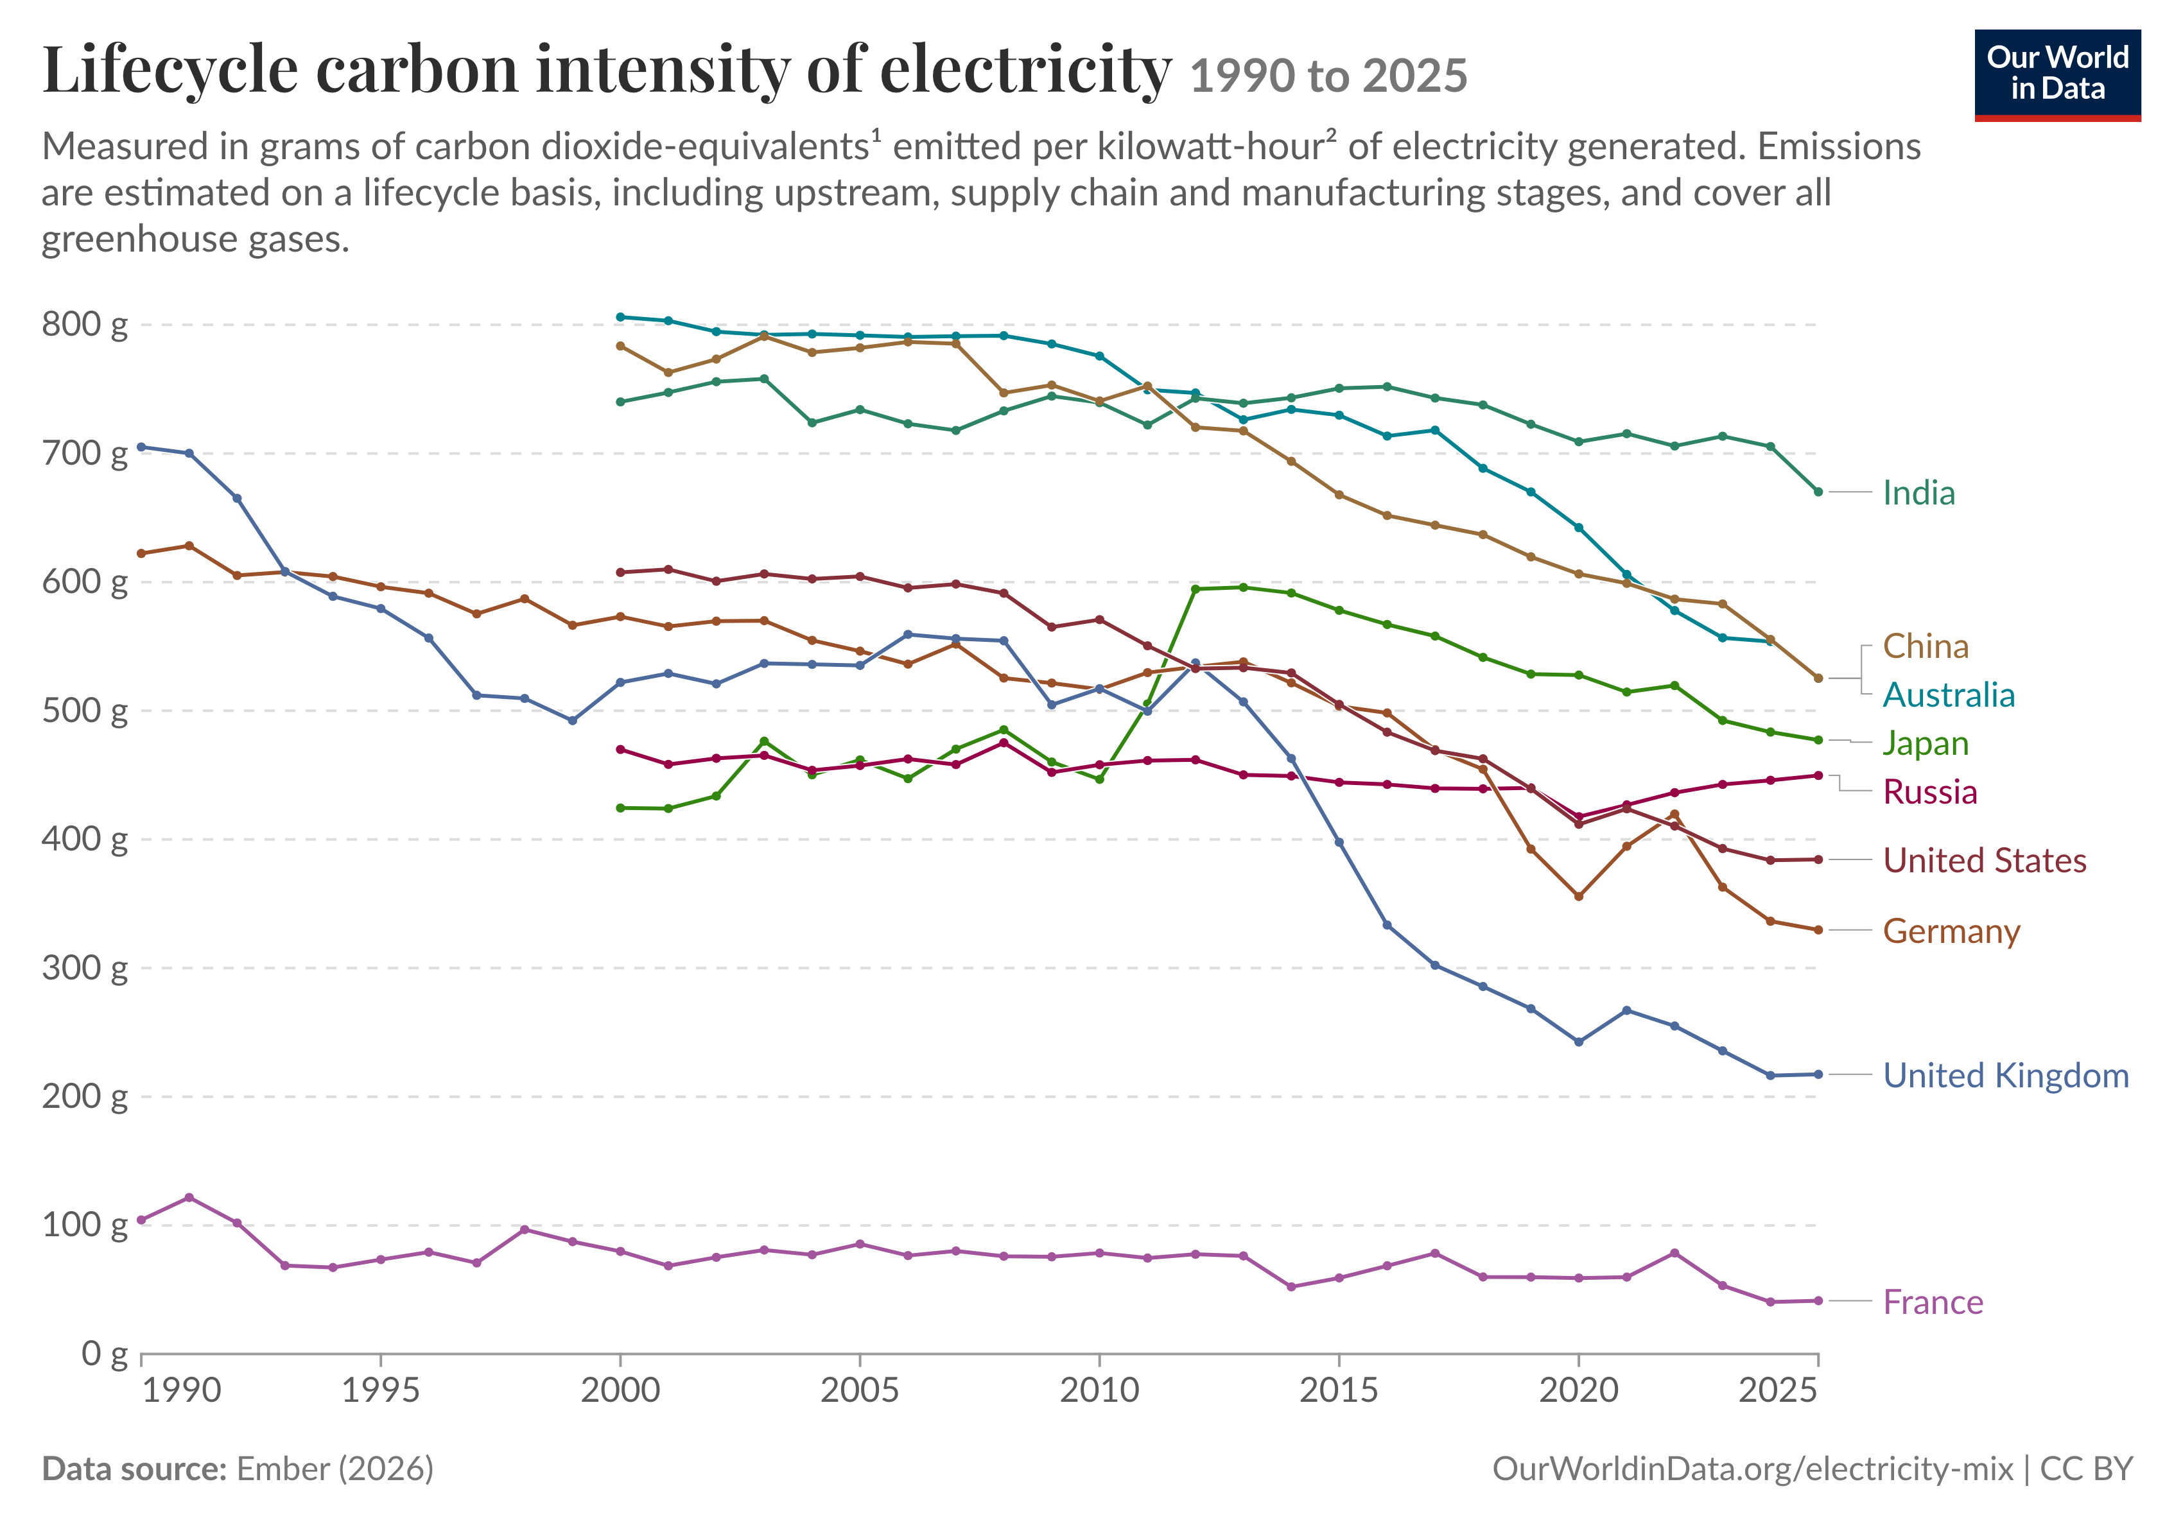
Carbon intensity varies by location (2)
This data compares values across the world (ref: Our World In Data):
Country | 2025 Carbon Intensity (gCO₂e/kWh)
France | 41
UK | 217
USA | 384
Germany | 330
Russia | 450
Japan | 477
Australia | 525

Slide 9
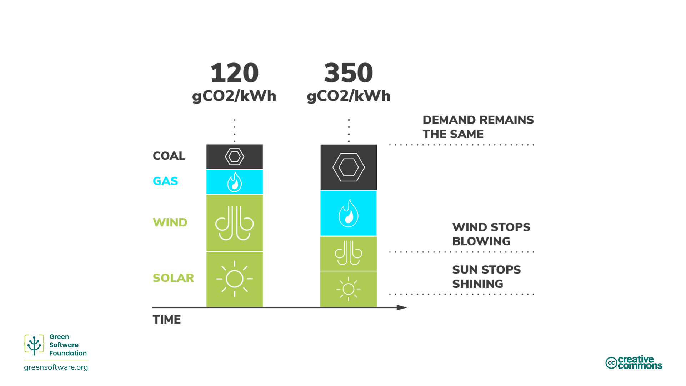
Carbon intensity varies over time
Primarily due to changes in weather conditions
Affects proportion of electricity generated from renewable sources
Shortfall made up by high carbon energy sources

Slide 10
Exercise: emissions variation from HPC
One estimate of the power draw of the ARCHER2 HPC system is 3.1 MW (this includes overheads due to power and cooling).
The mean carbon intensity (CI) varies across the UK regions. In 2024, three CI regions were identified.
Type | Carbon Intensity [gCO₂e/kWh]
low | 30
medium | 120
high | 250
What would the carbon emissions be from the electricity use required for 1 year of ARCHER2 operations in the three different emission regions?

Slide 11
Solution: emissions variation from HPC
First, we need to estimate the amount of energy consumed by ARCHER2 in kWh for 1 year from the power draw estimate.
3,100 kW × 365 days × 24 hours = 27,156,000 kWh
Next, we multiply this energy use by the quoted carbon intensity values to get the estimated emissions from a year of ARCHER2 operation in the three different regions.
Type | Emissions [kgCO₂e]
low | 815,000
medium | 3,260,720
high | 6,790,000
Hosting ARCHER2 in a high CI region instead of the low CI region would lead to an additional 5,980,000 kgCO₂e of emissions per year, a more than eightfold increase.

Slide 12
Carbon markets

Slide 13
Dispatchability and curtailment
Demand
For fossil fuels and nuclear power, the amount of electricity produced can be controlled easily
  These sources of power have high dispatchability
Some renewable sources of energy, such as solar and wind, have low dispatchability…
… if the energy provided by those power sources exceeds demand, the electricity must be "thrown away", aka, curtailment

Slide 14
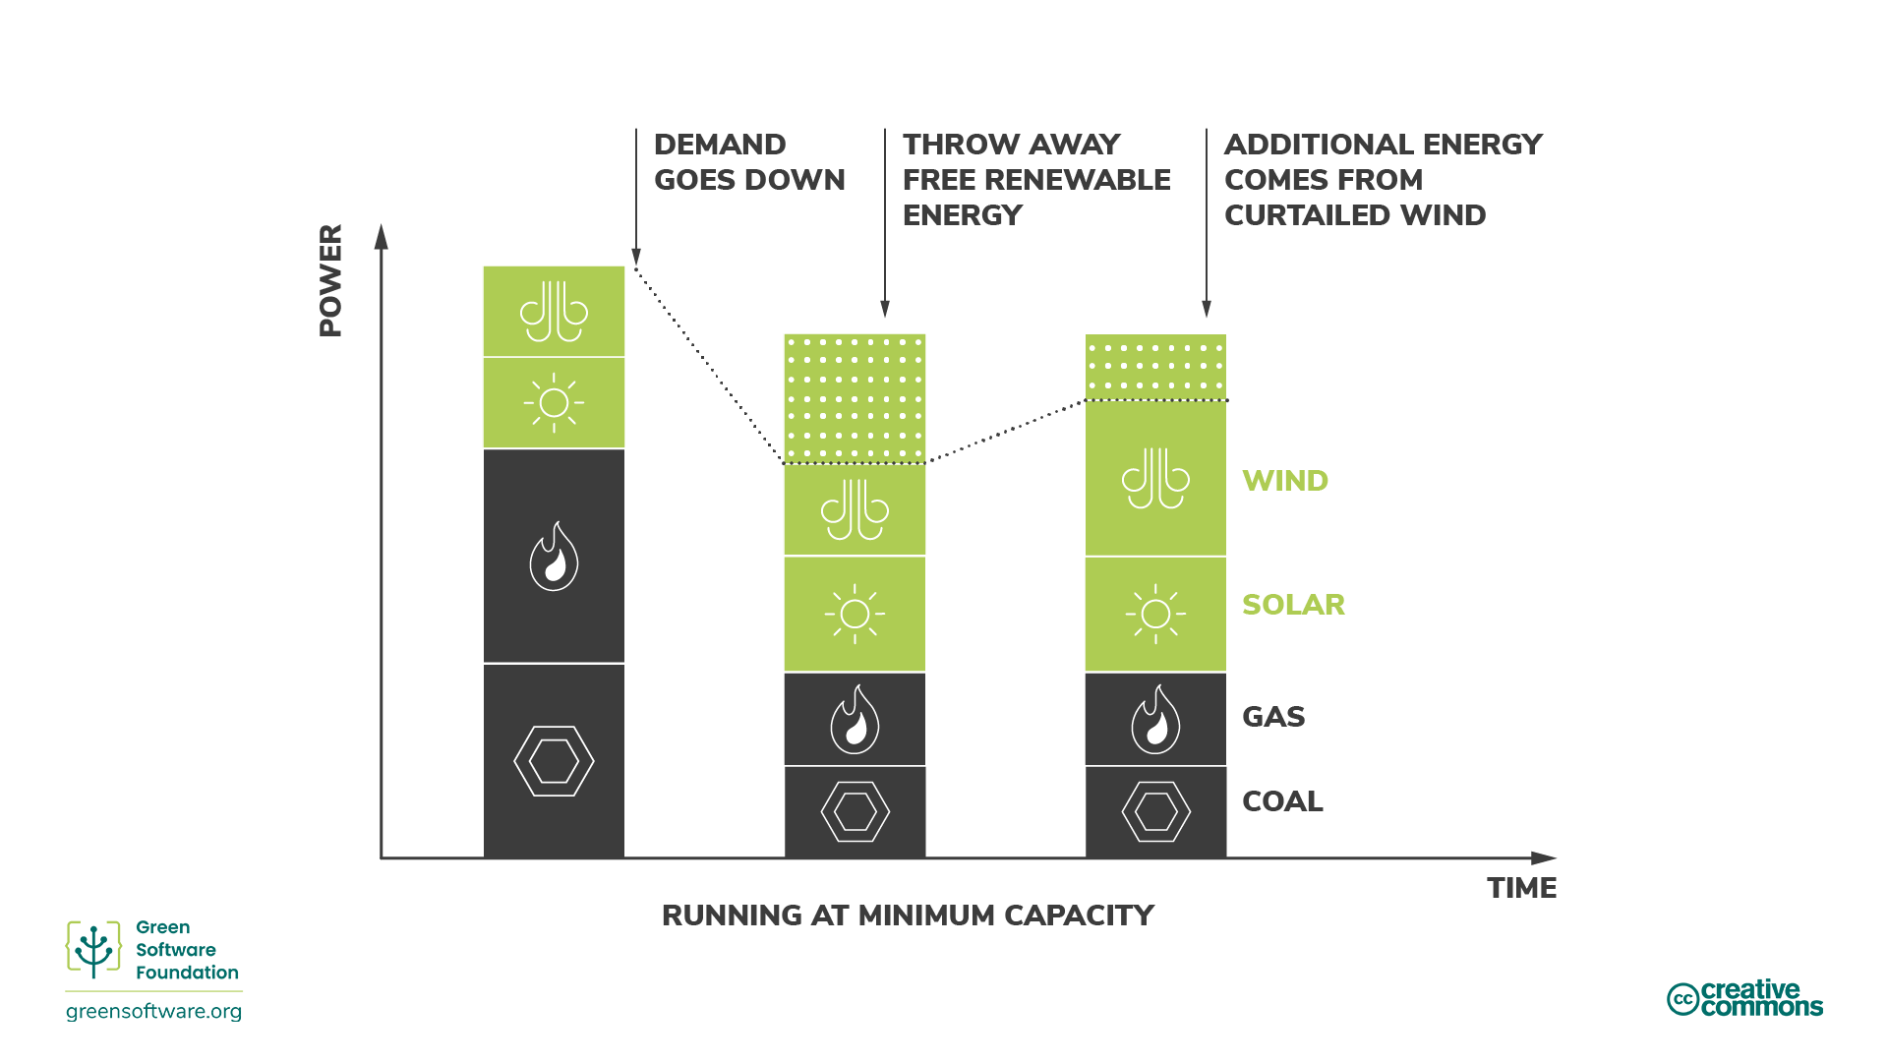
Marginal carbon intensity
If you suddenly increase demand, that energy comes from a marginal power plant
  The marginal power plant usually runs on a power source that has high dispatchability
Marginal carbon intensity is simply the carbon intensity of a marginal power plant
Fossil fuel plants have a lower threshold
  They provide an “always-on” baseline
Notes:
Often end up in the scenario where you are throwing away renewable energy (curtailing) while still burning fossil fuels because:
Fossil fuels have a lower threshold they cannot be lower than
You need the fossil fuels running for their high dispatchability

Slide 15
Energy market drivers
Energy prices fluctuate with demand; in general, the market can respond as follows.
When demand drops buy less energy from...
  fossil fuel plants – preferred as these are more expensive
  renewable sources – last resort, leads to curtailment
When demand rises buy more energy from...
  renewable sources that are currently being curtailed – preferred as cheapest
  fossil fuel plants – utilise inherent dispatchability, but expensive
The above picture is a simplification, energy markets are some of the most complex in the world
Our goal when we are being carbon aware is to drive investment in renewables
  How do we do this?

Slide 16
Being more carbon aware

Slide 17
Driving investment in renewables
Electricity production is moving towards renewables
Driver is economic – renewable energy is cheaper
To accelerate this transition we should aim to use more electricity when renewables are supplying and use less when it is supplied by fossil fuels
We can do this by different forms of demand shifting and shaping
  This means being aware of the carbon intensity of electricity production and increasing or decreasing our demand in response
  We will look at: spatial shifting, temporal shifting and demand shaping

Slide 18
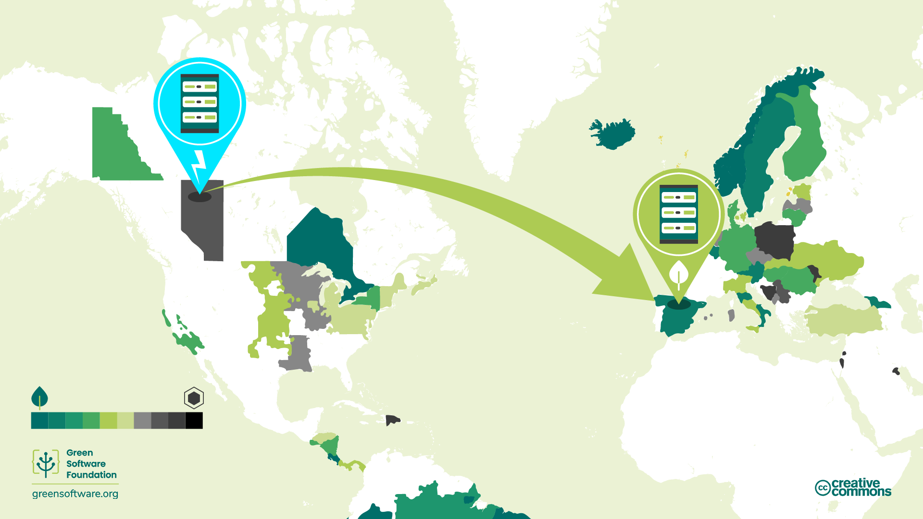
Spatial shifting
Spatial shifting means moving your computation to a location where the current carbon intensity is low
This requires the ability to easily run at different locations

Slide 19
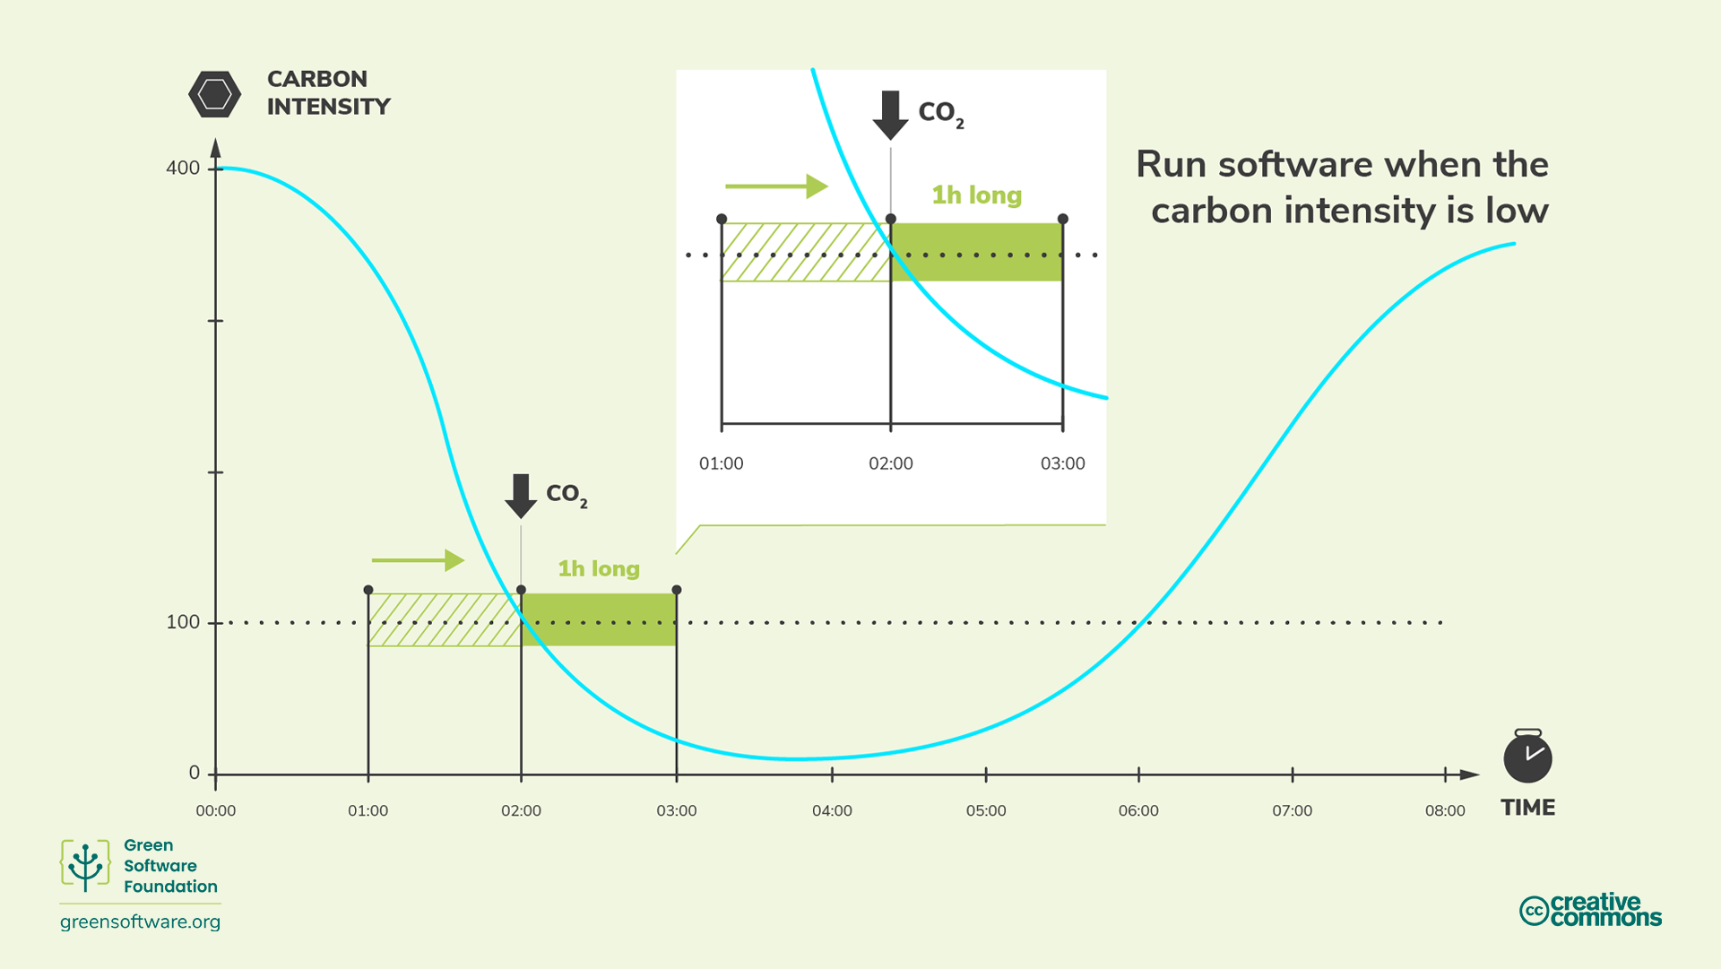
Temporal shifting
Temporal shifting means moving your computation to a time when the carbon intensity is expected to be low
Relies on carbon intensity forecasts – e.g. from carbonintensity.org.uk website and API
Relies on the ability to specify a start time for computational work

Slide 20
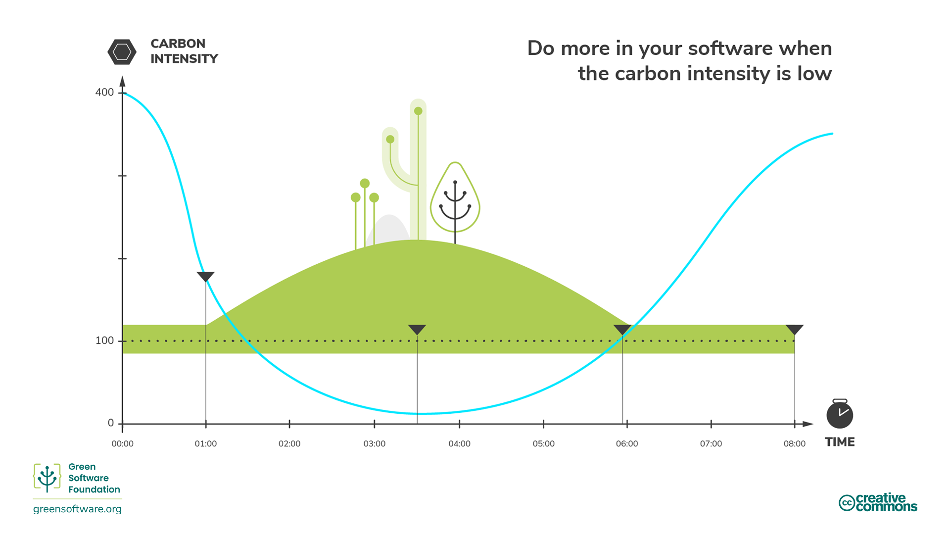
Demand shaping
In demand shaping we shape our computation based on how the carbon intensity varies
If carbon intensity is low, increase the demand
If carbon intensity is high, decrease demand
Demand shaping is related to a broader concept in sustainability, which is to reduce consumption. We can achieve a lot by becoming more efficient with resources, but we also need to consume less at some point

Slide 21
Exercise: demand shifting and shaping
A typical HPC system has a wide variety of jobs to schedule and different HPC systems have different scheduling and charging policies for jobs that run on them
Write down some ideas on how you could potentially modify the scheduling and charging of jobs to enable demand shaping and/or temporal shifting on an HPC system.
For each idea, who would be responsible for implementing this on an HPC system (e.g. individual users, service operators)?

Slide 22
Solution
Scheduling based on power intensity
  Manual: users place jobs into different queues based on predicted power intensity; charging discounts for users who use this facility
  Automatic: system detects/predicts power intensity of jobs and schedules accordingly
Credit based system:
  Earning and spending periods: during earning period, users start with a number of tokens and subtract based on efficiency (to stop more tokens for more use). During spend period, users with most efficiency from earning period get priority on system
  This type of approach has been piloted on the Fugaku HPC system in Japan
Power capping approaches:
  System power cap fluctuates with grid carbon intensity
  Need a tool to distribute power cap amongst jobs
  For example HPE’s PowerSched tool

Slide 23
Key Points
Carbon awareness means understanding that the energy you consume does not always have the same impact in terms of carbon intensity.
Carbon intensity varies depending on the time and place it is consumed.
The nature of fossil fuels and renewable energy sources means that consuming energy when carbon intensity is low increases the demand for renewable energy sources and increases the percentage of renewable energy in the supply.
Demand shifting means moving your energy consumption to different locations or times of days where the carbon intensity is lower.
Demand shaping means adapting your energy consumption around carbon intensity variability in order to consume more in periods of low intensity and less in periods of high intensity.

