Slide 1
Energy Efficiency
Green Software use on HPC

Slide 2
Questions
What are low carbon sources of electricity generation?
How do we quantify energy efficiency?
What aspects should we consider when looking at energy efficiency of HPC system use?

Slide 3
Objectives
Understand how different ways of generating electricity lead to different carbon emission rates.
Understand key concepts in improving energy efficiency of HPC system use.
Appreciate how the different bounds on HPC application performance impact energy efficiency.

Slide 4
Energy use by HPC systems
HPC systems require energy to do computational work, and this energy is provided in the form of electricity
Generation of electricity produces carbon emissions
Improving energy efficiency of HPC system use reduces the amount of carbon emissions per unit of output
The reduction of energy consumed by work on an HPC system depends on a lot of things, including:
The design and algorithm choices of the software engineers who wrote the software
The technology of the HPC system itself
How the source code is interpreted by compilers to produce machine-executable code (including compiler optimisations)
The input and setup of the software given by the user themselves.
The responsibility for improving energy efficiency lies with all HPC stakeholders

Slide 5
Key Concepts

Slide 6
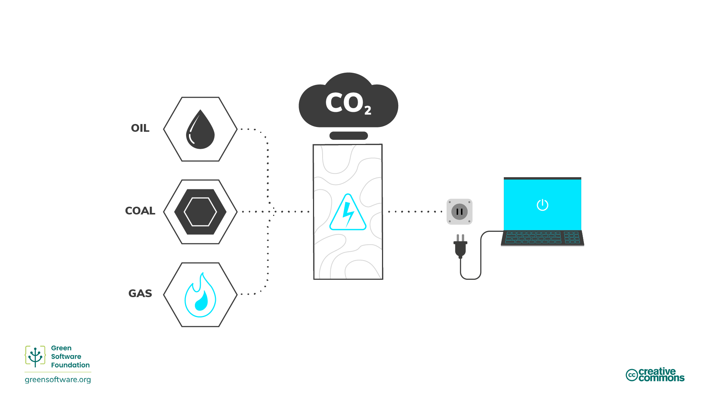
High carbon sources of electricity
High-carbon sources
  Burning fossil fuels, coal, oil and gas, generates GHGs
  Where these methods of electricity generation dominate – there is a direct link from electricity use to carbon emissions

Slide 7
Case study: UK emissions
“Between 1990 and 2023, UK territorial carbon dioxide emissions decreased by 49.8%, and total greenhouse gas emissions by 52.7%. The largest factor behind this long-term decrease was the change in the mix of fuels being used for electricity generation, with a shift away first from coal to gas in the 1990s, and more recently to renewable energy sources. This was combined with lower electricity demand, owing to greater efficiency resulting from improvements in technology and a decline in the relative importance of energy intensive industries. Overall inland energy consumption is provisionally estimated to have decreased by 24.1% since 1990…”
From: 2023 UK greenhouse gas emissions, provisional figures
While there is still a lot of work to be done on decarbonising the UK electricity grid, it is clear that further reductions in UK carbon emissions increasingly need to focus on other sources of carbon emissions.

Slide 8
Low carbon sources of electricity
Terms can sometimes be confusing here and categories overlap
Clean energy - does not produce carbon emissions e.g. nuclear
Green energy - sources from nature
Renewable energy - sources will not expire e.g. solar, wind
Increasing the electricity generation capacity from such sources reduces the emissions per unit of electrical energy consumed.

Slide 9
Energy units refresher
Energy is measured in joules (J), the SI unit of energy
Power is measured in watts, where 1 watt (W) is a rate corresponding to one joule per second
A kilowatt (kW) therefore corresponds to 1000 joules per second
A kilowatt-hour (kWh) is an alternative measure of energy corresponding to one kilowatt of power sustained for one hour
  kWh is the typical unit of energy used to measure electricity consumption

Slide 10
Energy Efficiency Factors

Slide 11
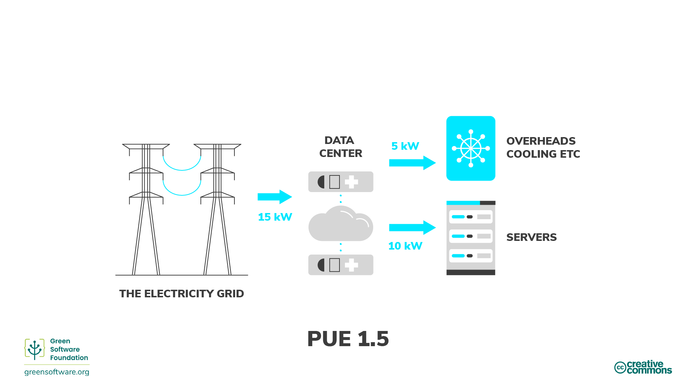
Power Usage Effectiveness (PUE)
The PUE metric was developed by Green Grid to measure the energy efficiency of data centres
The PUE captures the overheads associated with running a data centre
e.g: a PUE of 1.5 means an additional 5 watts of power is required for every 10 watts of power used for HPC.
  Includes overheads such as cooling and power distribution.
  Can also be thought of as a multiplier to your energy consumption from HPC use

Slide 12
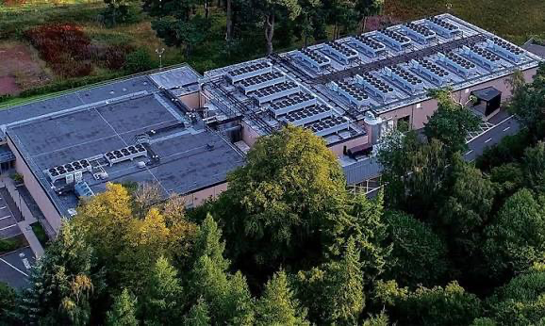
PUE is not constant
The PUE varies according to how much energy is needed to
the cool the HPC system.
More cooling is required if...
More compute nodes of the HPC system are in use
Compute nodes are running more power-intensive work
The outside air temperature is warmer
Sometimes the outside temperature is cold enough to cool the HPC system without additional refrigeration – this is known as free cooling.
For example, for ARCHER2 hosted at the EPCC ACF data centre
The PUE averaged over the calendar year is around 1.1
As the ACF is located in Scotland, where air temperatures are cool, ARCHER2 benefits from free cooling for most of the year.

Slide 13
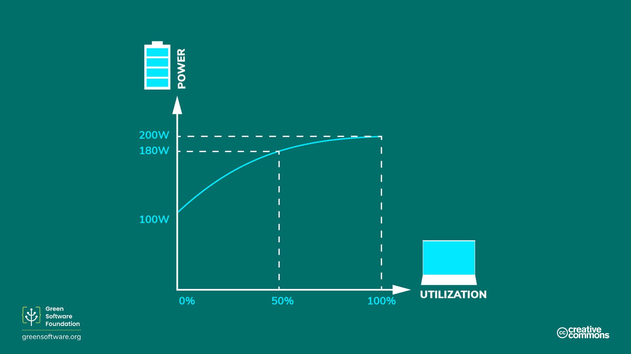
Energy proportionality
Energy proportionality is the relationship between power consumed by a HPC system and its utilisation.
  Relationship is not linear
  Power is consumed even if the system is not being used at all – Static Power Draw
The more we utilise a HPC system the more efficient it becomes at using electricity to support HPC users.
  But, how much of that utilisation is doing useful work?

Slide 14
HPC application performance
Energy proportionality holds if the HPC application is compute-bound
  Its performance is limited by processor speed - more usually, the performance of the floating-point units within the processor
Performance can also be memory-bound in that it can be limited by the time it takes to access data in memory
  Extra power draw does not increase the number of instructions done per unit of time
Applications can also be communications-bound if running in parallel or IO-bound.
Different constraints will apply at different points during the application's runtime
HPC applications are, if at all, compute-bound only for short periods of their runtime…
…energy proportionality breaks down if trying to relate power consumed to useful work.

Slide 15
Static power draw
The static power draw of a HPC system is the amount of power drawn when the system is in an idle state (0% utilisation).
Personal computers have a hibernation mode that is entered automatically should the computer not be used for a period of time configurable by the user.
  The cost of this energy saving is that additional time is needed to "wake up" from hibernation.
HPC systems need to be "always on" since demand is unpredictable, maximising idle power consumption.
  For this reason, HPC sites aim to run as close as possible to 100% utilisation.

Slide 16
Exercise: Computing energy efficiency
The GROMACS application running on ARCHER2 for a simulation time of 0.02 ns has the following performance for a range node of counts and CPU frequency settings.
 | 2.0 GHz |  | 2.25 GHz + boost
Nodes | Runtime (s) | Energy (kWh) | Runtime (s) | Energy (kWh)
1 | 369 | 0.0464 | 288 | 0.0464
2 | 198 | 0.0450 | 156 | 0.0465
3 | 155 | 0.0438 | 109 | 0.0465
4 | 117 | 0.0471 | 93 | 0.0513
What are the most energy efficient combinations of node count and CPU frequency
in terms of kWh/ns?
Which combination has the worst performance and what is the percentage difference between this and the best-performing combination?

Slide 17
Solution
We can compute the energy efficiency in kWh/ns by dividing the energy use by the simulation time in nanoseconds, which is 0.02 ns.
 | 2.0 GHz |  | 2.25 GHz + boost
Nodes | Runtime (s) | kWh/ns | Runtime (s) | Energy (kWh)
1 | 369 | 2.32 | 288 | 2.32
2 | 198 | 2.25 | 156 | 2.32
3 | 155 | 2.19 | 109 | 2.32
4 | 117 | 2.36 | 93 | 2.56
The most energy efficient combination is 3 nodes at 2 GHz CPU clock frequency, and the worst is 4 nodes with 2.25 GHz + boost CPU clock frequency. The worst case is around 17% less energy efficient than the best case.
While this difference may not amount to much energy for a single run, it can lead to a significant reduction in consumed energy if many simulations are to be run as part of a project.

Slide 18
Key Points
In regions where electricity production is dominated by burning fossil fuels, electricity is a good proxy for carbon, so using HPC in an energy efficient way is equivalent to using HPC in a way that is carbon efficient.
In regions of where electricity production is dominated by low carbon energy sources, electricity is not a good proxy for carbon.
Green HPC use takes responsibility for its electricity consumption and considers how this relates to carbon emissions.
Quantifying the energy consumption of your HPC use is a step in the right direction to start thinking about how you can operate more efficiently. However, understanding the energy consumption of your use of HPC is not the only story. The hardware your software is running on uses some of the electricity for operational overhead. This can be estimated through the power usage efficiency (PUE) metric for HPC systems (and for computing resources hosted in data centres more generally).
How you go about improving the energy efficiency of use of an HPC system depends on the software you are using and the input parameters as well as the hardware.
Often, the only practical way forward in the face of this complexity is to perform some benchmarking to assess how energy efficiency can be improved.

