Slide 1
Introduction
Green Software Use on HPC

Slide 2
Questions
What is green HPC system use and how can we approach it?
What research activities produce carbon emissions?
Objectives
Define green HPC system use.
Appreciate emissions from HPC in the wider context of other research activities.

Slide 3
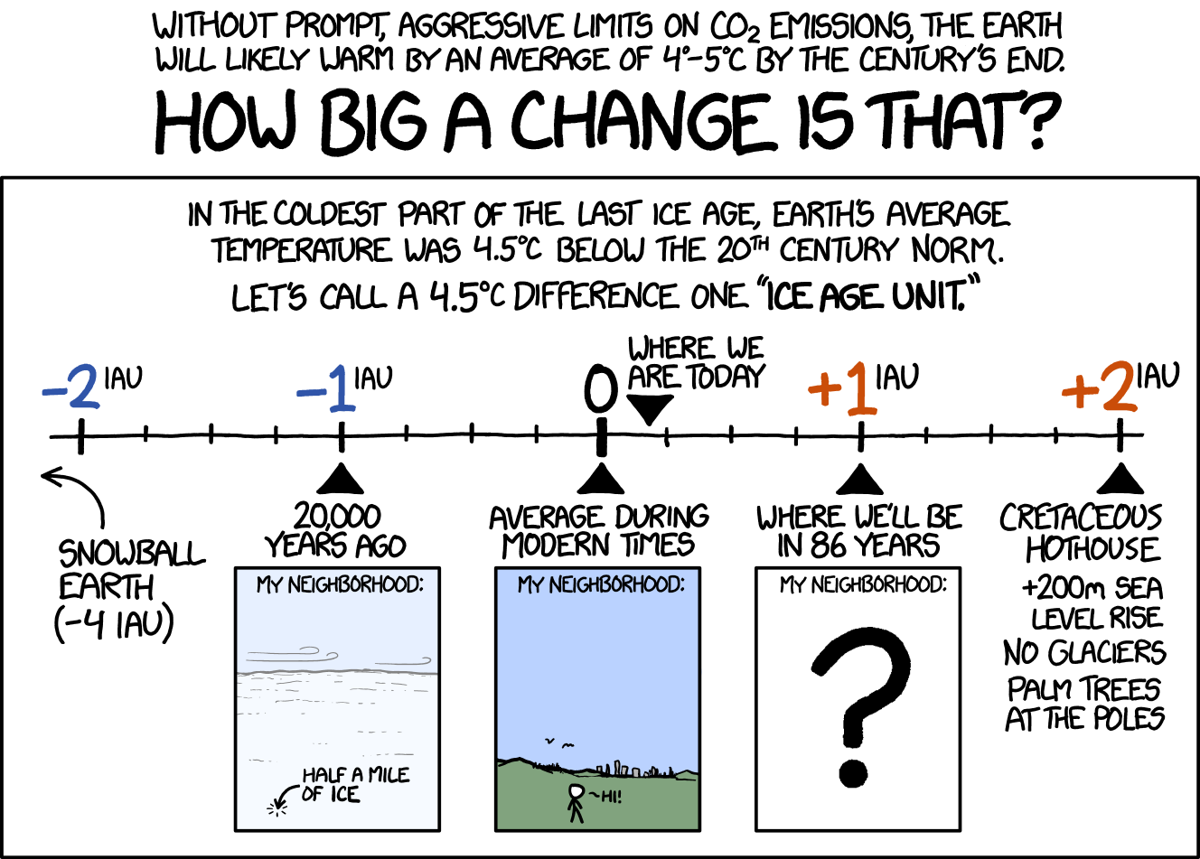
https://xkcd.com/1379/

Slide 4
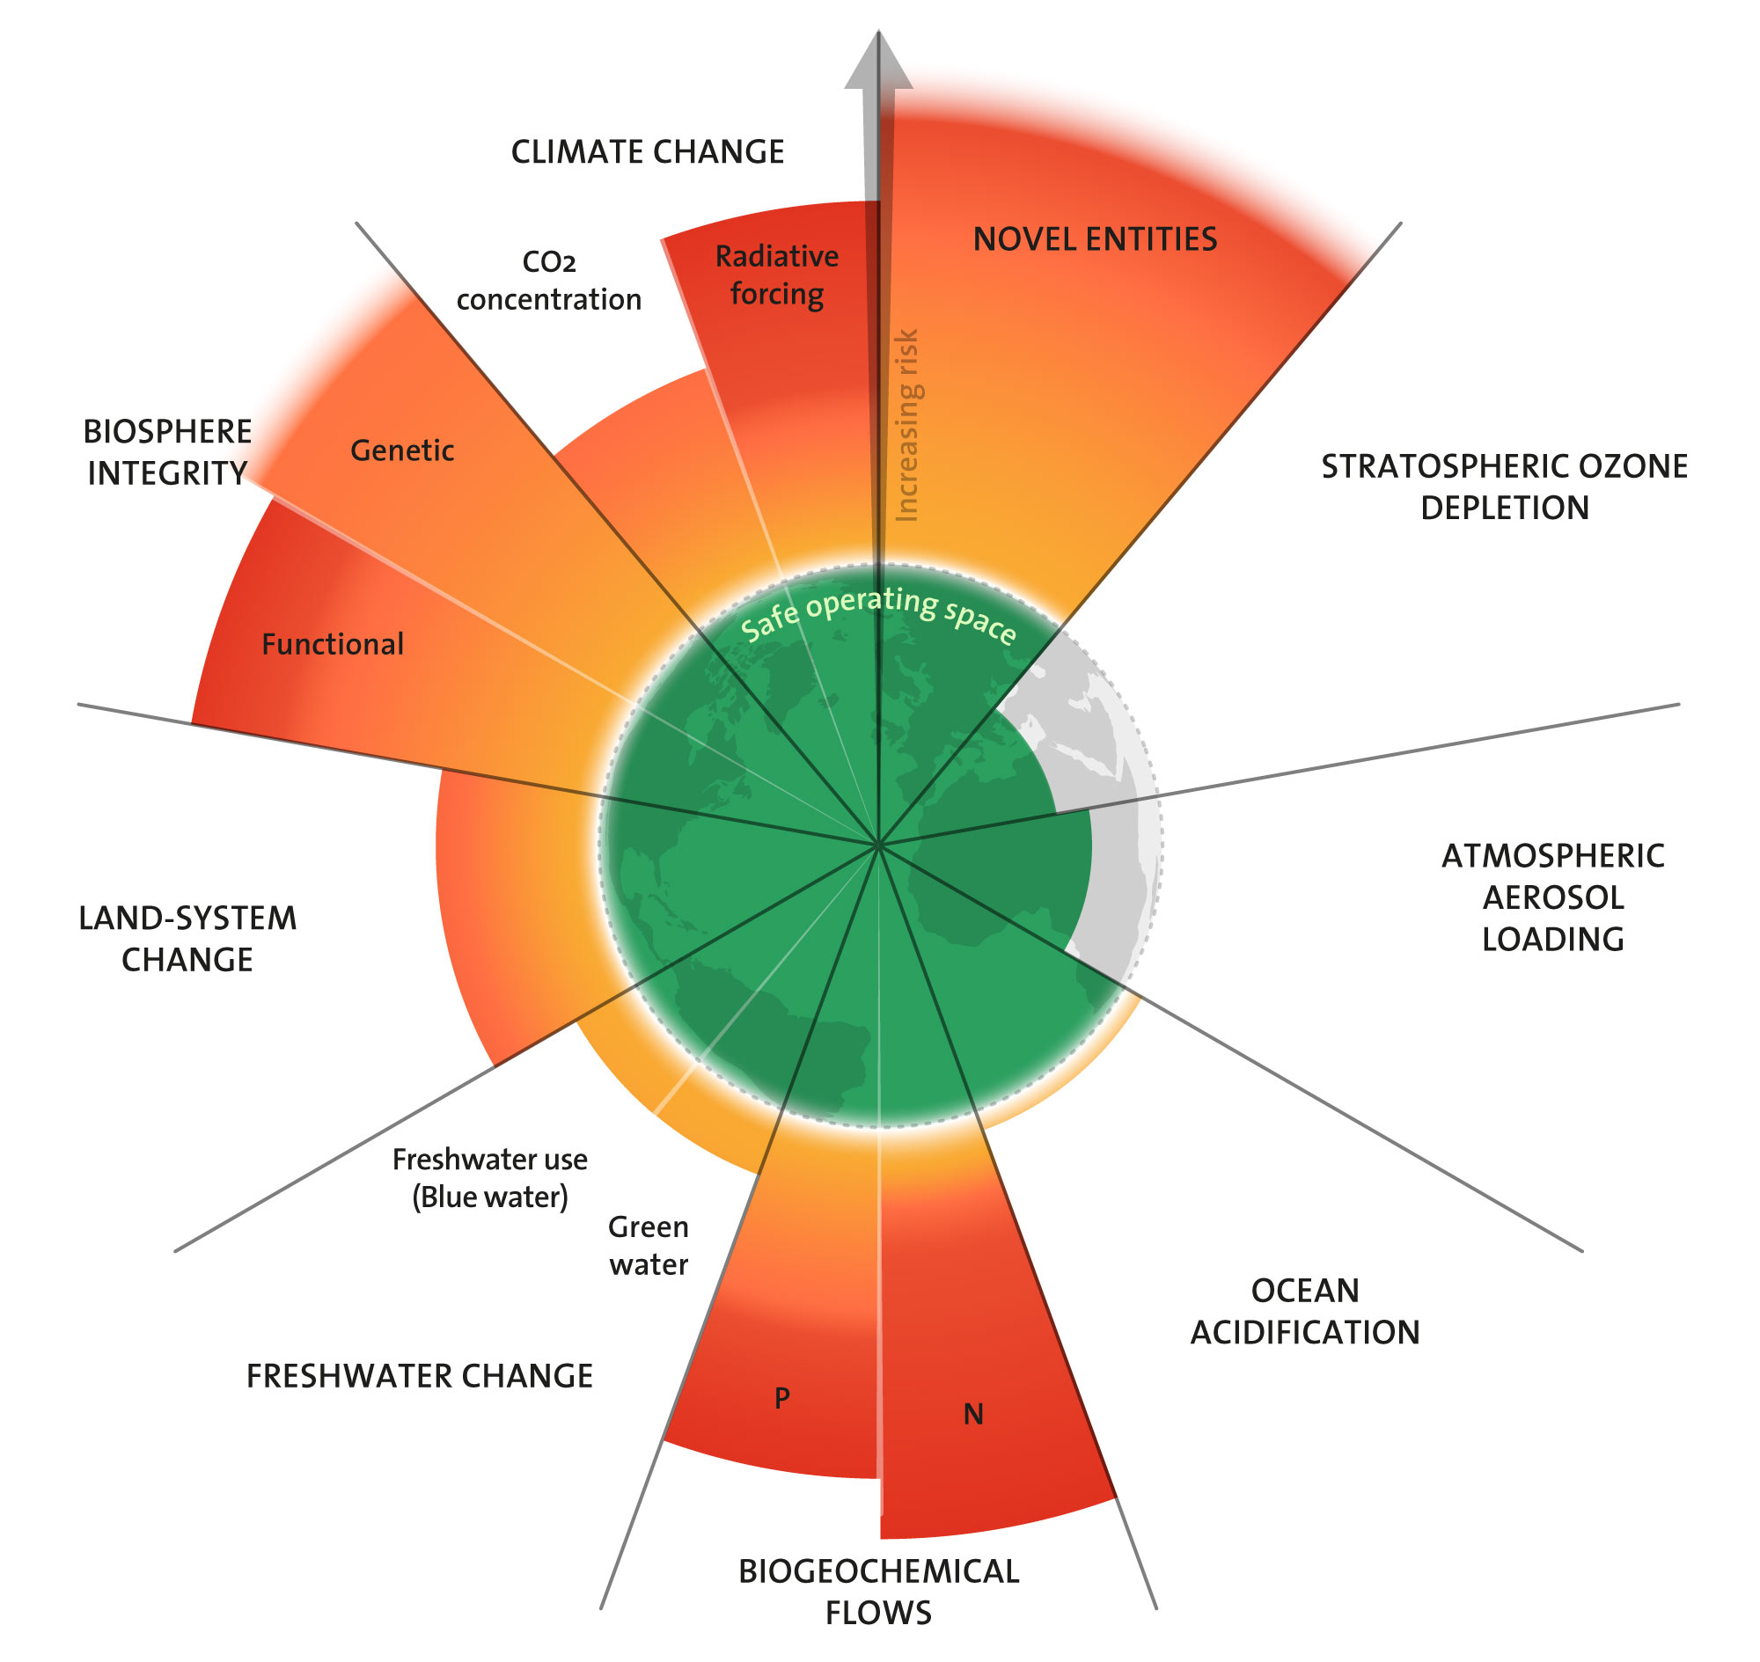
The issues are wider than just GHG emissions
Multiple measures of earth systems integrity are being breached
“Planetary boundaries are interdependent. This means we cannot consider planetary boundaries in isolation in any decision-making on sustainability. Action that affects one process in the planetary boundaries framework will affect the risks of the other processes.”
Credit: "Azote for Stockholm Resilience Centre, based on analysis in Sakschewski and Caesar et al. 2025".
https://www.stockholmresilience.org/research/planetary-boundaries.html

Slide 5
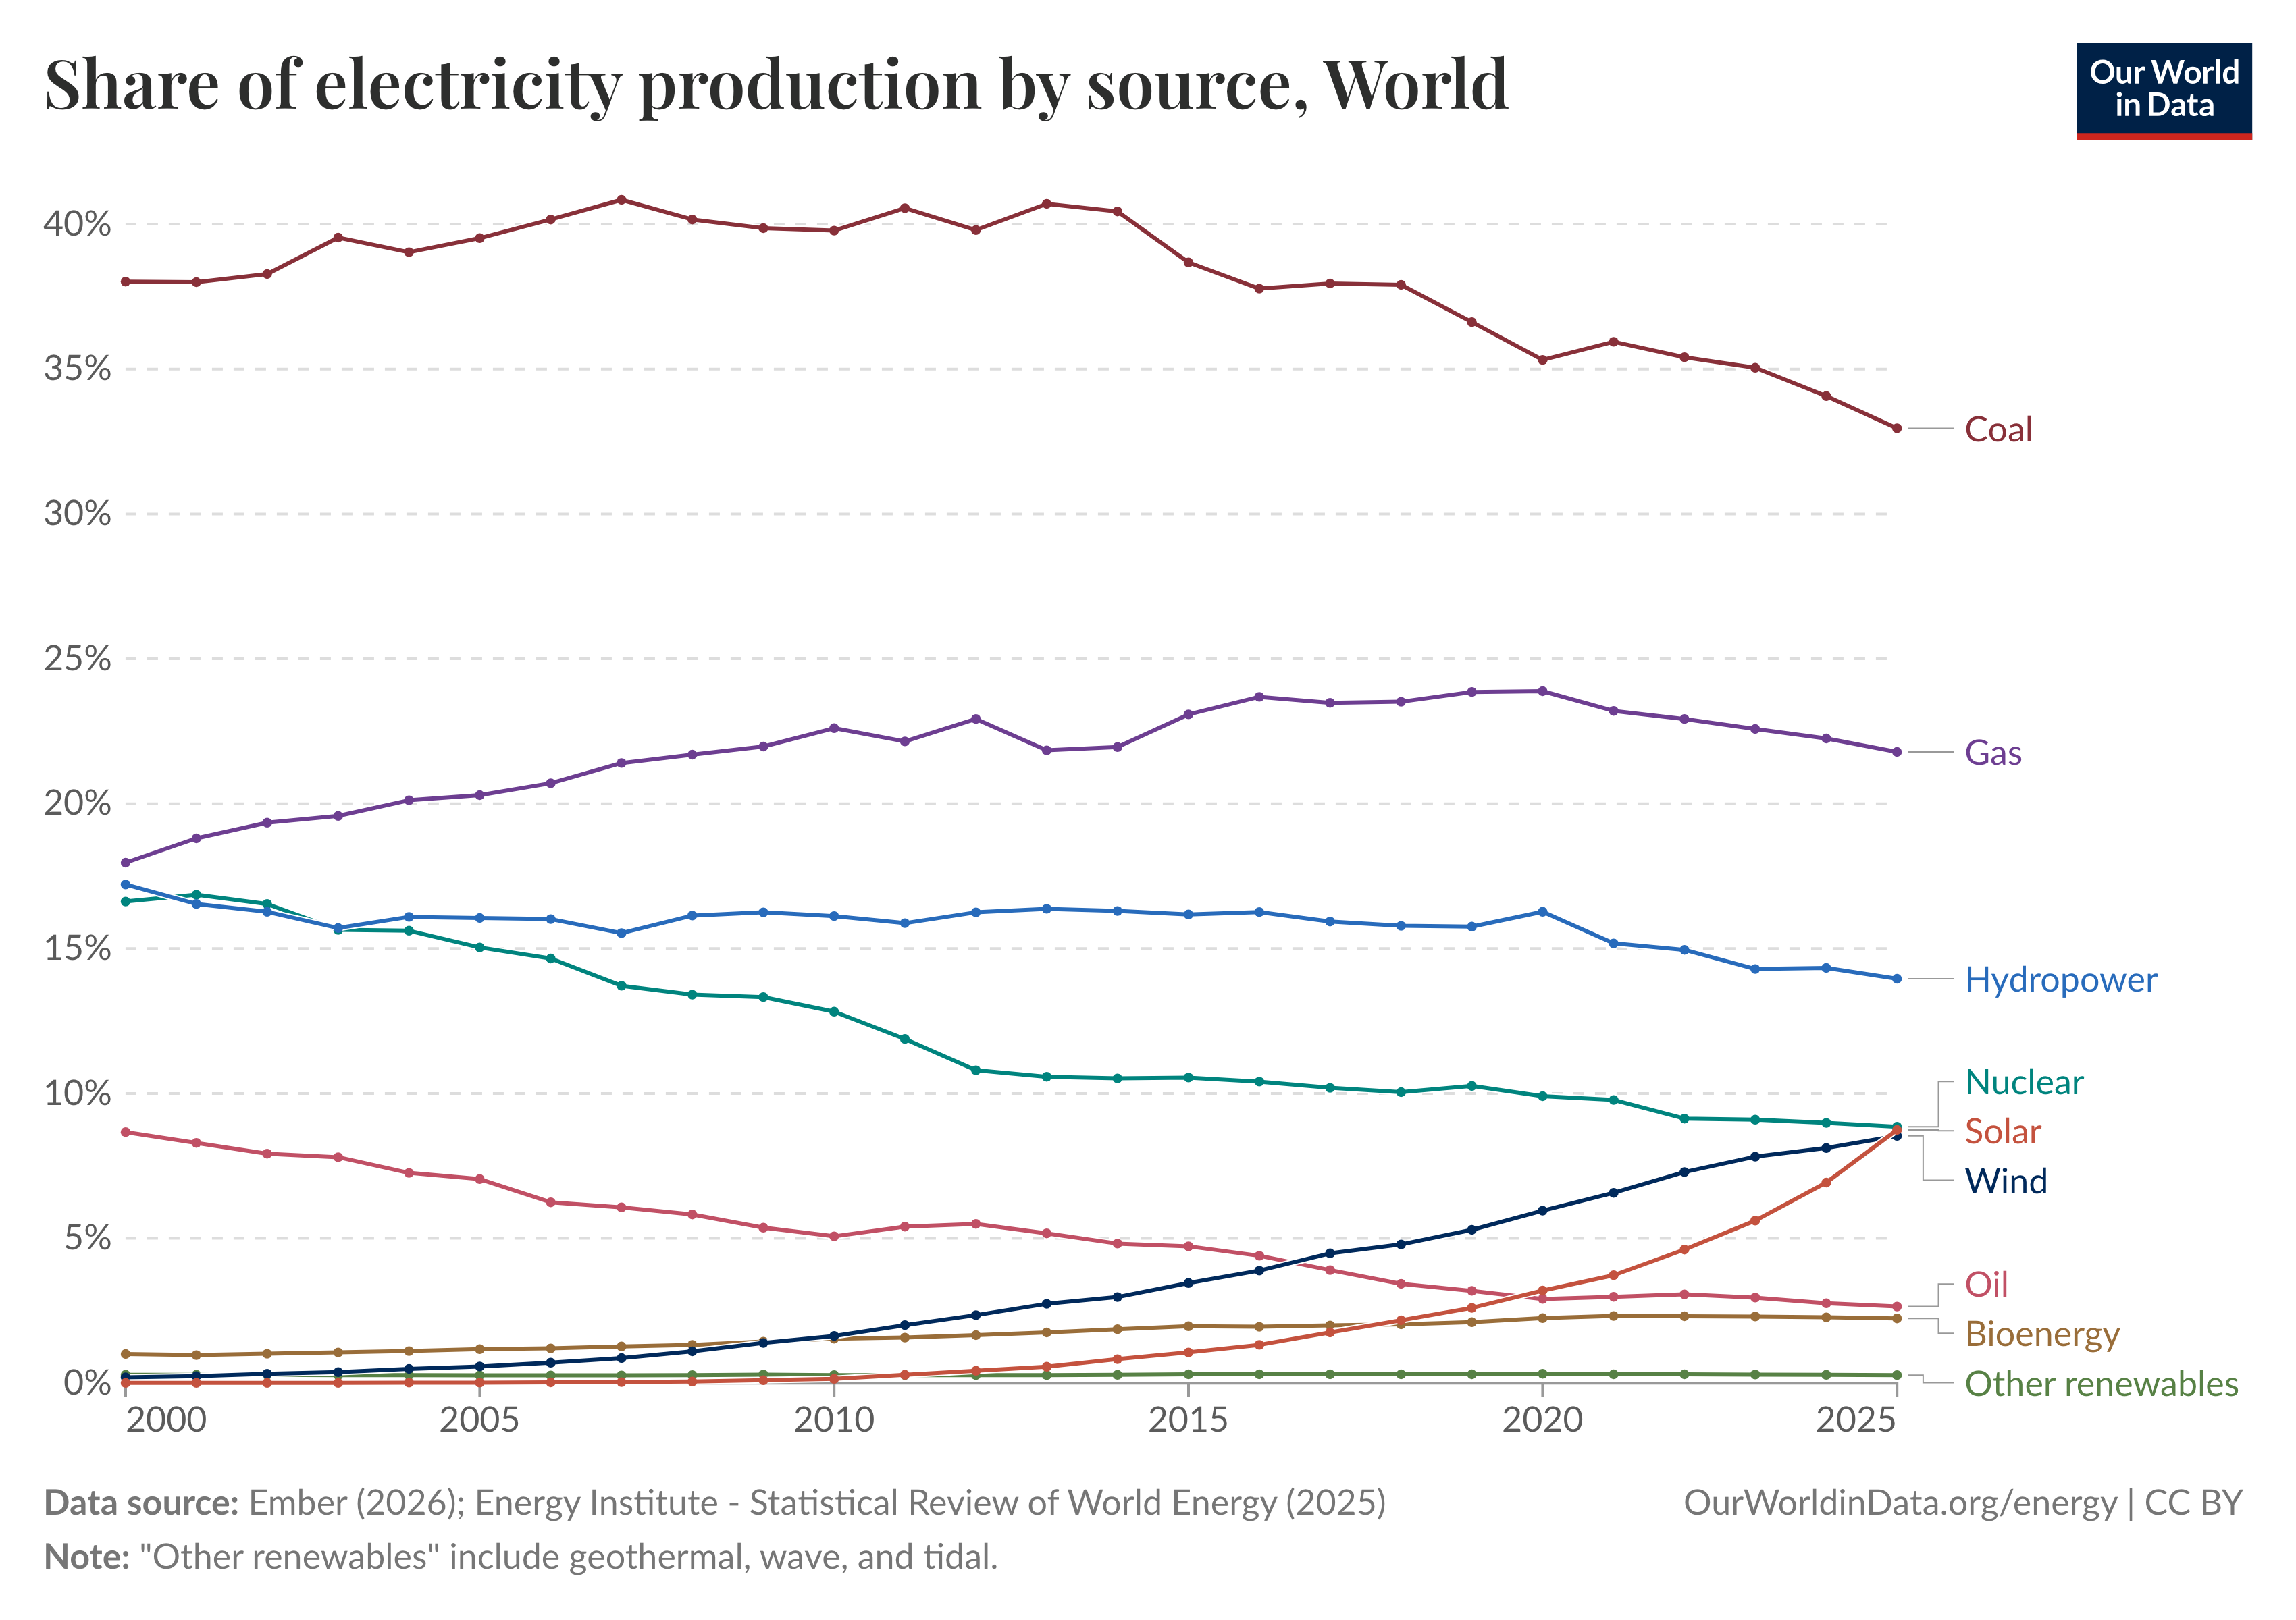
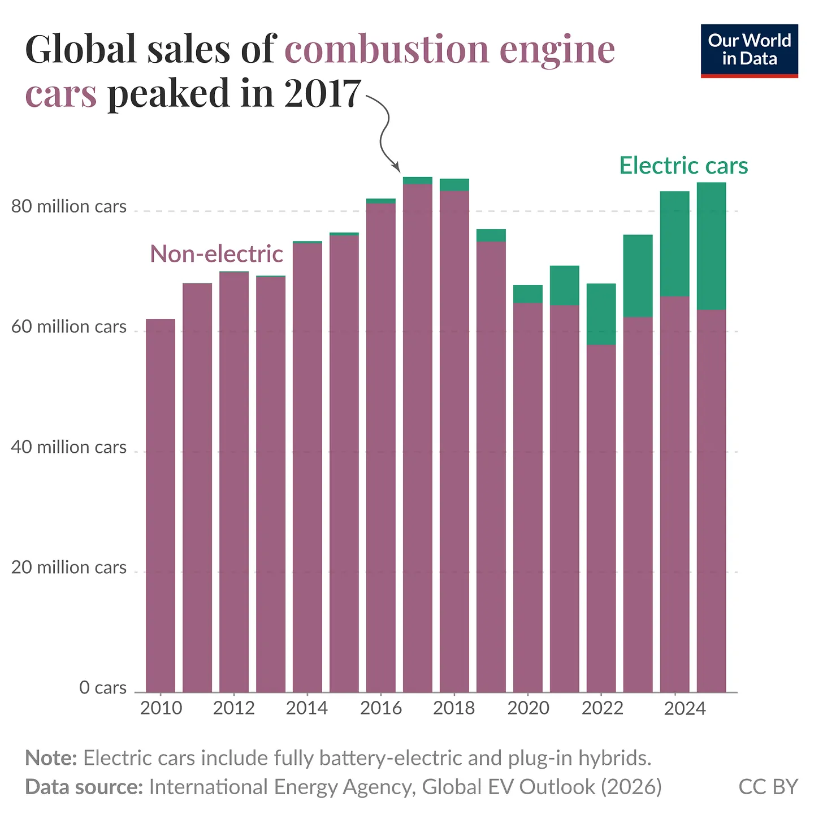
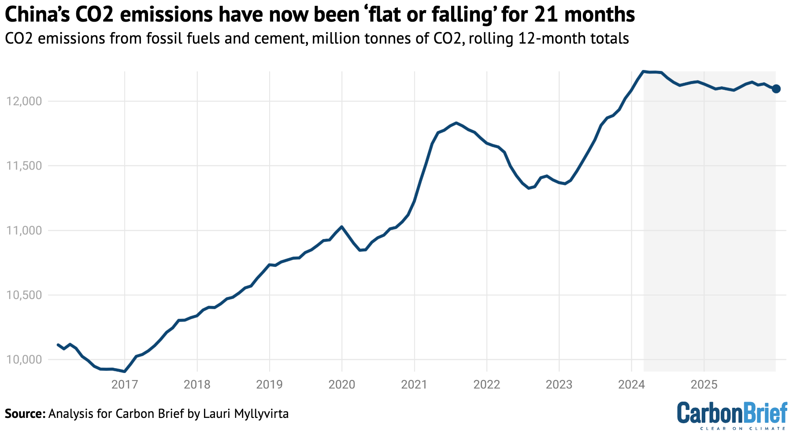
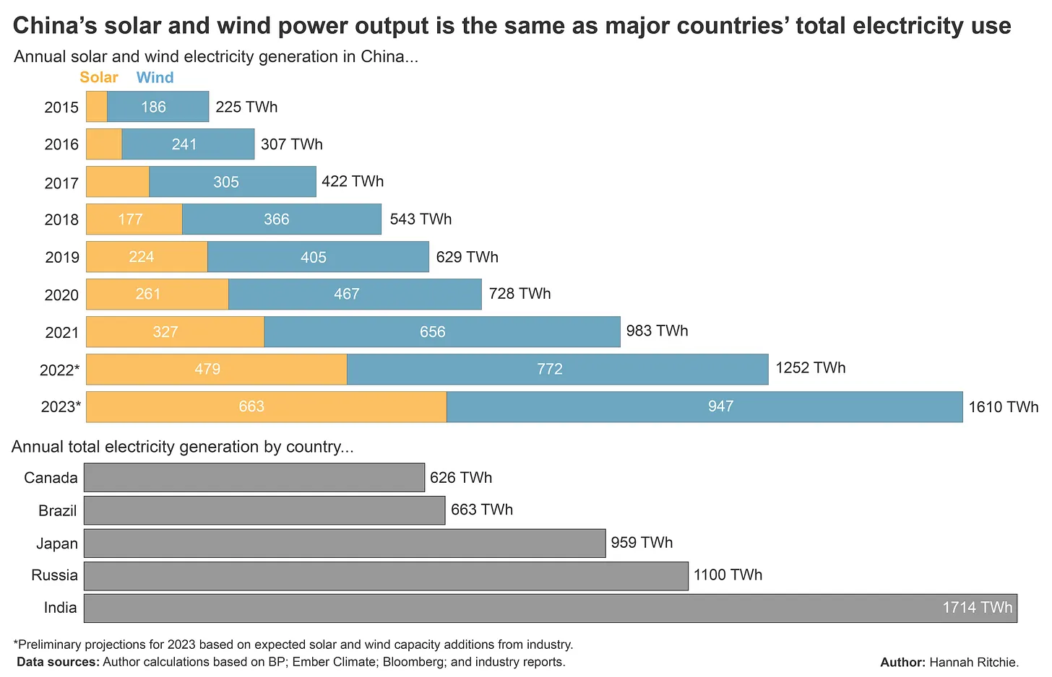
Positive signs
Notes:
Many experts believe China’s emissions have now reached their peak and will continue to decrease
Electricity generation from fossil fuels is rapidly decreasing almost everywhere
Take up of electric vehicles (both commercial and private) is accelerating
97% of new cars bought in Norway last year were electric (25% in the UK)

Slide 6
Why does individual action matter?
Common comments:
  “It is a global challenge, my individual action does not matter.”
  “The UK emissions are small compared to China or the USA, why should we act first and create hardship for ourselves?”
  “Discussing individual action helps large organisations absolve themselves of needing to act.”
Taking no action is not a reasonable response – things we do as individuals have a real impact and we can be a meaningful force for change by:
  Exerting pressure on workplaces, councils, governments, companies, etc. to make changes
  Leading by example
  Normalising discussion and activism
We must ensure that discussions and action by ourselves is always placed in the context of holding large organisations to account

Slide 7
Action matters, activism matters more
Can take many forms:
Discussions with friends and family
Activism at your workplace
Activism within your communities
Political activism
Consumer choices
Climate protests
Action cycle:
Measure
Prioritise
Implement
Measure impact
Reflect and review
Action
Activism
Initial circle diagram from How Bad Are Bananas, M. Berners-Lee, 2020

Slide 8
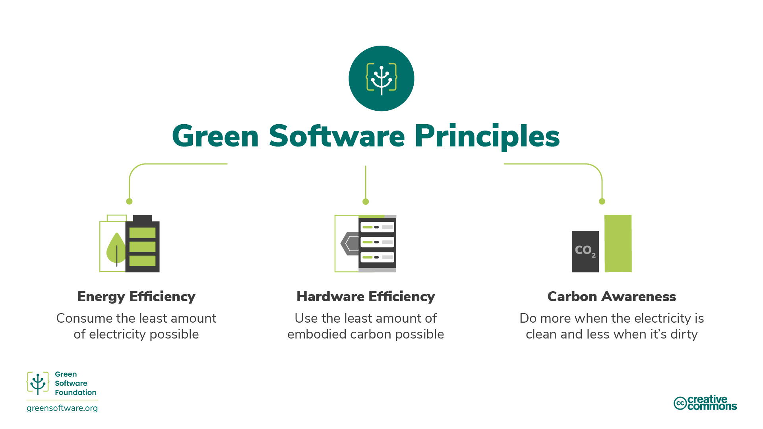
What is green HPC?
What is Green HPC?
Green HPC is carbon-efficient use of HPC.
  It concerns patterns of usage that emit the least carbon possible.
  It applies also to the construction and decommissioning of a HPC system.
There are three strategies for reducing carbon emissions produced by HPC.
Green HPC is carbon-efficient use of HPC.
  It concerns patterns of usage that emit the least carbon possible.
  It applies also to the construction and decommissioning of an HPC system.

Slide 9
Course overview
During this course, we will cover six key areas of green HPC, derived from the principles of green software engineering.
Carbon Efficiency: Emit the least amount of carbon possible.
Energy Efficiency: Use the least amount of energy possible.
Carbon Awareness: Do more when the electricity is "cleaner" and do less when the electricity is "dirtier".
Hardware Efficiency: Use the least amount of embodied carbon possible.
Measurement: What you cannot measure, you cannot improve.
Reducing Emissions: Understand mechanisms of carbon reduction.
For each area, we'll introduce some new concepts and explain in detail why it is important in terms of the climate, and how you can apply them on HPC systems.
We will use the ARCHER2 UK National Supercomputing Service to provide concrete examples of how the principles can be applied.

Slide 10
Exercise: Emissions from your work
Use of HPC will be only one part of your activities associated with your work and may not even be the largest source of carbon emissions.
List sources of carbon emissions from your work activities other than via HPC systems
Try to rank them in order of what you think the largest will be to the smallest

Slide 11
Solution
You may have come up with activities from the list below
Travel to/from place of work
Travel and accommodation for conferences, training and meetings
Use of non-HPC computing resources
  e.g. laptops/workstations, cloud resources and the internet
Data storage
Laboratory work, e.g. chemicals, instruments
Printed materials, e.g. books, journal articles
Ordering these by size of emission is more difficult and will differ from person to person.
Typically, any sort of flying to conferences or meetings will be the most carbon intensive activity you can undertake through your work. Whether this is the largest contribution depends on how often you fly.
If you work in a laboratory, that may well be the next highest source of emissions.
Use of a petrol/diesel may also place highly, especially if you have a long commute and travel alone.

Slide 12
Useful information sources
All activities that we undertake as part of our work (and personal life) produce carbon emissions. While, in an ideal world, we would be able to reduce emissions from all our activities, we have finite time and effort, and so we need to prioritise based on which reduction strategies will have the largest impact.
This means that the first step is to estimate the emissions from different activities we are involved in as part of our work, even if the estimate is very rough.
Travel emissions calculator (Deloitte UK)
Emissions from laptops (Circular Computing)
Transparent reporting of research-related greenhouse gas emissions through the scientific CO₂nduct initiative
Quantifying the carbon footprint of clinical trials: guidance development and case studies
Emissions measurement and reporting approaches for the public sector (UK Government)
Carbon footprint and mitigation strategies of three chemistry laboratories

Slide 13
Key points
This course covers green HPC system use, in particular:
  Carbon Efficiency: Emit the least amount of carbon possible.
  Energy Efficiency: Use the least amount of energy possible.
  Carbon Awareness: Do more when the electricity is cleaner and do less when the electricity is dirtier.
  Hardware Efficiency: Use the least amount of embodied carbon possible.
  Measurement: What you cannot measure, you cannot improve.
  Reducing Emissions: Understand mechanisms of carbon reduction.

