Slide 1
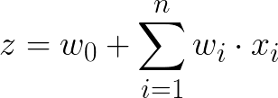

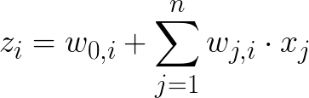
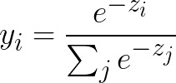
Logistic Regression: Representations and Inference
1
w₀
Binary setting
x₁
w₁
w₂
z
logistic
y
0.86
x₂
w_{n}
…
x_{n}
1
Multi-class setting
(e.g. 3 classes)
z₁
y₁
0.76
x₁
z₂
softmax
y₂
0.05
x₂
…
z₃
y₃
0.19
x_{n}

Slide 2
Neural Network: Representations
1
1
x₁
a₁
c₁
z
logistic
y
0.73
Binary
x₂
activation function
(linear, relu, logistic, tanh)
a₂
c₂
…
x_{n}
a₃
c₃
Input layer
Hidden layer
Output layer
Prediction

Slide 3
Neural Network: Representations
1
1
z₁
y₁
0.09
x₁
a₁
c₁
z₂
y₂
0.05
softmax
Multiclass
(e.g. 4 classes)
x₂
activation function
(linear, relu, logistic, tanh)
a₂
c₂
z₃
y₃
0.62
…
x_{n}
a₃
c₃
z₄
y₄
0.24
Input layer
Hidden layer
Output layer
Prediction

Slide 4
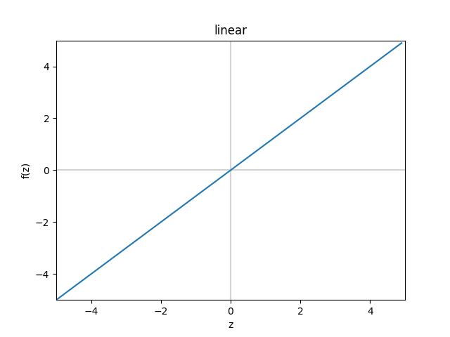
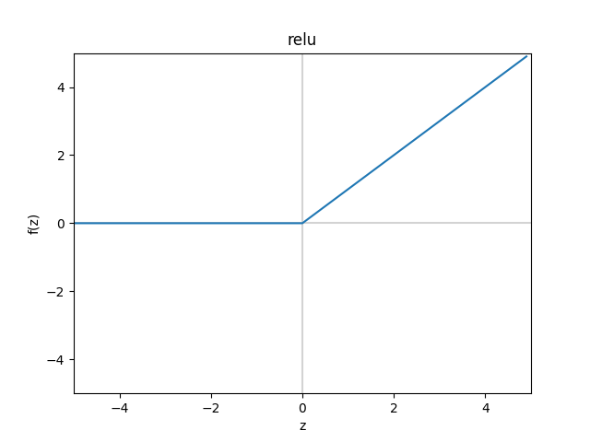


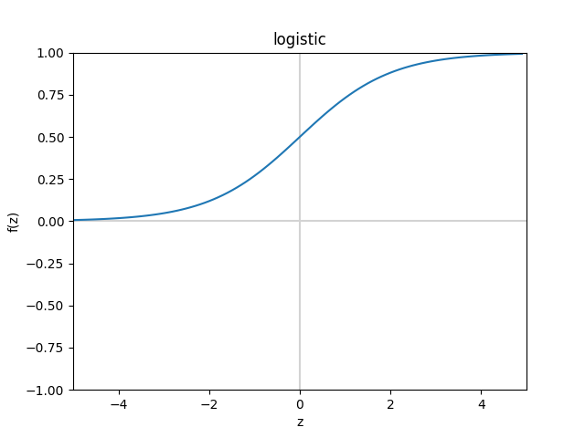
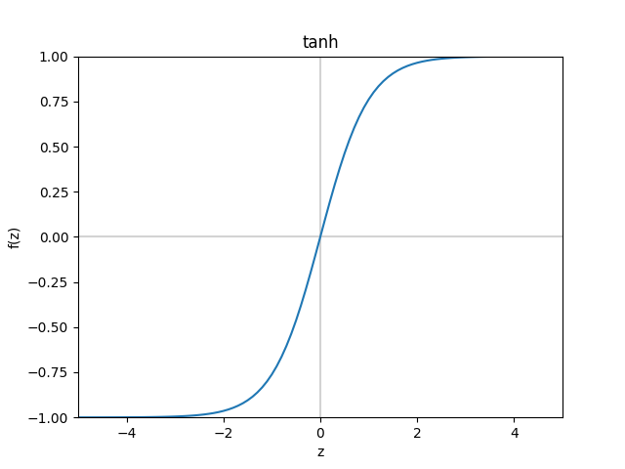


Logistic Regression & Neural Network: Activation Functions

Slide 5

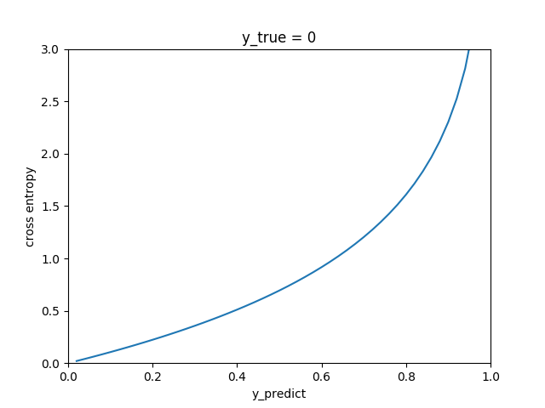
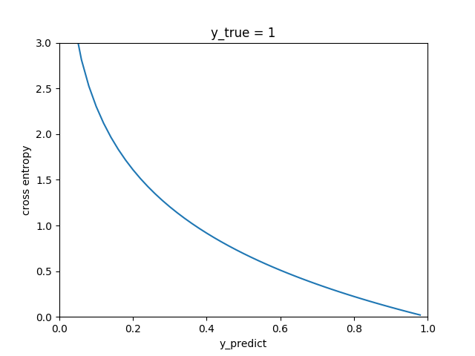

Logistic Regression & Neural Network: Learning
Binary problem:
Cross-entropy loss
Regularization
Multiclass problem:

Slide 6
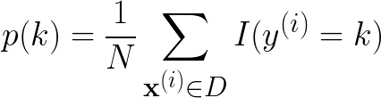
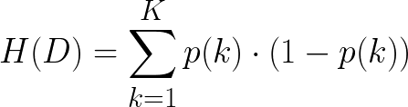
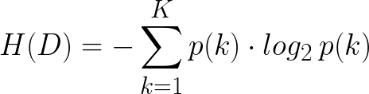



Decision Tree: Representation, Learning and Inference
Given training data D of size N at node m,
Gender
Measure of uncertainty:
male
female
Gini
Age
No
< 30
≥ 30
Entropy
No
BMI
Given feature X_{i}:
< 25.5
≥ 25.5
No
Yes
where
Feature set F = {X₁ , …, X_{n}}
Classes k = 1, …, K
Split with feature that reduces uncertainty the most:

Slide 7
Random Forest: Representation, Learning and Inference
Training data D
Sample D with replacement
(Bootstrap)
Set D₁
Set D₂
Set D_{T-1}
Set D_{T}
Feature Set F
T trees
Sample F without replacement at each node
Learning
……
Given a new sample x
+
+
……
-
+
Inference
Majority vote
+

Slide 8
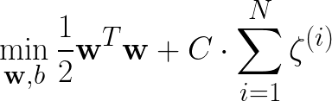






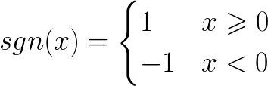
Linear SVM: Representation, Learning and Inference
Objective function:
margin
Margin size
Slack penalty
subject to
slack
support vector
Given a new point ,

Slide 9
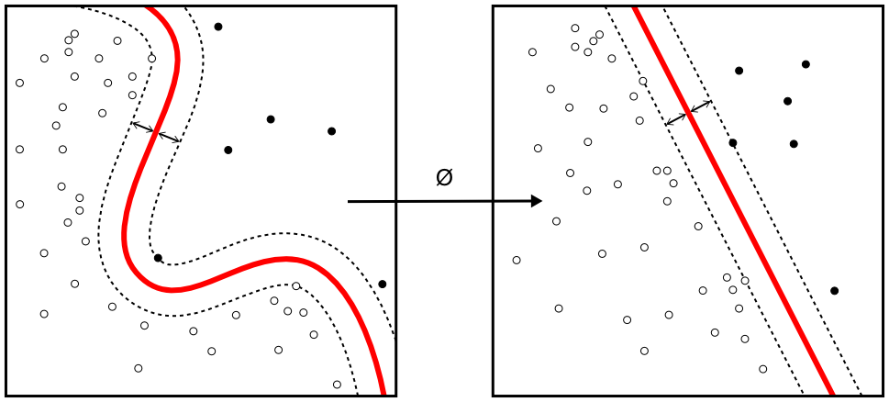





Kernel SVM: Representation
(Image from Wikipedia)
linear
RBF
polynomial
sigmoid

Slide 10

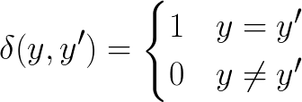
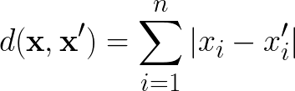
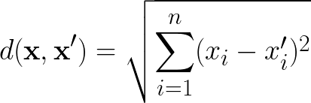
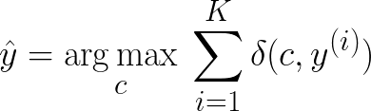
K-Nearest Neighbors: Representation, Learning and Inference
Class 0 training point
Class 1 training point
New point
K = 3
K = 5
Find K training points
closest to the new point .
Measure of distance:
Manhattan distance
(L¹ distance)
Euclidean distance
(L² distance)

Slide 11


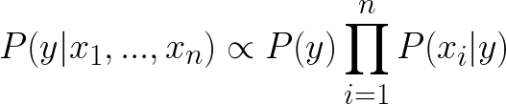
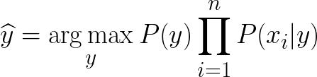

Naïve Bayes: Representation and Inference
y
Class
x₁
x₂
x₃
x₄
……
x_{n}
Features
(independence)
Discrete feature
Continuous feature

Slide 12

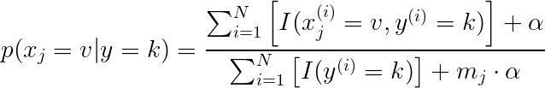


Naïve Bayes: Learning
Recall
To estimate :
To estimate :
Discrete feature
Continuous feature

