Slide 1
Good enough practices in research computing How to not lose your stuff, and generally be more efficient
Dr. Edward Wallace, ICB & SynthSys
Edward.Wallace@ed.ac.uk
12th October 2020
© Edward Wallace 2020, Licence: CC BY 4.0

Slide 2
Who am I and why do I care?
PhD simulating biological networks
Postdoc, evolution of coding sequences
Postdoc, heat shock + proteomics
Lab head, environmental responses and gene expression regulation in fungi
Lots of code, data, data re-use.
I’ve learned that good habits matter.
https://ewallace.github.io/

Slide 3
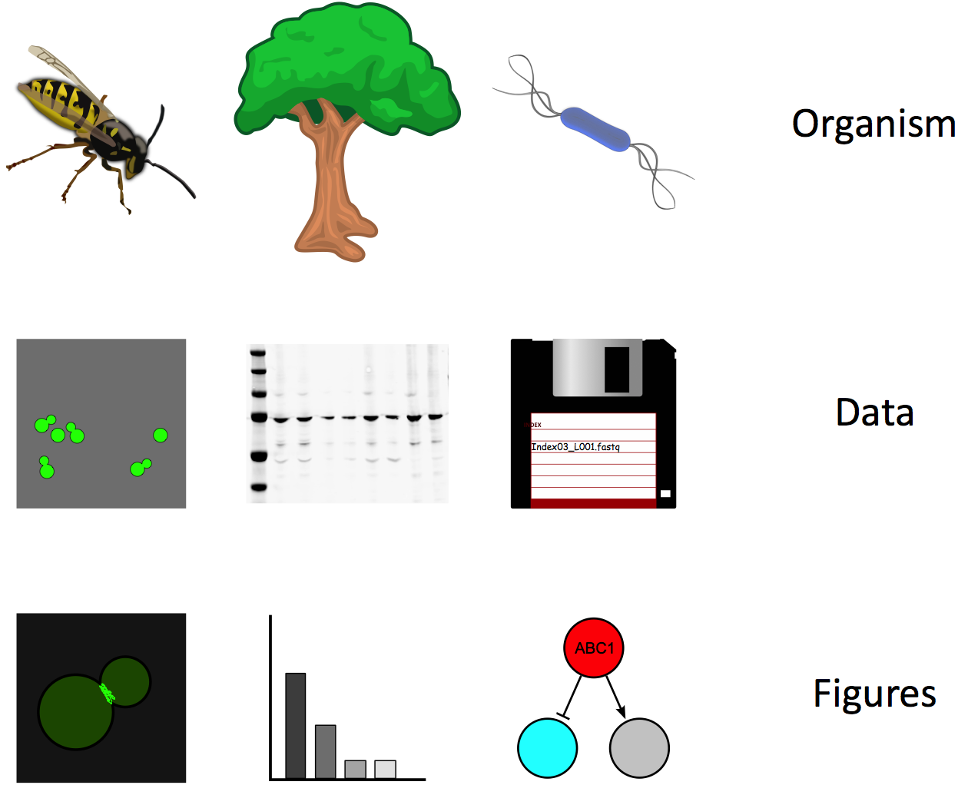

Slide 4
What can go wrong in research computing?
You can lose your data.
...?
Please respond in the chat box.
Notes:
Suggestions from participants. EW to mention the time we found 5-year-old raw data needed for publication, on a hard drive in the back of a bottom drawer in the office, after looking for 3 days.

Slide 5
What can go right in research computing?
You can re-analyze your data in 1 year’s time and learn something important.
...?
Please respond in the chat box.
Notes:
Suggestions from participants. EW could say, made simulation code available from 2010 publication, about 1 Masters student/year can still run the simulation.
Research computing is research.

Slide 6
Challenges in data-heavy biology
All your raw data are digital files
How do you manage them?
There are many tools to process data
Too much choice, many bad choices
E.G. Excel changes gene names, and loses COVID test results...
There are more steps to understand
Where do you even start?

Slide 7
Good news!
Your problems are not unique
Smart people have thought about good practices and created good tools
You don’t have to reinvent them
You can learn them
This is an ongoing process through your career

Slide 8
Today’s session: Good enough practices in research computing
A set of good computing practices that every researcher can adopt
Practically, future you will
curse current you (bad), or
thank current you (better).
Habits and practices that save you time in the future, and improve your work

Slide 9
Good enough practices in Scientific Computing
Data management
Software
Collaboration
Project organization
Keeping track of changes
Manuscripts
Wilson et al., PLoS Comput. Biol 2017 https://doi.org/10.1371/journal.pcbi.1005510
Notes:
Are these really any different from experimental science? Or just different style tools?

Slide 10
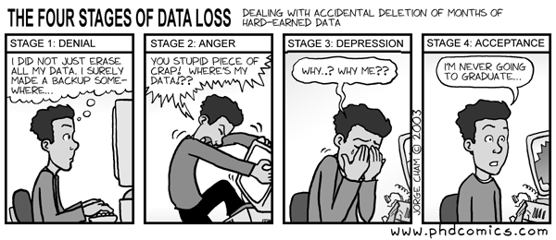
Data management problems

Slide 11
Data management problems
I can’t remember what this file means
I am disgusted to even look at this file
...
Discussion (breakout rooms) – what goes wrong with data management?

Slide 12
Data management
Save the raw data.
Ensure that raw data are backed up in more than one location.
Create the data you wish to see in the world.
Create analysis-friendly data.
Record all the steps used to process data.
Anticipate the need to use multiple tables, and use a unique identifier for every record.
Submit data to a reputable DOI-issuing repository so that others can access and cite it.
Notes:
Are these really any different from experimental science? Or just different style tools?

Slide 13
What is a DOI???
A digital object identifier is a persistent identifier or handle used to identify objects uniquely.
Data with a persistent doi can be found even when your lab website dies
doi-issuing repositories include: zenodo, figshare, dryad, Edinburgh’s DataShare

Slide 14
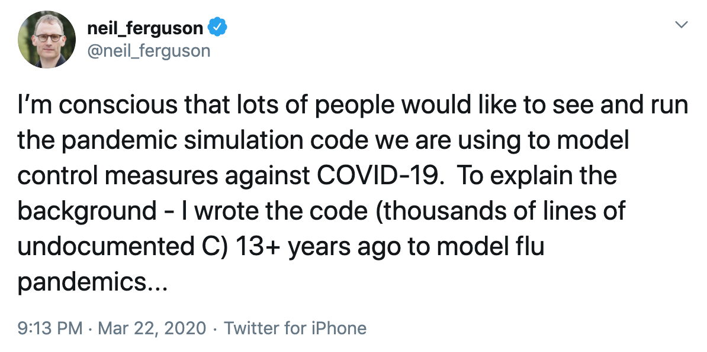
What your future self may think...
Neil Ferguson's covid code twitter thread

Slide 15
What is Research Software?
Any code that runs in order to process your research data
“Record all the steps used to process data.” That means, script everything if possible. Data analysis is software.
R, python, MATLAB, shell, openrefine, imageJ, etc. are all scriptable. Use them.

Slide 16
Software problems
I don’t remember what this code does
This code doesn’t work any more
I’m not sure if this calculation is correct
...
Discussion (breakout rooms) – what goes wrong with software?

Slide 17
Software
Place a brief explanatory comment at the start of every program.
Decompose programs into functions.
Be ruthless about eliminating duplication.
Always search for well-maintained software libraries that do what you need.
Test libraries before relying on them.
Give functions and variables meaningful names.
Make dependencies and requirements explicit.
Do not comment and uncomment sections of code to control a program's behavior.
Provide a simple example or test data set.
Submit code to a reputable DOI-issuing repository.
Notes:
Are these really any different from experimental science? Or just different style tools?

Slide 18
Collaboration problems
What are we trying to do?
Whose job is it to do this thing?
...
Discussion (breakout rooms) – what goes wrong with collaboration?

Slide 19
Collaboration
Create an overview of your project.
Create a shared "to-do" list for the project.
Decide on communication strategies.
Make the license explicit.
Make the project citable.
Notes:
Are these really any different from experimental science? Or just different style tools?

Slide 20
What is a licence?
Specifies allowable copying and reuse
Without a licence, people cannot legally reuse your code or data
Different options for different goals and funder requirements (Apache, MIT, CC, ...)
For example, this presentation is reusable with attribution under a Creative Commons Attribution (CC BY) 4.0 licence.
© Edward Wallace 2020, Licence: CC BY 4.0

Slide 21
README.txt
README files are magic
You look at a directory (or project), you read it, and it tells you what you need to know
As long as you update it

Slide 22
Project organisation problems
Where is the code that made this figure?
I am disgusted to even look at this directory
...
Discussion (breakout rooms) – what goes wrong with project organisation?

Slide 23
Project organization
Put each project in its own directory, which is named after the project.
Put text documents associated with the project in the doc directory.
Put raw data and metadata in a data directory and files generated during cleanup and analysis in a results directory.
Put project source code in the src directory.
Put external scripts or compiled programs in the bin directory.
Name all files to reflect their content or function.
Notes:
Are these really any different from experimental science? Or just different style tools?

Slide 24
Some helpful organisation tools
Integrated Development Environments (IDEs)
VSCode for python, etc.
RStudio for R, etc.
Notebooks (jupyter, .Rmd)
Collect data, code, results, thinking
Cookie Cutter project templates https://github.com/mkrapp/cookiecutter-reproducible-science

Slide 25
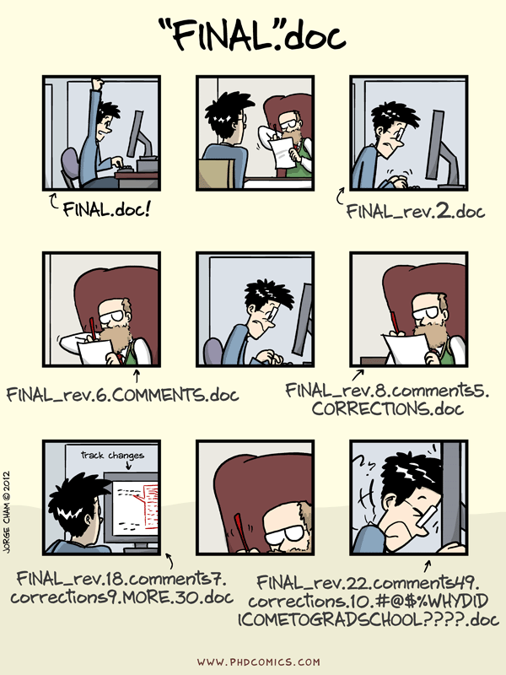
http://phdcomics.com/
Wit and wisdom from Jorge Cham
Notes:
Nothing is ever final.

Slide 26
Problems with change
I have fifteen versions of this file and I don’t know which is which
I can’t remake this figure from last year
...
Discussion (breakout rooms) – what goes wrong while keeping track of change?

Slide 27
Keeping track of changes
Back up (almost) everything created by a human being as soon as it is created.
Keep changes small.
Share changes frequently.
Create, maintain, and use a checklist for saving and sharing changes to the project.
Store each project in a folder that is mirrored off the researcher's working machine.
Add a file called CHANGELOG.txt to the project's docs subfolder.
Copy the entire project whenever a significant change has been made.
Use a version control system.
Notes:
Are these really any different from experimental science? Or just different style tools?

Slide 28
Version control software, e.g. git
git is a system for backup, change tracking, sharing, safely trying things...
I use git routinely, even for lab website
Good websites make git easy:
https://github.com/
https://git.ecdf.ed.ac.uk/ - UoE private
Best Practices for Scientific Computing. https://doi.org/10.1371/journal.pbio.1001745
Notes:
This is powerful magic. A best practice, even beyond good enough.

Slide 29
Some git resources
Software Carpentry git workshop https://swcarpentry.github.io/git-novice/
Edinburgh Carpentries runs courses: https://edcarp.github.io/
https://ourcodingclub.github.io/tutorials/git/
Crash course on youtube: https://youtu.be/SWYqp7iY_Tc
Learn git branching: https://learngitbranching.js.org/
Learn git-game: https://github.com/git-game/git-game

Slide 30
Some closing thoughts
Open practices are good practices
Research is changing
There are lots of resources, especially in Edinburgh

Slide 31
Open practices are good practices
Five selfish reasons to work reproducibly. Florian Markowetz, Genome Biology https://doi.org/10.1186/s13059-015-0850-7
When will ‘open science’ become simply ‘science’? Mick Watson, Genome Biology https://doi.org/10.1186/s13059-015-0669-2

Slide 32
Open practices: Data Sharing from Funders and others...
FAIR science: https://www.force11.org/group/fairgroup/fairprinciples
Wellcome Trust blogpost on their open data policy: https://wellcome.ac.uk/news/our-new-policy-sharing-research-data-what-it-means-you
UKRI (government science funding) open data policy: https://www.ukri.org/funding/information-for-award-holders/data-policy/
A view against open data and analysis, and a response: https://www.nejm.org/doi/full/10.1056/NEJMe1516564 http://octavia.zoology.washington.edu/publications/Bergstrom16.pdf
The research parasite awards: http://researchparasite.com/

Slide 33
Research is changing: “papers” aren’t paper any more
Executable research articles in eLife: https://elifesciences.org/for-the-press/eb096af1/elife-launches-executable-research-articles-for-publishing-computationally-reproducible-results
Interactive figures in f1000 articles: https://blog.f1000.com/2017/07/19/so-long-static-we-now-support-interactive-ploty-figures-in-our-articles/
Preprints: arxiv, biorxiv,...

Slide 34
Places to share Data, with DOIs
UoE DataShare (https://datashare.is.ed.ac.uk/) local open-access repository
UoE DataVault (https://datavault.ed.ac.uk) local long-term retention.
Dataverse (http://thedata.org): A repository for research data that takes care of long-term preservation and good archival practices, while researchers can share, keep control of, and get recognition for their data.
FigShare (http://figshare.com): A repository where users can make all of their research outputs available in a citable, shareable, and discoverable manner.
Zenodo (http://zenodo.org): A repository service that enables researchers, scientists, projects, and institutions to share and showcase multidisciplinary research results (data and publications)
Dryad (http://datadryad.org): A repository that aims to make data archiving as simple and as rewarding as possible through a suite of services not necessarily provided by publishers or institutional websites.
From Ten Simple Rules for the Care and Feeding of Scientific Data: https://doi.org/10.1371/journal.pcbi.1003542

Slide 35
Resources: PLoS Computational Biology
Ten Simple rules https://collections.plos.org/ten-simple-rules
Data, coding, careers, writing,...
Education section https://collections.plos.org/compbiol-education

Slide 36
Ten simple rules for reproducible computational research
Keep Track of How Every Result Was Produced
Avoid Manual Data Manipulation Steps
Track Versions of All External Programs Used
Version Control Your Protocols/Scripts
Record All Intermediate Results
Track Relevant Sources of Randomness
Store Raw Data behind Plots
Allow Layers of Detail to Be Inspected
Connect Statements to Underlying Results
Share Scripts, Runs, and Results
https://journals.plos.org/ploscompbiol/article?id=10.1371/journal.pcbi.1003285
Notes:
Are these really any different from experimental science? Or just different style tools?

Slide 37
Resources in Edinburgh
Research Data Service (plans, archiving, skills)
Digital Research Services (data management, electronic lab notebooks) http://www.digitalresearchservices.ed.ac.uk/
Data/Software Carpentry workshops on computing skills, https://edcarp.github.io/ - you can get involved and help!
Geoscience coding club, https://ourcodingclub.github.io/
Quantitative imaging network, http://imaginghub.bio.ed.ac.uk/vanilla/
Edinburgh genomics, https://genomics.ed.ac.uk/services/training
Clinical Research Facility, https://www.ed.ac.uk/clinical-research-facility/courses
Statistics Consulting Unit, https://www.maths.ed.ac.uk/school-of-mathematics/scu
Bioinformatics users group, http://nextgenbug.org/

Slide 38
Resources: External Training
Many institutions and societies run training courses, for example:
EMBL, https://www.embl.de/training/events/index.php
Cold Spring Harbor, https://meetings.cshl.edu/courseshome.aspx
Woods Hole, https://www.mbl.edu/education/courses/
Your PhD programme may have funding. Most of these courses have bursaries that you can apply for.
For more courses:
look at the posters on the walls around your lab
ask for advice!
google “bioinformatics course”, etc.

Slide 39
Resources: External sites
The Carpentries worldwide, https://carpentries.org/
Stack Overflow, https://stackoverflow.com/
Your colleagues! (even on twitter, @ewjwallace)
What are your favourite resources?

Slide 40
Today’s session was: Good enough practices in research computing
A set of good computing practices that every researcher can adopt
Practically, future you will
curse current you (bad), or
thank current you (better).
Habits and practices that save you time in the future, and improve your work
Focused on motivation and awareness

Slide 41
Good enough practices in Scientific Computing
Data management
Software
Collaboration
Project organization
Keeping track of changes
Manuscripts (not covered today)
Wilson et al., PLoS Comput. Biol 2017 https://doi.org/10.1371/journal.pcbi.1005510
Notes:
Are these really any different from experimental science? Or just different style tools?

Slide 42
Thank you! Please send feedback.
Edward.Wallace@ed.ac.uk
https://ewallace.github.io/
When you lose your data, or stare, disgusted, at a horrible file, think of today.

