Slide 1
Criptography Essentials for Carpentries Curriculum
Francisco Palm
Pecha Kucha Style

Slide 2
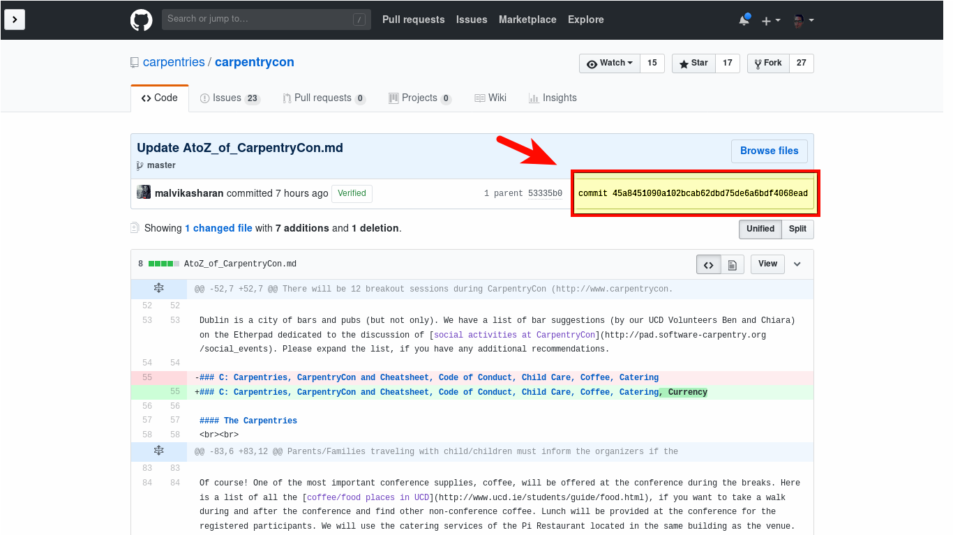
What is a commit hash?

Slide 3
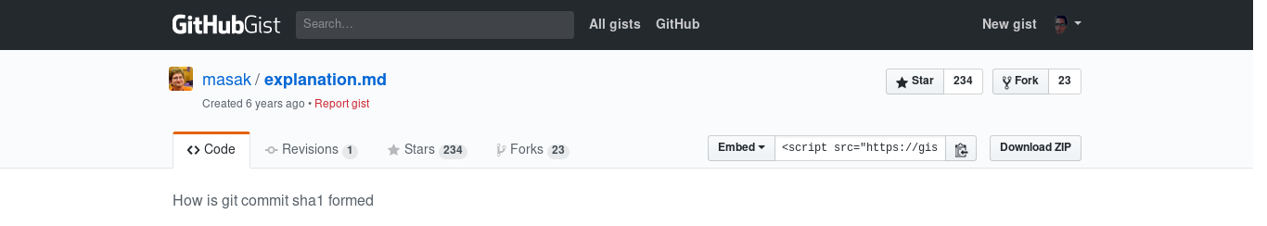
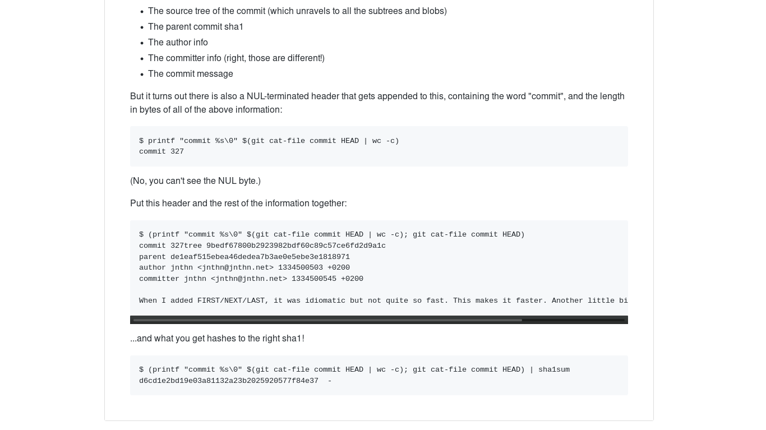
What is a sha1sum?
For Git “It's purely a consistency check. The security parts are elsewhere”. Linus Torvalds
https://gist.github.com/masak/2415865

Slide 4
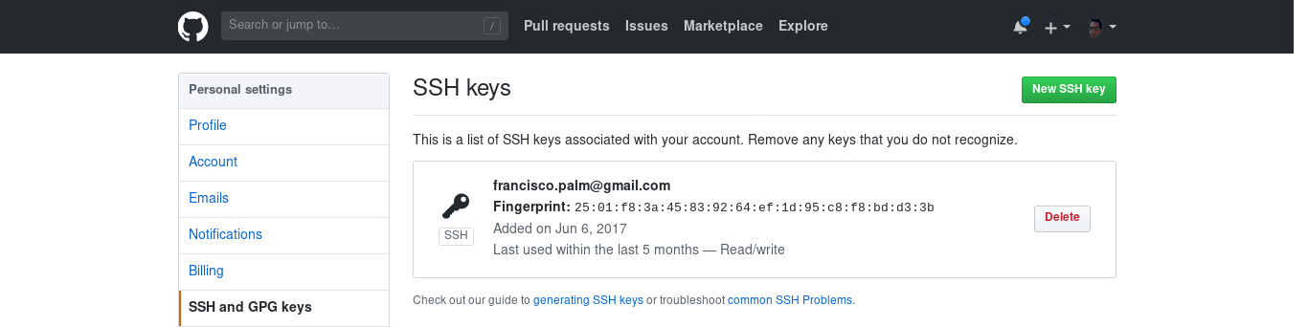
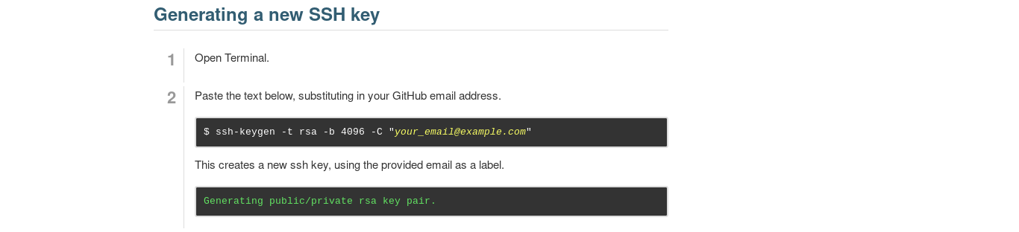
The security parts...
What happen when SSH or GPG keys are generated?
RSA Key pair?

Slide 5
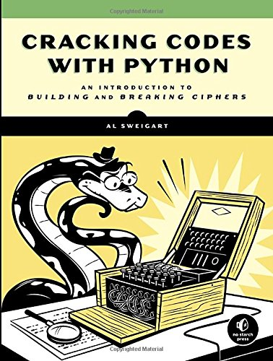
Cracking Codes with Python teaches complete beginners how to program in the Python programming language.
...
The final chapters cover the modern RSA cipher and public key cryptography.
Black magic or accessible content?

Slide 6
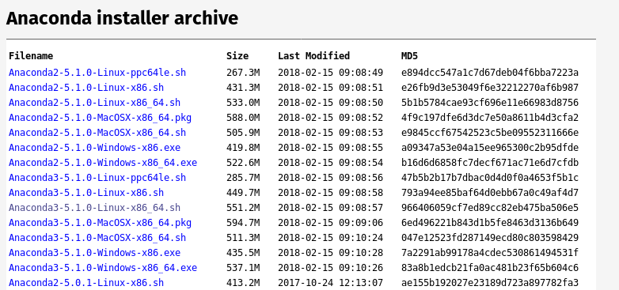
How to use this information?
Is important?

Slide 7
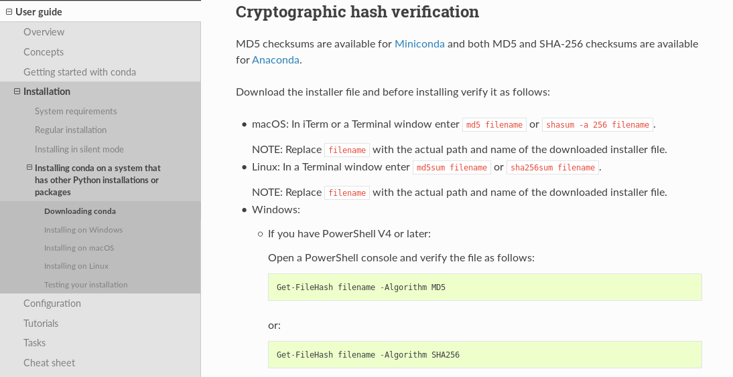
Enough and comprehensive?

Slide 8
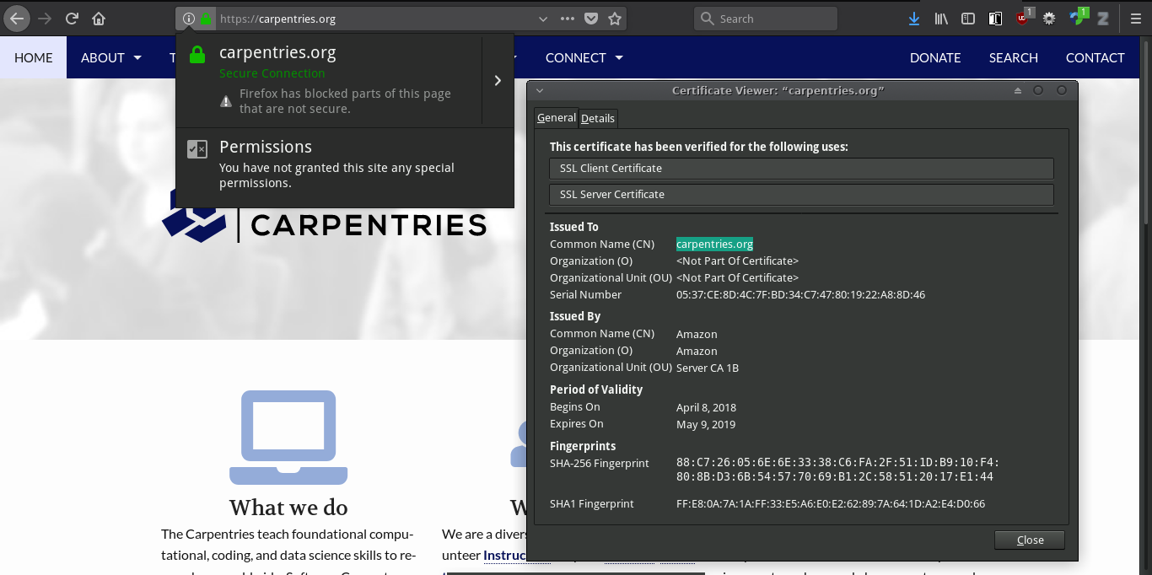
Certificates are important?
Do you use bank services on-line?

Slide 9
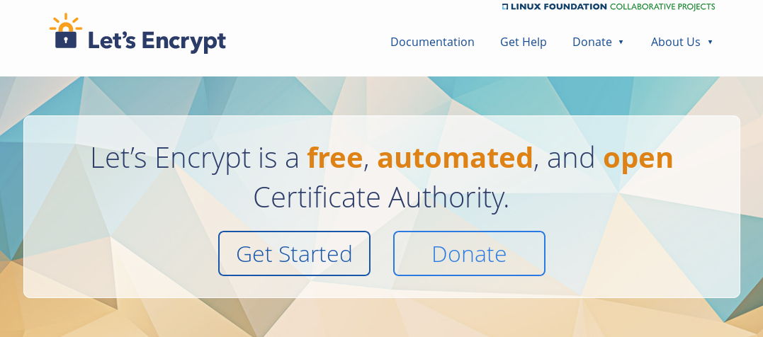
Do you know that now is easy and cheap to obtain certificates?

Slide 10
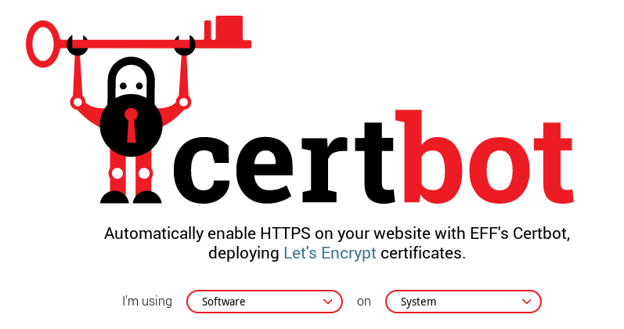
Very easy!
$ sudo certbot –apache
0 0,12 * * * python -c 'import random; import time; time.sleep(random.random() * 3600)' && certbot renew

Slide 11
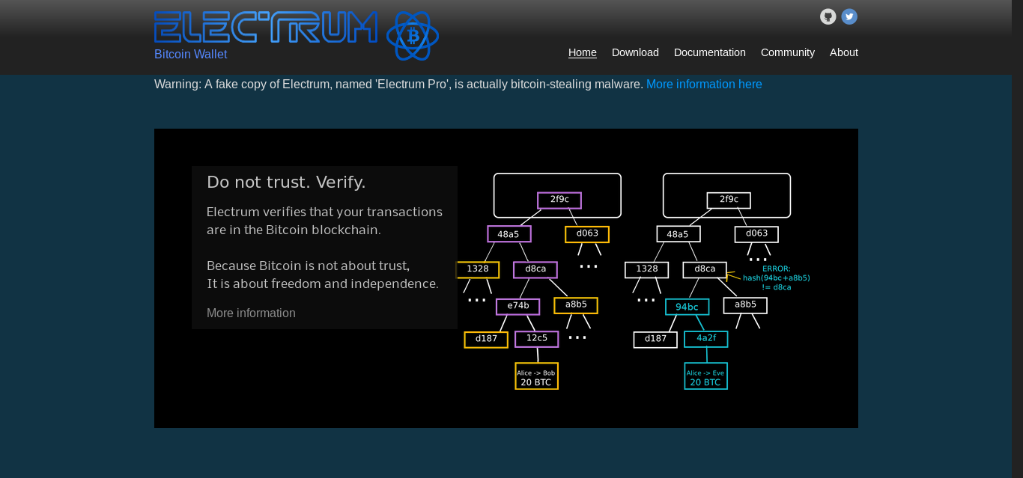
Is also very easy create a Bitcoin wallet
to understand public key cryptography

Slide 12
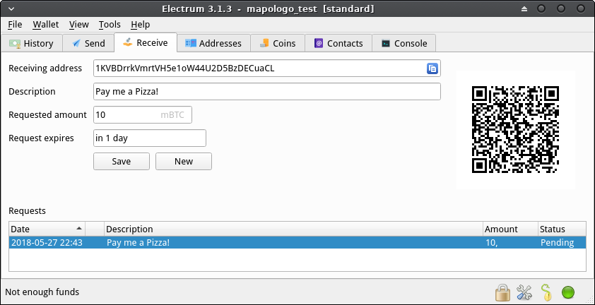
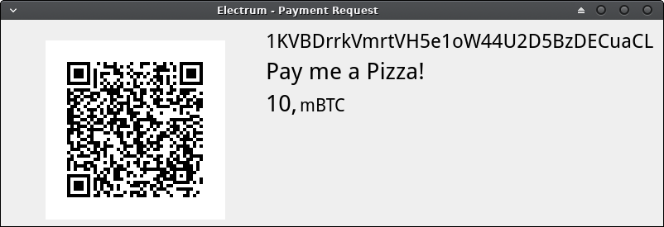
And receive payments!
In case of doubt use testbeds

Slide 13
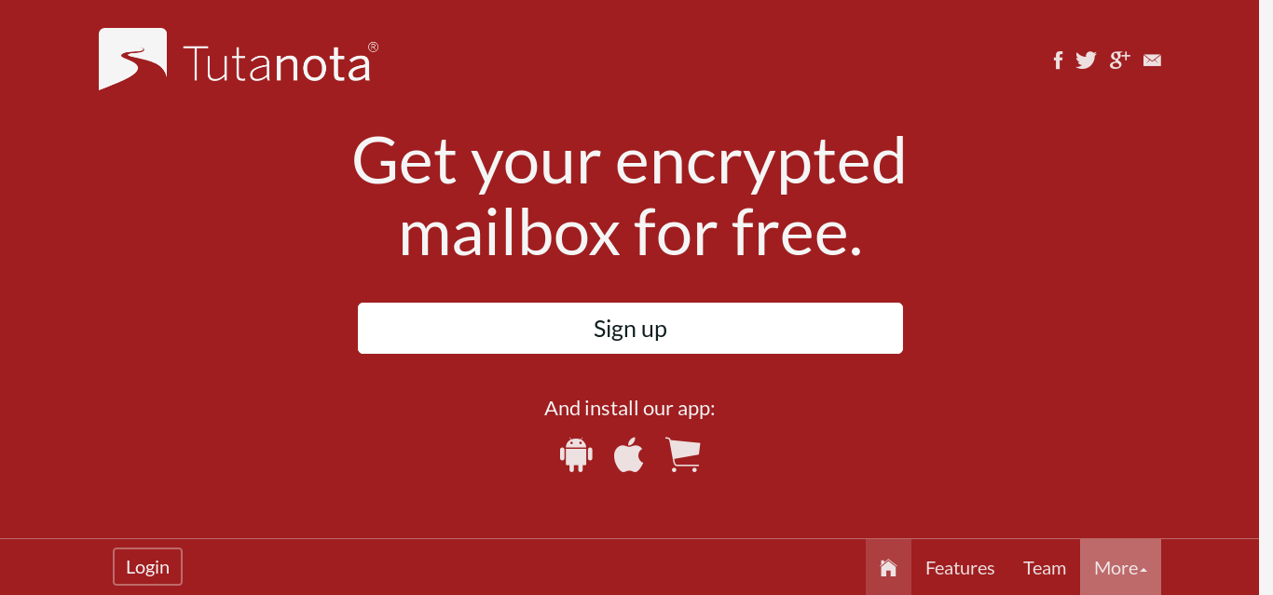
Why you may need to encrypt your emails? How?

Slide 14
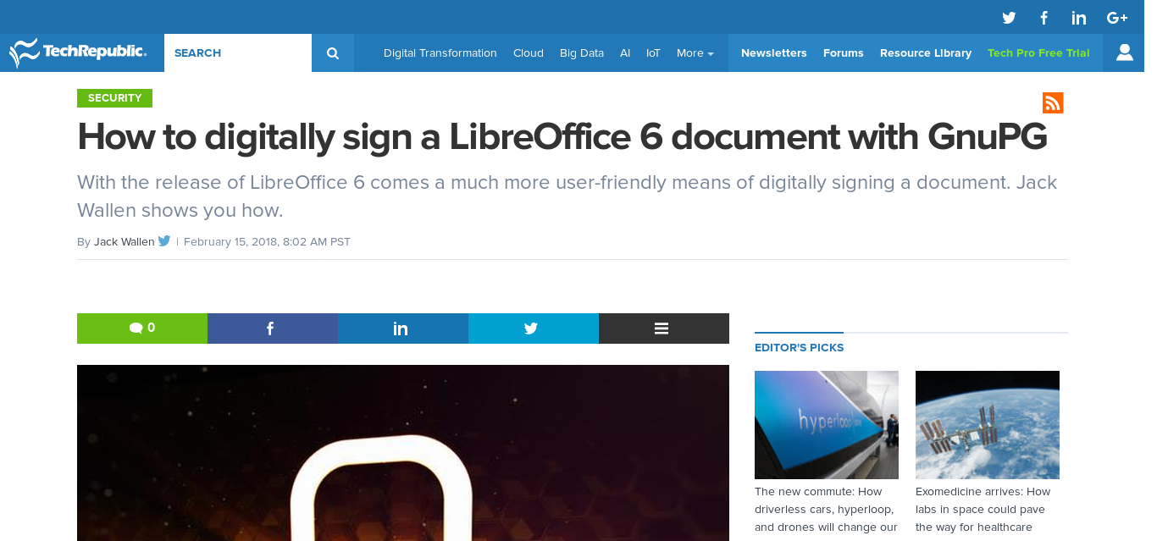
Why you would need to sign digitally a document?

Slide 15
We really need it?
How to prioritize it?
How we can implement it?
Which approach would be useful?

