Slide 1

Workshop Elements
Bash (Command Line)
Task Automation
Git
Version Control
Programming
(Scripting Language)
Python
R
SQL
(Data Mgmt)
MATLAB
Additional
Lessons
Make
(Automation)
Mercurial
(Version Control)

Slide 2
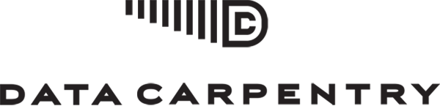
Workshop Elements
Project Management
Data Organization
Spreadsheets
Genomics
Ecology
Intro to
Command Line
Data Cleaning
OpenRefine
Data Wrangling &
Processing
Data Management
SQL
Intro to
Cloud Computing
Data Analysis + Visualization
R
Python
Data Analysis + Visualization in R

Slide 3

Workshop Elements
Additional Lessons
Intro to
Data
Webscraping
The Unix Shell
SQL
OpenRefine
Intro to
Python
Intro to
Git
Data for Archivists

