Slide 1

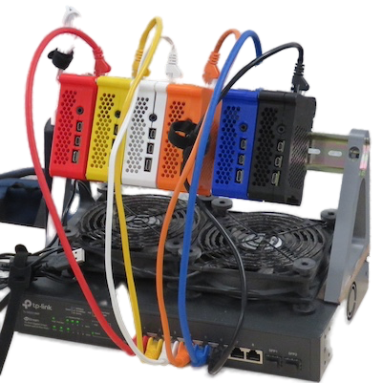
Building a miniHPC
Team: Jannetta Steyn, Bryn Noel Ubald, Andrew Walker, Loïc Lannelongue, Colin Sauze, Raniere Silva, Mario Antonioletti
https://github.com/carpentriesoffline/CW24_Build_miniHPC
https://github.com/carpentriesoffline/pxe-boot

Slide 2
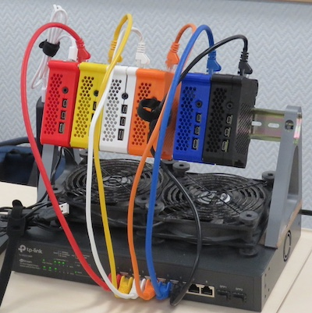
Why a miniHPC?
What we are building on:
Use single board computers such as the Raspberry Pi
Full control over system
Portable and self contained
Relatively inexpensive (budget for 8 nodes £1200)
Hardware less abstract
Own access point, so no need to get people on university network
Hardware miniHPC requiring some love and care to work
All this was in Jannetta’s head and what was documented (carpentriesoffline.org) needed her head to interpret it.
Notes:
The problem started when we ran an intro to HPC carpentries workshop and discovered that people didn’t register logins beforehand, the login node became unavailable during the workshop and the Internet also decided to play up. Hence the idea of a self-contained mini-HPC using readily available hardware such as Raspberry Pis, over which instructors have full control, it is portable, inexpensive and actually give learners an idea of what an HPC looks like in real life. You can also create your own contained network so that instructors and learners do not need access to the Internet. All this was in my head and what was documented needed my head to interpret it.

Slide 3
Our approach to collaborative working
3 teams working in parallel, with hourly catch ups
Agreed licence, contributor code of conduct and approach to collaborating up front
One team “led the way”, others tested and cleaned the process, worked on presentation
Added other tools as we went
Documentation built in a GitHub repository, with pull requests against upstream repos as needed (#Transparency #CodingBestPractices)
What worked?
What didn’t work?
Parallel work to documentation creation and multi-staged testing
Scripting as we wrote and tested the instructions
Initial issues with getting the cluster to start, more development than expected needed
In room networking issues
Reduced scope as we went

Slide 4
Where we started
Hardware miniHPC
Required some love and care to work
Some existing config documentation

Slide 5
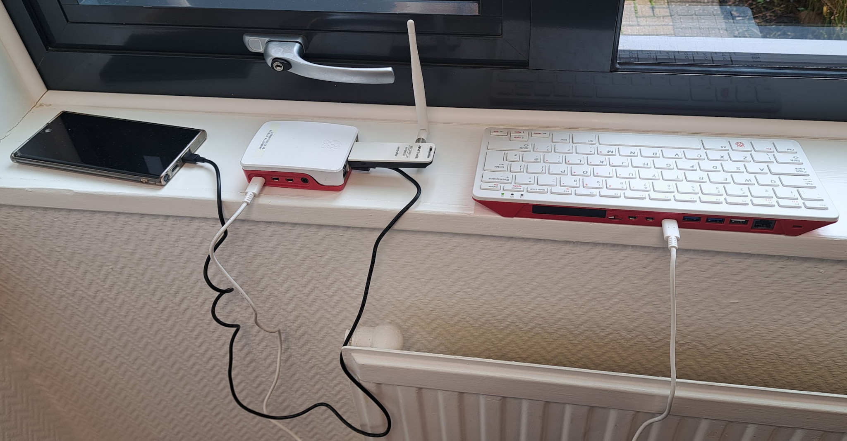
What we did during this hackday
Created our very own network access point
GitHub repo for PXE network boot
Repo CW24_Build_miniHPC with step-by-step guide
Three levels of user testing and updating documentation

Slide 6
What we did during this hackday
Turn the prototype into a working plug-and-play training resource
Write a step by step guide for trainers with minimal expertise to put together a working miniHPC
Test the guide by having users of different levels of expertise follow it and build their HPC

Slide 7
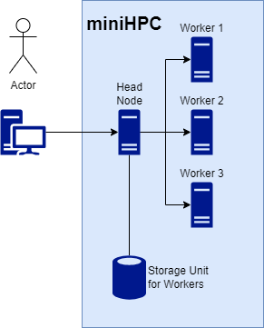
What we did during this hackday
Turn the prototype into a working plug-and-play training resource
Write a step by step guide for trainers with minimal expertise to put together a working miniHPC
Test the guide by having users of different levels of expertise follow it and build their HPC
Created our very own network access point
GitHub repo for PXE network boot

Slide 8
What we did during this hackday
Turn the prototype into a working plug-and-play training resource
Write a step by step guide for trainers with minimal expertise to put together a working miniHPC
Test the guide by having users of different levels of expertise follow it and build their HPC
Repo CW24_Build_miniHPC with step-by-step guide
Create SD image of RPi OS
Install HPC infrastructure (e.g. SLURM)
Launch RPi (head and compute nodes)
Have fun!

Slide 9
What we did during this hackday
Turn the prototype into a working plug-and-play training resource
Write a step by step guide for trainers with minimal expertise to put together a working miniHPC
Test the guide by having users of different levels of expertise follow it and build their HPC
Three levels of user testing done successively
Each updating the documentation to fit the target audience (novice to expert)

Slide 10
Our approach
Build documentation in a new repository, with pull requests against upstream repos as needed
Main documentation inside new repository inside carpentriesoffline GitHub organisation, we all have access
New Git repository for pxeboot creation script
Changes to green algorithms project (added Pi as a hardware choice)
Worked in parallel with regular catch up discussions
Agreed licence, contributor code of conduct and approach to collaborating up front
One team “led the way”, others tested and cleaned the process
Added other tools as we went
What worked?
What didn’t work?
Parallel pipeline to documentation creation
Scripting as we wrote and tested the instructions
Cluster not ready to go at start, more development than expected needed
In room networking issues
Reduced scope as we went

Slide 11
Where next?
Get Sadie to test the configuration instructions for us
Adapt the Carpentry HPC Intro lesson to incorporate changes
Use the instruction with CATS
CATS is the Climate Aware Task Scheduler, winner of last year’s CW hackday and is being used to time shift when HPC jobs are run to when electricity is cleanest.
Publicise to the WORLD
Enable sustainable, reproducible, low-resource and green HPC training applications for the whole community

Slide 12
Where next?
Roll out and advertise new documentation
Finish testing of installation roadmap by different audiences
Adapt the Carpentry HPC Intro lesson to incorporate changes
Publicise to the WORLD
Enable sustainable, reproducible, low-resource and green HPC training applications for the whole community
Deploy (and test) on Sadie’s HPC for CATS
CATS is the Climate Aware Task Scheduler, winner of last year’s CW hackday and is being used to time shift when HPC jobs are run to when electricity is cleanest.

Slide 13
Use cases: Environmentally Sustainable HPC training in the classroom
The issue: overkill use of dozens of GPUs in the classroom
A more sensible alternative: a shared physical mini-HPC
Energy-efficient (6 times less than a Xeon Gold core, 150 times less than a NVIDIA GPU)
Users can better relate to computing resources: both embodied and use-stage environmental impacts
Discuss the concept of shared resource, and the limitations
Raspberry Pi 4 now in Green Algorithms calculator!

Slide 14
https://github.com/carpentriesoffline/CW24_Build_miniHPC
https://github.com/carpentriesoffline/pxe-boot

Slide 15
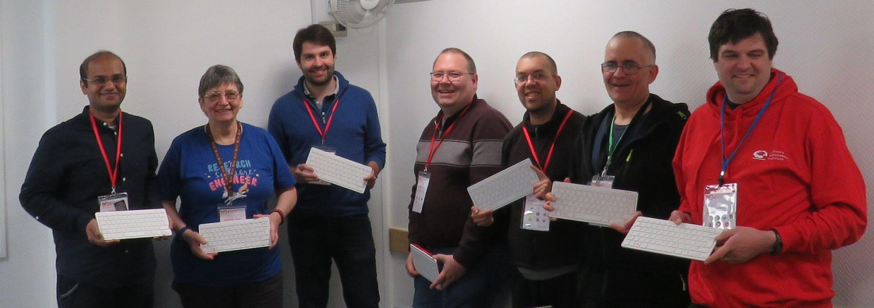
Team miniHPC (proudly holding their PIs)
https://github.com/carpentriesoffline/CW24_Build_miniHPC
https://github.com/carpentriesoffline/pxe-boot

Slide 16
Live demo

