Slide 1
NEUE FISCHE · CAPSTONE I · 2025/26
PMC Research
Assistant
Access to millions of biomedical research papers
Thomas
Viktor
Markus

Slide 2
THE DATA SOURCE
3–5k
What is PubMed ?
new biomedical papers
published daily
PUBMED / PMC
(ResearchGate / SciReader 2018)
— largest biomedical literature database
- 30+ million research articles
- 9+ million open access full-text articles
— Covers journals worldwide, going back to 1965
~4 h
literature reading per clinician
per week — 63% abstracts only
(Saint et al., J Gen Intern Med 2000)
ARTICLE STRUCTURE: SECTIONS
Title & Abstract
17 yr
— Each section indexed
— Retrieved as PDF, XML , …
Introduction
Methods
average: research finding
→ clinical practice
Results
Discussion
(Morris et al., J R Soc Med 2011)

Slide 3
THE PROBLEM
CLINICAL QUESTION – Real World:
WHY DIRECT SEARCH OFTEN FAILS
— Requires boolean syntax — AND, OR, standardized Keywords
— Returns full papers to read — not answers
— No synthesis across multiple sources:
"Three of my patients on nivolumab developed severe liver inflammation within 4 weeks. Is this pattern documented? Are there predictive markers?”
Why the question is hard?
Complexity
Needs linking of many papers
Clinical language for answer required
  Article A → Method 1
  Article B → Method 2
  …
— PubMed returns zero results for this exact question.
— If simplified: thousands of unrelated papers.
No appropriate answer either way.

Slide 4
THE SOLUTION
From hours to seconds —
Answerable questions instead of hundreds of results.
BEFORE
AFTER
Query → PubMed → hundreds of results → manual reading → maybe an answer
Query → PMC Assistant → structured answer + evidence strength + citable sources → 30 seconds

Slide 5
THE CORE
Language Model + Retrieval — why both?
LANGUAGE MODEL ALONE
LANGUAGE MODEL + RETRIEVAL PIPELINE
— Trained on general language corpus
— Not on current biomedical literature
— Answers may sound plausible
— No citation of real source
— Can diverge from current evidence.
At query time the model receives the most relevant passages from 44,393 PubMed articles. It synthesises an answer grounded exclusively in that retrieved evidence — with citable sources and measurable accuracy.
WHAT THE RETRIEVAL ADDS
KNOWN LIMITS
Top-5 passages ranked by biomedical semantic similarity · Source article, year, and journal visible · Grounding measurable on held-out benchmark [68% on PubMedQA golden-69]
Retrieval gap: −35 percentage points vs. direct paper access · Index covers Open Access articles only · Answers are not a substitute for clinical judgement
The language model receives the most relevant passages from the index before each response — and grounds its answer in citable evidence rather than general training.

Slide 6
Teil II

Slide 7
HOW IT WORKS
The Pipeline — Clinical Question to Answer
Index built once offline (10,000 articles · 46,853 chunks)
1
2a
2b
3
4
5
Query
›
Keyword
Search
+
Semantic
Search
›
Fusion
›
Top-K
Articles
›
LLM
Answer
[BM25]
[FAISS · PubMedBERT]
[RRF]
[Llama-3 70B]
plain-language
clinical question
tokenised · scored
against 46k chunks
query embedded · biomedical
model · nearest-neighbour
both lists merged
· deduped to article
highest-scoring
excerpts as context
cited answer · context
only · no general training
68% accuracy on 69 standardised benchmark questions · Retrieval gap to direct paper access: −35 pp — main remaining lever.

Slide 8
HOW THE SYSTEM IMPROVED
Three Stages — Same Question, Different Quality
PHYSICIAN’S QUERY
"Nivolumab — grade 3 liver inflammation in 3 patients within 4 weeks. Documented? Predictive markers? Management?"
Stage 1 · First Prototype
Stage 2 · Semantic Search
Stage 3 · Full Pipeline
Query → [BM25 only] → Small AI (flan-t5-s)
Query → BM25 + FAISS (MiniLM) → Llama 8B
Query → PubMedBERT + BM25 → FAISS + RRF → Llama 70B
Hepatotoxicity is a known adverse event in oncology patients. Monitoring of liver enzymes is generally recommended during treatment.
Immune-related hepatotoxicity has been reported with checkpoint inhibitors. General management includes holding treatment and considering corticosteroids. [Chang et al., 2019]
Nivolumab-induced grade ≥3 hepatotoxicity occurs in 1–2% of cases and is immune-mediated. [Brahmer et al., NEJM 2018] Predictive markers include elevated baseline AST and IL-6 levels. [Wang et al., JCO 2020] Management: hold nivolumab, initiate prednisone 1–2 mg/kg. [Puzanov et al., JCO 2017]
↳ Biomedical embeddings get the correct papers
— Grounded
— citable answer covering all three aspects.
↳ No paper retrieved.
LLM answered from general training only
no context, no citations.
↳ A paper retrieved,
—Not very specific
— Answer partially grounded

Slide 9
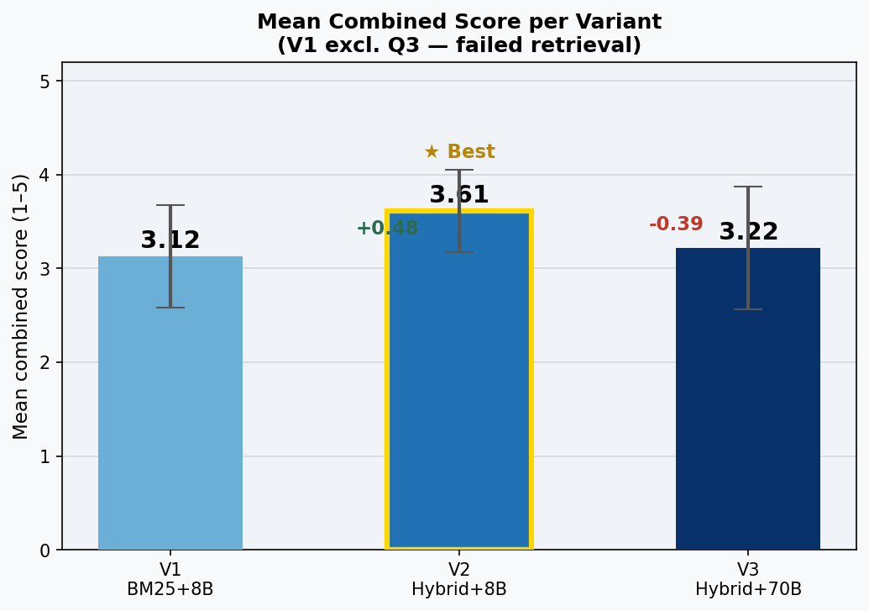
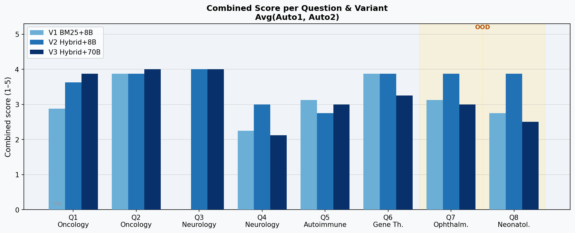
PIPELINE EVALUATION
Which pipeline answers best?
8 clinical questions • scored by 2 independent raters (Auto1 + Auto2) • scale 1–5
V2 Hybrid + 8B wins (3.61 / 5)
Q4 (LRRK2) weak across all — topic gap in corpus

Slide 10
LIVE DEMO · PMC RESEARCH ASSISTANT
● LIVE
Demo runs live at presentation time — requires local backend + API key.
Biomarkers for EGFR-mutated NSCLC?
Cardiotoxicity with checkpoint inhibitors?
Immunotherapy melanoma phase II trials?
PD-L1 expression and treatment response?
Enter a clinical question…
→ Ask
Ask a clinical question to see a live response…
Note — this interface calls a language model directly. It does not connect to the retrieval index at runtime. For a full demonstration including live retrieval, run the backend locally. Requires an Anthropic API key.

Slide 11
WHERE WE ARE — WHERE THIS COULD GO
Status & Outlook
01
Retrieval pipeline — biomedical index built and evaluated on standardised benchmark questions
Done
02
Language model integration — grounded answer generation with cited sources from retrieved evidence
Done
03
Accuracy evaluation — comparison against established baselines; gap analysis between retrieval and model quality
Done
04
Retrieval quality improvement — closing the gap between retrieved-context accuracy and upper-bound accuracy is the next measurable step
Next priority
05
Potential extensions — real-time index updates, specialty-specific fine-tuning, multi-language support, integration into clinical workflow tools
Outlook

