Slide 1
PubMed Research Assistant
Keyword Prediction - Literature Discovery - AI-powered
Markus
Thomas
Viktor
34,246
1,481
2,749
20k
Articles
Journals
Keywords
FAISS Index
Capstone Project - neue fische AI Engineering Bootcamp 2025/2026

Slide 2
FEATURES - ALL RAG-POWERED
What the Research Assistant Can Do
Keyword Prediction
Similar Papers
Journal Recommender
Author has abstract, no keywords yet. System predicts standard field terms for journal submission.
Find the most relevant published work via semantic similarity over the full corpus.
Which journals publish papers with these keywords? Based on 1,481 journals in corpus.
Related Keywords
Title Suggestions
Keyword Trends
'Researchers in your area also use...' — surfaced from co-occurrence clusters.
Alternative title formulations grounded in similar published papers.
Is my topic growing? Year distribution from retrieved similar papers.

Slide 3
MOTIVATION
Why Keyword Prediction?
The Use Case
CORPUS
A researcher has written an abstract but has no keywords yet. Most journals require them for submission — standard field terms are not always obvious to the author.
~128k
XML files
34,246
Extracted
Training Data Challenge
34.7%
Success rate
Only 34.7% of PMC articles contain author-assigned keywords. These serve as ground-truth labels. Articles without keywords are the prediction target.
1,481
Journals
Domain Bias
2,749
Keywords
We restricted to the non-commercial archive due to storage constraints. This skews the corpus toward clinical journals — a bias to account for in evaluation.
2.26
Avg / article
STAKEHOLDERS
Universities - Science communicators - Scientific publishers - Students - Science journalists - Interested non-professionals

Slide 4
Project Vision & Data Source
PROJECT IDEA
RAG VISION
Incremental modeling: start simple, increase capability each iteration
Step 1: Keyword Prediction — establish baseline
Step 2: Abstract generation from full paper text
Step 3: Prediction reliability — know when to trust output
Step 4: Full RAG system — the long-term vision
The ultimate goal: a Research Assistant where all features emerge from a single unified RAG pipeline grounded in the PMC corpus.
Abstract in -> retrieve similar papers
Enrich context with domain knowledge
LLM generates all outputs from evidence
DATA SOURCE
PubMed Central (PMC) — NIH's free full-text biomedical archive
Open Access XML — structured JATS format, machine-readable
~128k articles available - 34,246 successfully extracted
ROADMAP
OK Keyword Prediction (Baseline)
OK Data Pipeline & Cleaning
WIP RAG Integration
Next Abstract Generation
Next Reliability Scoring

Slide 5
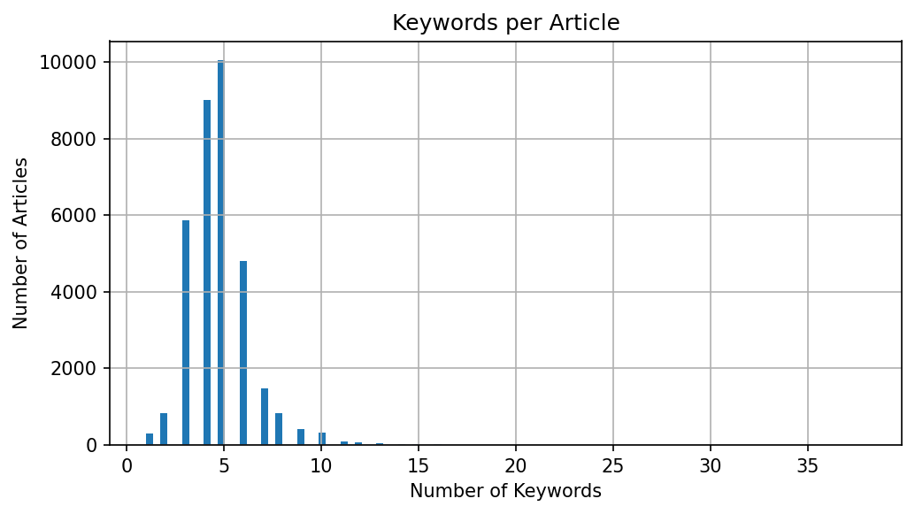
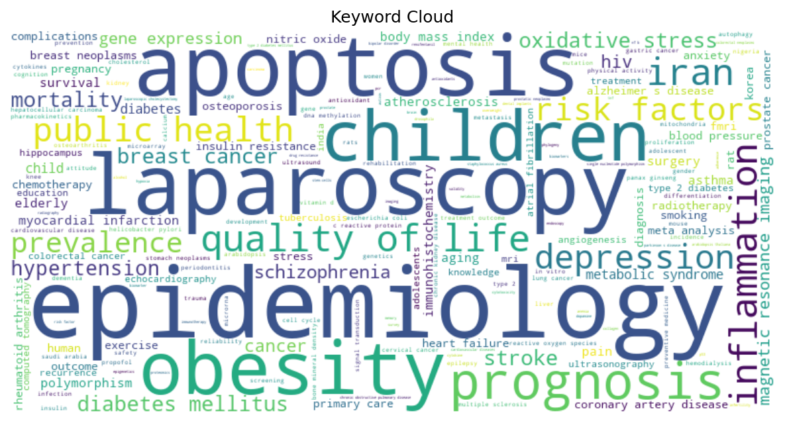
DATA PIPELINE & CLEANING
From Raw XML to Clean Training Data
EXTRACTION (Markus + Thomas)
34,246
2,749
Parallel processing of ~128k XML files
Structured text: abstract, intro, methods, results, discussion
Precise keyword extraction from XML metadata
Filter: research articles only, non-empty abstracts
Articles
Keywords
after filtering
min. 10 occurrences
⚑ KEY CHALLENGE: SPARSITY
2,749 keywords × 34,246 articles -> ~94M binary cells
Only 0.082% non-zero — extreme class imbalance
CLEANING — All Three - final iteration: Thomas
e.g. 11 positive vs. 19,000 negative cases per keyword
Encoding artefacts — mojibake fixed
Greek letter keywords removed
Chemical formula names filtered
Abbreviation expansions removed, standalone kept
Result: 2,749 valid keywords (min. 10 occurrences)
Keywords per article
Most frequent keywords

Slide 6
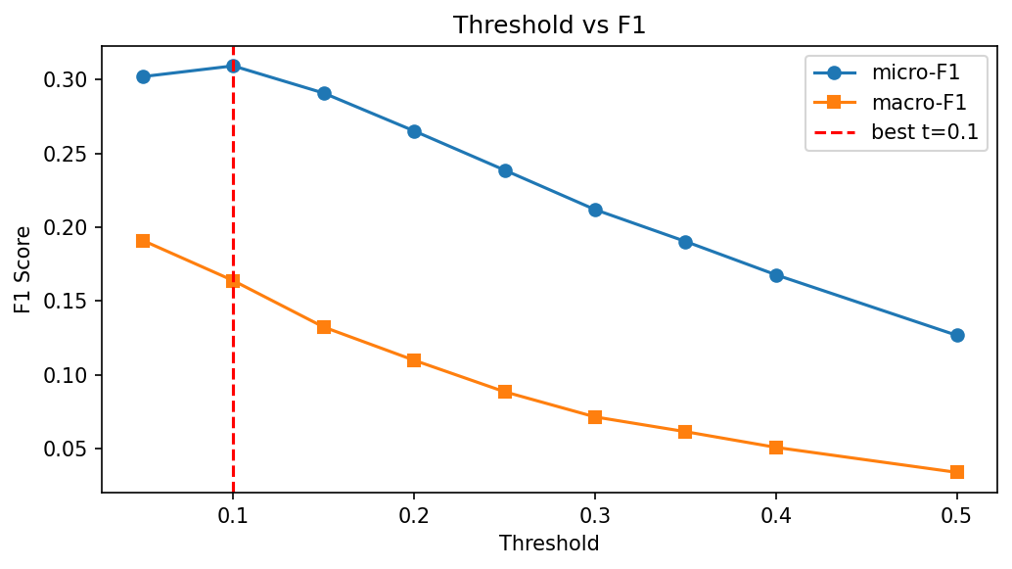
BASELINE MODEL
Classical NLP: Three Iterations
EXPERIMENT PROGRESSION
Approach | micro-F1 | Note
Term frequency + logistic regression | 0.205 | First run — often empty predictions
Same + stronger regularization | 0.006 | Over-regularized — worse than random
Term frequency + semantic compression + linear classifier | 0.306 | OK Best result
F1 vs. threshold — peak at t=0.10
0.306
Term Frequency
Semantic Compression
Linear Classifier
Converts text to numeric weights — how characteristic is each word?
Reduces 50k words to 300 latent topics — finds related concepts
One binary classifier per keyword, class-balanced for sparsity
micro-F1
Best baseline

Slide 7
What the Baseline Reveals
EXAMPLE PREDICTIONS vs. GROUND TRUTH
Article | True Keywords | LogReg C=1.0 | LinearSVC+LSA
#1 | learning curve | empty | empty
#2 | dog - e.coli - urinary tract infection | empty | e.coli OK
#3 | cns - microglia - tnf - il interleukin | empty | empty
#4 | craniotomy | empty | empty
The Problem
The Limitation
The Solution
Classical models see only word frequencies. They cannot know that 'microglia' implies 'neuroinflammation'.
2,749 independent classifiers with extreme imbalance. Rare, specific keywords almost never predicted.
Retrieve similar papers that already have keywords. Use their labels as evidence. Let the LLM reason over context.

Slide 8
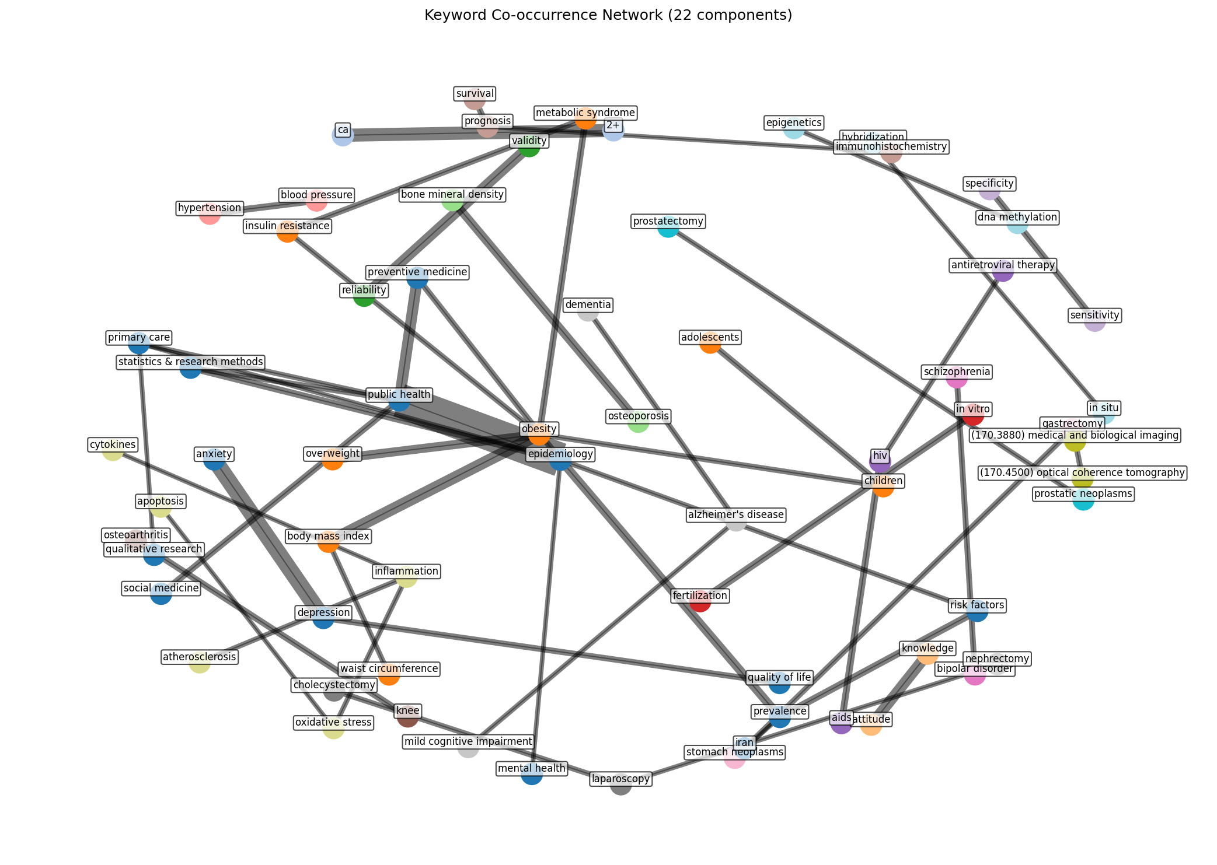
CLUSTERING
Mapping Keyword Relationships
APPROACH
Count how often two keywords appear together across articles
Build an adjacency matrix of keyword co-occurrences
Apply logarithmic scaling to reduce frequency dominance
Result: a graph where edge weight = semantic relatedness
STRONGEST RELATIONSHIPS
140
epidemiology ↔ public health
65
depression ↔ anxiety
55
ca²⁺ ↔ calcium
49
obesity ↔ body mass index
Force-directed keyword network — each component = research domain
~40
public health ↔ preventive medicine

Slide 9
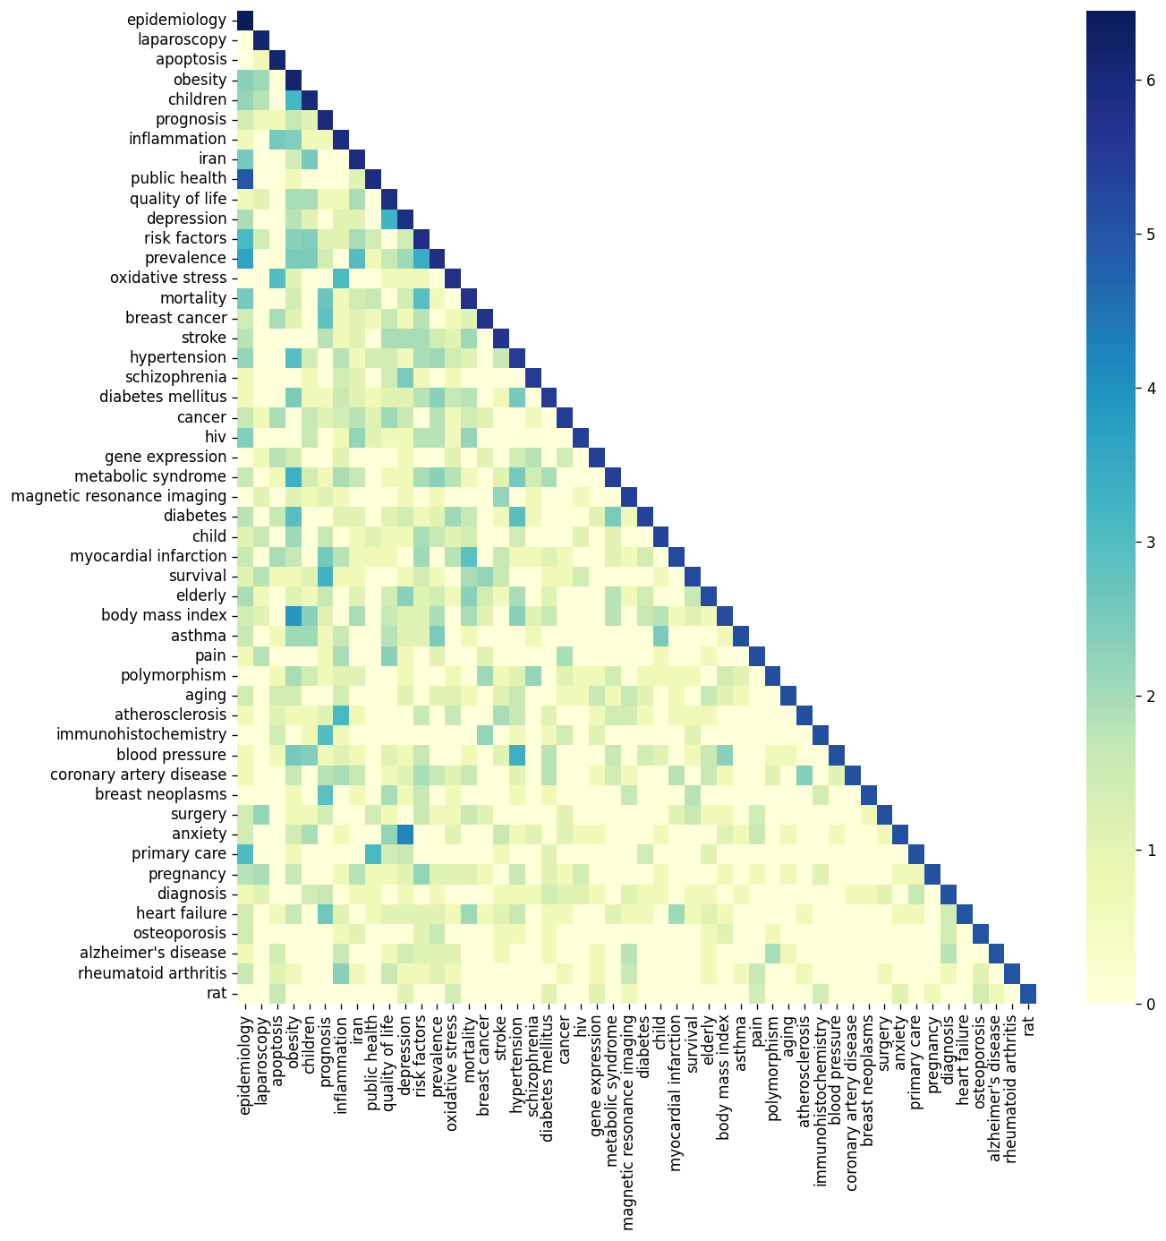
CLUSTERING
Semantic Clusters -> Domain Labels for LLM
Graph-based clustering groups keywords by co-occurrence patterns into semantic domains.
10
C0
Plant Biology / Genomics
arabidopsis, photosynthesis, rice, transcriptome, oryza sativa
Semantic Clusters
2,960 keywords grouped
C1
Clinical / Epidemiology
epidemiology, laparoscopy, obesity, inflammation, depression
RAG INTEGRATION
C2
Oncology
Assign abstract to nearest cluster
Pass domain label to LLM prompt
Narrows keyword search space
Better precision for domain terms
apoptosis, cancer, tumor, cell proliferation, metastasis
C3
Neuroscience
brain, neurons, alzheimer, parkinson, neurodegeneration
C4
Immunology
immune response, cytokines, t-cells, inflammation, antibody
+ 5 more clusters (Cardiology, Microbiology, Biochemistry...)
Co-occurrence heatmap

Slide 10
FUTURE SYSTEM ARCHITECTURE
All Components Feed the RAG Pipeline
INPUT: Abstract (no keywords yet)
Candidate Keywords
Domain Label
Similar Papers
Fast classical NLP generates a shortlist as context hint
Cluster assignment tells LLM which research domain
Semantic retrieval finds relevant published work
→ RAG PIPELINE — Context = Similar Papers + Candidate Keywords + Domain Label
LLM reasons over evidence -> generates all outputs
KWD Keywords
SIM Similar Papers
JRN Journal Recommender
REL Related Keywords
TTL Title Suggestions
TRD Keyword Trends

Slide 11
TECHNICAL CHALLENGES
From Development to Production
Dev: DURING DEVELOPMENT
Prod: FOR PRODUCTION
Semantic index build: one-time ~10 min on CPU
Classical NLP components: already trained, milliseconds
Local LLM: 10–30s per response on CPU
Bottleneck: LLM latency slows iteration cycles
Pragmatic approach: hosted LLM API during prototyping
Requirement | Minimum | Comfortable
Semantic search | Any CPU | Any CPU
LLM inference | GPU 8GB | GPU 16GB+
Total RAM | 16 GB | 32 GB
Response time | < 5s | < 2s
Concurrent users | 1 (local) | Dedicated server
DEMO STACK
TRADEOFF
Semantic index - allenai-specter | LLM - Claude API | Frontend - Lovable.dev
Local LLM: full control, higher latency - Hosted API: fast, external dependency

Slide 12
SUMMARY
Where We Are
POSSIBLE FUTURE DIRECTIONS
-> Connect all components into a full RAG pipeline and evaluate against baseline
-> Journal recommendation based on keyword-to-journal mapping in the corpus
-> Keyword trend analysis using publication year distribution
-> Abstract generation from full paper text
-> Prediction reliability scoring — know when to trust the output

