Slide 1
PaperForge –
a PubMed Research Assistant
Keyword Trends · Literature Discovery · Offline RAG
Markus
Thomas
Viktor
Capstone 1 · neue fische AI Engineering Bootcamp 2025/2026

Slide 2
THE OBJECTIVE
The Objective
Build an offline RAG system over PubMed Open Access papers
Multi-hop reasoning across papers — draw conclusions, check plausibility
Predict reliablilty before anwer generation
Stakeholders: Academia · Companies with offline RAG needs
PubMed XML
2.3 Mio → 10K
Parse &
Clean
Baseline
Model
Semantic
Clusters
FAISS
Index
RAG
Pipeline
Multi Agent RAG
Similar Papers
Journal Recommendation
Keyword Trends
Title Suggestions
Possible outputs (future)

Slide 3
WHAT WE HAVE
What We Have
Data Pipeline
10k articles · 16 columns · full text sections
Simple Retrieval Works
No Benchmarks yet
Semantic Clusters
10 domain clusters stored in DataFrame
FAISS Index
started— semantic similarity over abstracts

Slide 4
DATA
Data
2.6Mio articles from pubmed central in XML format
For baseline : focused on a 127,999 XML file due to storage constraints
Extraction → 44,393 raw articles
research articles only, no articles without keywords, or sections too short
Cleaning → 34,246 clean articles
    UTF8 symbols in keywords removed
    >= 10x frequency of each keyword
Valid keywords: 2749
2.6Mio
XML files in Pubmed Central archives
FOR BASELINE
127,999
raw articles extracted from a part of the overall dataset:
(open-access, non-commercial, baseline)
44,393
raw articles extracted
34,246
clean articles (filtered)
2,749
valid keywords (min. 10×)
Data Funnel

Slide 5
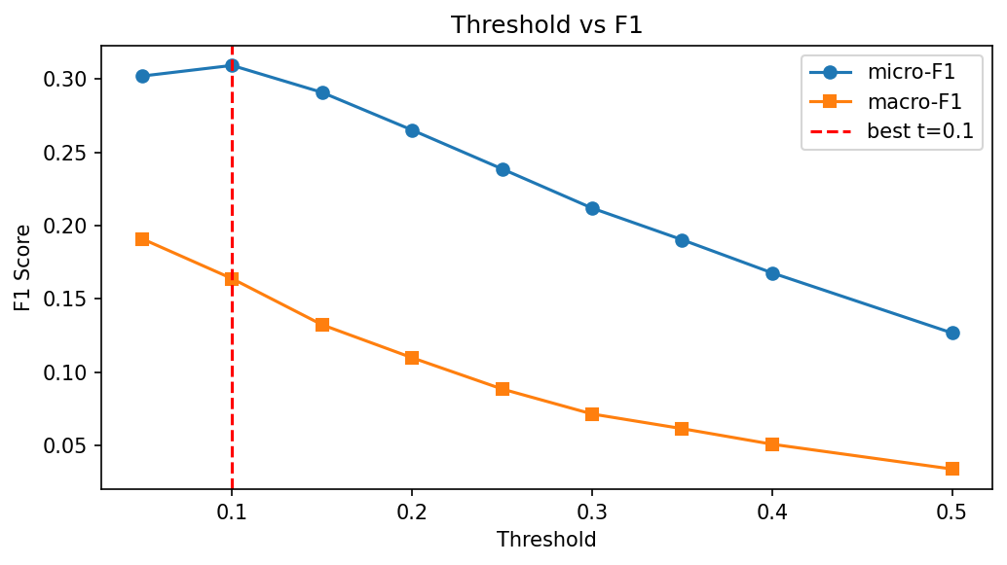
EVALUATION METRIC
Evaluation Metric: Baseline
Objective: keyword prediction from article titles and abstracts
Multi-label: each article has multiple keywords
Extreme imbalance – only few keywords per article out of 2749
BASELINE:
We trained a separate linear classifier for each of the 2,749 keywords — does this article belong to keyword X, yes or no?
micro-F1: weighted by frequency — primary metric
macro-F1: equal weight per class — shows rare keyword weakness
Imbalance lowered by threshold tuning:
Threshold t=0.10 optimal (default 0.5 too high)
Baseline: max. micro-F1 = 0.306 · macro-F1 = 0.156
RAG outlook: Precision@k (retrieval) + end-to-end F1
F1 vs. threshold — peak at t=0.10

Slide 6
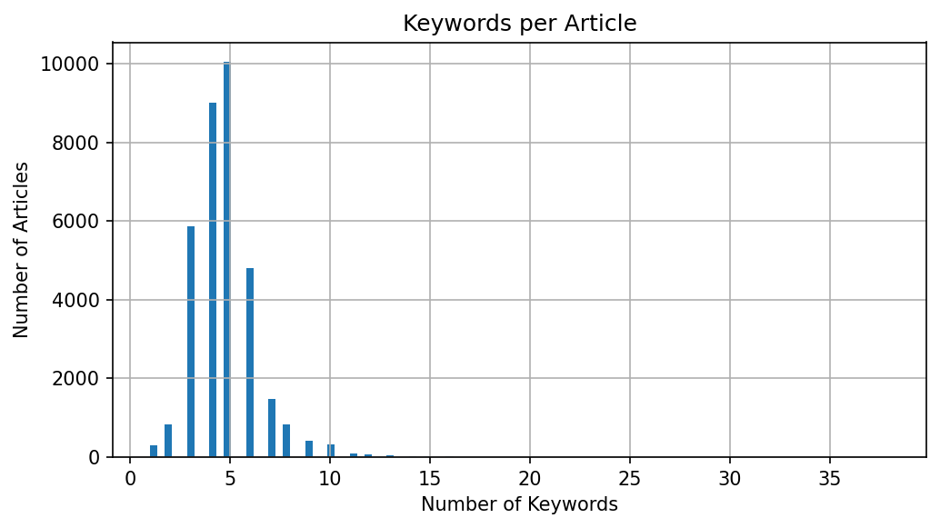
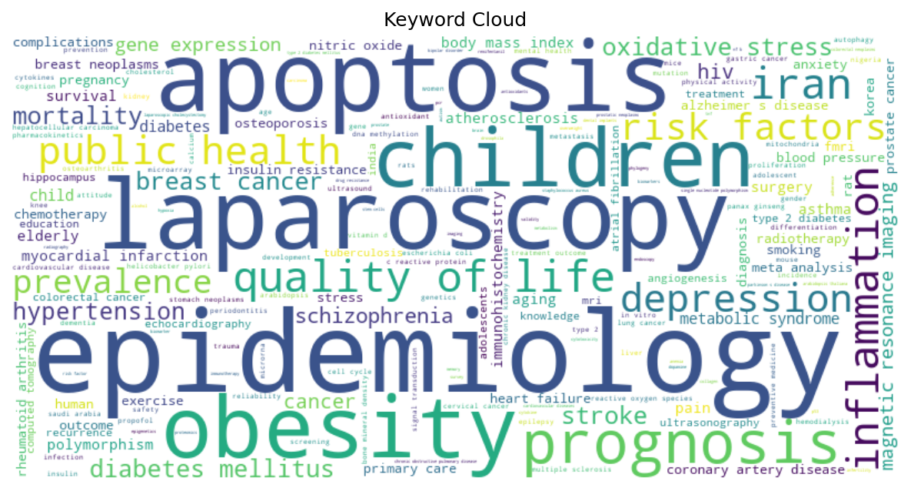
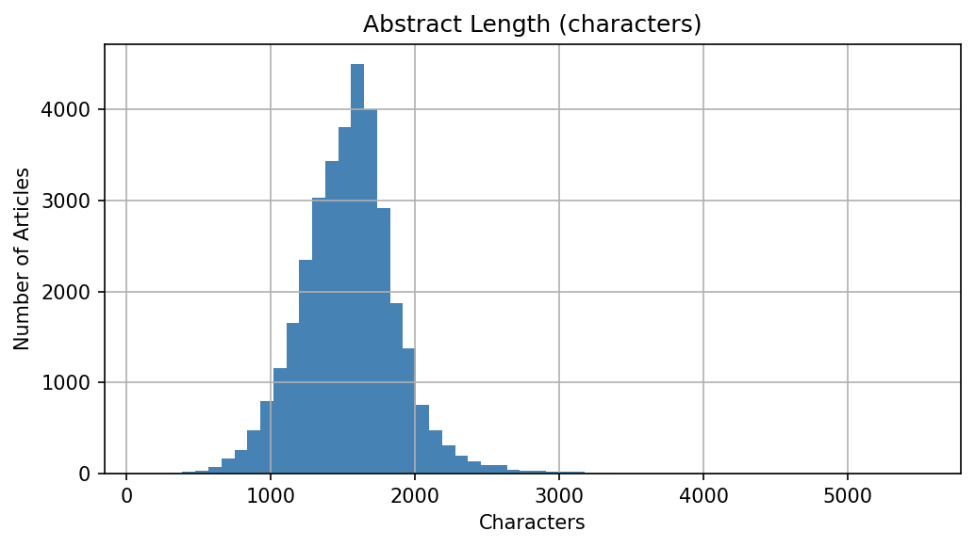
EDA
Exploratory Data Analysis
Keywords per article
Most frequent keywords
Abstract length (chars)
2,749 valid keywords after 5 cleaning iterations
0.082% matrix density → extreme class imbalance
Avg 2.26 keywords/article · Abstracts: 500–3,000 chars

Slide 7
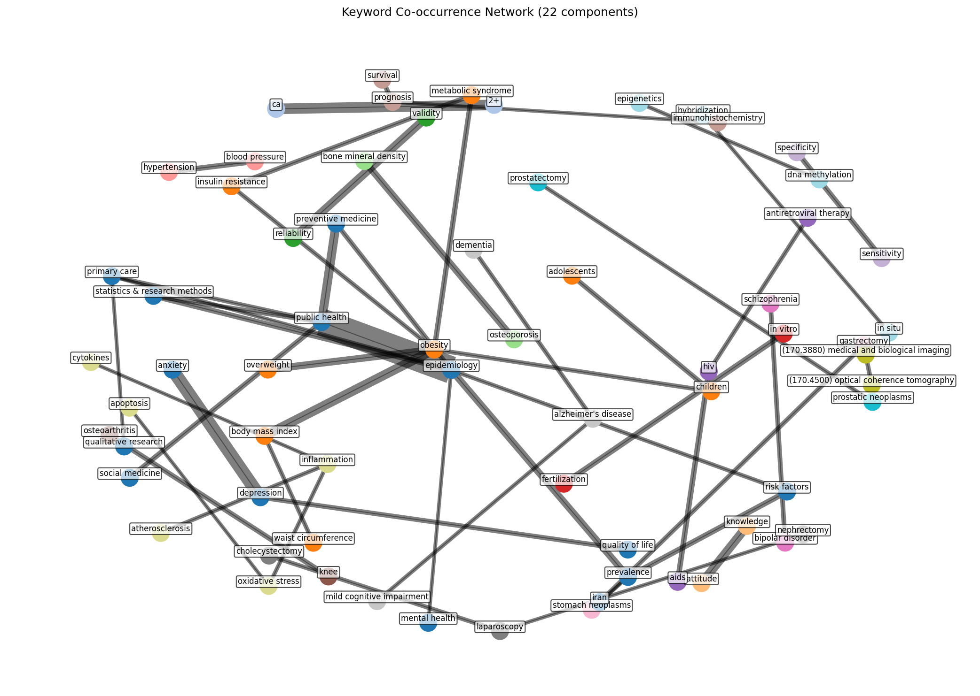
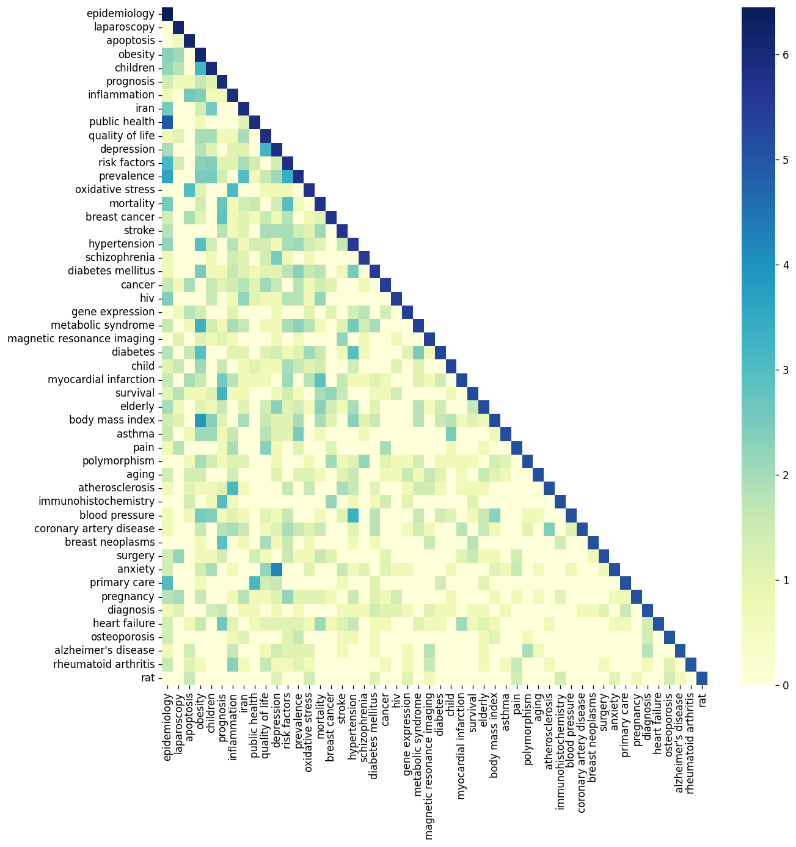
METHODOLOGY
Co-occurrence matrix → adjacency graph → Graph Laplacian
Spectral Clustering: robust for sparse keyword graphs
  10 semantic clusters, stored in DataFrame
TF-IDF + N-grams on text sections (abstract, intro, methods)
FAISS: cluster labels retrieved alongside similar papers
Methodology
C0
Plant Biology / Genomics
C1
Clinical / Epidemiology
C2
Oncology
C3
Neuroscience
C4
Immunology
+ 5 more clusters
Force-directed keyword network — 22 components
Co-occurrence heatmap

Slide 8
TIMELINE
Timeline & Current Status
OK
Data extraction pipeline
OK
Keyword cleaning & EDA
OK
Baseline: TF-IDF → Latent Semantic Analysis (LSA) → SuportVectorMachines (LinearSVC)
OK
Co-occurrence graph + Spectral Clustering → 10 clusters
OK
Parser iterations, section extraction
WIP
FAISS index — allenai-specter embeddings
WIP
RAG pipeline — connecting components
Next
End-to-end evaluation: RAG vs. baseline
Next
Features: Journal Recommender, Keyword Trends

Slide 9
POSSIBLE FUTURE DIRECTIONS
Where We Could Go
Full RAG pipeline — evaluate vs. baseline (0.306)
N-gram + TF-IDF on full text sections
Journal Recommender · Keyword Trends
Abstract generation from full paper text
Reliability scoring — know when to trust output
Production: local LLM on GPU server (offline)

